Slide 1
Real-Time Digital
Hearing Aid
30.0
30.0
25.4
20.4
17.5
Multirate filter bank and FFT overlap-add on the TMS320C6748
< 750 Hz
0.75–1.5k
1.5–3k
3–6k
> 6 kHz
Aneesh Venkatesha Rao (24ECB0A03) · Akula Sahasra (24ECB0A02) · Adhvay Shrujal (24ECB0A01)
DSP Lab project, Department of ECE, NIT Warangal · October 2026
N3 band gains (dB)
Notes:
Real-time digital hearing aid on the TI LCDK C6748. Two processing modes on one board: a five-band multirate filter bank (Mode A) and FFT overlap-add (Mode B). The bars on the right are the five Mode A band gains for the Bisgaard N3 audiogram, the motif used through the deck.

Slide 2
Hearing loss depends on frequency
48 kHz
sampling rate: octave crossovers land on 6, 3, 1.5 kHz and 750 Hz
≤ 30 dB
gain per band, following the audiogram (half-gain rule)
< 10 ms
end-to-end delay, or the wearer hears an echo [S1, S6]
Notes:
A sensorineural loss grows with frequency. The Bisgaard N3 standard audiogram (moderate loss) runs from 35 dB HL at low frequencies to 65 dB HL at 6 kHz. The half-gain rule prescribes half of that as gain, capped at 30 dB. The two hard requirements: follow this curve closely, and keep the delay under 10 ms because the wearer also hears the direct sound.

Slide 3



One signal chain, two ways to shape the gain
Mode A
5-band multirate bank
LINE IN
AIC3106 ADC
HPF 100 Hz
2 biquads
Notch
optional, auto
Limiter
−1 dBFS
LINE OUT
AIC3106 DAC
S2 selects the mode
Mode B
FFT-256 overlap-add
C674x DSP at 300 MHz
McASP + EDMA3
Live controls
LCDK C6748, 256 KB L2, float32 data path
Read FIFO, 4-sample blocks, one interrupt per 83.3 µs
S2 mode, S3 preset (N3/N2/S2/bypass), DIP: NR and auto notch
Notes:
Codec samples at 48 kHz. A 100 Hz Butterworth high-pass removes DC and rumble. An optional bilinear notch removes feedback howl. Then one of two modes applies the audiogram gain, and a limiter holds the output at -1 dBFS. The McASP serial port and EDMA move 4-sample blocks, so there is one interrupt every 83.3 microseconds.

Slide 4
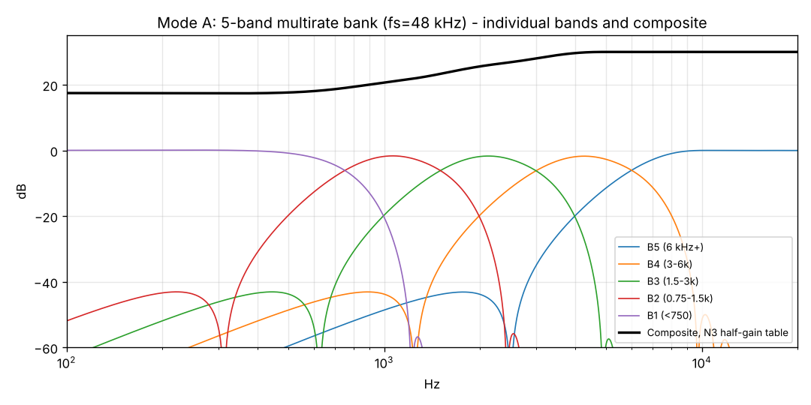
Mode A: a five-band multirate filter bank
7.81 ms
bank delay: 375 samples = 25·(2⁴ − 1)
52.5 dB
stopband of G (Kaiser β = 4.5); alias rejection 73 dB per level
Five octave bands and the N3 composite (research/calc/figs2.py)
5.1×
Each level: 21-tap Kaiser low-pass G, then decimate by 2
31-tap half-band F interpolates back up by 2
High band = input − delayed low path, so the bank is complementary
Per-sample processing with power-of-2 circular buffers
fewer operations than a single-rate bank (61 vs 313 per sample, calculated)
Notes:
Mode A splits the signal into octave bands by repeated low-pass filtering and decimation by 2: 48, 24, 12, 6 and 3 kHz. The half-band interpolator brings the low path back up. Because the high band is the input minus the delayed low path, the bands add back to the input exactly when all gains are 1. Delay is 375 samples, 7.81 ms. Working at lower rates makes it 5 times cheaper than a single-rate bank.

Slide 5
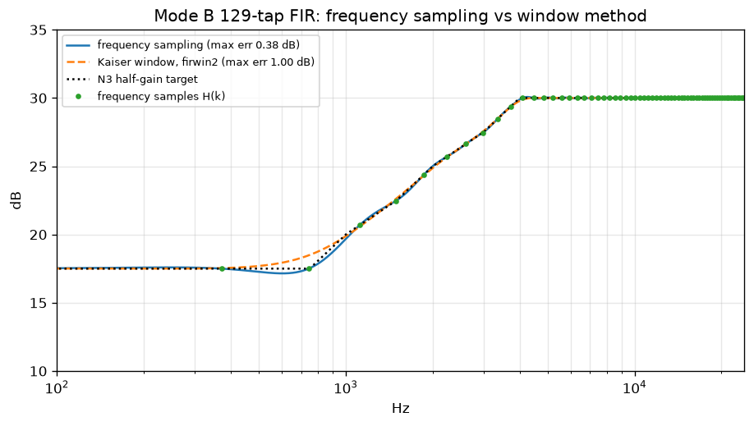
Mode B: frequency-sampling FIR by FFT overlap-add
No time aliasing when
N ≥ L + M − 1
256 = 128 new samples + 129 taps − 1
0.38 dB
max error vs the N3 target (Kaiser window: 1.00 dB)
1e-14
129-tap FIR: frequency sampling vs Kaiser window (python/p1_fir.py)
OLA and OLS vs direct convolution; N = 224 already aliases
Notes:
Mode B samples the target gain at 65 frequencies and inverse-transforms to a 129-tap linear-phase FIR. Frequency sampling hits the target within 0.38 dB, the window method misses by 1 dB. The filter runs by overlap-add: 128 new samples zero-padded to 256, FFT, multiply, inverse FFT, add the tails. 256 is exactly L + M - 1, the smallest size with no circular wrap-around.

Slide 6



Number format and structure chosen by measurement
float32 data path
Q15 loses 73–119 dB of SNR; in the HPF, poles at r = 0.995 amplify the rounding noise
HPF: 2 DF-II-T biquads
4th-order direct form is unstable with 16-bit coefficients; the cascade keeps −3 dB at 100.8 Hz
Double-precision HPF state
float32 state gave 3.9e-5 error, pushing the chain past its 1e-4 gate (C14)
Notes:
Phase 2 compared float32 with 16-bit fixed point on the real chains. Float32 stays more than 80 dB clean; Q15 collapses, worst in the HPF, because rounding noise passes through 1/A(z) with poles near z = 1. The C674x has hardware floating point, so float32 is free. For the HPF, a cascade of two transposed direct-form II biquads was the only structure that stayed accurate when quantised.

Slide 7





Every stage checked against the one before
Python reference
MATLAB mirror
Portable C on the PC
C6748 board
dsp_ref.py: every block
8 scripts, Signal Processing Toolbox
GCC, own FFT and TI's DSPLIB FFT
headless with CCS DSS, memory dumps
12 / 12 scripts pass
same numbers (C26)
≤ 2.2e-5 vs Python
≤ 2.0e-5 vs Python
Gates fixed before testing: single blocks 1e-5 of full scale · modes and chains 1e-4 · on-board tone gains 0.05 dB · real-time budget 25 000 cycles per 4-sample block
Notes:
Nothing ran on the DSP before it matched a reference. Python is the single source of truth; MATLAB mirrors reproduce it; the portable C is fed the same test vectors on the PC with two FFT back ends; and the same C runs on the board, where memory dumps are compared sample by sample with Python. The pass thresholds were written down before each test.

Slide 8
On the board, the DSP does exactly what was designed
6.1e-6
max |board − Python| on tones and noise, both modes (gate 1e-4)
0.01 dB
on-board gains vs the simulated design, all 11 tones
1.53 / 0.38
dB worst error vs the target, Mode A / Mode B: a property of the design
Notes:
internal.out runs both modes over a stored signal with no codec: 11 tones at -40 dBFS, then noise. The output is dumped and compared with Python sample by sample: 6.1e-6 at worst. The DSP's own Goertzel meter reads every band gain within 0.01 dB of the design. Mode A's 1.5 dB deviation at 750 Hz sits at a crossover and was predicted. The analogue codec path is outside this test (no external input, C31).

Slide 9
Real time with about 90 % of the CPU to spare
2 617
cycles per 4-sample interrupt, Mode A (max 2 785 of 25 000)
829 + 7 242
Mode B: interrupt + FFT block per 128 samples (deadline 800 000)
0
overruns, McASP errors or clipped samples in the 60 s live runs
Notes:
CPU load measured with the time-stamp counter, 60 seconds per mode with the codec running: 10.5 % for Mode A and 4.2 % for Mode B. Noise suppression costs 2.5 to 3 times the core and still fits. Mode B is inside its pre-board estimate of 2.6 to 5 %; Mode A is slightly above its 10.2 % estimate. No deadline was missed.

Slide 10
What the C674x architecture buys
50 000×
DSPLIB FFT vs direct DFT (VLIW: up to 8 instructions per cycle)
24×
plain-C FIR, -O3 vs -O0: software pipelining
326 ≈ 316
cycles per 256-term MAC, float vs int16: hardware floating point
Notes:
The lab programs measure the processor itself. The hand-optimised DSPLIB FFT takes 2145 cycles against 108 million for a direct DFT. The compiler's software pipelining makes a plain C FIR 24 times faster at -O3. A float multiply-accumulate costs the same as int16, which, with the Phase 2 SNR results, is why float32 was used. Our own FFT is slow because it computes twiddles with double-precision sin/cos in the loop.

Slide 11

Four bugs that only the board could show
C27 Clock read 302.77 MHz
C28 McASP XDMAERR at every start
Cause: Start-up overruns stretched the first second
Fix: Measure over the second second: 300.001 MHz
Cause: CPU and EDMA both wrote the first output word
Fix: Remove the CPU write: XSTAT = 0
C29 No audio after a power cycle
C30 Corrupt readings after a reload
Cause: Book code cleared the first EDMA interrupt
Fix: Re-evaluate the interrupt (IEVAL): 3 of 3 starts
Cause: The previous program's EDMA kept writing
Fix: Stop EDMA and McASP first (io_quiesce)
Notes:
All four are timing interactions between the CPU, the EDMA and the serial port, invisible in simulation. C29 was the hardest: it depended on start-up timing, passed in the first session and failed after every power cycle. After C30 every board measurement was re-run with tools/board_regress.sh.

Slide 12
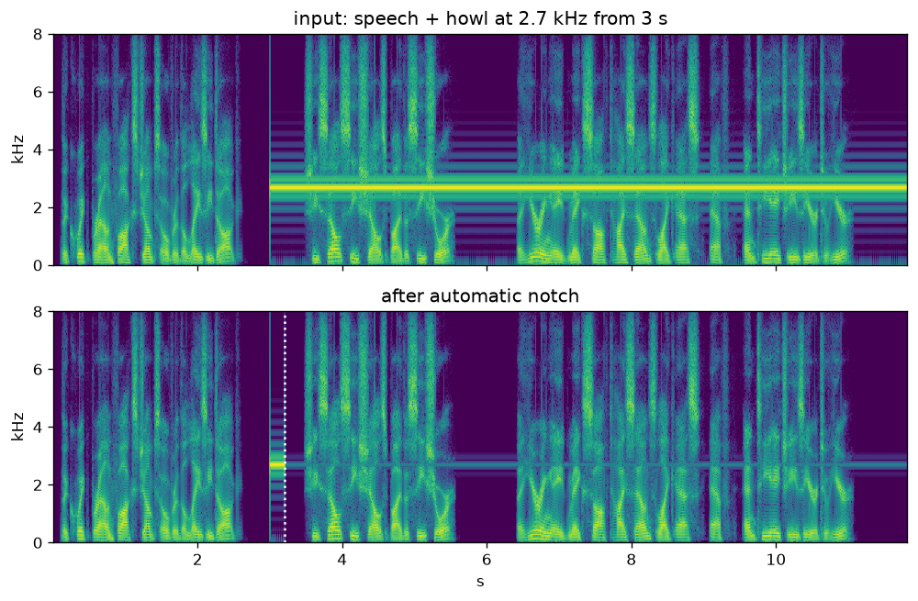
Extras: auto notch and noise suppression
2500.48 Hz
notch placed on the board within 0.5 s of switching on, for a 2500 Hz howl
0 false notches
on 12 s of built-in speech (the detector needs a peak 25 dB above the band)
+8.4 / +8.8 dB
SNR gain on the board, Mode A / B, speech with noise at 5 dB SNR
PC simulation: a 2.7 kHz howl is found and notched (python/p3_notch_nr.py)
Notes:
Two items from the brief, both off by default. The notch is a second-order IIR from the bilinear transform, designed on the DSP at run time; a windowed FFT-256 howl detector places it. Noise suppression uses a Wiener-type gain with a minimum-statistics noise floor, per band in Mode A and per frequency sample in Mode B. Both were verified on the board with built-in signals: board output equals Python within 2e-5.

Slide 13

Mode A vs Mode B
 | Mode A: filter bank | Mode B: FFT overlap-add
Gain accuracy, N3 | 1.53 dB (at crossovers) | 0.38 dB
Steep loss (S2 audiogram) | 6.82 dB: not suitable | 0.49 dB
Delay (calculated) | 8.81 ms (bank 7.81 ms) | 7.67 ms (buffering + FIR 6.67 ms)
CPU, live (measured) | 10.5 % | 4.2 %
Processing | per sample, no block delay | 128-sample blocks, double buffered
Natural extension | per-band compression (WDRC) | spectral processing (noise suppression)
Mode B is more accurate and cheaper; Mode A has no block structure and suits per-band compression.
Notes:
Mode B follows the audiogram more closely, handles steep losses and uses less CPU. Mode A costs more because G and F run per sample in C at four rates; a block-based version with DSPLIB FIRs was calculated at about 2 % but not built. Both delays are calculated, not measured on the board.

Slide 14
Course lab list: 14 of 15 topics covered
Arithmetic
DFT
IDFT
Overlap-add
Overlap-save
Linear convolution
Circular convolution
DIT FFT
DIF FFT
Split-radix FFT
Mixed-radix FFT
IFFT
IIR filter design
FIR filter design
Digital image processing
on the board
PC only
explained only
not covered
Mixed radix: DSPLIB fftSPxSP at N = 256 = 4⁴ runs radix-4 stages only. Overlap-save is compared in Python. Image processing is outside an audio project.
Notes:
Every topic in the lab list maps to code in the repository (report section 9.1). Twelve run on the DSP. Overlap-save is a Python comparison against overlap-add. Split radix is covered by operation counts only: 456 multiplies against 642 for radix-2 at N = 256. The DSPLIB mixed-radix routine is used, but at N = 256 it only uses radix-4 stages. Digital image processing is not covered.

Slide 15



What is calculated, and what is still open
Calculated, not measured (C31)
Open on the board
No external audio input was used: the board was tested with built-in signals
Latency: Mode A 375 + 10 samples + codec ≈ 8.81 ms; Mode B 320 + 10 + codec ≈ 7.67 ms
Crossover spurs −68 dBc and the limiter: simulation only
Listening: board output dumps played as WAVs on the laptop, not in real time
6 kHz stored tone not heard at LINE OUT, though its on-board gain is +30.00 dB; cause not found
S2/S3: LEDs respond, but once mode and preset changed together
No-library builds and the input channel (tip vs ring) not run on the board
Noise-suppression and howl methods not cited from primary sources
Future work: WDRC compression, live-input tests (latency, spurs, limiter), 60 dB ANSI stopbands (would cost 10.79 ms)
Notes:
These are stated as they are in the report. Latency was never measured because no audio input was used; the figures are calculated from the filter delays plus FIFO buffering. Items open on the board are documented limitations, not hidden. WDRC was optional and not built.

Slide 16
Both modes run in real time
on the C6748
30.0
30.0
25.4
20.4
17.5
Board output = Python within 2e-5; band gains within 0.01 dB of design
10.5 % (A) and 4.2 % (B) of a 300 MHz CPU with the codec running
Checking each stage caught 9 errors before they reached a result
< 750 Hz
0.75–1.5k
1.5–3k
3–6k
> 6 kHz
N3 band gains (dB)
github.com/AneeshVRao/c6748-hearing-aid · v1.0 · MIT licence
Notes:
Both processing modes run in real time with about 90 % of the CPU free. The DSP's output matches the Python design within 2e-5 and its band gains within 0.01 dB. A meter-length error (C10), an impossible FIR lattice (C12), a precision problem (C14), two library-documentation traps (C15, C16) and the four board bugs (C27-C30) were caught by pre-declared gates, not by listening. Code, data and every result are in the public repository, tag v1.0.

