Slide 1
Superstore Sales Dashboard –
Overview (2014–2017)
By Uppu Aneesha

Slide 2
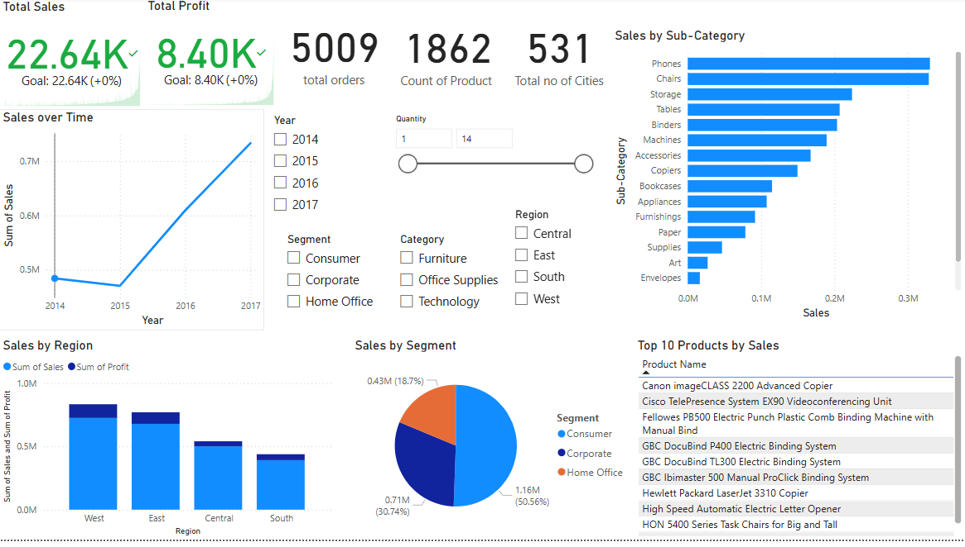
Overview
• Total Sales: 22.64K, Total Profit: 8.40K • Over 5,000 orders, spanning 1,800+ products and 531 cities • Key focus areas: Sales trends, product/category performance, regional analysis

Slide 3
Sales Performance Trends
- Sales Over Time: • Sharp increase in 2017; dip in 2015 • 2017 had the highest annual sales (>0.75M) - Sales by Region: • West outperforms in both sales and profit • South shows lowest performance

Slide 4
Product & Category Insights
- Top Products: • Canon, Cisco, Fellowes are top selling products • High sales in tech and office automation - Sub-Category Sales: • Phones, Chairs, Storage dominate • Art and Envelopes underperform

Slide 5
Customer Segment Analysis
- Segment-wise Sales: • Consumer leads with over . 50% share • Corporate and Home Office . . provide balanced support - Category Trends: • Technology and Furniture . . . . show strong demand

Slide 6
Strategic Insights & Recommendations
- Key Takeaways: • Phones and tech products dominate • South region underperforms • Yearly growth is promising - Recommendations: • Prioritize best-selling categories • Improve outreach in low-performing regions • Create segment-based marketing plans

Slide 7
Thank you
Queries?

