Slide 1

page 9
Data Modelling

Slide 2
Data Modelling 101
› DATA & METADATA
› DATA MODELLING: WHAT & WHY?
› TYPES & LEVELS OF DATA MODELS
› DATA MODEL COMPONENTS
› NORMALISATION
› DIMENSIONAL DATA MODELLING
› SUMMARY

Slide 3












Where does Data Modeling fit?
› Enterprise Data Modelling
› Value Chain Analysis
› Related Data Architecture
› Specification
› Analysis
› Measurement
› Improvement
DATA ARCHITECTURE MANAGEMENT
› Analysis
› Data modelling
› Database Design
› Implementation
DATA QUALITY MANAGEMENT
DATA DEVELOPMENT
› Architecture
› Integration
› Control
DATA GOVERNANCE
› Strategy
› Organisation & Roles
› Policies & Standards
› Issues
› Valuation
› Acquisition
› Recovery
› Tuning
› Retention
› Purging
› Delivery
META DATA
DATABASE OPERATIONS MANAGEMENT
MANAGEMENT
DOCUMENT & CONTENT MANAGEMENT
› Acquisition & Storage
› Backup & Recovery
› Content Management
DATA SECURITY MANAGEMENT
› Standards
DATA
REFERENCE & MASTER DATA MANAGEMENT
› External Codes
› Internal Codes
› Customer Data
› Classifications
› Administration
› Authentication
› Auditing
WAREHOUSE & BUSINESS
› Retrieval
› Retention
INTELLIGENCE
MANAGEMENT
› Architecture
› Implementation
› Training & Support
› Monitoring & Tuning
› Product Data
› Dimension Management

Slide 4
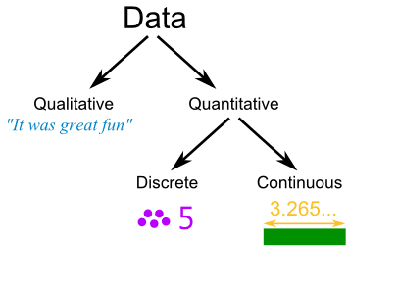
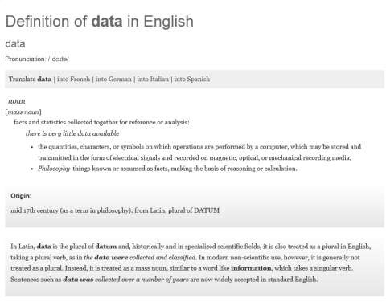

What is Data?
FIGURES
FACTS
THINGS
OBSERVED FACTS
Data in context = Information
Current Balance Home Town
Order Placed Date Customer id
= $400
= Bath
= 4th November 2013
= 987654321
Data is objective
Person image
=

Slide 5
Data
Person id | Forename | Family Name | Salutation | NI number | Player Rating | Office address | Credit limit | Emergency Contact
12356 | Mitchell | Stark | Mr | 112113 | 2 | 123 St James Place, London, WC1 | $0.25m | F.J Banks
124 | Gary | Sobers | Sir | 112141 | 2 | Shellmex house, London, EC1 | $0.25m | E.C. Dollar
09211 | Alan | Knott | Mr | 201221 | 4 | IBM House, White Plains, NY | $0.35m | F.E. Goodwin
43219 | Rachel | Hahoe-Flint | Mrs | 202119 | 5 | Microsoft, MS Business Park, Seattle, WA | $0.55m | R.B. Gibb
12 | Allan | Border | Mr | 311456 | 5 | Dell park, Palo Alto, CA | $0.5m | S.T.Law
230 | Ian | Botham | Sir | 429876 | 0 | Seattle Aero Park, Seattle, WA | - | -

Slide 6

What is Metadata?

Slide 7


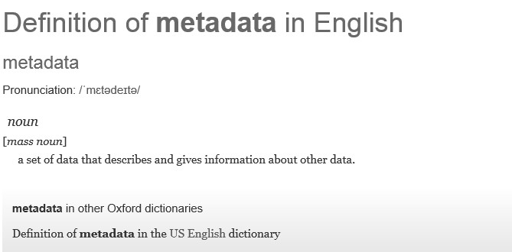

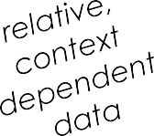


What is Metadata?
THIS is the difference
It is, however, data ABOUT
data
Metadata is .... data
Person id: This is the unique identification number for the customer as used in our organisation.
Forename: The preferred name used by the person. Note this is not the same as the birth certificate forename.
NI Number: The National Insurance number for the person.
KEY point
Metadata is
context
dependent

Slide 8
Metadata
Metadata has
“properties”
These describe the characteristics & rules of the metadata
Description = This is the unique identification number for the person as used in our organisation.
Size = 1-5 numeric
PERSON ID
Mandatory = Yes
Unique key = Yes

Slide 9

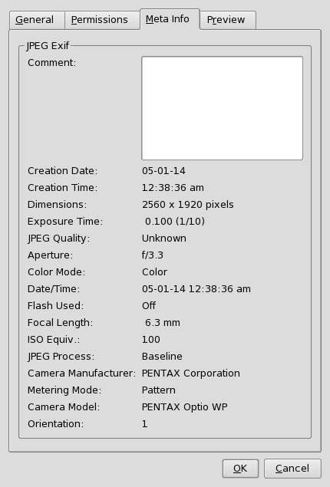
MetaData
DATA
METADATA

Slide 10
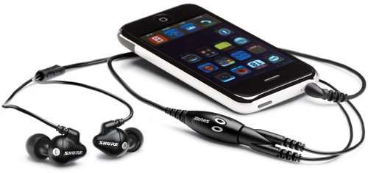
Where else do you use metadata every day?

Slide 11
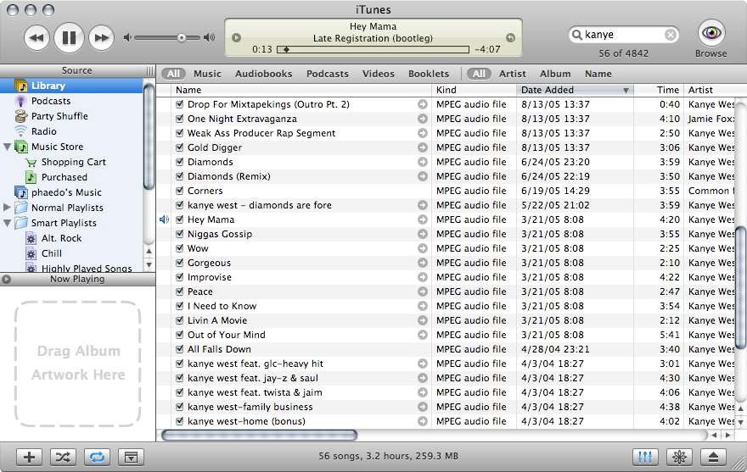

MetaData
DATA
METADATA

Slide 12


Data or Metadata
DATA OR METADATA?
Exercise 1:
Chris Bradley Company Name 750 metres
1 Royal Crescent, Bath
Date Of Birth Order Date
Nov 3rd 2014 Singer Name Order Status
Chris.bradley@DMAdvisors.co.uk
+44 7808 038 173
Shell Location Dubai

Slide 13
Data or Metadata
DATA OR METADATA?
Exercise 1:
Chris Bradley Company Name 750 metres
Date Of Birth Order Date
Data
Metadata
Metadata
Data
Metadata
Data
Data
1 Royal Crescent, Bath
Data
Nov 3rd 2014
Data
Metadata
Singer Name
Shell Location Dubai
Data
Metadata
Order Status
Chris.bradley@DMAdvisors.co.uk
Metadata
Data
Data
Data
+44 7808 038 173

Slide 14




What Is Data Modelling?

Slide 15
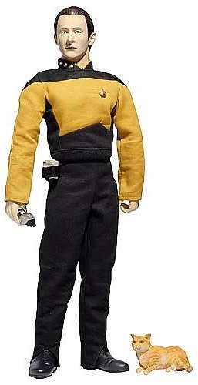
What Is A Data Model?
A model is a representation of something in our environment making use of standard symbols to enable improved understanding of the concept
A data model is a diagram (with additional supporting metadata) that uses text and symbols to represent data to give the reader a better understanding of the data
A data model describes the inherent logical structure of the data within a given domain and, by implication, the underlying structure of that domain itself
A data model describes the specification, definition and rules for data in a business area

Slide 16
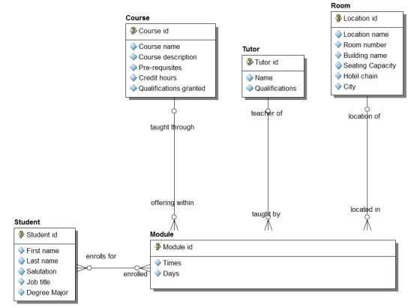
What Is A Conceptual Data Model?
A description of a Business (or an area of the Business) in terms of the things it needs to know about.
The Data things are “entities” and the “facts about things” are attributes & relationships.
It’s a representation of the “real world”, not a technical implementation of it
Should be able to be
understood by Business users
Definition:
A Student is any person who has been admitted to a course, has paid, and has enrolled in one or more modules within a course. Tutors and other staff members may also be Students
Business Assertions The Other Way?
A Student enrolls for one or more modules
A Course can be taught through one or more Modules
A Room can be the location of one or more
modules
A Tutor can be the teacher of one or more modules
A Module is enrolled in by many students
A Module is an offering within one course
A Module is located in one room
A Module is taught by one tutor
Really?
page 30

Slide 17
A Data Model Represents
WHO
Person, Employee, Vendor, Customer, Department, Organisation, …
WHAT
Product, Service, Raw Material, Training Course, Flight, Room, …
Classes of
entities
(kinds of things) about which a company wishes to know or hold information
WHEN
Time, Day, Date, Calendar, Reporting Period, Fiscal Period, …
WHERE
Geographic location, Delivery address, Storage Depot, Airport, …
WHY
Order, Complaint, Inquiry, Transaction, …
HOW
Invoice, Policy, Contract, Agreement, Document, Account, …

Slide 18






What is an Entity?
The “Who, What, Where, When, Why” of the Organization
Entity: A classification of the types of objects found in the real world -- persons, places, things, concepts and events – of interest to the enterprise. ¹
¹ DAMA Dictionary of Data Management
WHO?
WHAT?
WHERE?
WHEN?
WHY?
HOW?

Slide 19
Sample Entities
Location
Product
Customer
Region
Order
Raw Material
Ingredient

Slide 20
Exercise 2: Entities
Which of these might / might not be valid entities?
Student
Building
Maths
Department
Course Catalogue
Attendance Sheet
Enrolment Form
Professor Plumb
Prerequisite list
Module
Organisation Chart
Student Directory
Module Description
Qualification
Certification Body
Graduation

Slide 21
Exercise 2: Entities
Which of these might / might not be valid entities?
Student
Building
Maths
Department
Course Catalogue
Attendance Sheet
Enrolment Form
Professor Plumb
Prerequisite list
Module
Organisation Chart
Student Directory
Module Description
Qualification
Certification Body
Graduation

Slide 22
A Data Model Represents
PERSON ID
FIRST NAME
the
attributes
of that information (facts about things)
DATE OF BIRTH
PRODUCT NUMBER
QUANTITY ORDERED
FLIGHT NUMBER
SEAT CLASS
…

Slide 23

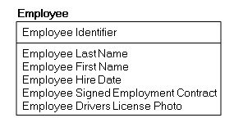
Attributes
An Attribute is a piece of information about or a characteristic of an Entity.
Entity
Employee
Employee Identifier
Employee Last Name
Employee First Name
Employee Hire Date
Employee Signed Employment Contract
Employee Drivers License Photo
Attributes
Entity
Attributes

Slide 24
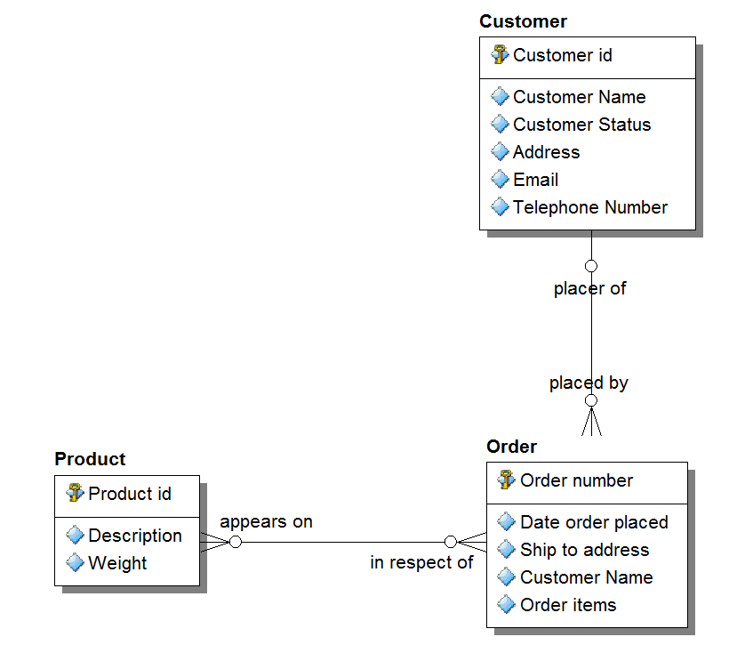
Attributes
Facts about “entities” are recorded as attributes & relationships.
We don’t record every fact, only the ones that are needed
Attribute Properties
“user-entered” vs. “constrained set”: The
attribute can only come from a finite set, such as code list / drop down set
Ok for a conceptual
data model
fundamental vs. redundant: the same
value is recorded multiple times in different entities
single-valued vs. multivalued: one attribute can have multiple values, at a time or over time

Slide 25
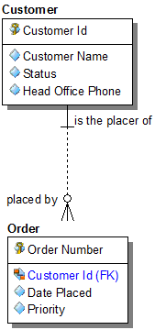


A Data Model Represents
Relationships form a concrete Business Assertion
A relationship called "is the placer of" operates on entity classes CUSTOMER and ORDER and forms the following concrete assertion:
Relationships should be named in both directions, thus in the other direction we have:
relationships
among those entities and (often implicit) relationships among those attributes
“Each CUSTOMER
is the placer of zero, one or more ORDER(s)"
"Each ORDER must be placed by one and only one CUSTOMER"
Is this true?
Is this true…
always?

Slide 26

A Data Model represents
Classes of
entities
(kinds of things) about which a company wishes to know or hold information
relationships
among those entities and (often implicit) relationships among those attributes
The model
describes the organization of the data irrespective of how data might be represented in a computer system
the
attributes
of that information (facts about things)
It’s much more than a
picture!
page 40

Slide 27
Why Produce A Data Model?
TOP REASONS*
Capturing Business Requirements
Promotes Reuse, Consistency, Quality
Bridge Between Business and Technology Personnel
Assessing Fit of Package Solutions
Identify and Manage Redundant Data
Sets Context for Project within the Enterprise
Interaction Analysis: Complements Process Model
Pictures Communicate Better than Words
Avoid Late Discovery of Missed Requirements
Critical in Managing Integration Between
Systems
Pre-cursor to DBMS design / generate DDL
* DAMA-I Survey

Slide 28

Why Data Modelling Is Important
Data is an asset of your corporation
Needs to be understood to be managed
Don’t need to
look at the detail right away (or sometimes ever)
Provides a common vocabulary
An aid to understanding
Context and high level views will be sufficient
Provide only the level of detail that is necessary
– fit for purpose

Slide 29
Why Data Modelling Is Important
BUSINESS ARCHITECTURE
Business Objectives & Goals
Motivations & Metrics
Functions, Roles,
Departments
INFORMATION ARCHITECTURE
Enterprise Data Model
Conceptual Data Models
Logical Data Models
Physical Data Models
PROCESS ARCHITECTURE
Overall Value Chain
High-Level Business Processes
Workflow Models
APPLICATION / SYSTEMS ARCHITECTURE
Systems within Scope
High-Level Mapping
Business Services
Presentation Services (use cases)

Slide 30
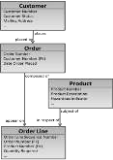



Why Data Modelling Is Critical
BUSINESS ARCHITECTURE
Business Objectives & Goals
Motivations & Metrics
Functions, Roles, Departments
INFORMATION ARCHITECTURE
Enterprise Data Model
Conceptual Data Models
Logical Data Models
Physical Data Models
PROCESS ARCHITECTURE
Overall Value Chain
High-Level Business Processes
Workflow Models
APPLICATION / SYSTEMS ARCHITECTURE
Systems within Scope
High-Level Mapping
Business Services Presentation Services
(use cases)
B U S I N E S S O B J E C T I V E S
I N F O R M A T I O N S E R V I C E S
B U S I N E S S P R O C E S S
B U S I N E S S S E R V I C E S
The company is undertaking a radical approach to enhance Customer experience, service and satisfaction by providing seamless multi-channel Customer access to all core services
PRESENTATION SERVICES
ALL of the Architecture disciplines use the language (and rules) of the data model

Slide 31












Data Model Levels
E N T E R P R I S E
F O C U S
I M P L E M E N T A T I O N
C
O N C
E P
T U A
L
C O M M U N I C A T I O N
L
O
G I C A L
P
L
H Y S I C A
F O C U S
S Y S T E M

Slide 32
Levels of Data Models
Enterprise Data Model
Conceptual
Data Model
(Subject area)
Logical
Data Model
(Application)
Physical Data Model
Documents the very high level business data objects and definitions. Enterprise wide scope to provide a strategic view of Enterprise data.
The business key, attributes and definitions of business data objects. Also shows the relationship between business data objects. Broader scope than LDM and may cover a subject area (also known as subject area data model).
Documents the business key, attributes and definitions of business data objects. It also shows the relationship between business data objects. Frequently is within the scope of a defined project.
Technical design eg tables, columns, keys, foreign keys, and other constraints to be implemented in the database . May be generated from a logical data model.
This model is within the scope of a defined project.

Slide 33
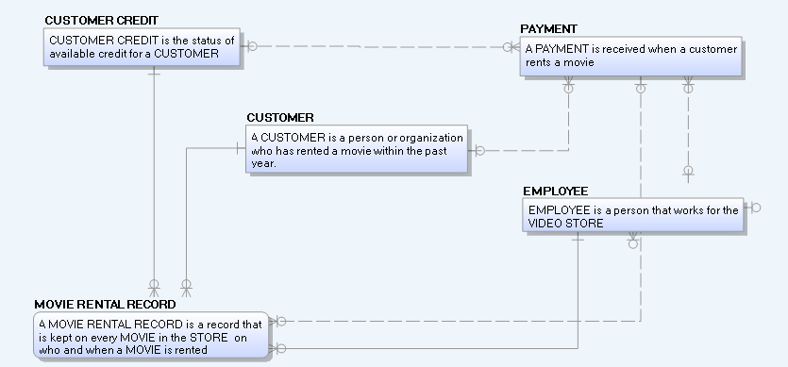
Different Data Models For
Different Audiences: Business

Slide 34
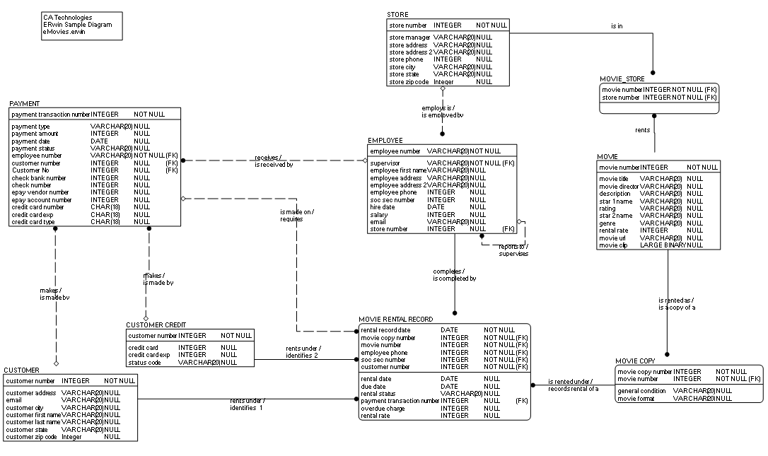
Different Data Models For
Different Audiences: Technical

Slide 35


Logical Data Modelling Components
Entities
Relationships
Attributes

Slide 36
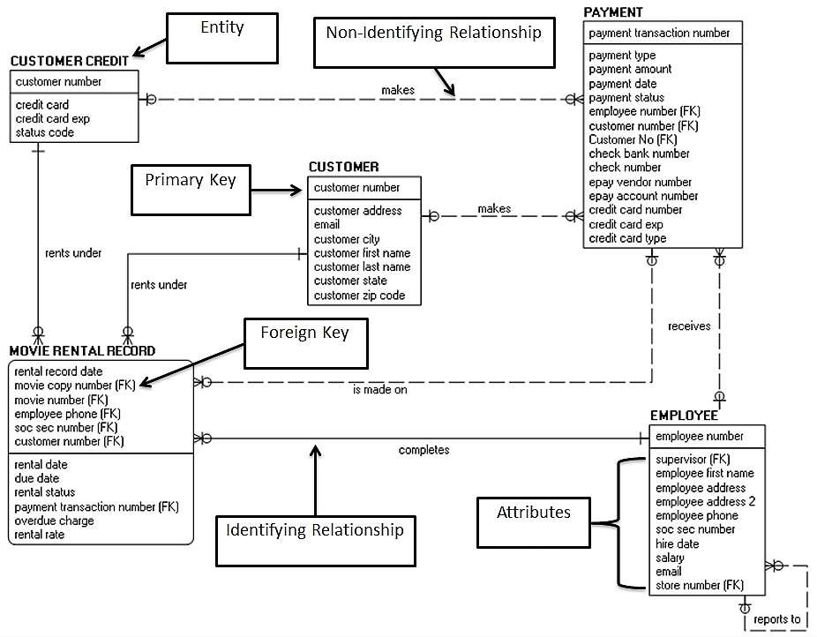

Logical Data Model Components
Entity
Non identifying
relationship
Primary
Key (PK)
Foreign
Key (FK)
Recursive
relationship
Attributes
Identifying
relationship

Slide 37




Entities
A THING OF SIGNIFICANCE TO THE BUSINESS ABOUT
WHICH INFORMATION NEEDS TO BE KNOWN OR HELD
WHO
Person, Employee, Vendor, Customer, Department, Organisation, …
REAL
ABSTRACT
WHAT
Product, Service, Raw Material, Training Course, Flight, Room, …
WHEN
Time, Day, Date, Calendar, Reporting Period, Fiscal Period, …
WHERE
Geographic location, Delivery address,
Storage Depot, Airport, …
DEPENDENT
INDEPENDENT
WHY
Order, Complaint, Inquiry, Transaction, …
HOW
Invoice, Policy, Contract, Agreement, Document, Account, …

Slide 38
Entity Naming Best Practice
Entity names must be unique
(e.g. Order)
Can be accomplished by placing qualifiers or quantifiers in front of the entity name.
Entity names must have business meaning
Use a noun alone wherever possible (e.g. Contract)
Use adjective + noun or, adjective + adjective + noun
to clarify meaning
e.g. Lease Contract or Back Order
Entity names should be
singular
The entity is defined in terms of a single occurrence. (e.g. “Product” not “Products”)
Acronyms or abbreviations should not be used
Do not use “_” within Entity names, this really is only needed for implementation artefacts (e.g. Tables)

Slide 39
Entity Definition Best Practice
› Can the term be understood by reading the definition?
› Is it unambiguous?
› Avoid jargon & stating the obvious
CLARITY
› Appropriate level of detail – not too generic – not too specific
› Goldilocks principle
› Contains all necessary components without omission (e.g. derivations, UOM)
COMPLETENESS
› A subject matter expert would agree
› Relevant to the state of the entity:
i.e. the stages an entity may go through over time
ACCURACY

Slide 40

Common Errors With Entities
page 58
A few common mistakes are regularly encountered when creating business focused data models:
› Creating an Entity that is really a report or a screen or form
› Failing to clarify if the entity deals with types (or categories) vs. specific instances of things
› Identifying an entity that exists in the real world, but whose instances can't be uniquely identified
e.g. “Billboard observer”
› Identifying entities that are too imprecise and / or the name doesn't' imply a single instance
e.g. “Weather”

Slide 41
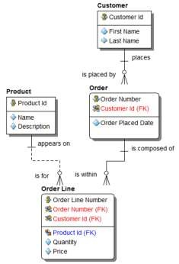
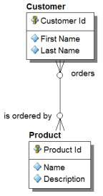
Dependent
Independent
Depends upon one (or more) other entities
Does not depend on any other entity for its existence.
Can be identified without reference to another entity on the model
You don’t need to know anything about a Customer to identify a Product
You don’t need to know anything about a Product to identify a Customer
Can depend upon Independent or Dependent entities
3 types:
Attributive (depends only on its parent
Associative (depends upon two or more entities)
Category (AKA supertype)
Why is it important to know whether an entity is independent or dependent?

Slide 42

Attributes & Keys
KEYS (SUMMARY):
AN ENTITY CAN CONTAIN FOUR TYPES OF KEYS
Entity Keys
PRIMARY KEY (PK)
› Identifies an entity/table for the system.
› May be “natural” or “surrogate”
› Could be composite
ALTERNATE KEY (AK)
› Another way to identify an entity/table.
› May be surrogate
Surrogate is often a
“made up” key
FOREIGN KEY (FK)
› Identifies a relation among entities/tables
INVERTED KEY (IK) OR INVERSION ENTITY [IE]
› Improves access to table information (physical)
Composite
is made up
of several
items to
form the key

Slide 43


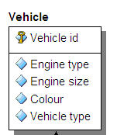
Primary Key
Can I use Registration Number as the PK?
Mandatory
Must Uniquely Identify Each Instance Of
The Entity
Unchanging
Attribute (Business Not Designer Added) May Indicate Relationship Membership (FK)
Attribute(s) that make up a PK are represented in modelling tools separately from the rest of the attributes by a line

Slide 44
Primary Keys
› What attributes might uniquely identify an entity? Let’s use Customer as an example.
› What might uniquely identify an individual customer?
Is Last Name + First Name enough?
Could there be 2 customers named John Smith? → Probably
Is Last Name + First Name + Date of Birth enough?
Could there be 2 customers named John Smith born on 1 June, 1963? → Less Likely, but Possible
Is Last Name + First Name + Date of Birth + Address enough?
Could there be 2 customers named John Smith born on 1 June, 1963 living at 1 Earl’s Court, London, UK? → Even Less Likely. Possible, but how many attributes do we want to use?

Slide 45

Keys:
Natural vs. Surrogate
› The “Customer” example keys we just identified would be classified as natural keys.
› Natural keys are based on business rules and logic that determine how an individual instance can be uniquely identified.
› As we’ve seen, natural keys can become unwieldy, requiring a number of attributes, which makes queries difficult.
› Also, extreme care is needed as components of natural keys could change
— Surrogate keys are often used instead, which are system-generated unique identifiers. e.g. Customer ID, Product ID, etc.
— While surrogate keys are more efficient, important business rules are lost when they are used. It’s a balancing act.

Slide 46


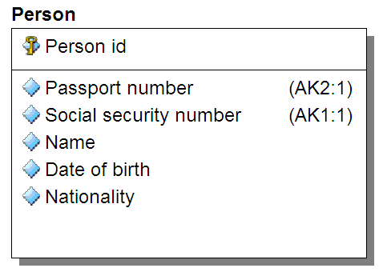

Alternate Key
ALTERNATE KEY (AK):
ANOTHER WAY OF IDENTIFYING THE ENTITY
Are these good AK’s for all circumstances?

Slide 47
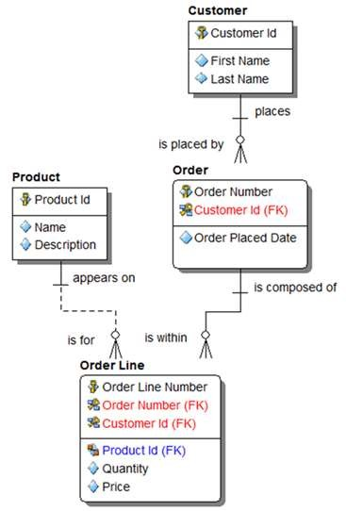

Foreign Key
FOREIGN KEY (FK):
POINTS BACK TO THE PARENT(S)
Can a FK be part of the Primary Key?

Slide 48




Inverted Key
INVERTED KEY (IK):
PHYSICAL IMPLEMENTATION ONLY
CAR IK
EYE COLOUR IK
NATIONALITY IK
TABLE
Audi (1, 5, 8)
Bentley (4)
BMW (2, 3, 9)
Ford (6, 7)
Blue (1, 4, 6, 9)
Brown (3, 5, 7, 8)
Green (2)
FR (3, 6)
UK (1, 4, 7, 9)
US (2, 5, 8)
Primary Car Eye Nationality Salary Key Colour
1 | Audi | Blue | UK | 100000
2 | BMW | Green | US | 95000
3 | BMW | Brown | FR | 85000
4 | Bentley | Blue | UK | 250000
5 | Audi | Brown | US | 60000
6 | Ford | Blue | FR | 50000
7 | Ford | Brown | UK | 45000
8 | Audi | Brown | US | 55000
9 | BMW | Blue | UK | 65000
IK IMPLEMENTED AS BITMAP INDEX
1 2 3 4 5 6 7 8 9
1 1 1
Car = Audi Car = Bentley
1
Car = BMW
1 1
1
Car = Ford
1 1
1 1
Eyes = Blue
1
1
Eyes = Brown
1 1 1 1
Eyes = Green
1
Nationality = FR
1
1
Nationality = UK
1
1
1 1
Nationality = US
1
1
1

Slide 49


Attribute Properties & Domains
Name
Logical
Physical
Unique
Part of primary key
Mandatory Datatype Domain Validation Rules Default Value Nullable (Y/N) Definition
Notes
Main Attribute Properties
THE COMPLETE SET OF VALID VALUES A DATA ELEMENT MAY CONTAIN (EG DROP DOWN)
DOMAINS CAN BE CASCADED TO OTHER ATTRIBUTES
Why are Domains useful?
Characteristics of
E.g.
Person Id “The unique identifier of a Person in Acme corporation. This is a unique integer length 13, with digit 13
being a checksum”
Employee Id: Domain name = Person Id Business Sponsor Id: Domain name = Person Id
Cost Centre Owner:
Domain name = Person Id
Customer Id:
Domain name = Person Id
Customer Name:
Domain name = Person Name
an attribute

Slide 50
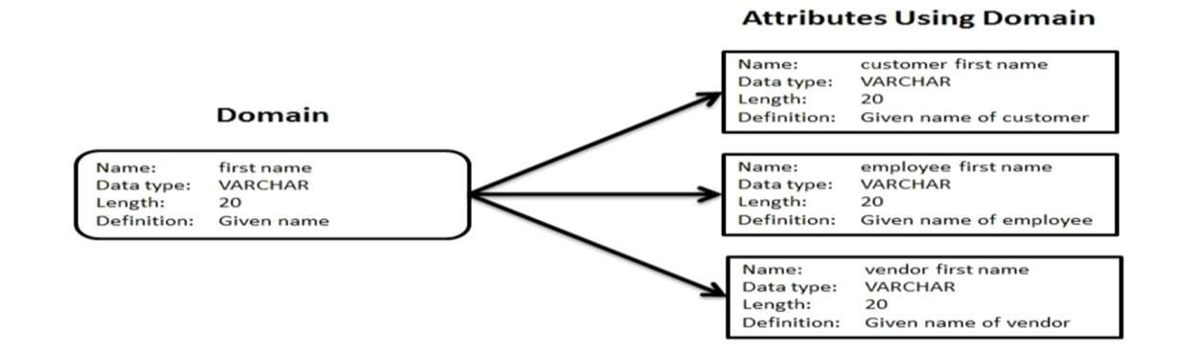
Domain Inheritance

Slide 51
Relationships

Slide 52
Relationships
Between Entities
Well formed
relationships
represent a business assertion that can be tested:
“Is it true that an Order
can only be placed by
one Customer?”
A relationship
represents an association between two entities, ensuring the referential integrity among instances of the entities.
When resolving Many to Many relationships, the “Intersection Entity” invariably has real business meaning
page 70

Slide 53


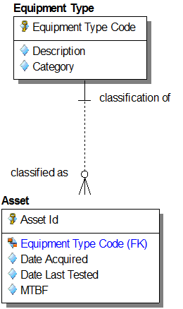
Relationship Types
TYPES OF “ONE TO MANY” RELATIONSHIPS:
MANDATORY, NON-IDENTIFYING
What does this tell us about Asset Id?
Denotes mandatory
(by the entity that is mandatory)
Denotes non-
identifying
Parent id IS NOT part of the child unique id. Just a
foreign key.

Slide 54
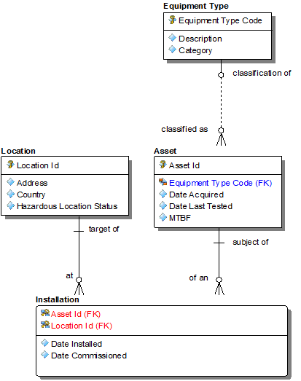

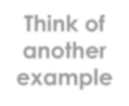
Relationship Types
TYPES OF “ONE TO MANY” RELATIONSHIPS:
MANDATORY, NON-IDENTIFYING
1 part in this PK Asset has 1 non-identifying
relationship to it
Think of another example
2 parts in this PK Installation has 2 identifying mandatory relationships to it

Slide 55
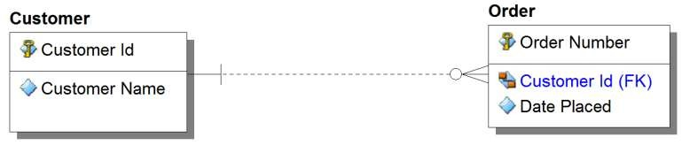
Relationship Types
TYPES OF “ONE TO MANY” RELATIONSHIPS:
MANDATORY, NON-IDENTIFYING
This tells us that the Order Number IS unique

Slide 56

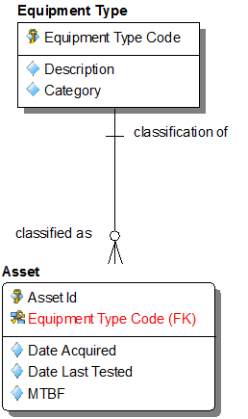

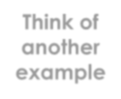
Relationship Types
TYPES OF “ONE TO MANY” RELATIONSHIPS:
MANDATORY, IDENTIFYING
What does this tell us about Asset Id?
Denotes mandatory
(by the entity that is mandatory)
Denotes
identifying
Think of another example
Parent id becomes a part of the child unique id

Slide 57
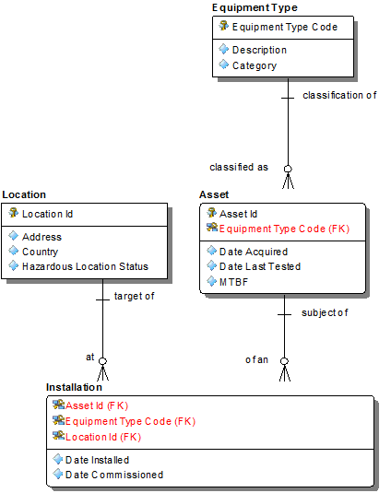
Relationship Types
TYPES OF “ONE TO MANY” RELATIONSHIPS:
MANDATORY, IDENTIFYING
Now there’s 2 parts in this PK
Asset has 1 identifying
mandatory relationship to it
Installation has 2 identifying mandatory relationships to it

Slide 58


Relationship Types
TYPES OF “ONE TO MANY” RELATIONSHIPS:
OPTIONAL, NON-IDENTIFYING
What does this tell us about Asset Id?
Denotes optional
(by the entity that is optional)
Denotes non-
identifying
Parent id IS NOT part of child unique id. Just a
foreign key.

Slide 59
Relationship Types
TYPES OF “ONE TO MANY” RELATIONSHIPS:
OPTIONAL, NON-IDENTIFYING
Think of another example
Installation still has 2 identifying mandatory relationships to it but the primary key has changed as it now doesn’t include Equipment Type Code

Slide 60
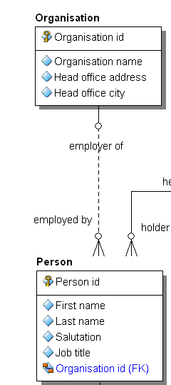

Relationship Types
TYPES OF “ONE TO MANY” RELATIONSHIPS:
OPTIONAL, NON-IDENTIFYING
This tells us that we don’t need to know the Organisation to find a
Person. A Person does NOT have to be “employed by” an Organisation.
Organisation to Person
relationship is optional,
non-identifying
Back to our Asset example

Slide 61
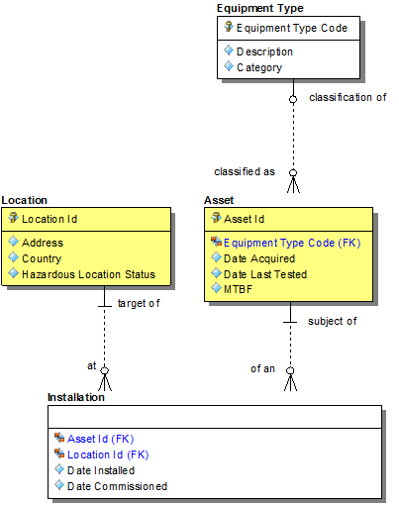


Relationship Types
TYPES OF “ONE TO MANY” RELATIONSHIPS:
OPTIONAL, NON-IDENTIFYING
So what have we got to do now?
See what happens to Installation if its 2 relationships become non-identifying.

Slide 62
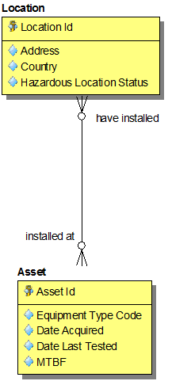




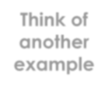

Relationship Types
TYPES OF “ONE TO MANY” RELATIONSHIPS:
MANY TO MANY (AKA NON SPECIFIC)
Why can’t a many to many relationship be an “identifying” relationship?
Chris’s law
99% of M:M relationships represent a real business concept that is the intersection entity
Think of another example
page 80

Slide 63


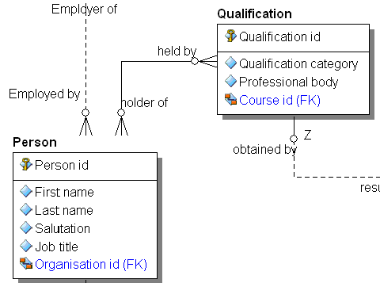


Exercise 3: Relationships
TYPES OF “ONE TO MANY” RELATIONSHIPS:
MANY TO MANY (AKA NON SPECIFIC)
What’s the real business “thing” that resolves this many to many?
Qualification to
Person relationship is
non-specific (AKA
many to many)
Think of 2 more common M:M examples

Slide 64

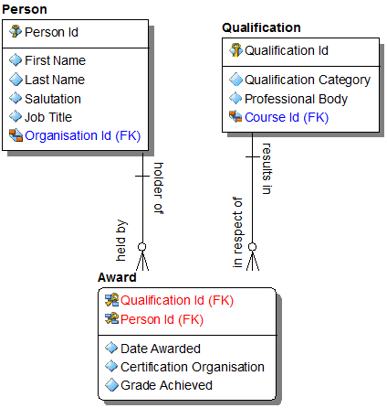

What’s the real business “thing” that resolves this many to many?

Slide 65

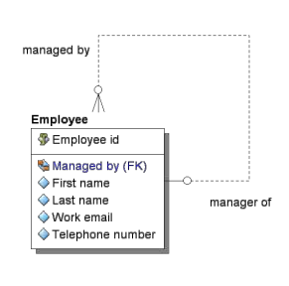


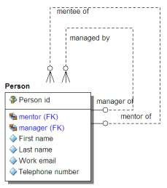
Recursive Relationships
Can a recursive relationship be “identifying”?
Can a recursive relationship be “mandatory”?
A recursive relationship occurs when there is a relationship between an entity and itself.
But we cannot have duplicated
Attribute Names in an Entity hence the FK must have a role (e.g.
Managed by).
It is possible to have many recursive relationships between the same entity and itself.

Slide 66
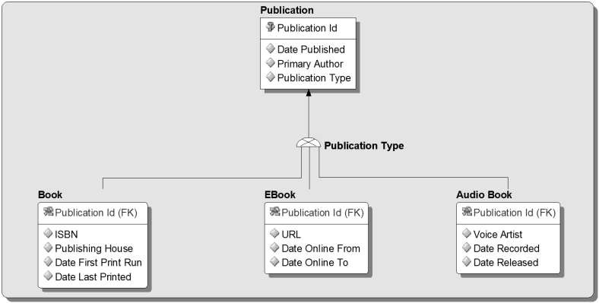
Entity Subtypes
Super-type Entity: Contains the primary key and common attributes
Discriminator: Attribute to determine which subtype we are talking about
Sub-type Entities: Contain Specific attributes for each type

Slide 67
Normalisation
WHY NORMALISE A DATA MODEL?
Improved understanding
Ensure data integrity
Easier to query
Remove data redundancy
LEADING TO
Improved data quality
Reduction in timescales
Easier maintenance

Slide 68
Normalisation Approaches
A data model is fully normalised when it is in Third Normal Form (3NF).
3NF is a normalisation method indicating 3 stages of normalisation:
Further normalisation methods can also be applied for very specific cases. See advanced course for details:
Boyce/Codd normal form (BCNF)
Fourth Normal Form (4NF)
Fifth Normal Form (5NF)

Slide 69
Normal Form
1st
1NF DEFINITION:
EVERY NON-KEY ATTRIBUTE IN AN ENTITY MUST DEPEND ON IT’S PRIMARY KEY
A P R I M A R Y K E Y M U S T B E
› Unique - the primary key uniquely identifies each instance of the entity
› Mandatory – the primary key must be defined
for every instance of the entity
› Unchanging – while not mandatory, it is desirable that the primary key does not change
T O P U T A M O D E L
I N T O 1 N F
› Identify the primary key
› Remodel repeating values
› Remodel multi-valued attributes

Slide 70
1st Normal
Form Example
NAME | GENDER | EMAIL ADDRESS
Barack Obama | Male | barack@whitehouse.org gobama@vote2012.com
 |  | judgementday@dontnuke.com
David Cameron | Male | Callmedave@tory.co.uk
 |  | DC@uk.gov.com
Angela Merkel | Female | FrauAng@gov.de
Julia Gillard | Female | madeinwales@gov.au
 |  | julia@outofwork.com
To put this in first normal form we must:
Identify a primary key
Remodel the multi-valued attribute of Name
Remodel the multi- valued attribute of Email Address

Slide 71
1st Normal
Form Example
A P R I M A R Y K E Y M U S T B E
What is the primary key: Name, Gender, Email?
› Unique - the primary key uniquely identifies each instance of the entity
› Mandatory – the primary key must be defined for every instance of the entity
› Unchanging – while not mandatory, it is desirable that the primary key does not change
So there is no primary key!
So what do we do…?
We create our own primary key (virtual key)
To put this in first normal form we must:
Identify a primary key
Remodel the multi-valued attribute of Name
Remodel the multi- valued attribute of Email Address

Slide 72

1st Normal
Form Example
NAME | GENDER | EMAIL ADDRESS
Barack Obama | Male | barack@whitehouse.org gobama@vote2012.com judgementday@dontnuke.com
David Cameron | Male | Callmedave@tory.co.uk DC@uk.gov.com
Angela Merkel | Female | FrauAng@gov.de
Julia Gillard | Female | madeinwales@gov.au julia@outofwork.com
Name = First Name + Last Name
To put this in first normal form we must:
Identify a primary key
Remodel the multi-valued attribute of Name
Remodel the multi- valued attribute of Email Address
page 90

Slide 73

1st Normal
Form Example
NAME | GENDER | EMAIL ADDRESS
Barack Obama | Male | barack@whitehouse.org gobama@vote2012.com judgementday@dontnuke.com
David Cameron | Male | Callmedave@tory.co.uk DC@uk.gov.com
Angela Merkel | Female | FrauAng@gov.de
Julia Gillard | Female | madeinwales@gov.au julia@outofwork.com
Next we look at this
To put this in first normal form we must:
Identify a primary key
Remodel the multi-valued attribute of Name
Remodel the multi- valued attribute of Email Address

Slide 74
1NF: Email Address?
› A multi-valued attribute: name & domain?
› Can we identify ALL available types?
» Home Email
» Work Email
» Club Email
› An exhaustive list?
› No; a Person can have any number of email addresses.
› We need to allow for a Person having any number of
email addresses.
Is it just a compound attribute?
No, it is multi- valued!
To put this in first normal form we must:
Remodel the multi-valued attribute of Name
Remodel the multi- valued attribute of Email Address
Identify a primary key

Slide 75
1st Normal
Form Example
1NF DEFINITION:
EVERY NON-KEY ATTRIBUTE IN AN ENTITY MUST DEPEND ON IT’S PRIMARY KEY
P E R S O N
P E R S O N E M A I L
PERSON ID | FIRST NAME | LAST NAME | GENDER |  | PERSON ID | EMAIL ADDRESS
1 | Barack | Obama | Male |  | 1 | barack@whitehouse.org
2 | David | Cameron | Male |  | 1 | gobama@vote2012.com
3 | Angela | Merkel | Female |  | 1 | judgementday@dontnuke.com
4 | Julia | Gillard | Female |  | 2 | Callmedave@tory.co.uk
 |  |  |  |  | 2 | DC@uk.gov.com
 |  |  |  |  | 3 | FrauAng@gov.de
& as it’s a simple example
they are in 2NF & 3NF too!
4
madeinwales@gov.au
4
julia@outofwork.com
We have now put our politicians in 1NF!

Slide 76


1st Normal
Form Example
1NF DEFINITION:
EVERY NON-KEY ATTRIBUTE IN AN ENTITY MUST DEPEND ON IT’S PRIMARY KEY
REGISTRATION | MODEL | CHASSIS NUMBER | MILEAGE | FEATURES
HV62SYG | Lexus 450H | 76365296745568432 | 7,129 | Electric Windows
 |  |  |  | Satellite Navigation
 |  |  |  | Bluetooth integration
 |  |  |  | Head Up Display
 |  |  |  | Speech Control
Y612 SYG | Audi A4 | 13847621837653275 | 10,732 | Electric Windows
 |  |  |  | Bluetooth integration
WN09 UTS | BMW 320d | 32178468273647327 | 31,123 | Electric Windows
 |  |  |  | Satellite Navigation
 |  |  |  | Bluetooth integration
WU52XUX | Ford Focus | 71283459735474924 | 104,123 | Electric Windows _{Tur}
n this into 1NF: State your
Keys

Slide 77
1st Normal
Form Example
C A R E N T I T Y
C A R F E A T U R E E N T I T Y
CHASSIS NUMBER | REGISTRA- TION | MANUFACT -URER | MODEL | MILEAGE | CHASSIS NUMBER | FEATURE
76365296745568432 | HV62SYG | LEXUS | RX450H | 7,129 | 76365296745568432 | Electric Windows
13847621837653275 | Y612 SYG | AUDI | A4 | 10,732 | 76365296745568432 | Satellite Navigation
32178468273647327 | WN09 UTS | BMW | 320D | 31,123 | 76365296745568432 | Bluetooth integration
71283459735474924 | WU52XUX | FORD | FOCUS | 104,123 | 76365296745568432 | Head Up Display
 |  |  |  |  | 76365296745568432 | Speech Control
 |  |  |  |  | 13847621837653275 | Electric Windows
 |  |  |  |  | 13847621837653275 | Bluetooth integration
 |  |  |  |  | 32178468273647327 | Electric Windows
The primary keys are in BLUE
But, refer back to primary key criteria
Feature names are likely to change
32178468273647327 | Satellite Navigation
32178468273647327 | Bluetooth integration
71283459735474924 | Electric Windows

Slide 78
1st Normal
Form Example
C A R E N T I T Y
C A R F E A T U R E E N T I T Y
CHASSIS NUMBER | REGISTRA- TION | MANUFACT -URER | MODEL | MILEAGE | CHASSIS NUMBER | FEATURE ID | FEATURE
76365296745568432 | HV62SYG | LEXUS | RX450H | 7,129 | 76365296745568432 | 1 | Electric Windows
13847621837653275 | Y612 SYG | AUDI | A4 | 10,732 | 76365296745568432 | 2 | Satellite Navigation
32178468273647327 | WN09 UTS | BMW | 320D | 31,123 | 76365296745568432 | 3 | Bluetooth integration
71283459735474924 | WU52XUX | FORD | FOCUS | 104,123 | 76365296745568432 | 4 | Head Up Display
 |  |  |  |  | 76365296745568432 | 5 | Speech Control
 |  |  |  |  | 13847621837653275 | 1 | Electric Windows
 |  |  |  |  | 13847621837653275 | 3 | Bluetooth integration
 |  |  |  |  | 32178468273647327 | 1 | Electric Windows
 |  |  |  |  | 32178468273647327 | 2 | Satellite Navigation
 |  |  |  |  | 32178468273647327 | 3 | Bluetooth integration
 |  |  |  |  | 71283459735474924 | 1 | Electric Windows

Slide 79
Normal Form
2nd
2NF DEFINITION:
EACH ENTITY MUST HAVE THE FEWEST POSSIBLE CORRECT PRIMARY KEY ATTRIBUTES
For each non- key attribute
(i.e. not a primary, foreign or alternate key)
Test if it depends entirely on the primary key
If it doesn’t, move it out to a new entity

Slide 80
2nd Normal
Form Example
C A R F E A T U R E E N T I T Y
CHASSIS NUMBER
FEATURE FEATURE
ID
76365296745568432
1
Electric Windows
76365296745568432
2
Satellite Navigation
Does Feature depend entirely upon Chassis Number and Feature Id?
76365296745568432
3
Bluetooth integration
76365296745568432
4
Head Up Display
76365296745568432 | 5 | Speech Control
13847621837653275 | 1 | Electric Windows
13847621837653275 | 3 | Bluetooth integration
32178468273647327 | 1 | Electric Windows
32178468273647327 | 2 | Satellite Navigation
32178468273647327 | 3 | Bluetooth integration
71283459735474924 | 1 | Electric Windows

Slide 81
2nd Normal
Form Example
Car Feature is an associative entity
C A R E N T I T Y
C A R F E A T U R E E N T I T Y
CHASSIS NUMBER
CHASSIS NUMBER
FEATURE ID
76365296745568432
HV62SYG
LEXUS
RX450H
7,129
76365296745568432
1
13847621837653275
Y612 SYG
AUDI
A4
10,732
76365296745568432 | 2
76365296745568432 | 3
76365296745568432 | 4
76365296745568432 | 5
13847621837653275 | 1
13847621837653275 | 3
32178468273647327 | 1
32178468273647327 | 2
32178468273647327 | 3
71283459735474924 | 1
32178468273647327
WN09 UTS
BMW
320D
31,123
71283459735474924
WU52XUX
FORD
FOCUS
104,123
FEATURE ID
1
Electric Windows
F E A T U R E E N T I T Y
2
Satellite Navigation
3
Bluetooth integration
4
Head Up Display
5
Speech Control
We have now put our cars into 2NF

Slide 82
Normal Form
3rd
3NF DEFINITION:
EACH NON KEY ELEMENT MUST BE DIRECTLY DEPENDENT UPON THE PRIMARY KEY AND NOT UPON ANY OTHER NON-KEY ATTRIBUTES
For each non- key attribute
(i.e. not a primary, foreign or alternate key)
Test if it depends entirely on the primary key & nothing else
If it doesn’t, move it out to a new entity
page 100

Slide 83
3rd Normal
Form Example
CHASSIS NUMBER | REGISTRA- TION | MANUFACT -URER | MODEL | MILEAGE
76365296745568432 | HV62SYG | LEXUS | RX450H | 7,129
13847621837653275 | Y612 SYG | AUDI | A4 | 10,732
32178468273647327 | WN09 UTS | BMW | 320D | 31,123
71283459735474924 | WU52XUX | FORD | FOCUS | 104,123
For 3NF, all attributes must depend only on Chassis Number.
But “Model” also depends upon Manufacturer

Slide 84
3rd Normal
Form Example
CHASSIS NUMBER | REGISTRA- TION | MODEL ID | MILEAGE MODEL MANUFACT ID -URER ID |  |  | MODEL
76365296745568432 | HV62SYG | 1 | 7,129 1 1
13847621837653275 | Y612 SYG | 2 | 10,732 2 2
32178468273647327 | WN09 UTS | 3 | 31,123 3 3
71283459735474924 | WU52XUX | 4 | 104,123 4 4
The model name on its own is not a key candidate since it may not be unique:
Its possible that 2 manufacturers may make a car with the same name. The manufacturer and model together make a key.

Slide 85
3rd Normal
Form Example
3NF DEFINITION:
EACH NON KEY ELEMENT MUST BE DIRECTLY DEPENDENT UPON THE PRIMARY KEY AND NOT UPON ANY OTHER NON-KEY ATTRIBUTES
CHASSIS NUMBER | REGISTRA- TION | MODEL ID | MILEAGE MODEL MANUFACT ID -URER ID |  |  | MODEL
76365296745568432 | HV62SYG | 1 | 7,129 1 1
13847621837653275 | Y612 SYG | 2 | 10,732 2 2
32178468273647327 | WN09 UTS | 3 | 31,123 3 3
71283459735474924 | WU52XUX | 4 | 104,123 ⁴ ⁴
MANUFACT- URER ID | MANUFACT- URER NAME | CONTACT EMAIL
1 | Lexus | hitori@lexus.jp
2 | Audi | hans@audi.de
3 | BMW | woflgang@bmw.de
4 | Ford | dwane@ford.com
We have now put our cars into 3NF

Slide 86
Normalisation Summary
Un-normalised (UNF or 0NF)
Contains a “repeating group”
First Normal Form (1NF)
Repeating attributes moved down to associative entities
Second Normal Form (2NF)
Only applies to dependent entities
No attributes in a child entity are really facts about a parent (or grandparent). No characteristic or associative entity redundantly contains facts from its parent(s) – if it does, move the fact(s) up and if necessary create a new parent entity
Third Normal Form (3NF)
If any entity redundantly contains facts from a related (non-parent) entity, move the fact(s) out to the other entity and create a new entity if necessary
0NF
1NF
2NF
3NF
Fourth and Fifth Normal Form (4NF, 5NF)
“Large” (3-way or more) associatives need to be broken down into more granular entities
4& 5NF

Slide 87
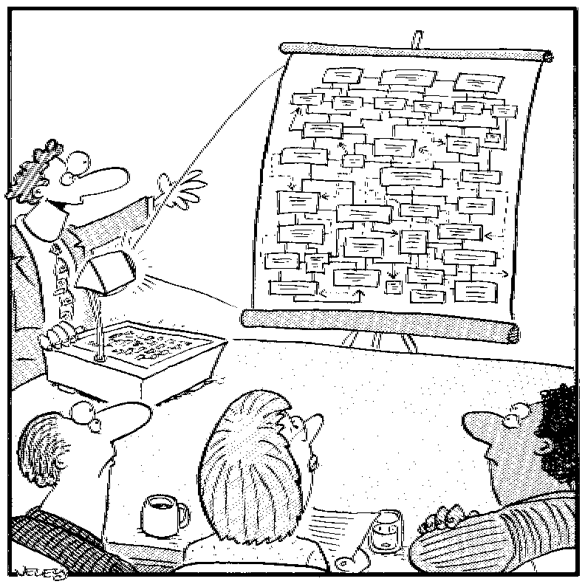
Graphical Principles
OUR MODELS SHOULD AID UNDERSTANDING BY:
› Using visual cues consistently
› Having a starting point and direction
› Abstracting
› Masking unnecessary detail
› Highlighting what matters
“Let’s start here with Special Tax Rate Variation Comment Type…”

Slide 88
Dimensional Data Models
Designed for the rapid recovery of information to be delivered to OLAP systems or ad hoc analysis
Modeled based on the dimensional modeling principles popularised by Ralph Kimball
“Entity-relationship modelling is a logical design technique that seeks to eliminate data redundancy”
A good choice for OLTP systems
“Dimensional modelling is a design technique that seeks to present data in a way that maximises both ease of use and query performance.”
A good choice for Data Warehouses / Business Intelligence systems

Slide 89
Model Features
R E L A T I O N A L
› Optimised for OLTP
› Normalised
› Low redundancy
› Relationships between entities are
explicit
› Tightly coupled to business model
D I M E N S I O N A L
› Optimised for reporting
› Business Entities are denormalised
› More redundancy to support faster query performance
› Relationships between entities are implicit
› Loosely coupled to business model

Slide 90
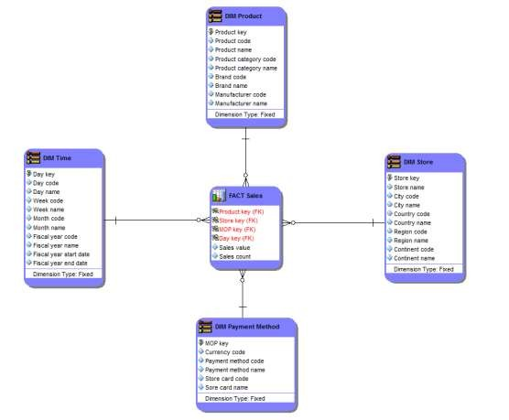
A Dimensional Model
‘STAR SCHEMA’
composed of Dimension and Fact tables
Dimension tables
Fact tables
› Contains measures (e.g.
Sales Value) and dimension FK’s
› Dimension columns are FK’s pointing to the respective dimensions.
› EG: Location, Product, Time, Promotion, Organisation …
› Product dimension includes Product Type, Brand, Manufacturer
› Store dimension includes Country, Continent

Slide 91
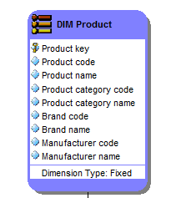
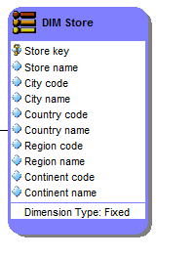
Dimensions & Hierarchies
Hierarchies for the dimensions are stored in the dimensional table itself so there is no need for the individual hierarchical lookup tables be shown in the model.
Records in dimension tables correspond to nouns, the tables are “short” – 10s to 1,000s of records
Rich set of attributes, tables are “wide” – many columns & the data changes slowly
Denormalised so no need to join to further lookup tables. This means there is some redundancy

Slide 92
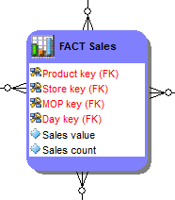
Fact Tables
Records in fact tables correspond to events, transactions, or measurements.
Data is added regularly; the tables are “long” – often millions of records
Rich set of attributes; the tables are “narrow”
– minimal number of columns
Low redundancy
The most useful
measures are “additive”
page 110

Slide 93
Advanced Concepts
Slowly Changing Dimensions
Aggregates
Bridge Tables
Factless Facts

Slide 94
Data Modelling:
SOA & XML
messages
It’s NOT just for DataBase Design
Data
Virtualisation
BI &DW
DATA MODEL
Package Selection & Config
Data Lineage
Communicating
with Business

Slide 95
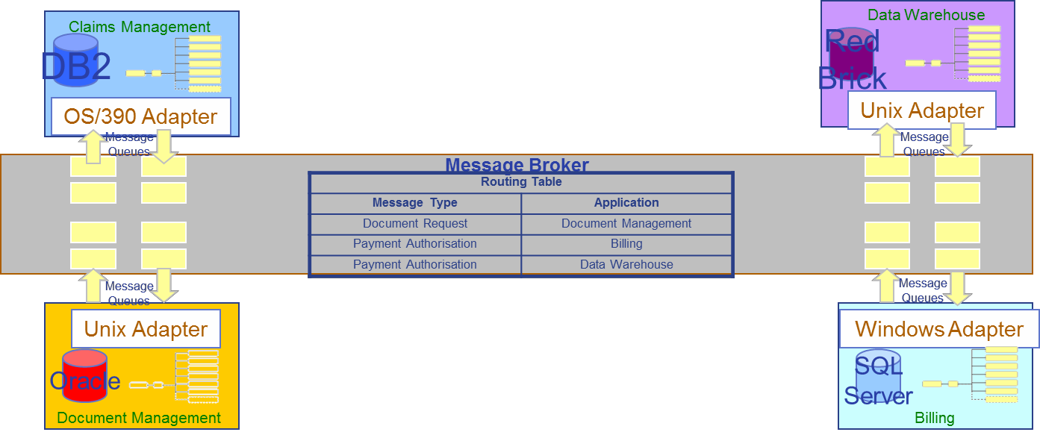
SOA 101
System Component
Proves 1 or more services for the complete architecture
Adapter
Translation where two worlds collide
Enterprise Service Bus The transport mechanism
Message Queues
Data movement to & from service components
Message Broker Policeman directing all traffic according to the Routing Table

Slide 96
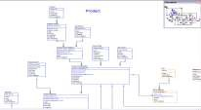



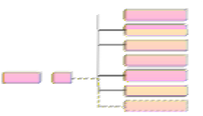
XML Messages Need Data Models
DBMS A
System A
ENTERPRISE SERVICE BUS
DBMS B
System B
XML message

Slide 97
XML versus E/R Structures
XML
› Hierarchical - tree structure.
› Each entity has just one parent.
› Used for transfer of data.
› Shared data appears multiple times in multiple messages.
E/R Structure
› Relational - network structure.
› Each entity can have many parents.
› Used for storage and maintenance
of data.
› Shared data typically appears just
once.
Well defined processes for converting ER/Model into XML Anyone Remember IMS & DL/1?

Slide 98



Data Virtualisation
BI, MI AND PORTALS & REPORTING DASHBOARDS
CUSTOM APPS
ENTERPRISE
SEARCH
S T A R
S Q L
W E B S E R V I C E S
D A T A M O D E L
Virtual | Shareable Data | Virtual Operational | Relational
Data Marts | Services | Data Stores | Views
FILES
LEGACY MAINFRAMES
PACKAGES
RDBMS
WEB
SERVICES

Slide 99
Data Modelling does not
have to be Complicated!
If you can write a sentence, you can build a data model.
If you understand how your business works, you can build a
data model.
Businesspeople should be involved in the development of data models, because only they understand the business needs
and rules.
Understanding data modelling basics will help the Business
better communicate with IT

Slide 100
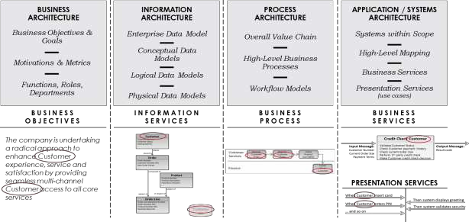
Summary
Data is at the heart of ALL architecture disciplines
Data has to be understood to be managed
Different levels of models for different purposes
It’s NOT just for
DBMS design
Data models are not (just) art
Professional development: certification & training
All of the Architecture disciplines use the language (and rules) of the data model

Slide 101

Data Modelling
page 126
THANK YOU

