Slide 1
Examples of Descriptive Statistics

Slide 2
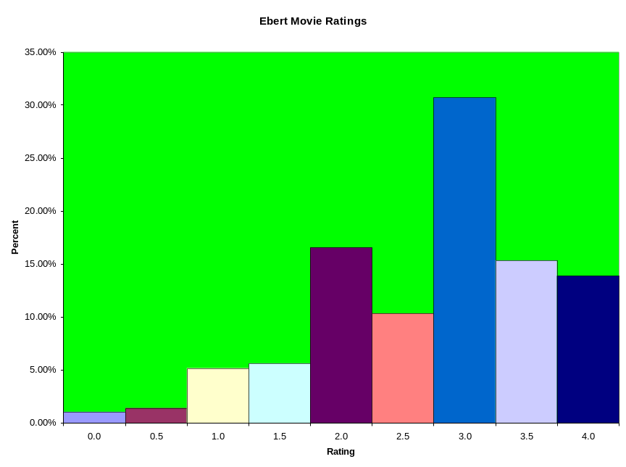
Roger Ebert Movie Ratings
Rating Scale (Ordinal): 0*, 0.5*,…,3.5*,4*
5501 Films (rogerebert.com, circa 3/2006)
Rating | Frequency | Relative Freq | Cumulative Freq
0.0 | 56 | 1.02% | 1.02%
0.5 | 76 | 1.39% | 2.41%
1.0 | 284 | 5.18% | 7.58%
1.5 | 309 | 5.63% | 13.22%
2.0 | 907 | 16.53% | 29.75%
2.5 | 568 | 10.35% | 40.10%
3.0 | 1684 | 30.70% | 70.80%
3.5 | 840 | 15.31% | 86.11%
4.0 | 762 | 13.89% | 100.00%
Note: Median (and Modal) Category is 3.0, LQ is 2.0, UQ is 3.5

Slide 3
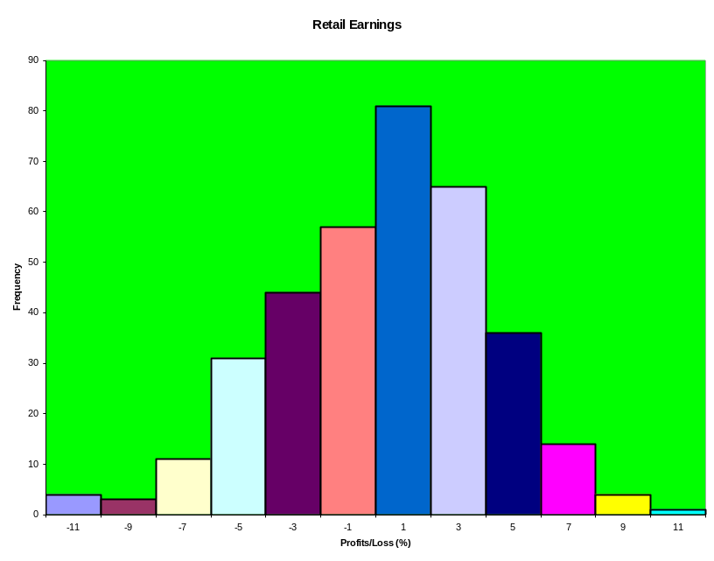
Profit Margins of Businesses
Net Profits/Losses (%) for department Stores
351 Firms (1925): Source: Harvard BBR
Mean | 0.277407
SD | 3.846284
IQR | 5.065
Percentile
10 | -4.69
25 | -2.125
50 | 0.36
75 | 2.94
90 | 5
%<mean-2s | 2.849003
% in (m-2s,m-s) | 13.10541
% in (m-s,m) | 31.90883
% in (m,m+s) | 37.32194
% in (m+s,m+2s) | 13.39031
%>mean+2s | 1.424501
Total % | 100

Slide 4
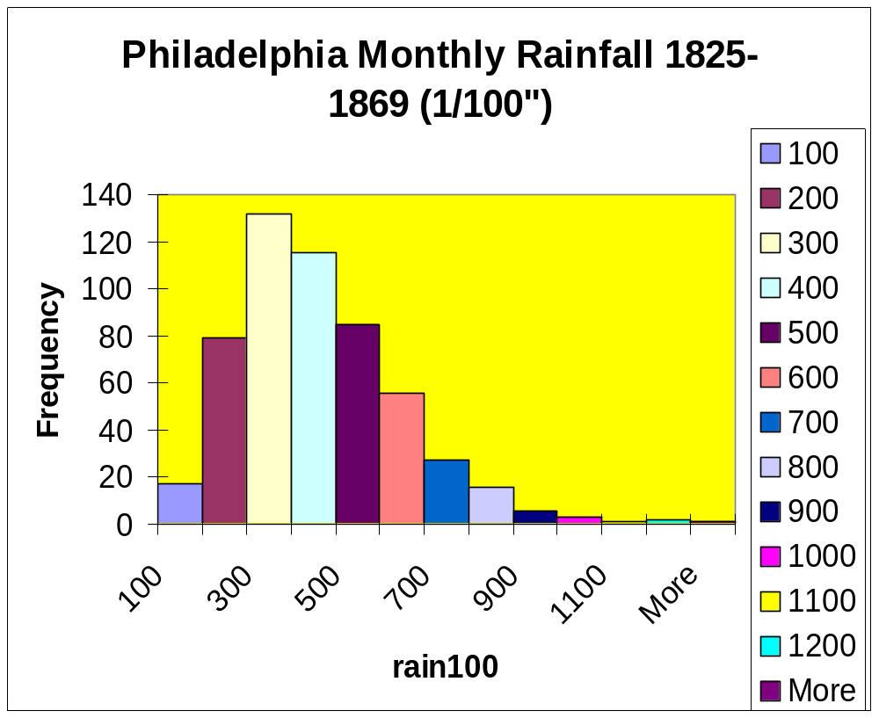

Slide 5
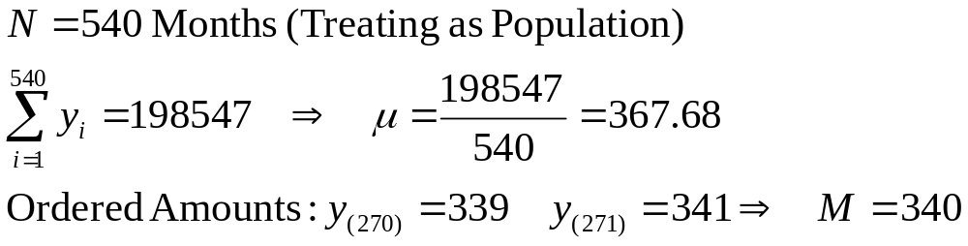
Example - Philadelphia Rainfall
Note: The mean is higher than median as a few very large amounts were observed.

Slide 6
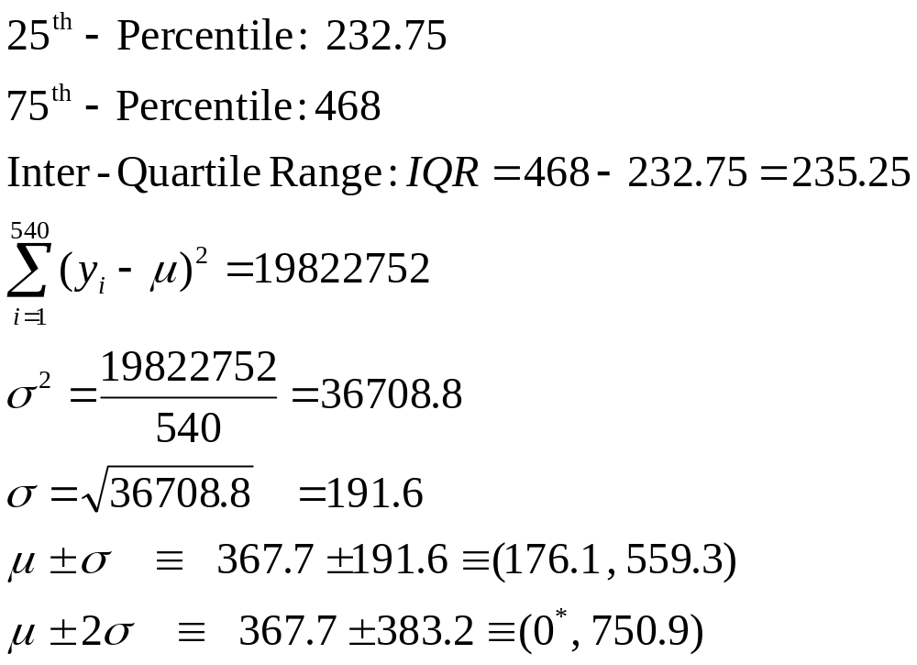
Example - Philadelphia Rainfall (Population)
Note: 383 (71%) Months lie within 1σ of μ and 518 (96%) within 2σ

