Slide 1
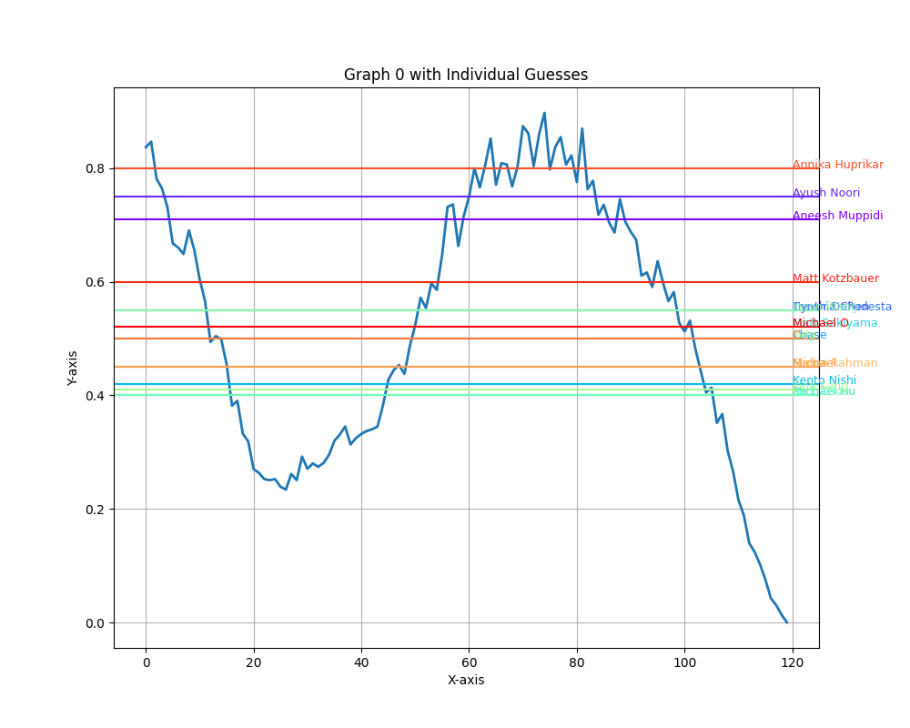
Graph 0 with Individual Guesses

Slide 2
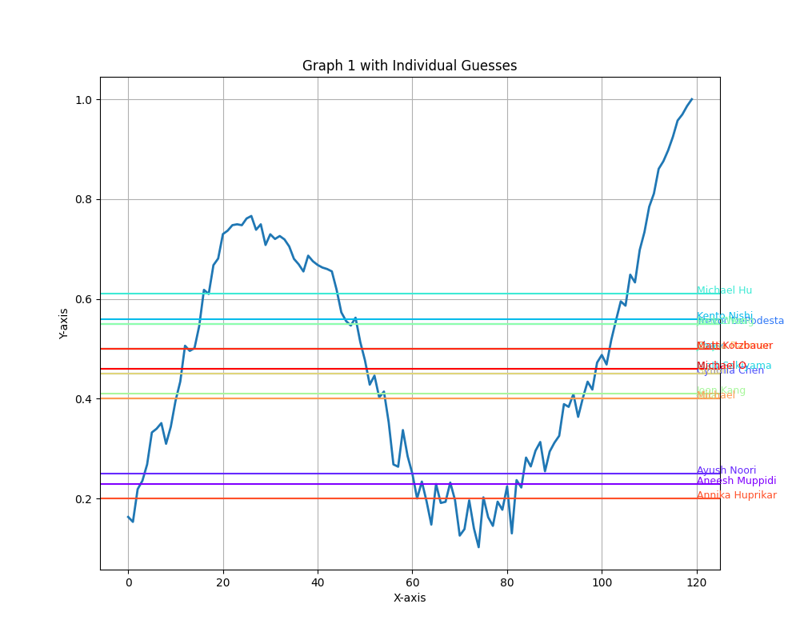
Graph 1 with Individual Guesses

Slide 3
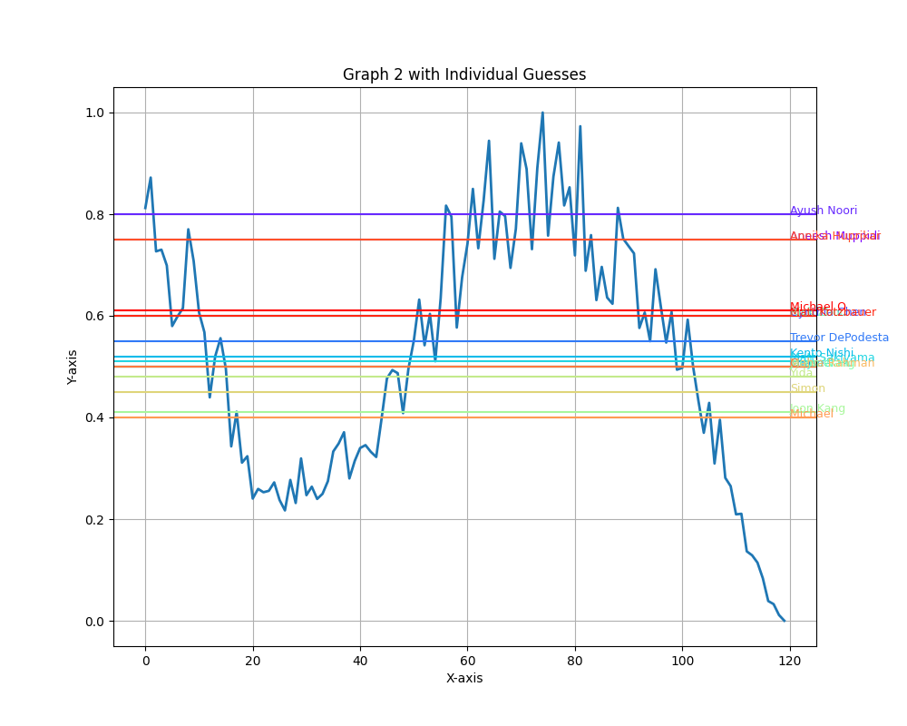
Graph 2 with Individual Guesses

Slide 4
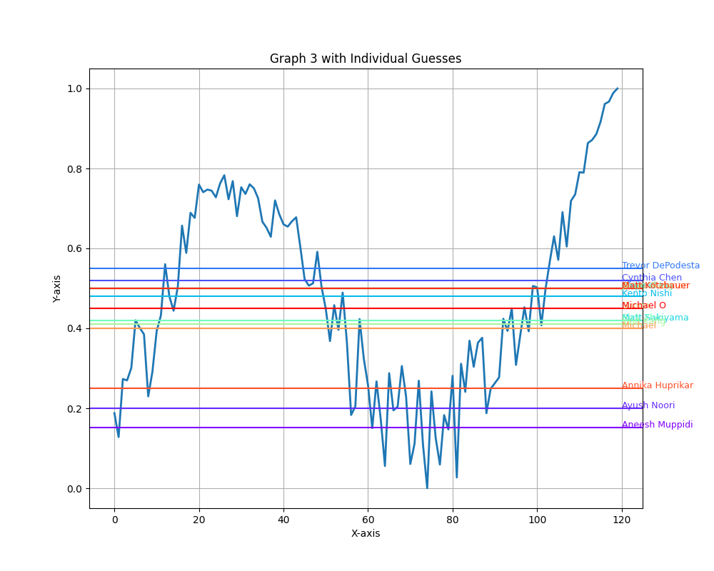
Graph 3 with Individual Guesses

Slide 5
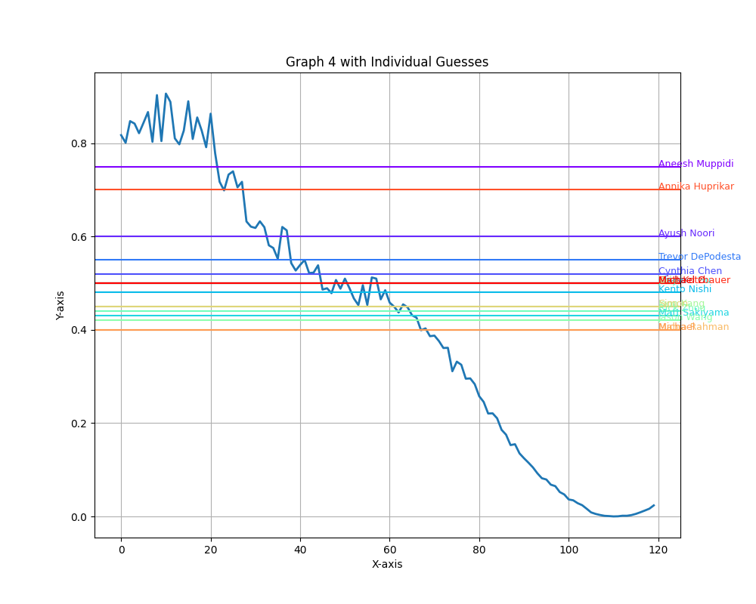
Graph 4 with Individual Guesses

Slide 6
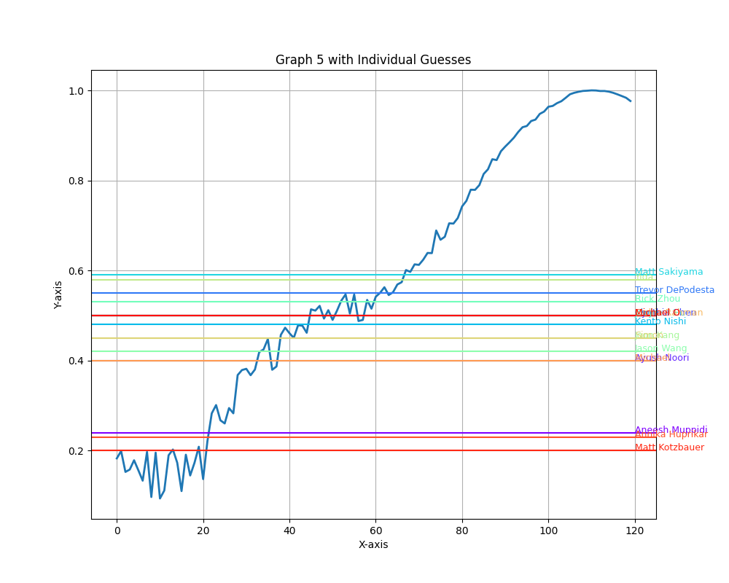
Graph 5 with Individual Guesses

Slide 7
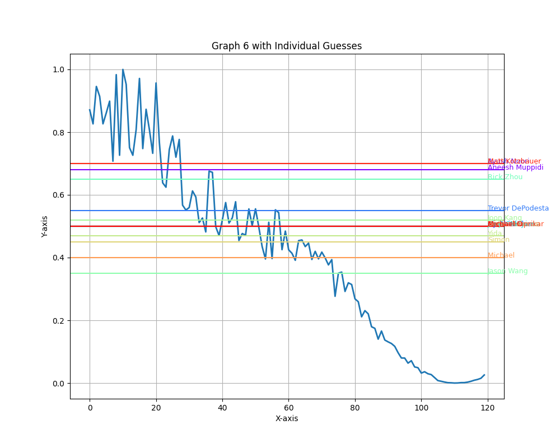
Graph 6 with Individual Guesses

Slide 8
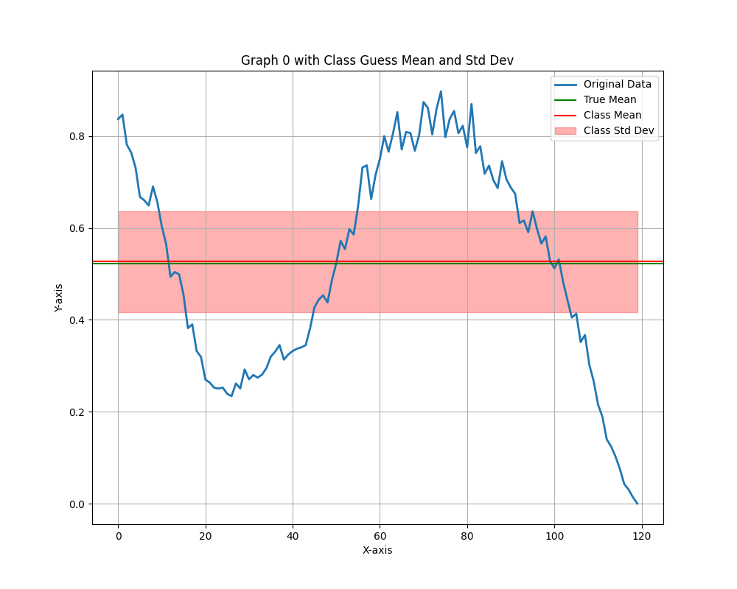
Graph 0 with Class Guess Mean and Std Dev (Error: 0.83%)

Slide 9
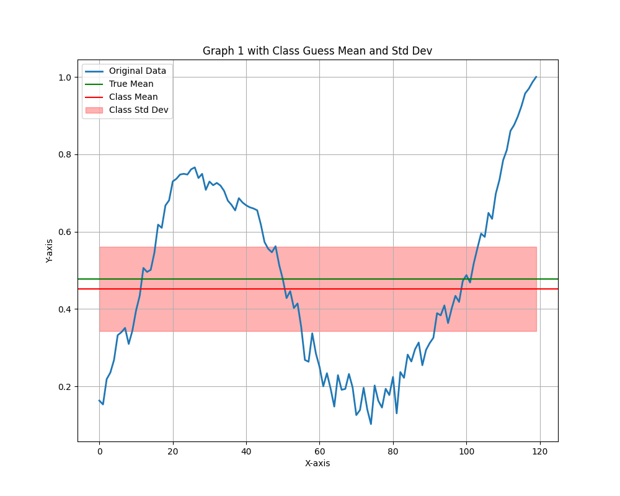
Graph 1 with Class Guess Mean and Std Dev (Error: 5.51%)

Slide 10
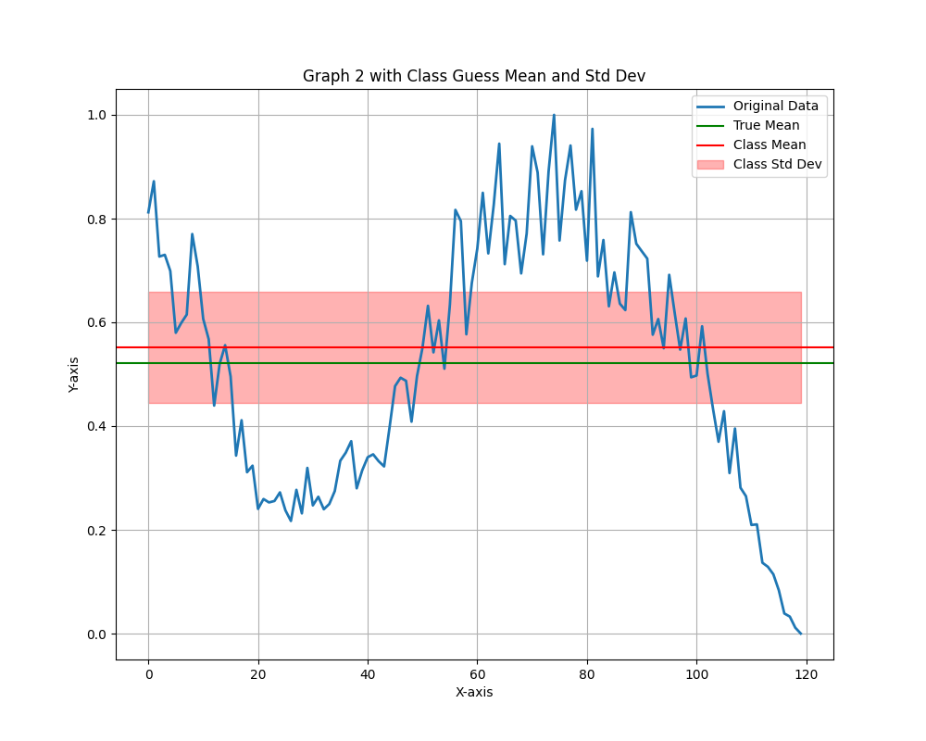
Graph 2 with Class Guess Mean and Std Dev (Error: 5.62%)

Slide 11
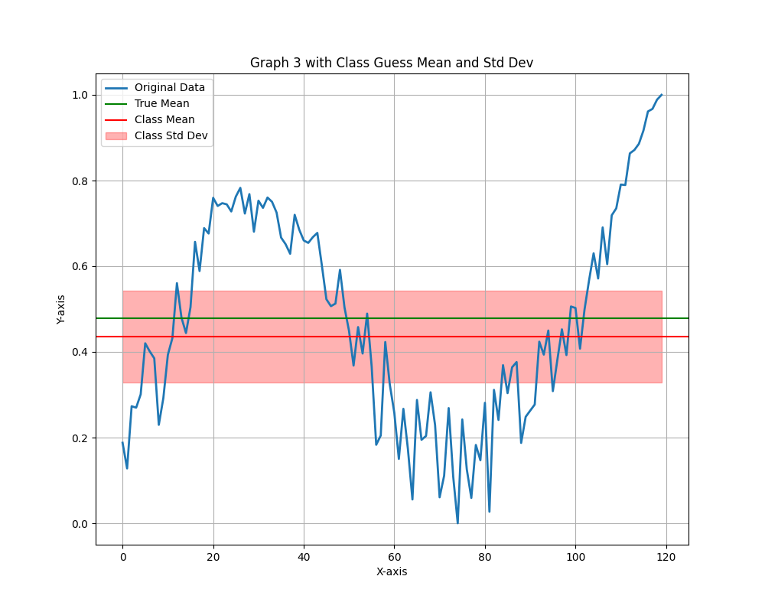
Graph 3 with Class Guess Mean and Std Dev (Error: 8.96%)

Slide 12
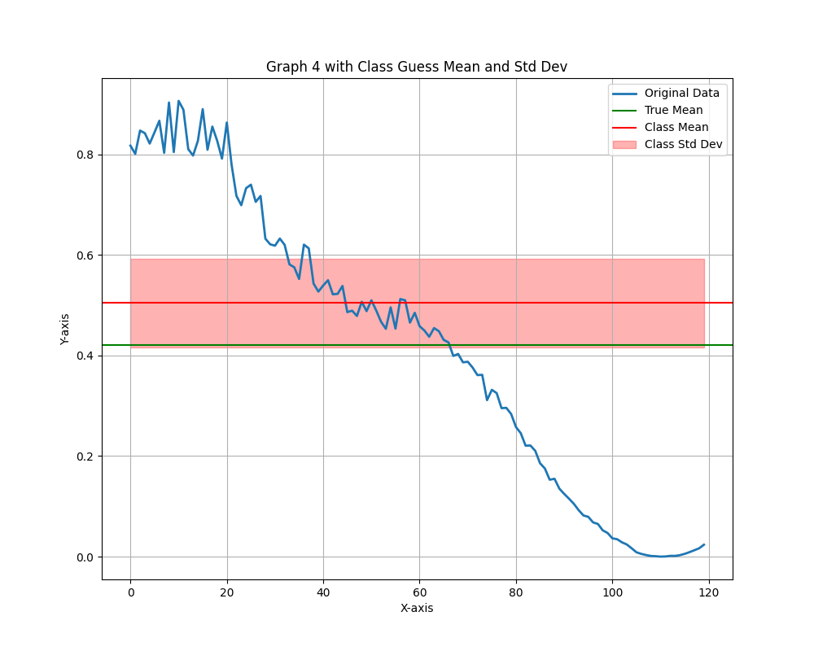
Graph 4 with Class Guess Mean and Std Dev (Error: 20.00%)

Slide 13
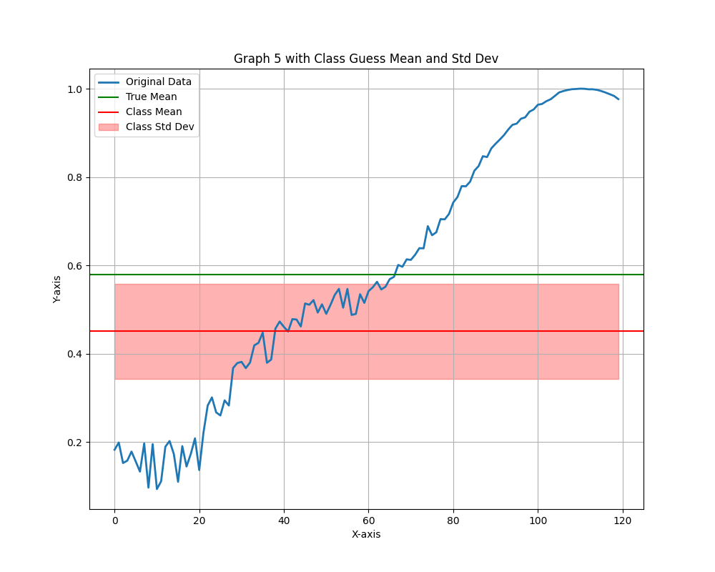
Graph 5 with Class Guess Mean and Std Dev (Error: 22.19%)

Slide 14
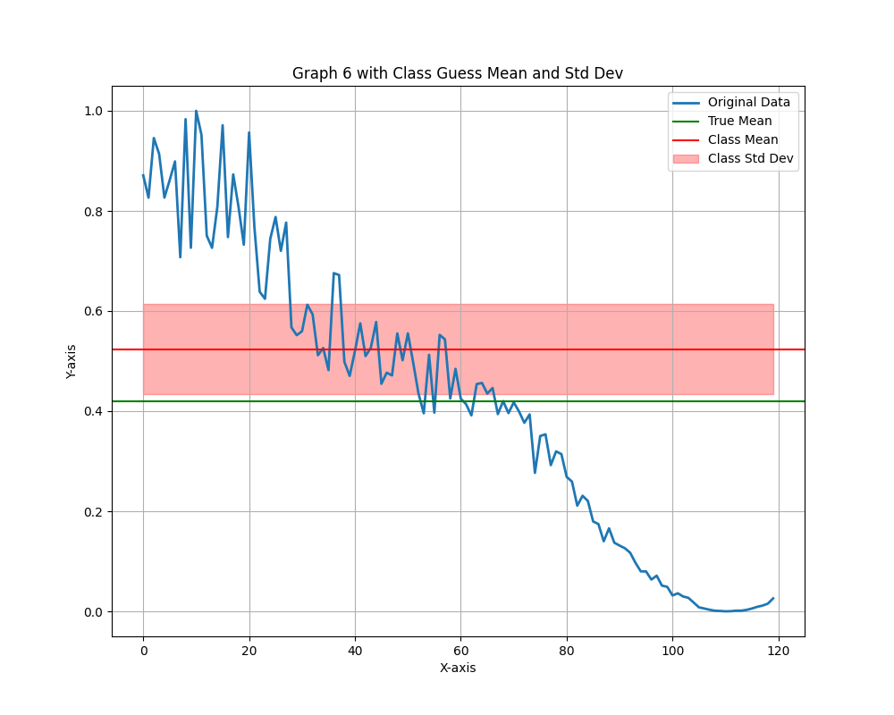
Graph 6 with Class Guess Mean and Std Dev (Error: 24.52%)

