Slide 1
MongoDB Introduction
Nagarajan Balraj

Slide 2
Contents
What is MongoDB
Use cases
Start the MongoDB
Schema Design Introduction
CRUD operations
Advanced Features
Summary

Slide 3
Design Philosophy
De Normalized data; No joins; No Relations; No transaction; No Schema
Simpler and faster. Performance is important
Uses (JSON/BSON) as data model; easy to map; easy to code; Supports Agile development
Scale out; scale horizontally to many machines

Slide 4
MongoDB
Developed by 10gen
NoSQL Database
Document – oriented database
Open source and written in C++
Mapping to the Objects of OOPs Applications is easy

Slide 5
MongoDB …
Uses BSON format
No fixed Schema
No complex Transactions
No Joins
Supports Simple query language
Agile
Scalable

Slide 6
MongoDB …
High Performance
High Availability
Easy interface with many programming Languages. Easy to develop the App.
It can be scaled to Tera bytes of data
It is good for web Applications, logging systems, storing news data, social network content
Supports Restful API

Slide 7
Use cases
MongoDB is suitable for
Web Applications
The Business Insider (TBE) web app has million views per day and stores analytics data.
Analytics and Logging Applications
GitHub, Disqus, Justin.tv uses MongoDB for Analytics and Logging.
Agile Development
Shutterfly and The New York Times uses it since app. development is quicker because of no schema and easy data representation of object oriented model.

Slide 8
MongoDB Server
MongoDB is a server and several clients can connect to it
To start the server
$ mongod
It uses the default dir /data/db/
$ mongod --dbpath d:\mongodb\data\db

Slide 9
MongoDB shell
It is the client and runs in command prompt
It comes with JavaScript shell
$ mongo
By default, on startup it connects to ‘test’ database

Slide 10
Schema Design
Choose a best data set to represent data based on
DB features,
Nature of data and
Application requirement.

Slide 11
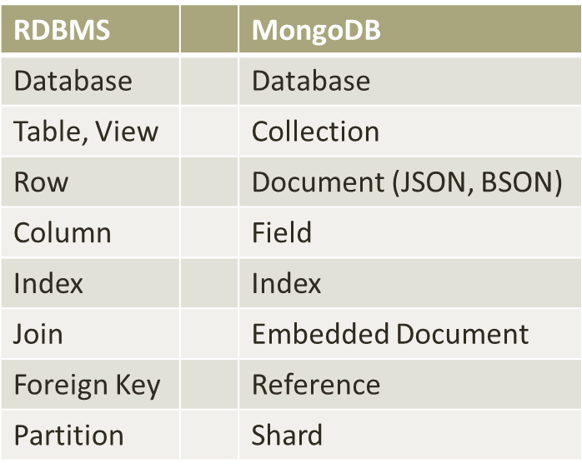
MongoDB Vs RDBMS

Slide 12
Documents
Basic entity of MongoDB
It is like ‘Rows’
It contains one or more fields
Document max 16 MB is supported
Contain simple field, embedded doc, Arrays
They are in BSON format and contains Key-Value pair. Key is string
{ “name”: “Tom” }
{ “price”: 100 }

Slide 13
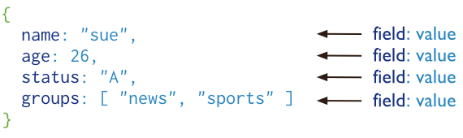
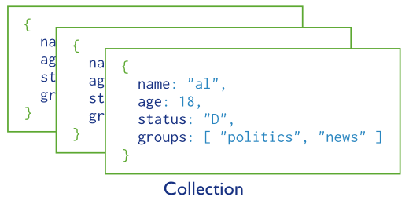
Documents and Collection
users

Slide 14
Collection
Group of documents. It contains one or more documents
It is like ‘Tables’
It can have ‘dynamic schemas’. It can contain any kind of document. Any document can be put inside a collection

Slide 15
Guidelines for Collection
Keep similar kind of document in a collection
It is easy for Application programming and maintaining
It is faster and improves the performance while querying
Indexing is possible which can be done on per collection

Slide 16
Database
MongoDB groups collections in a Database
It contains one or more collections
MongoDB can host many databases
Guideline: Store all data of an Application in a single database

Slide 17
JSON
JavaScript Object Notation
JSON is simple representation of data and it is easy to write/read, easy to parse/generate
It is made up of Name – Value pairs and it can be nested
MongoDB uses JSON like structure on documents
JSON supports six data types: string, numeric, boolean, array, object and null

Slide 18
JSON Data types
null { “x” : null }
boolean: { “x” : true }
Number: { “constant” : 10 }
{ “pi” : 3.14 }
String { “name” : “Tom” }
Array { “tag” : [ “books”, “electronics” ] }
Object { “first name” : “Tom”, “last name”: “Ford“}

Slide 19
BSON
Is known as Binary JSON
Supports Binary-encoded serialization of JSON docs
Few BSON – Extended Data Types
Object id
Embedded document
Date
Java script code
Binary data

Slide 20

Object ID
Every document is stored using the “_id” key which is a unique value (like primary key)
Object ID usually generated by MongoDB. It contains 12 bytes of storage
MongoDB supports Custom ID also

Slide 21
Embedded Document
Document can contain another document embedded as a value
It is used to organize the data in a natural way
It is de normalized way of storing the data
{ “address” : {
“city” : “Chennai”
“state”: “TN”
}
}

Slide 22
Embedded Document Benefits
Objects in the collection are stored contiguously on disk
Locating is faster
Embedded objects brought in the same query
Only one trip to the DB is needed
Joins are avoided
Faster performance

Slide 23
CRUD Operations

Slide 24
CRUD
Create
db.collection.insert( <document> )
db.collection.save( <document> )
Read
db.collection.find( <query>, <projection> )
db.collection.findOne( <query>, <projection> )
Update
db.collection.update( <query>, <update>, <options> )
Delete
db.collection.remove( <query>, <justOne> )
Notes:
Create
The field name _id is reserved for use as a primary key; its value must be unique in the collection, is immutable, and may be of any type other than an array.
The field names cannot start with the $ character.
The field names cannot contain the . character.
Create with save
If the <document> argument does not contain the _id field or contains an _id field with a value not in the collection, the save() method performs an insert of the document.
Otherwise, the save() method performs an update.
sds

Slide 25
CRUD example
> db.user.insert({
first: "John",
last : "Doe",
age: 39
})
> db.user.find ()
{
"_id" : ObjectId("51…"),
"first" : "John",
"last" : "Doe",
"age" : 39
}
> db.user.update(
{"_id" : ObjectId("51…")},
{
$set: {
age: 40,
salary: 7000}
}
)
> db.user.remove({
"first": “John”
})

Slide 26
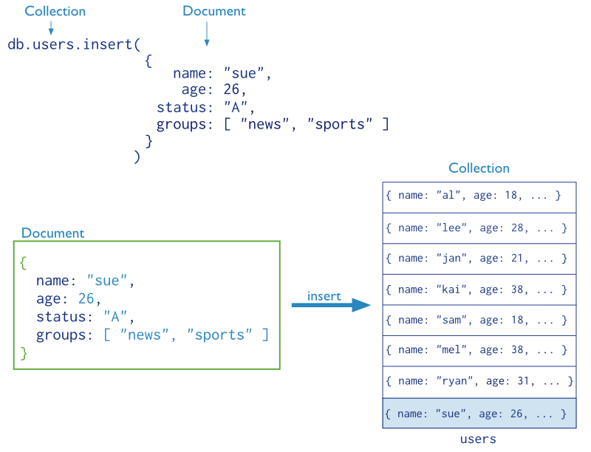
CRUD operations – create (cont’d)

Slide 27
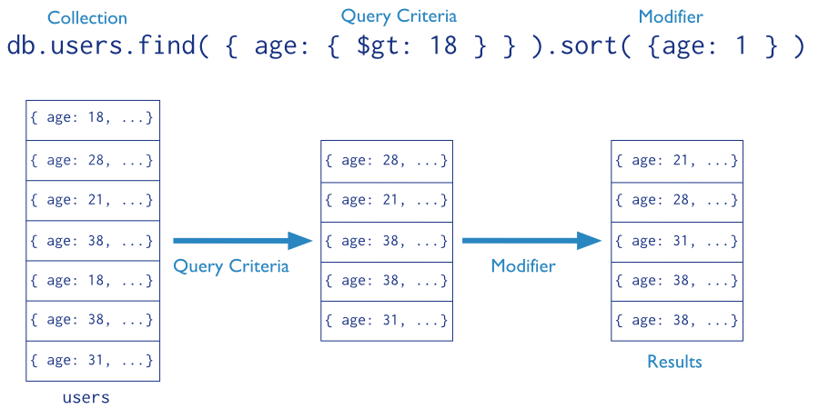
CRUD operations - read
Find the users of age greater than 18 and sort by age.

Slide 28

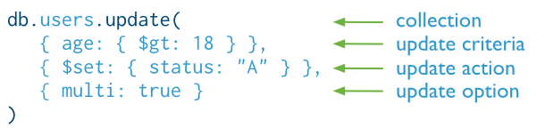
CRUD operations - update
Update the users of age greater than 18 by setting the status field to A.
SQL
MongoDB
©MongoDB [4]

Slide 29

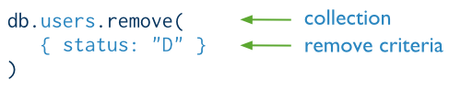
CRUD operations - delete
Delete the users with status equal to D.
SQL
MongoDB
©MongoDB [4]

Slide 30
MongoDB Advanced Features

Slide 31
MongoDB - Advanced
Replica
Indexing
Aggregation
MapReduce
Capped Collection
Storing Files

Slide 32



MongoDB is fast and scalable
Better data locality
In-Memory
Caching
Distributed Architecture
Replication /HA
Relational
MongoDB
Horizontal Scaling

Slide 33
MongoDB Benefits
MongoDB is fast
Easier and faster integration of data
Scalable
Suitable for Web Applications
Suitable for huge volume of data that does not require relational model
Can work on many platforms and there are many language drivers

Slide 34
Limitations
MongoDB runs in 64 bit machines
Not suitable for complex transaction system
High degree of de-normalization and it needs updating at many places

