Slide 1
Introduction to NoSQL
Nagarajan Balraj

Slide 2
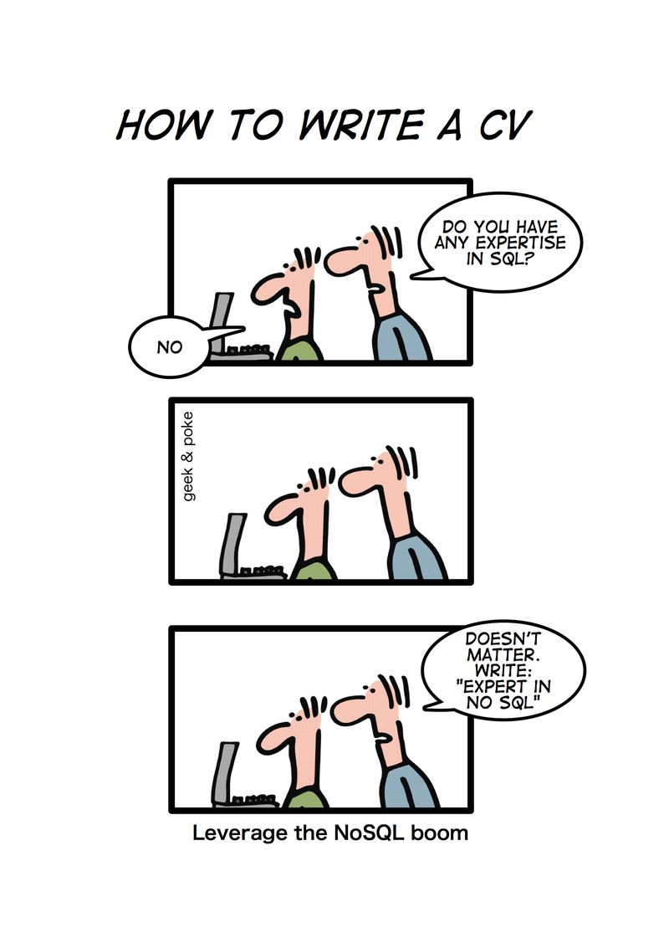
What is NoSQL

Slide 3
Advantages of RDBMS
Persistence
Support Transaction
Supports SQL
Reporting
Supports ‘write many times’ scenario

Slide 4
Problems with RDBMS
Rigid Schema
Data structure is made up of many related tables which is complex and needs unintuitive joins
Application deals with objects and there will be mismatch. ORM is needed and App. development is tough.
RDBMS is mostly designed to work in a single system
Not easily scalable

Slide 5
Scalability
Scalability and performance becomes a big issue
RDMBS needs high end machines to increase the capacity.
And it is a costlier solution

Slide 6
Need for new Data Model
Big Data: Huge volume of data
Programming Model: Agile Development
New Hardware Architecture: Cloud storage and horizontal scaling

Slide 7
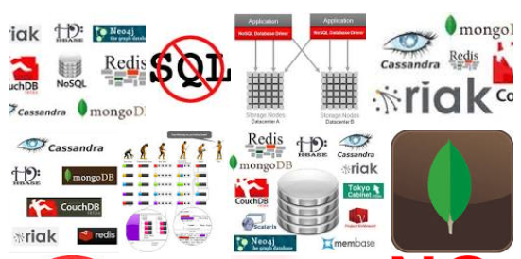
NOSQL DBs

Slide 8
NoSQL
NoSQL means ‘Not only SQL”.
Distributed; Highly Scalable; Horizontal scalability / Scale out
Highly Available
No Schema or Schema less; supports Flexible schema
No Relational and No Joins
No Transaction

Slide 9
NoSQL
High Read/Write throughput
Different interfaces of programming Language
Programmer friendly
Easier Application development
Faster Application development
Cluster friendly
Open source
Handles all varieties of data

Slide 10








NoSQL Database
Key-value
Document-oriented
Column family
Graph database
Notes:
Huge quantity of data => Distributed systems => expensive joins =>
New fields, new demands (graphs) =>
Different data strucutres:
Simplier or more specific

Slide 11
Family of NoSQL DB
Key-values Stores
Focus on scaling to huge amounts of data
E.g. Oracle BDB
Column Family Stores
To store and process very large amounts of data distributed over many machines
E.g. Cassandra, HBase
Document Databases
Appropriate for Web apps.
E.g. CouchDB, MongoDB
Graph Databases
Appropriate for Social networking, Recommendations
E.g. Neo4J, Infinite Graph

Slide 12
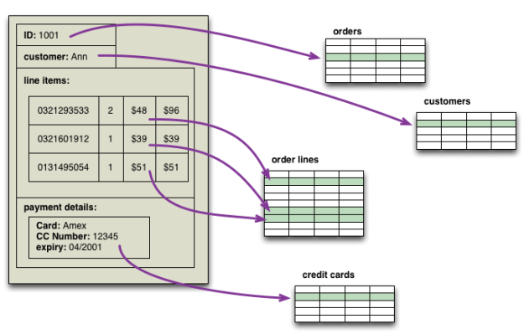
Aggregate
It is a complex structured/related data that is kept in a single unit.
It is de normalized form of data

Slide 13
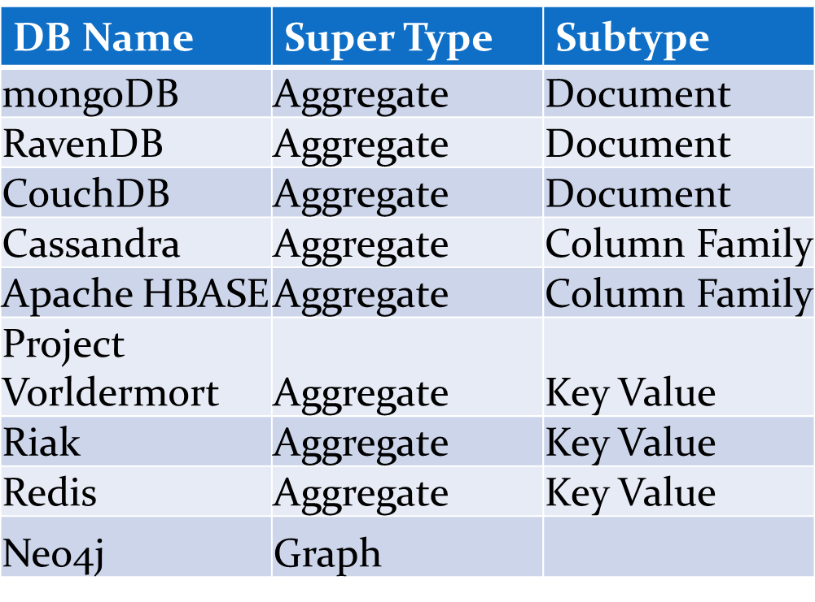
NoSQL Database

Slide 14
NoSQL vs. SQL
SQL Databases | NoSQL Databases
Scale Up or Vertical Scaling. | Scale out or Horizontal Scaling.
Consistency, Availability. | Consistency, Availability, Partition tolerance.
Single Data Model i.e Relational. | Multiple Data Models i.e Columnar, Document, Key-Value, Graph and many.
Single Query Language i.e SQL. | Multiple Query Languages i.e Simple CLI, HQL,CQL, REST, Thrift, DSLs.
Rigid Schema. | Schema free/ Flexible Schema.
Joins are expensive. | Free from Joins.
Good for Real time Querying i.e point queries | Good for Real time Querying as well as Real time Decisioning.
Scales up to a few Tera bytes. | Scales up to Peta bytes.

Slide 15
Contd…
Good for Low data traffic. | Good for high volumes of data traffic.
Complexity in managing Distributed databases i.e Adding/Removing machines is so complex | Majority are Distributed in Nature. Very easy to add/remove Machines to the Existing clusters.
Good for non volatile data | Good for volatile data.
Hard to implement i.e schema design, data integrity | Simple to implement.
Good for Transactions i.e OLTP. | Good for Decisioning i.e OLAP.
Write throughput is very low. | Write throughput is very high.
Good for handling Structured data. | Good for handling Unstructured and Semistructured data.
Not Programmer friendly. | Programmer Friendly.

