Slide 1
Basics of 3G Technology

Slide 2
What is 3G
It’s 3rd Generation Technology.
It came in release 99. Supports high data rates up to 2Mbps compare to EDGE(2.5G).
Use WCDMA access Technique.
Allocated bandwidth is 5Mhz.
Supports variable bit rates data transmission.
Frequency reuse factor is 1.
Efficient power mechanism i.e.1500Hz.
Utilizes the multipath fading with rake receiver.

Slide 3
Protocol
Set of rules govern data communication between 2 entities so that MS & network involved in the communication can able to understand what is happening at each event of communication.
UMTS Protocol Structure:
UMTS protocol stack consist of 3 layers
Physical layer
Data link layer
Network layer
Each Layer perform specific functions according to their protocol constitutes.

Slide 4
Network layer divided into following sub layers
1)RRC(Radio Resource Control)
2)MM(Mobility Management)
3)GMM(GPRS Mobility Management)
4)CM(Communication Management)
a) CC(Call Control)
b) SS(Supplementary Services)
c) SMS(Short Message Services)
d) SM(Session Management)
e) GSMS(GPRS Short Message Services)

Slide 5
Data Link Layer divided into 4 sub layers
MAC(Medium Access Control)
RLC(Radio Link Control)
BMC(Broadcast Multicast Control)
PDCP(Packet Data Convergence Protocol)
According to signaling, protocol model may be divided into 2 plane:
Control Plane: It will carry singling information to maintain the connection.
User Plane: It will carry user data or information.

Slide 6
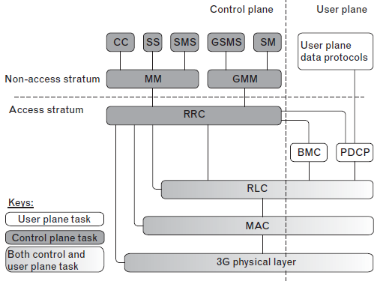
Protocol Layers

Slide 7
Protocol Layer
From the development point of view, this protocol stack can be divided into 2 stratum.
Access Stratum(AS)
Non Access Stratum(NAS)
Reason for this division:
To keep the higher layers independent of radio interface protocol.
To simplify development criteria for increasing the throughput.
NAS contains CN protocols. UTRAN will remain transparent for this protocol but radio interface protocols terminate in UTRAN.

Slide 8
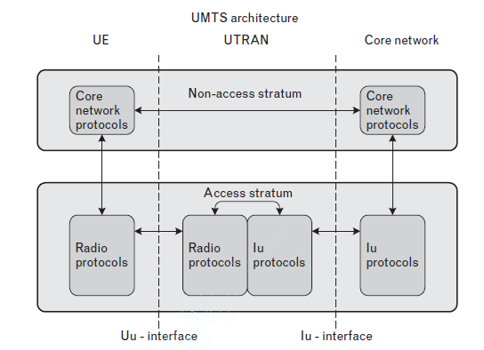
Protocol architecture with NAS & AS

Slide 9
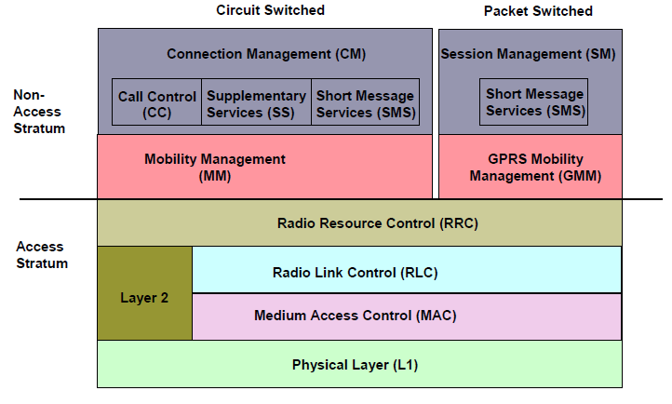
NAS & AS Protocol architecture in CS & PS domain

Slide 10
RLC Layer
It works in both user & control plane.
Responsible for efficient peer to peer packet data transmission as well as construction of fixed size PDUs.
It works in mainly three modes TM, UM, AM.
Segmentation and reassembly: This function performs segmentation/reassembly of variable-length higher layer PDUs into/from smaller RLC Payload Units (PUs).
Concatenation: If the contents of an RLC SDU do not fill an integral number of RLC PUs, the first segment of the next RLC SDU may be put into the RLC PU in concatenation with the last segment of the previous RLC SDU.
Padding: If after Segmentation or concatenation, RLC PDU is not fully filled then padding is used to fill it.
Transfer of user data: It uses three modes to transfer data from sender to receiver based on QoS.
Error correction: It correct the error in data transmission by retransmission in AM mode only.

Slide 11
RLC Layer
In sequence delivery of data: It maintains the sequential delivery of AM PDUs by tracking sequence numbers.
Duplicate detection: It ensures the duplication in received PDUs before sending it to higher layers.
Ciphering: To protect user data from unauthorized access, UMTS uses the ciphering procedure. This is performed by RLC layer in UM & AM modes.

Slide 12
MAC Layer
Mapping between logical channels and transport channels.
Identification of UEs on common transport channels.
Priority handling between UEs by means of dynamic scheduling.
Transport-channel type switching.
Traffic-volume monitoring.
Ciphering for transparent RLC.
Access service class selection for RACH transmission;

Slide 13
RRC Layer
Initial cell selection and cell reselection.
Broadcast of SIB information.
Reception of paging messages.
Establishment, maintenance, and release of RRC connection.
Measurement control.
Security mode control.
Outer-loop power control.
Handovers (HOs), which include the preparation and execution of
HOs and intersystem HOs.

Slide 14
Physical Layer
FEC encoding/decoding of transport channels.
Radio measurements and indications to higher layers.
Error detection on transport channels.
Frequency and time synchronization.
Modulation, spreading/demodulation, and despreading of physical
Channels.
Rate matching.

Slide 15
UMTS CHANNEL
Channel:
To transfer data from one layer to another layer, some interface is required bw this layers. Channel provides path for transferring data from layer to layer. 3 types of channels are available in UMTS.
Logical Channel: Logical channels define what type of data is transferred. It transfers data from RLC layer to MAC layer.
Transport Channel: Transport channels define how and with what characteristics of data is transferred by the physical layer.
Physical channel: It define the exact physical characteristics of the radio channels.

Slide 16
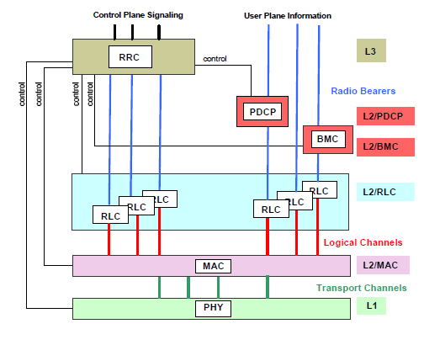
Information flow through channels are shown in below figure.

Slide 17
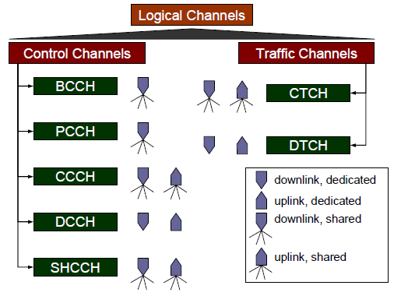
Logical Channel
Logical channels can be divided into control channels and traffic channels. Control channels transfer Control plane (C-plane) information and traffic channels User plane (U-plane) information.

Slide 18
The defined logical control channels are:
Broadcast control channel (BCCH)
Downlink common channel;
Broadcasts system and cell-specific information
Paging control channel (PCCH)
Downlink channel;
Transfers paging information and some other notifications.
Dedicated control channel (DCCH)
Bidirectional point-to-point channel;
Transfers dedicated control information.
Common control channel (CCCH)
Bidirectional point-to-multipoint channel;
Transfers control information.

Slide 19
The used logical traffic channels are:
Dedicated traffic channel (DTCH)
Bidirectional point-to-point channel;
Transfers user info.
Common traffic channel (CTCH)
Downlink point-to-multipoint channel;
Transfers dedicated user information for a group of users.

Slide 20
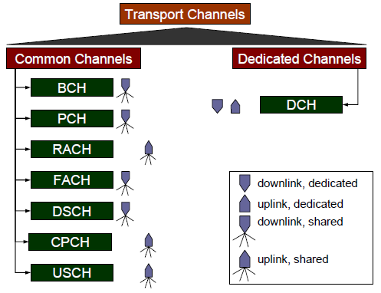
Transport channels
This are divided into common channels and dedicated channels. They are all unidirectional.

Slide 21
Common transport channels
Broadcast channel (BCH)
A downlink channel for broadcast of system and cell-specific info.
Paging channel (PCH)
A downlink channel used for transmission of paging and notification messages.
Transmission associated with transmission of paging indicator in PICH physical channel.
Random access channel (RACH)
A contention-based uplink channel;
Used for initial access or non-real-time dedicated control or traffic data.
A limited-size data field.

Slide 22
Common transport channels
Common packet channel (CPCH)
A contention-based channel used for transmission of bursty data traffic.
An uplink channel;
Only in FDD mode.
Forward access channel (FACH)
A common downlink channel;
May carry small amounts of user data.
Downlink shared channel (DSCH)
A downlink channel shared by several UEs;
Used for dedicated control or traffic data;
Associated with a DCH (does not exist alone).

Slide 23
Transport channels
Uplink shared channel (USCH)
An uplink channel shared by several UEs;
Carries dedicated control or traffic data;
Only in TDD mode.
The only dedicated transport channel type is:
Dedicated channel (DCH)
For one UE only;
Either uplink or downlink.

Slide 24
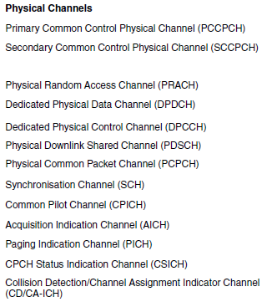
Physical Channels

Slide 25
Physical Channels
The DL physical channels are:
Synchronization channel (SCH)
Used for cell search. Spreading factor 256. Transmitted only during the first 256 chips (i.e., one-tenth) of each timeslot.
Two sub channels, the primary and secondary SCH.
Primary SCH is used for slot synchronization. It contains primary synchronization codes which is universal for all cells.
Secondary SCH is used for frame synchronization & code group identification. It encoded with secondary synchronization codes. There are total 16 codes which can form 64 code group. Each group consist of 15 successive codes. Each code group represent 8 PSC.

Slide 26
Physical Channels
Common pilot channel (CPICH)
Fixed rate of 30 Kbps. Spreading factor 256.
Carries a predefined bit sequence.
Two types: primary and secondary CPICH:
Primary CPICH (P-CPICH) is the phase reference for SCH, primary CCPCH, AICH, and PICH, and the default reference for other downlink physical channels. Scrambled with unique PSC. Different for each cell.
Secondary CPICH (S-SPICH) may be the reference for the downlink DPCH, and for the associated PDSCH. The presence of S-CPICH in a cell is optional. It used to focus small areas.
Primary common control physical channel (P-CCPCH)
Fixed rate of 30 Kbps. Spreading factor is 256.
Carries BCH;
Not transmitted during the first 256 chips of each timeslot.

Slide 27
Physical Channels
Secondary common control physical channel (S-CCPCH)
Variable rate.
Carries FACH and PCH.
FACH and PCH can be mapped to the same or separate channels;
Transmitted only when there is data available.
Physical downlink shared channel (PDSCH)
Carries DSCH (downlink shared channel);
Always associated with a downlink DPCH, which carriers its control information.
Paging indicator channel (PICH)
Carries page indicators to indicate the presence of a page message on the PCH.

Slide 28
Physical Channels
Paging Indicator Channel (PICH)
PICH is a fixed rate (SF=256) physical channel used to carry the paging indicators. The PICH is always associated with an S-CCPCH to which a PCH transport channel is mapped. One PICH radio frame of length 10 ms consists of 300 bits. Of these, 288 bits are used to carry paging indicators. The number of PI per frame can then be 18, 36, 72, or 144. PICH channel is time multiplexed with S-CCPCH with 3 slot delay.

Slide 29
Physical Channels
Physical random access channel (PRACH)
Carries RACH.
Uses open loop power control.
Uses acquisition indicators or signature.
Only 10 or 20ms message part could be transmit.
Physical common packet channel (PCPCH)
Carries CPCH (common packet channel);
Uses DSMA-CD technique with fast acquisition indication to avoid collision.
More than 20ms data frame could be transmit.
Physical uplink shared channel (PUSCH)
Carries USCH. Only in TDD mode.

Slide 30
Physical Channels
Downlink and Uplink
These are dedicated channel called DPCH. DPCH channel only can support soft handover & close loop power control.
Dedicated physical data channel (DPDCH)
Carries DCH (dedicated channel);
Carries data generated at layer 2 and above.
Variable spreading factor in UL on frame basis but fixed in DL.
Dedicated physical control channel (DPCCH)
Carries control information generated at layer 1.
Fixed spreading factor used in both direction 256.

Slide 31
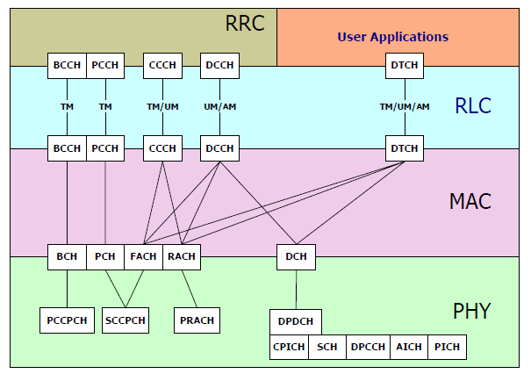
Channel Mapping:
Different channels exit bw different layers. So for smooth flow of data one channel should be mapped to another. It will performed by intermediate layer.

Slide 32
SIB(System Information Block)
Broadcast information (or system information, as it is also known) is information about the system and the serving cell that is sent by the network in a point-to-multipoint manner; the information is broadcast to all UEs. Broadcast information consists of messages called system information blocks (SIBs). A SIB contains system information elements of the same nature. There are 18 different blocks, named SIBs 1 through 18. In addition to the SIBs, there is a master information block (MIB) and up to two scheduling blocks (SBs).
Basics SIBs are following:
MIB
Contains PLMN identity;
Includes references to other SIBs.
SIB 1
Contains NAS system information.
Includes UE timers and counters to be used in idle mode and in connected mode.

Slide 33
SIB(System Information Block)
SIB 3
Contains parameters for cell selection and reselection.
SIB 5
Contains parameters for the configuration of the common physical channels (PhyCHs) in the cell.
SIB 7
Contains the fast-changing parameters UL interference and dynamic persistence level.
SIB 11
Contains measurement control information to be used in the cell.

Slide 34
HO(Hand Over)
Handover is a procedure of handing over the call or existing RRC connection from one cell to another cell in connected mode while moving to another cell. Handover decision will be taken by UTRAN RRC based on measurement reports sent by UE. There are two types of handover exist in UMTS.
Soft handover:
When the target cell belongs to same frequency then it is called soft handover.
Hard handover:
When the target cell belongs to another frequency or different RAT i.e.(GSM or LTE) then it is called hard handover.

Slide 35
Thanks
Any Questions….

