Slide 1
Projects

Slide 2
Tracking Students and using SMS in Education
http://docs.rapidsms.org/en/develop/ to send SMS tracking status of Students
https://www.clickatell.com/ - API to send SMS
Read this Page:
https://github.com/unicefuganda/rapidsms-edtrac Sample Project

Slide 3
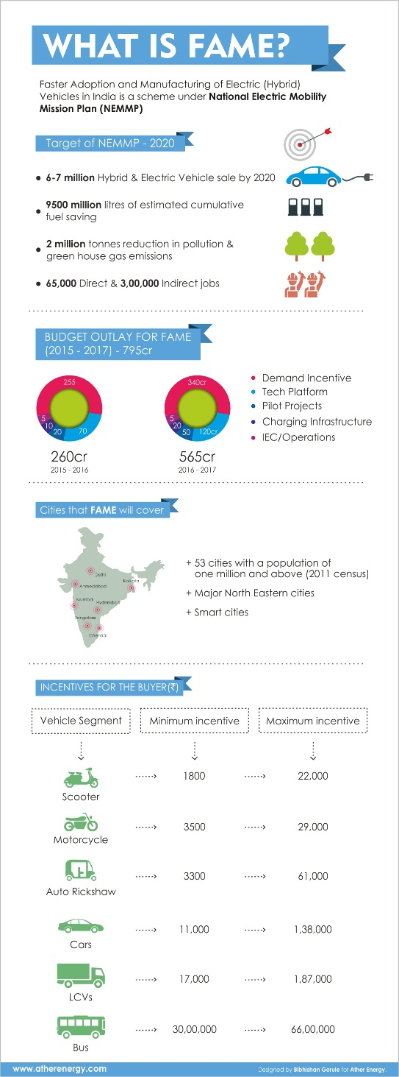
FAME – Accelerated Electric Vehicle Program
Ather Energy S340
http://atherenergy.com/understanding-the-fame-india-scheme/
http://www.jagranjosh.com/current-affairs/union-government-launched-fameindia-scheme-to-boost-electric-hybrid-vehicle-sales-1427981521-1
http://dhi.nic.in/writereaddata/Content/NEMMP2020.pdf
http://dhi.nic.in/writereaddata/Content/Final_AMP_Report.pdf

Slide 4

Solar
How to Earn Electricity for Free:
  http://www.princeindia.org/pdf/electrical-india-cover-story-january-2015.pdf

Slide 5
Solar Electricity
http://www.kirloskarsolar.com/Product/Solar-Lighting/claraLux-NEO-Solar-Lantern/ Price is ONLY 1900/- and can charge Phones.
http://indiagoessolar.com/

