Slide 1
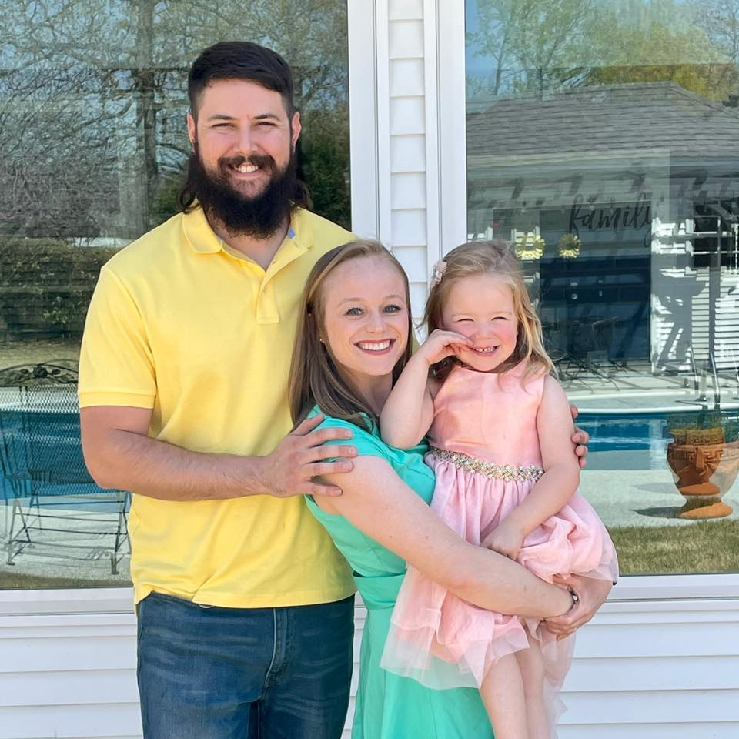
Alyson Neighbors

Slide 2
“Adventurers are tolerant and friendly, & usually just do what needs to be done regardless of whether their colleagues pull their own weight”

Slide 3
Real world life experience
10+ years in the workforce
Lead tech at work
People skills

Slide 4
Technical Skills
Enjoy coding
Writing code for a website allows more freedom
When code isn’t working its like a puzzle to solve
Fast learner

Slide 5
adventurer personality type = worrying about letting others down

