Slide 1
Login and registration system
Submitted in the partial fulfillment for the award of the degree of
BACHELOR OF ENGINEERING
IN
CLOUD COMPUTING
Submitted by:
Tanu Aneja
20BCS4177
Under the Supervision of:
ROHIT KATYAL
Department of AIT-CSE
DISCOVER . LEARN . EMPOWER

Slide 2
Outline
Introduction to Project
Problem Formulation
Objective of the work
Methodology used
Results and outputs
Conclusion
Future Scope
References

Slide 3
Introduction to Project
This is a project where an individual get there details registered.
To get an user himself/herself register they have to give their name,user_name and password.
Once a user is registered they can also perform various function in it.
Here anyone can update and can delete the existing data.
In this project if a user want to find them self they can also get it done through user_name.
In this project password created has to be strong as it defined as char data type which consists all lower case, upper case and special characters.

Slide 4
An individual can also get their data displayed on the screen if they want to check their credentials.
User can also delete an existing data with the help of the user_name.
In this project we have used the extensive concept of class, it’s object, file handling, function passing as argument.
This also uses some of the basic concept of c++ like switch case, goto statement and conditional statements(if else).

Slide 5
Problem Formulation
This project desingned in C++ provides ease to the user in getting themselves register.
In it user will get easy access to their credentials where they can do amendments in it.
This provides an good interface to user and also plenty amount of options where an individual can explore.
Finding data of an registered user here is easy they can find their data just only by entering their user_name.
This project also provides an brief idea to set a strong password so that their account is highly secured.
This also provides an option where an user can see his/her registered credentials if they have forgotten it.

Slide 6
Objectives
Main objective of this project is to provide user best platform to get themselves register.
Curve out the problem of the earlier login and registration platforms.
Giving good amount of options on the user side to explore them.
Providing them idea of keeping a strong password to get their accounts highly secured.
Also if password doesn’t meet the criteria then again asking the user to re-enter the password.

Slide 7
Results and Outputs
a). Through this project we have got a brief idea about the file handling concept and way data is stored in the login and registration system.
b). In this project we have concluded we have concluded that we can perform update, delete , search function in login and registration system also.
c). This project also results in getting use familiar with the class and it’s different features which is handeled with the help of the file handling.
d).Here we have also witnessed the different function in file handling like seekg, seekp, remove, write,read, rename etc.

Slide 8
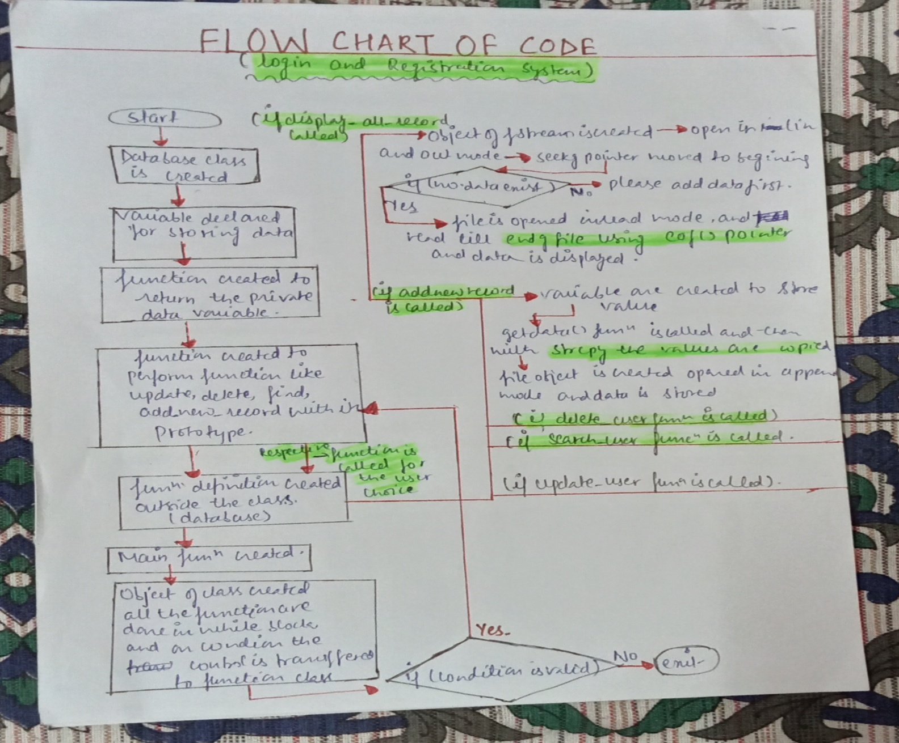
METHODOLOGY

Slide 9
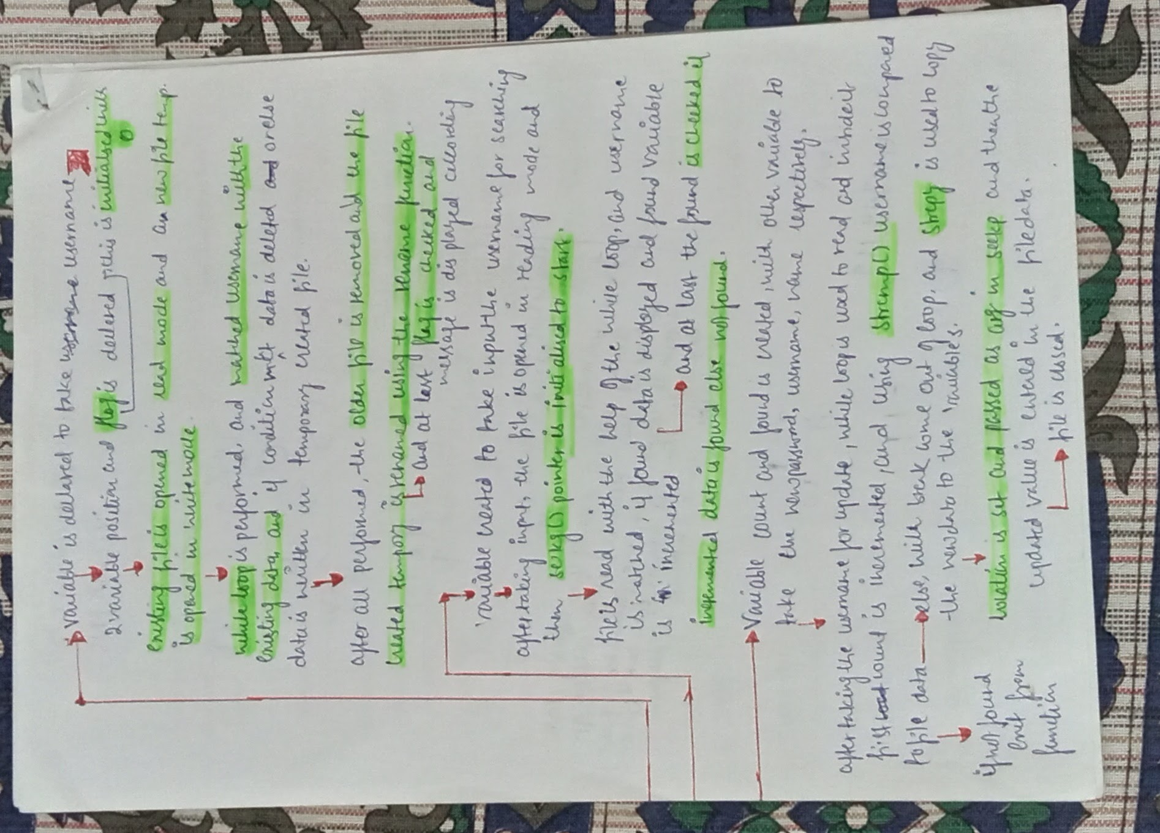

Slide 10
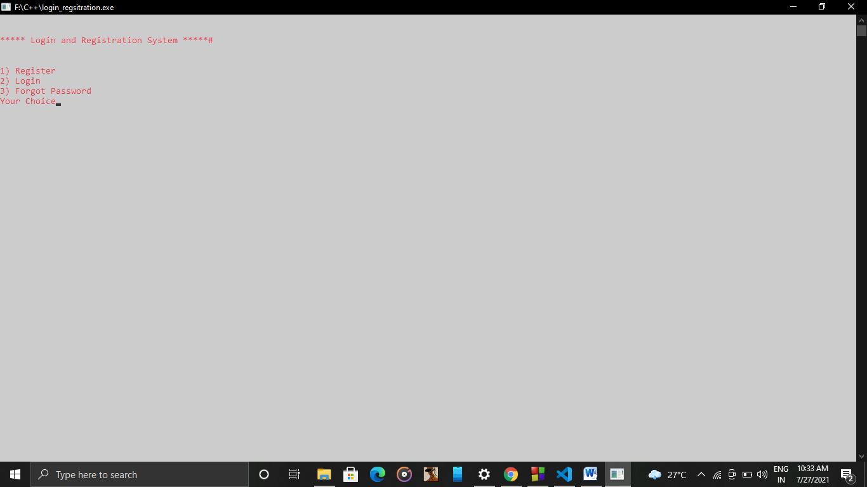

Slide 11
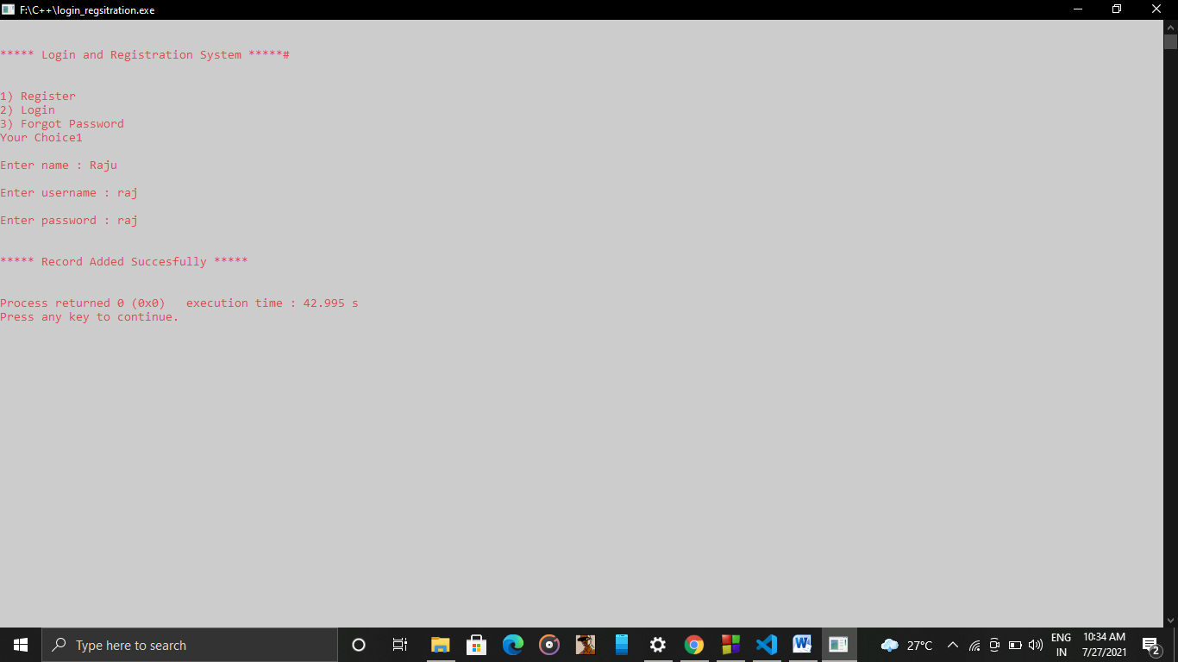

Slide 12
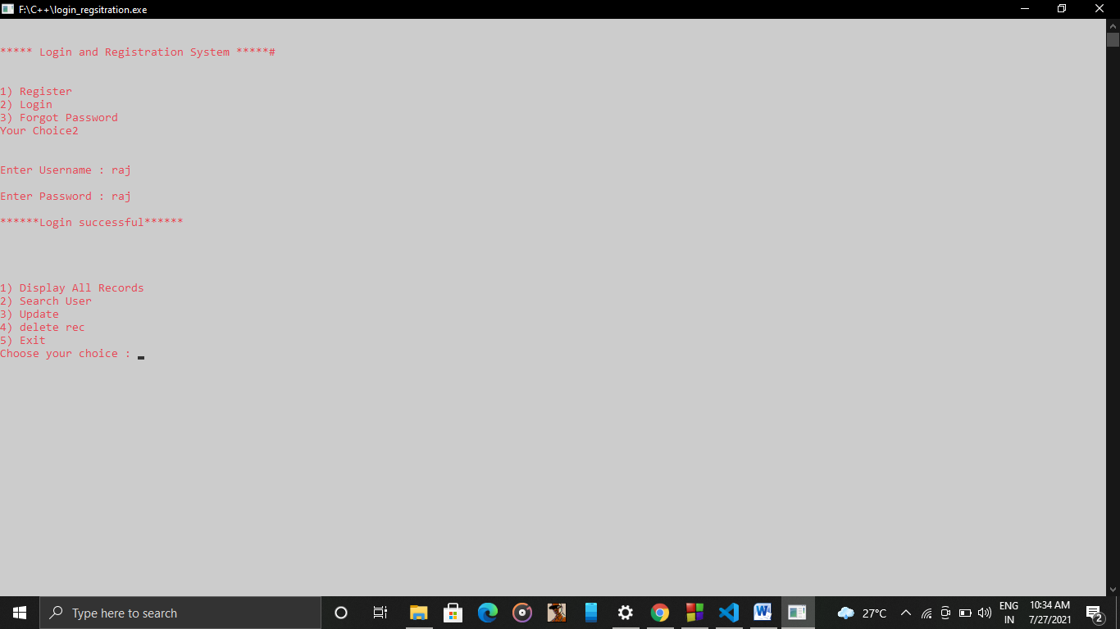

Slide 13
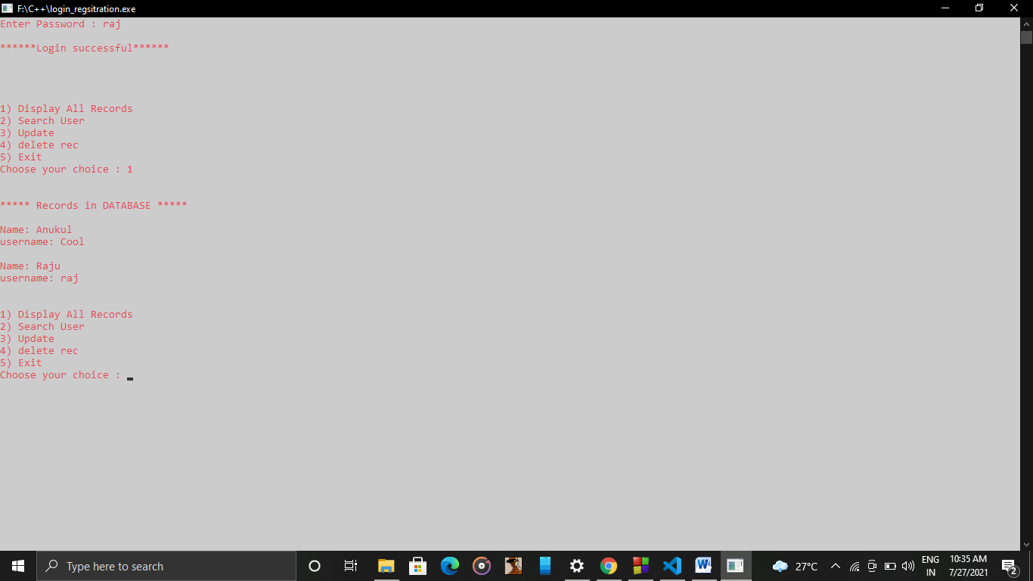

Slide 14
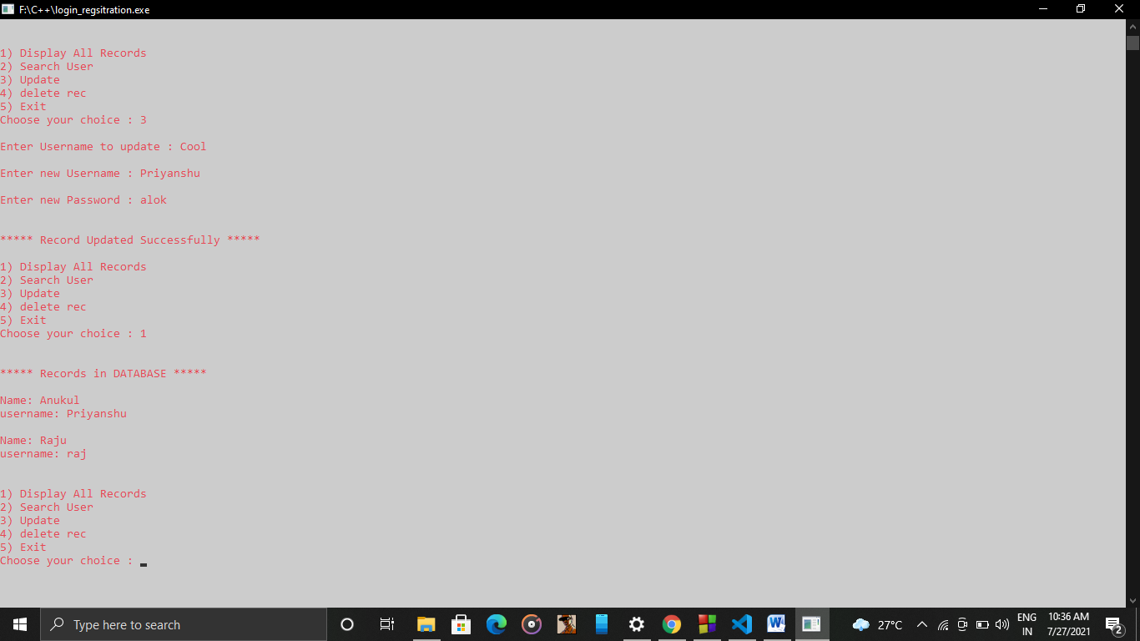

Slide 15
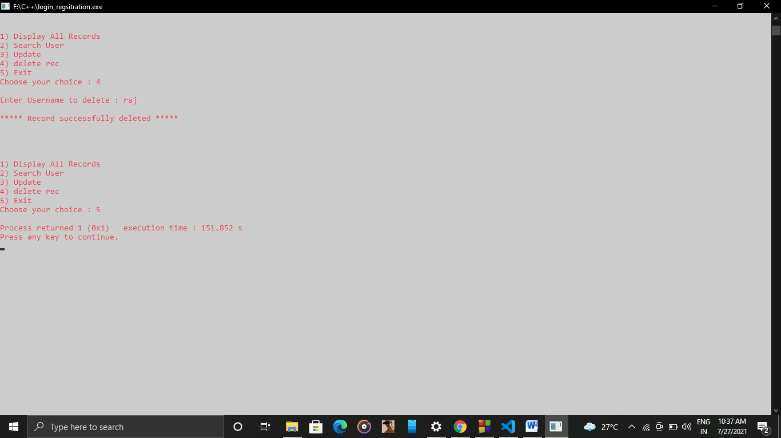

Slide 16
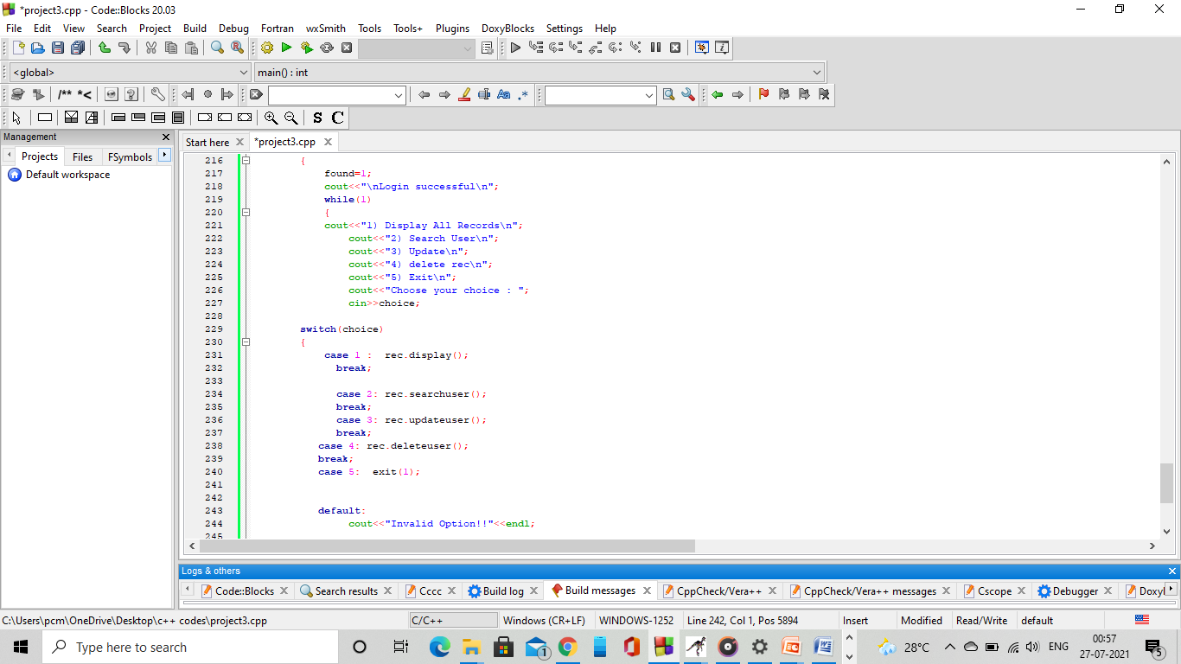

Slide 17
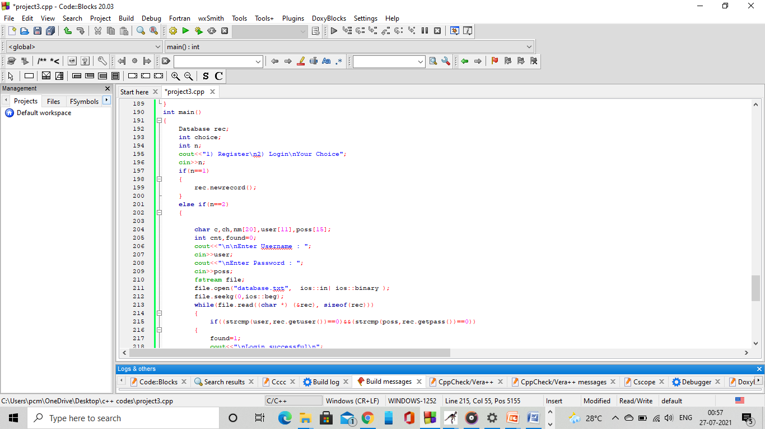

Slide 18
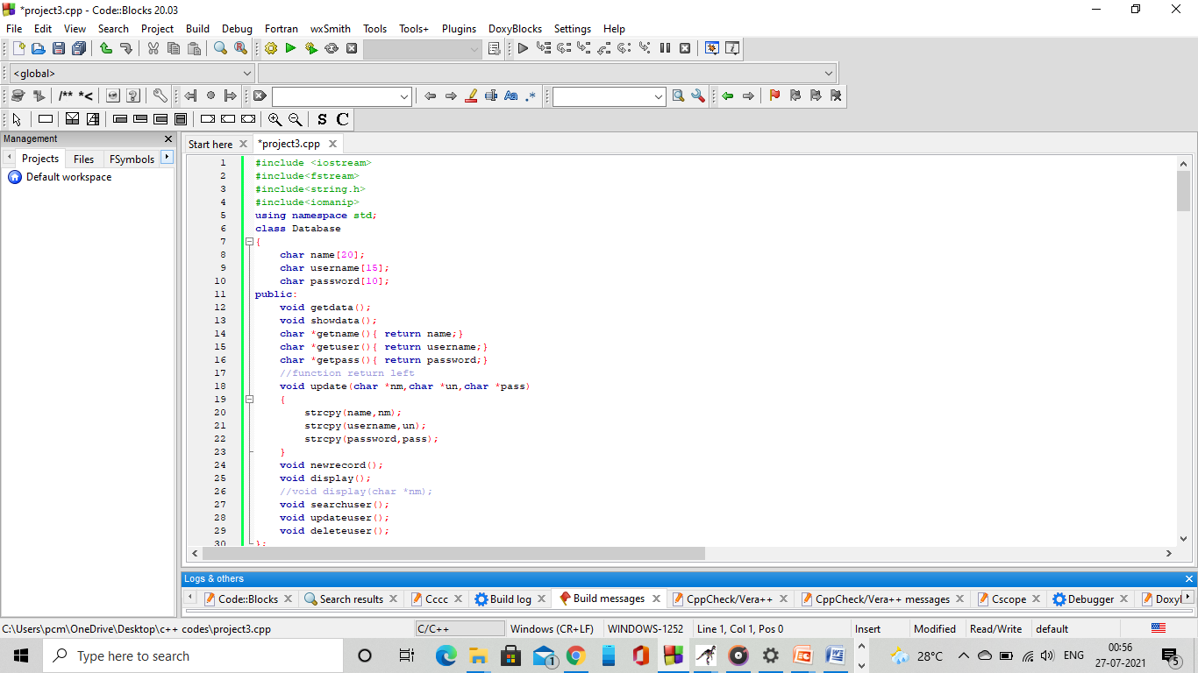

Slide 19
CONCLUSION
Through this project we can conclude that we can use the combined concept of the class and file handling to make database of login and registration system .
This project also briefly conclude that pointer can be used to access the data of the file which is stored with the help of the class(data members and member function).
In this we can also see that the user gets a real time exposer while registering and login themselves.

Slide 20
Future Scope
In this project in the coming near by future we can also create a separate database for the each registered user and they can be accessed through their individual database.
Also In the coming days we can also add a option where an individual can update his/her password in case they forgot their password. This can be done by making one more function forgot in the main function.

Slide 21
References
Sumita Arora, “Computer Science With C++” , File Handling, Dhanpat Rai & Co, Volume 11 Edition
Herbert Schildt, “ The Complete Refrence C++”, Mc Graw Hill 4th Edition OSBORNE
https://www.geeksforgeeks.org/file-handling-c++-classes
https://www.geeksforgeeks.org/file-handling-c-classes/

