Slide 1
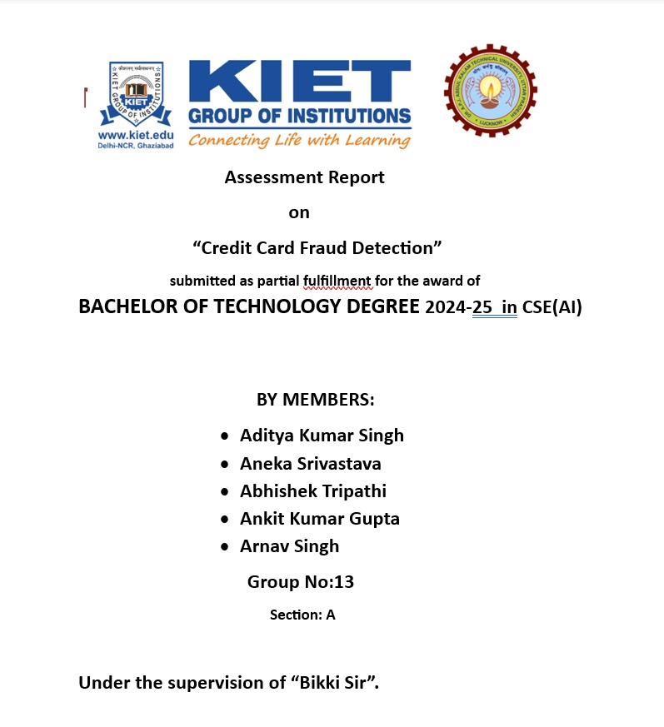

Slide 2
Problem Statement
Objective:
Develop an anomaly detection system to identify fraudulent credit card transactions using unsupervised learning techniques.
Challenges:
- Imbalanced data (fraud cases are rare and different)
- Lack of labeled data for training
- Need for real-time detection

Slide 3
Introduction
- Fraud in credit card transactions causes billions in losses annually.
- Traditional systems rely on rules or supervised models.
- We explore unsupervised learning to detect anomalies without labeled data.

Slide 4
Dataset Description
- Source: Kaggle Credit Card Fraud Dataset
- Transactions by European cardholders in Sept 2013.
- Total Records: 284,807
- Fraudulent Transactions: 492 (~0.17%)
- Features: V1–V28 (anonymized), Time, Amount, Class

Slide 5
Data Preprocessing
- Scaling: StandardScaler on 'Amount' and 'Time'
- No Missing Values
- Class Imbalance: Heavily skewed
- Optional: PCA visualization

Slide 6
Methodology Overview
Unsupervised Learning Models Used:
- Isolation Forest
- One-Class SVM
- Local Outlier Factor (LOF)
Key Steps:
1. Preprocessing
2. Model Training
3. Outlier Detection
4. Performance Evaluation

Slide 7
Isolation Forest
- Detects anomalies by randomly partitioning data
- Suitable for high-dimensional data
- Contamination parameter set to match fraud rate (~0.0017)

Slide 8
Local Outlier Factor (LOF)
- Measures local density deviation
- Identifies samples with significantly lower density
- Effective for subtle anomaly detection

Slide 9
Performance Metrics
Metrics used:
- Confusion Matrix
- Precision, Recall, F1-score
- ROC-AUC Score
Model Performance:
Isolation Forest: Precision 0.28, Recall 0.32, F1 0.30, AUC 0.85
LOF: Precision 0.24, Recall 0.41, F1 0.30, AUC 0.81
One-Class SVM: Precision 0.12, Recall 0.58, F1 0.20, AUC 0.74

Slide 10
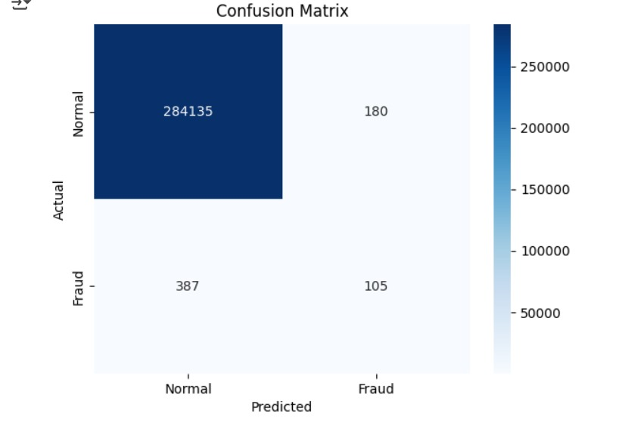
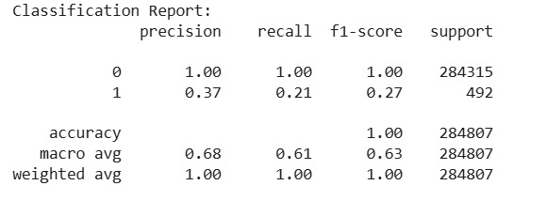
Visualization of Results
- 2D PCA plot showing fraud vs. non-fraud
- Highlighted detected outliers
- Validates anomaly detection effectiveness

Slide 11
Conclusion
- Unsupervised learning is useful with limited labels.
- Isolation Forest was the most effective.
- Prioritize recall for fraud detection.
- Combine with supervised methods for better results.

Slide 12
References
- Kaggle: Credit Card Fraud Detection Dataset
- Scikit-learn Documentation
- 'Isolation Forest' by Liu et al., 2008

