Slide 1


INFOSYS SPRINGBOARD VIRTUAL INTERNSHIP 7.0
Enterprise Learning Platform with Skill and Career Guidance System
An all-in-one online learning & career platform — powered by AI
Web App
AI Assistant
Secure Login
Project Mentor
Shakthi Gopala Krishnan — Infosys Internship Mentor
Team
T.S Anekka · Chandni Singh · B. Rajya Lakshmi
G.S. Bharanidharan · CH.GV Sindhusha

Slide 2
THE PEOPLE BEHIND IT
Meet the Team
T.S. Anekka
B. Rajya Lakshmi
Chandni Singh
Built the backend logic and designed the database that powers the app.
Built the student and mentor screens and connected them to the backend.
Built backend features and integrated every part of the app together.
G.S. Bharanidharan
CH.GV Sindhusha
Designed key screens and helped structure how data is stored.
Connected the AI assistant to the app and helped manage the database.

Slide 3


THE BIG PICTURE
What is Enterprise Learning Platform?
In Simple Words
Built to Be Reliable
One website where students learn, practice, and get ready for real jobs
Brings courses, mentors, and career tools into a single place — no more juggling apps
Built for three kinds of users: Students, Mentors, and Admins, each with their own view
Feels less like a course catalog and more like a complete learning journey
Made with modern, industry-standard web technology
Every user's information is protected behind secure sign-in
The AI assistant learns from real progress, not guesswork
Designed to grow — new features can be added without breaking things

Slide 4


WHY WE BUILT THIS
The Problem We're Solving
The Problem Today
Our Solution
Students juggle too many separate apps and tools just to learn
Everyone sees the same generic course list — no personal guidance
Mentors have no easy way to track, approve, or guide student work
Learning and career-building feel completely disconnected
1
One Simple Course Journey
Create → Approve → Join → Test → Certificate — all tracked in one place
2
Smart AI Guidance
A personal roadmap and AI chat that actually knows your progress
3
Career Tools Built In
Internship listings, a resume builder, and coding practice — all inside

Slide 5



HOW IT WORKS
Three Roles, One Platform
Student
Mentor
Admin
Browse and join courses
Watch lessons & track progress
Take quizzes, get instant results
Create and publish courses
Review & approve student work
Schedule live sessions
Approve new courses
Manage all users
Keep the platform running smoothly
The Student Journey
Enroll
→
Learn
→
Get Tested
→
Grow with AI

Slide 6
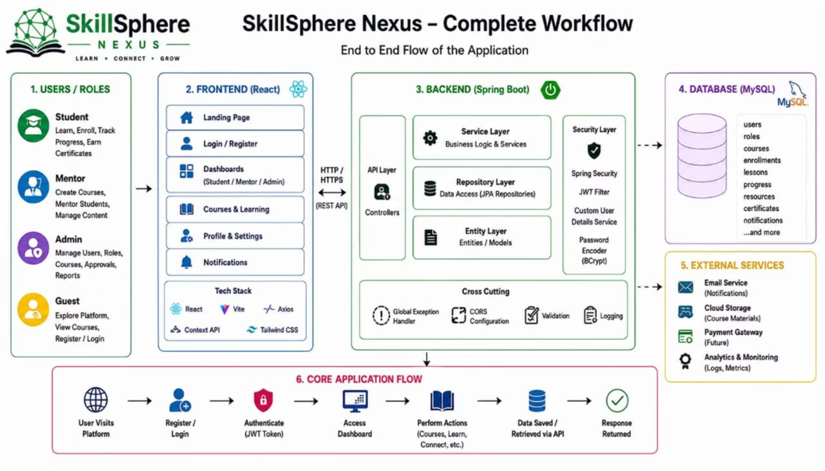


Workflow

Slide 7
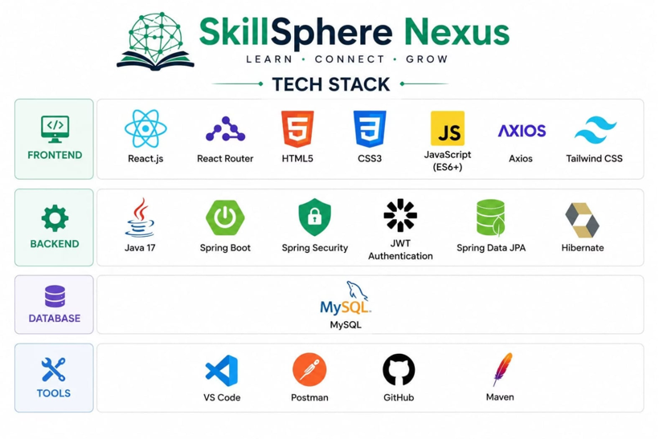
Tech Stack

Slide 8

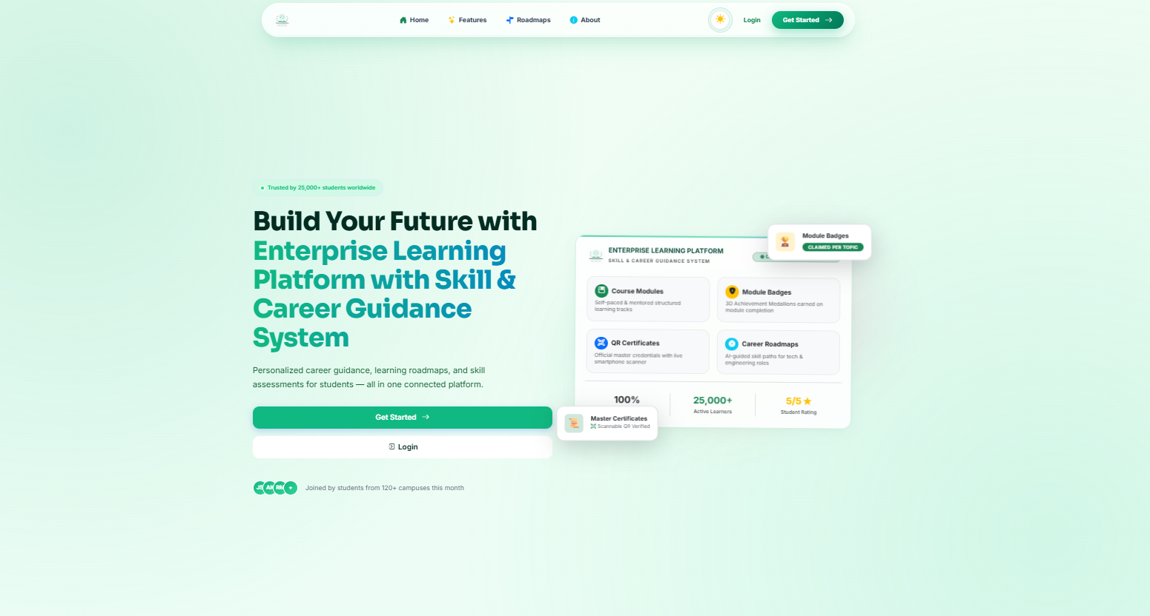
SCREEN WALKTHROUGH
The Landing Page
The very first page a visitor sees — designed to explain the platform in seconds.
What It Does
Introduces SkillSphere Nexus and what it offers, right away
Simple buttons to Login or Sign Up — no guesswork
Shows the three types of users: Student, Mentor, Admin
Smooth animations as you scroll down the page
Light and dark mode — switches to your preference automatically

Slide 9

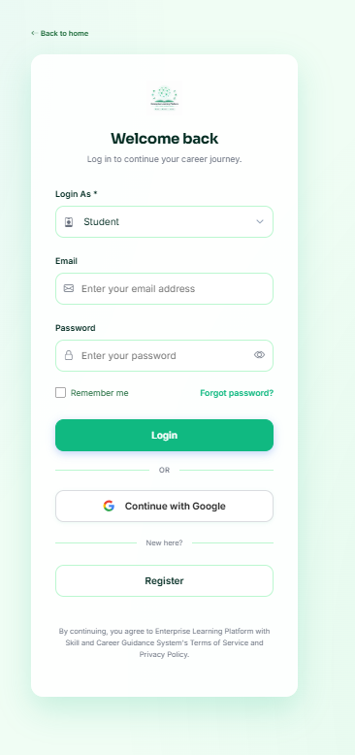
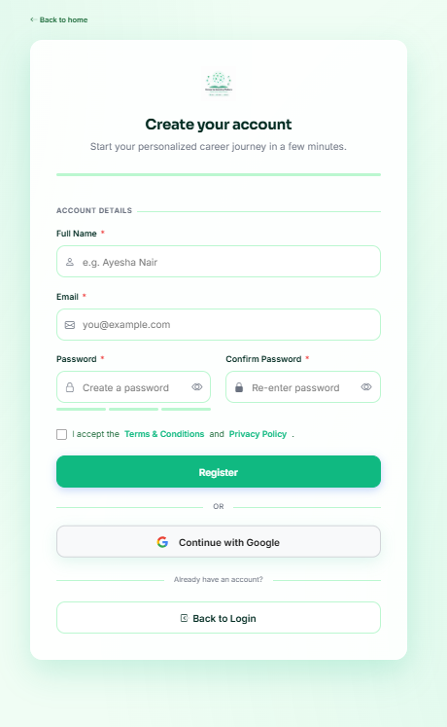

SCREEN WALKTHROUGH
Signing In & Signing Up
Getting into the platform is simple, fast, and kept secure behind the scenes.
Signing In
Sign in with email + password, or one click with Google
"Remember Me" keeps you signed in longer
Forgotten your password? A reset link is emailed to you
Signing Up
Choose your role: Student, Mentor, or Admin
Your password is encrypted the moment you create it
Signing up with Google creates your account automatically

Slide 10
SCREEN WALKTHROUGH
A Dashboard for Every Role
Everyone gets their own personal home screen, built around what they actually need to do.
Student Dashboard
Mentor Dashboard
Admin Dashboard
My Courses & Progress
Quizzes & Assignments
AI Chat Assistant
Personal Learning Roadmap
Skill Gap Checker
Coding Practice
Resume Builder & Certificates
Create & Manage Courses
Build Quizzes & Review Work
Post Internships
Schedule Live Sessions
Manage All Users
Approve New Courses
Handle Reports & Complaints
View Activity Logs
A peek at the real Student Dashboard

Slide 11


LOOKING BACK & AHEAD
What We Achieved & What's Next
What We Built Well
What's Next
Clean, organized code that's easy to maintain and extend
The AI can be swapped out anytime without breaking the app
Secure sign-in that blends Google login with our own system
16+ screens that load quickly, even on slower connections
Covers the full journey — from course creation to career-readiness
Store files and uploads safely in the cloud
Real-time notifications the moment something happens
Longer, even safer login sessions
More automated testing to catch issues early
Simpler admin tools for managing large numbers of users

Slide 12

Thank You!
SkillSphere Nexus · Infosys Springboard Virtual Internship 7.0
T.S Anekka · Chandni Singh · B. Rajya Lakshmi · G.S. Bharanidharan · CH.GV Sindhusha

