Slide 1
Calling conventions and GDB
(aka GDB is not that scary and actually useful)

Slide 2
GDB
Run GDB locally
Run GDB on Athena
Questions about GDB

Slide 3
Refresher on assembly
C -> assembly (.S or .asm files) -> binary (.o files)
https://6190.mit.edu/_static/fall22/resources/references/riscv_isa_reference.pdf
Demo 1

Slide 4
RISC-V vs x86
RISC-V specifications
x86 specifications
Other reduced instruction sets: https://en.wikipedia.org/wiki/List_of_products_using_ARM_processors

Slide 5
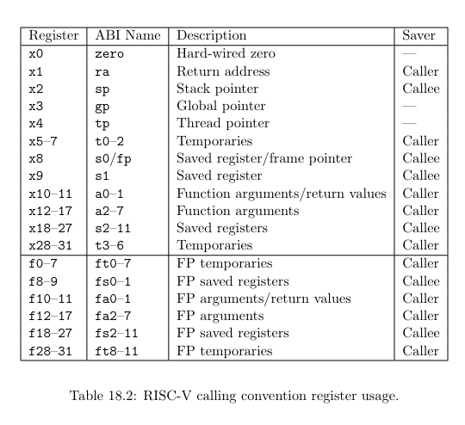
Calling conventions

Slide 6
What happens if we don’t follow calling conventions?
Show demo 2

Slide 7
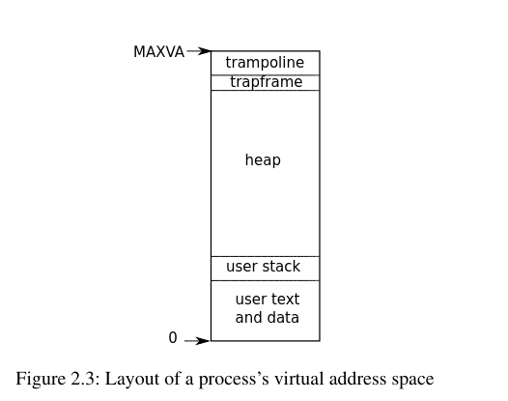
Virtual address space

Slide 8
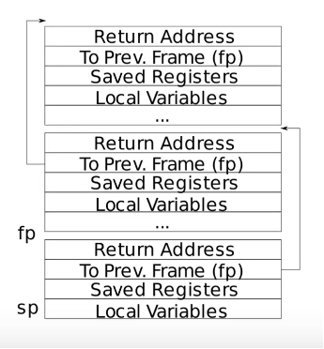
The stack

Slide 9
More demos!
Show demo 3, 4 and 5

