Slide 1
PROG6212_POE
By ST10328767_Anelisiwe Matsotsi

Slide 2
Key features for part 3
Login for each user.
HR creates user profiles and generates a report.
Lecturer does not manually input rate the rate is pulled from what the HR input when creating the profile.
Validation is added so that the amount of hours can not be more than 180 a month.
Auto calculates the total amount (salary) using the hourly rate when hours are submitted by lecturer.

Slide 3
LOGIN
Handles all user authentication (logging in and logging out).
Verifies a user’s identity and then directs the to the correct part of the application (e.g., Lecturer, HR, Coordinator, Manager).
Sessions are used as a temporary storage to remember information about the user while they are browsing the website (B&B BILISIM, 2025).

Slide 4
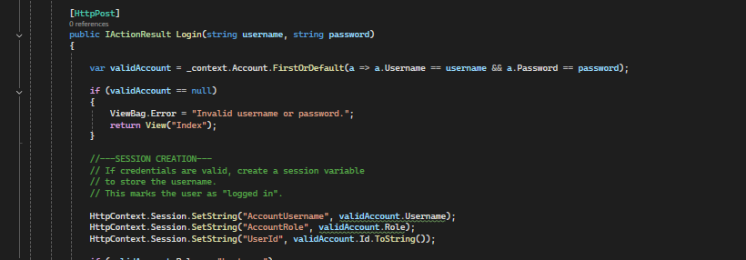
Login code

Slide 5
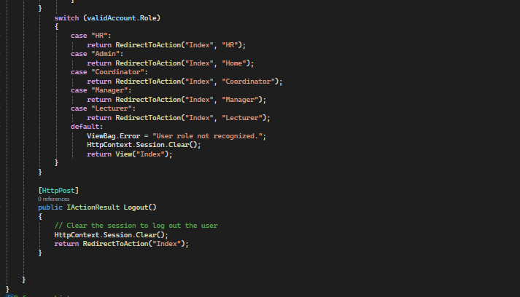

Slide 6
HR CONTROLLER
Purpose:
  Allows HR staff to manage accounts and generate detailed financial reports.
Responsibilities:
  Create and edit user accounts
  Generate reports on claims and payment
  Create and download PDF reports and invoices

Slide 7
1. Role-Based Access Control
HRController restricts actions using HttpContext.Session
Ensures only HR users can access sensitive operations
Protects system integrity (Troelsen & Japikse, 2021)

Slide 8
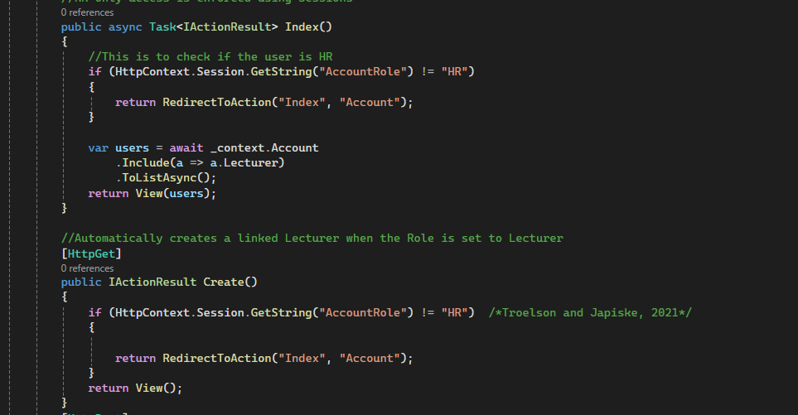
Hr controller code

Slide 9
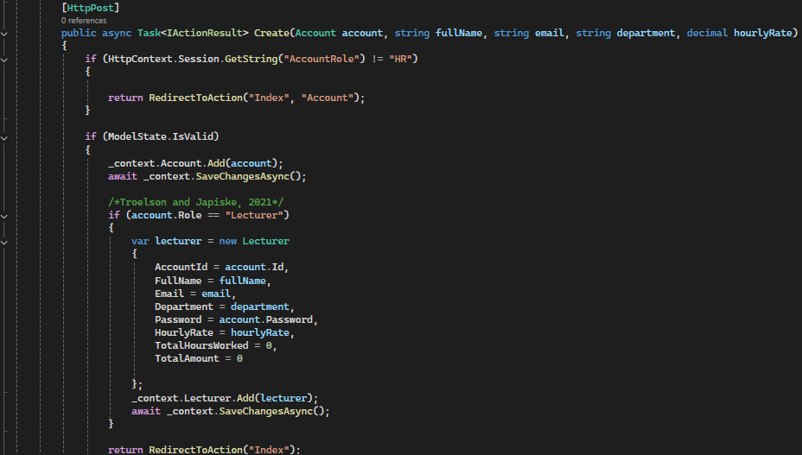

Slide 10
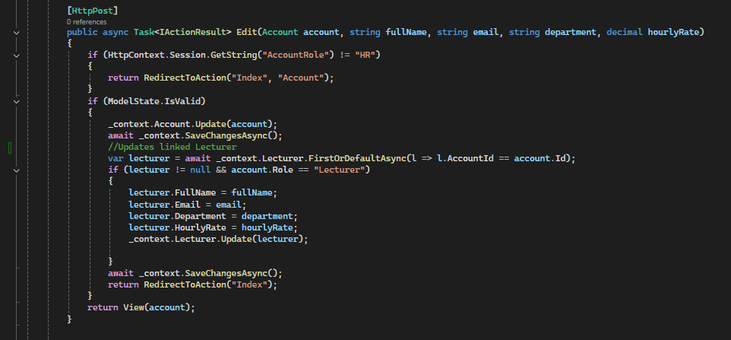
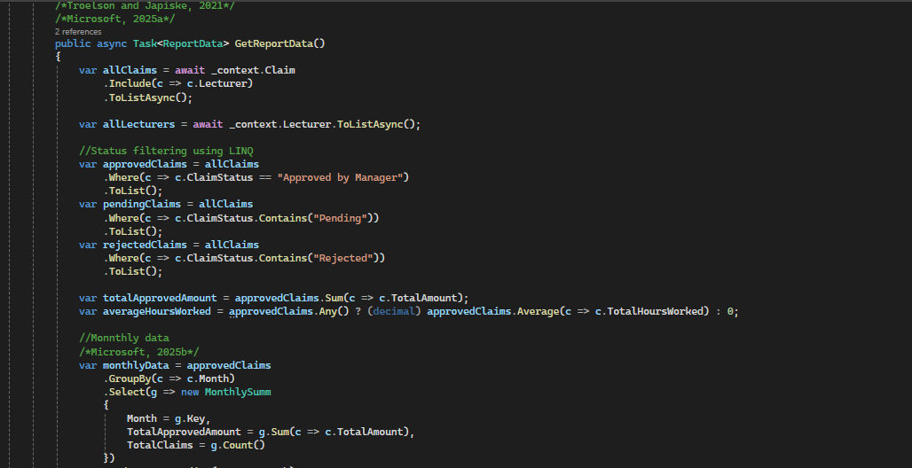

Slide 11
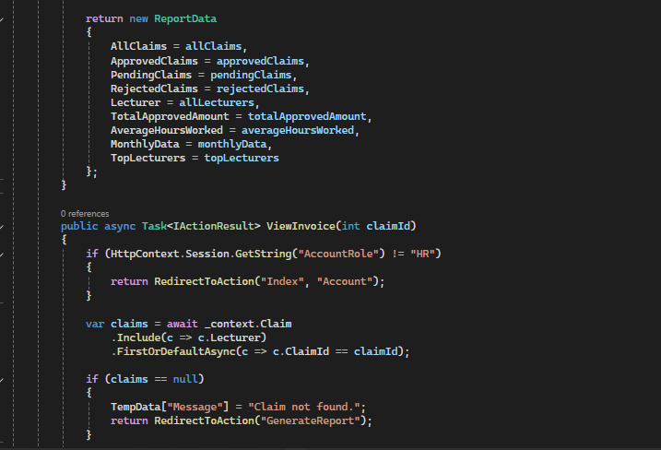
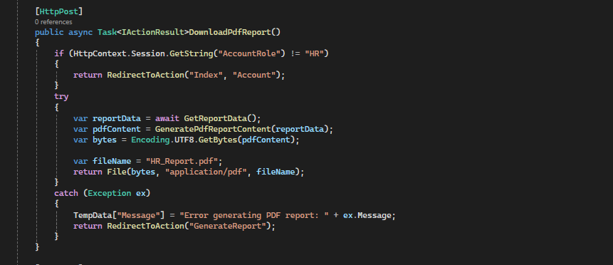

Slide 12
2. Account & Lecturer Management
HR can create and edit accounts
EF Core used for relational data and navigation loading
Lecturer entity auto-created when role == Lecturer

Slide 13
3. Report Generation
Uses advanced LINQ filtering, grouping & aggregation
Monthly summaries created with GroupBy (Microsoft, 2025)
Top lecturers sorted using financial metrics

Slide 14
4. PDF Exporting
Reports and invoices generated using StringWriter
UTF-8 encoded into downloadable PDF text files

Slide 15
5. LINQ Processing Examples
• Summaries: claims.GroupBy(c => c.Month)
• Aggregations: Sum, Count, Average
• Filtering: Where(c => c.ClaimStatus == "Approved")

Slide 16
6. System Workflow Summary
1. HR logs in
2. HRController validates session
3. HR manages accounts & lecturers
4. Claims processed → Reports generated
5. PDF exports available for all details

Slide 17
Reference list
B&B BILISIM.2025. Storing Data in the Browser: localStorage, sessionStorage, and Cookies. [online]. Available at: <https://bb.com.tr/en/blog/software-development/storing-data-in-the-browser-localstorage-sessionstorage-and-cookies>. [Accessed 16 November 2025].
Microsoft. 2025.Write C# LINQ queries to query data. [online]. Available at: <https://learn.microsoft.com/en-us/dotnet/csharp/linq/get-started/write-linq-queries>.Accessed 19 November 2025].
Troelsen,A. and Japikse, P. 2021.Pro C# 9 with .NET 5:Foundational Principles and Practices in Programming. 10th ed.Apress.

