Slide 1


Slide 2
first-meetup!
Introduction
Syllabus
Schedule
Mentorship
Getting started!

Slide 3
introduction
“
aBraincode is community for developers who
are interested to becoming ‘polyglot’ developer,
developer rockstar, and have an ambition for
cultivating technology.
http://abraincode.id

Slide 4
introduction
#android-dev
#web-dev
#ios-dev

Slide 5
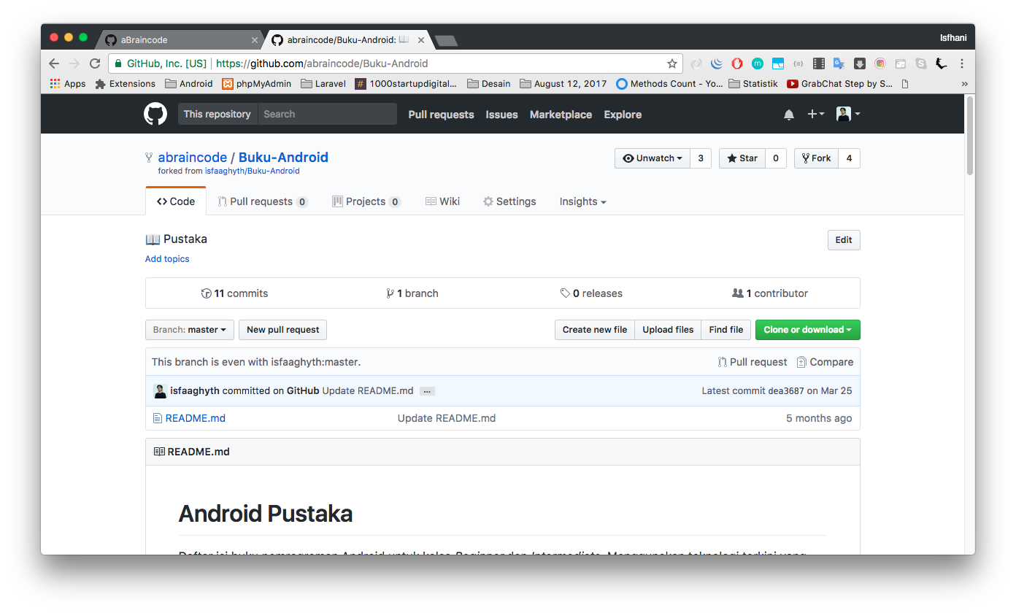
syllabus
#android-dev
github.com/abraincode/Buku-Android

Slide 6
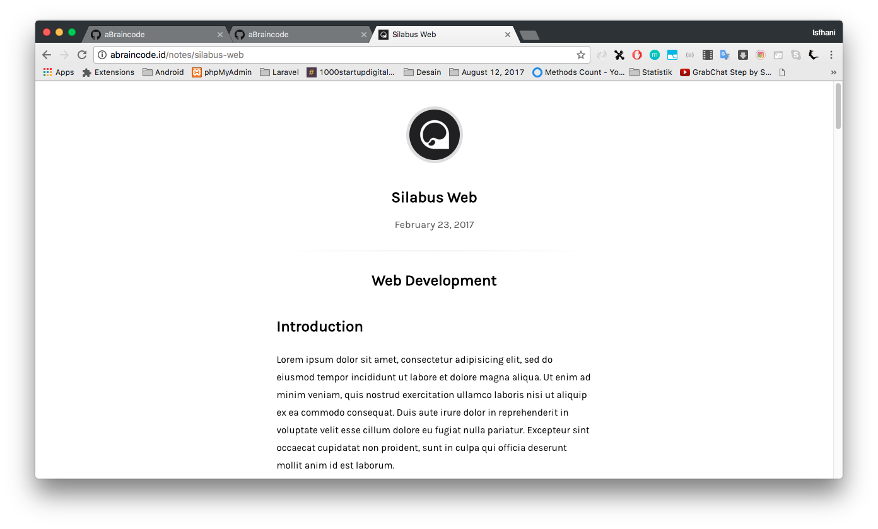
syllabus
#web-dev
abraincode.id/notes/silabus-web

Slide 7
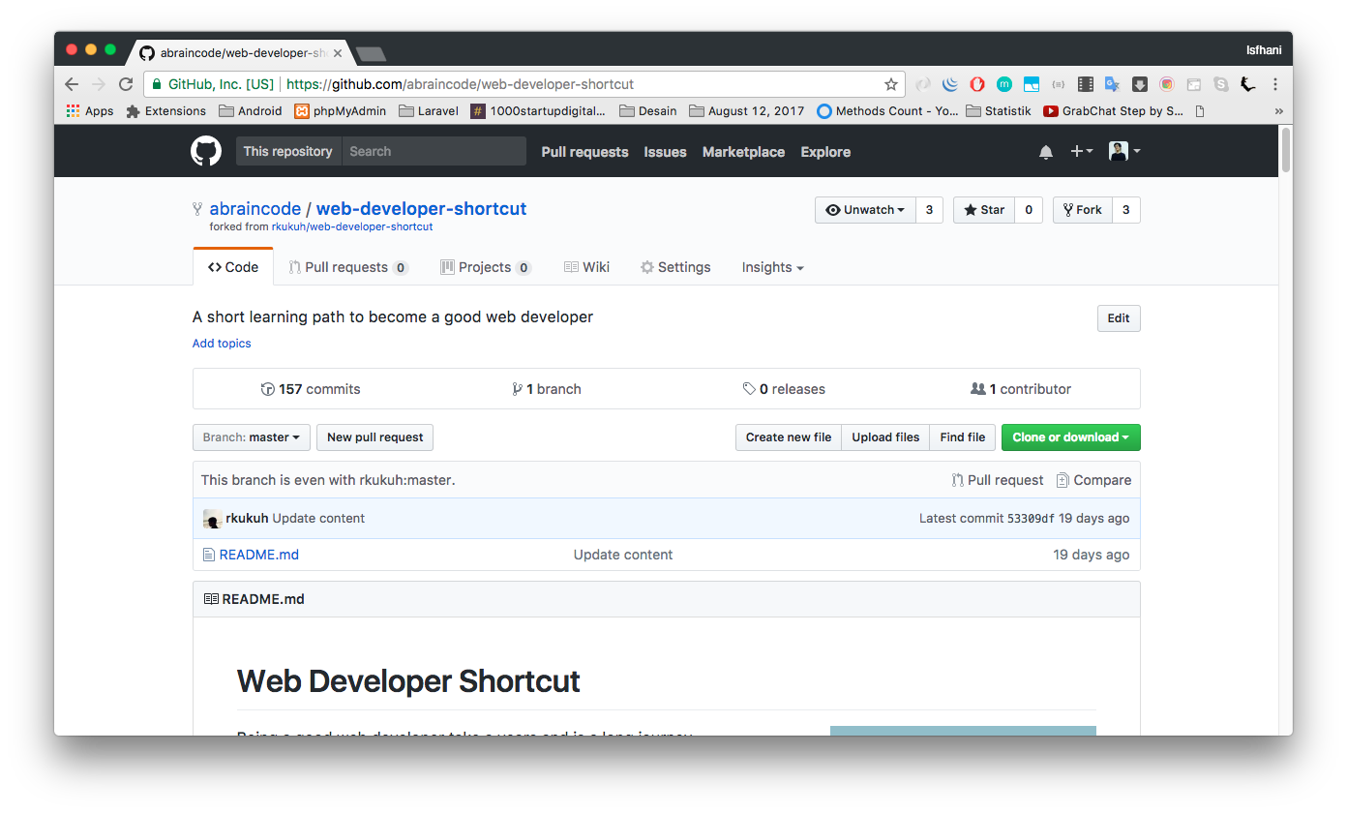
syllabus
#web-dev
github.com/abraincode/web-developer-shortcut

Slide 8
mentorship
@isfaaghyth
@dhimasanb
mobile-dev
dev-dev
@arobiyatul
@hardiantiflash
@aufaroot18
@shifter27

Slide 9
getting started
Setiap anggota abraincode, wajib memiliki akun github.
https://github.com/
Memilih peminatan
*) boleh lebih dari satu
*) disarankan pilih salah satu agar bisa fokus dan efisien
Instalasi paket aplikasi yang dibutuhkan
Android Studio
XAMPP, Composer, Text Editor (Atom atau Sublime Text)

Slide 10
schedule
Homework.
option:
2x / week
1x / week

Slide 11
be handsome developer.
be developer rockstar!
registration
http://s.id/ET5

