Slide 1
Week 4 (1) – Brute Force String Matching
CST370 – Design & Analysis of Algorithms
Dr. Byun
Computer Science

Slide 2
Lecture Objectives
After completion of this lecture, you will be able to
  explain the time efficiency of best case and worst case of the brute-force string matching algorithm.

Slide 3
Chapter 3: Brute Force and Exhaustive Search
3.1 Selection Sort and Bubble Sort
3.2 Sequential Search and Brute-Force String Matching
3.3 Closest-Pair and Convex-Hull Problems by Brute Force
3.4 Exhaustive Search
3.5 Depth-First Search and Breadth-First Search

Slide 4
<<< Course Instruction >>>
Optional reading of page 104 of our textbook.
  Sequential search is a simple algorithm to find a key value in an array of n elements.
  Since you already took a data structure course, I think that you learned the sequential search before.
  But if you want to recall it, read the textbook.

Slide 5
String Matching Problem
Given a string of n characters called the text and a string of m characters called the pattern, find a substring of the text that matches the pattern.
Example
  Assume that you have a text file named “vision_statement.txt” which is composed of 1000 characters. (= n is 1000)
  Find a pattern “CSUMB” in the file. (= m is 5)

Slide 6
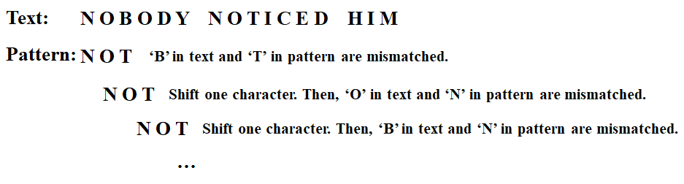
Brute-Force String Matching
Basic idea
  Character by character comparison.
  If a mismatching happens, shift a character and resume the comparison.
Example

Slide 7
<<< Course Instruction >>>
Read pages 105-106 of the textbook.
  Brute-force string matching is pretty straightforward.
  However, you have to consider the best case and worst case in the brute-force string matching.

Slide 8
Exercise
Suppose the text is 7 characters and the pattern is 3 characters for the string match problem.
  Provide a sample text and a sample pattern that take the smallest number of comparisons (= best case example).
  Also provide the worst case example that requires maximum number of comparisons.

Slide 9
Best Case
If an immediate match occurs, a minimum number of comparisons will occur.
Example
  Text: CSUMBGO
  Pattern: CSU
  This example requires three comparisons for the characters 'C', 'S', and 'U'.
  Typically, it’s relatively easy to think of a best case example.

Slide 10
Worst Case
Do not immediately see the answer on the next page.
A worst case sample is not obvious.
  It may require more comparisons than you think immediately.

Slide 11
Worst Case Example
Text: AAAAAAA
Pattern: AAB
  Consider why this example requires maximum number of comparisons.
  Note that many other similar examples are possible.

Slide 12
<<< Course Instruction >>>
This lecture is over.
  When you are done, study the next lecture (week_4_2.ppt) on the iLearn.

