Slide 1
Week 4 (2) – Exhaustive Search
CST370 – Design & Analysis of Algorithms
Dr. Byun
Computer Science

Slide 2
Lecture Objectives
After completion of this lecture, you will be able to
  apply exhaustive search to solve combinatorial problems such as TSP, knapsack, and job assignment problems.

Slide 3
Chapter 3: Brute Force and Exhaustive Search
3.1 Selection Sort and Bubble Sort
3.2 Sequential Search and Brute-Force String Matching
3.3 Closest-Pair and Convex-Hull Problems by Brute Force
3.4 Exhaustive Search
3.5 Depth-First Search and Breadth-First Search

Slide 4
Exhaustive Search
Watch this video first
  https://youtu.be/o_Bk8lE795Q
Exhaustive search is a brute-force approach to solve combinatorial problems such as TSP.
  Generate all potential solutions (or all possible cases) to the problem.
  Evaluate each case one by one.
  Determine the solution among the possible cases.

Slide 5
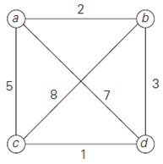
Traveling Salesman Problem (TSP)
TSP is to find the shortest tour through a given set of n cities that visits each city exactly once before returning to the city where it started.
  We introduced it in Chap. 1.3.
  https://youtu.be/67DMNFzzIpo
Example

Slide 6
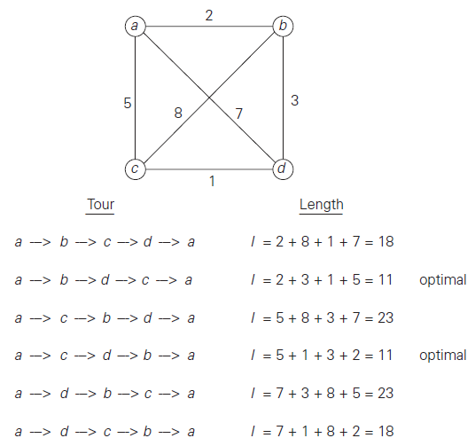
Exhaustive Search for TSP
To solve the problem, you must find all permutations of the nodes b, c, and d.

Slide 7
Time Complexity of TSP
  If there are n nodes in the question, we should identify all possible paths of the (n-1) node, except for the starting node.
  The total possible paths are
  (n-1)! = (n-1) * (n-2) * … * 2 *1
  Therefore, the time efficiency of the problem requires at least (n-1)!

Slide 8
<<< Course Instruction >>>
Read pages 115-116 of the textbook to completely understand the idea of exhaustive search and TSP.

Slide 9
Knapsack Problem
Watch this video first
  https://youtu.be/OC85aM7SFts
Given n items
  weights: w₁, w₂, . . . , w_{n}
  values: v₁, v₂, . . . , v_{n}
Find the most valuable subset of the items that fit into a knapsack with the capacity W.
Note that there is only one quantity per item.

Slide 10
Example
Knapsack capacity: 10 (i.e.: W = 10)
Item 1: w₁ = 7, v₁ = $42
Item 2: w₂ = 3, v₂ = $12
Item 3: w₃ = 4, v₃ = $40
Item 4: w₄ = 5, v₄ = $25

Slide 11
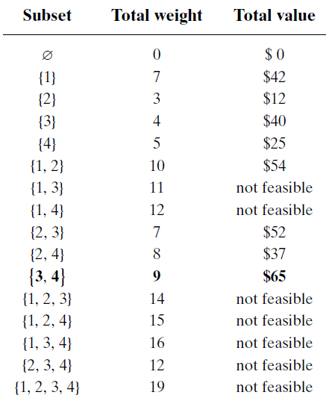
Knapsack Problem – Exhaustive Search
Basic Idea
Consider all possible subsets.
Compute the weight and value of each subset.
Find the best subset which provides the maximum value.

Slide 12
Time Efficiency of Knapsack Problem
Note that the number of possible subsets of a set with n items is 2^{n}.
  Thus, the exhaustive search algorithm requires at least (2^{n}) time complexity.
  For example, the solution to the question in our example has 16 (= 2⁴) subsets for a set of 4 items.

Slide 13
<<< Course Instruction >>>
Read pages 116-119 (before “Assignment Problem”) of the textbook.

Slide 14
Assignment Problem
Assume that there are n people who need to be assigned to execute n jobs.
  You have to assign one job to exactly one person.
  Since each person has different skillset, the time to execute each task is different.
  The assignment problem is to allocate the jobs to the people in the most cost-effective way.

Slide 15
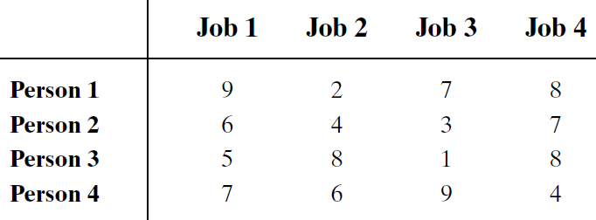
Example
This table presents the relationship between persons and tasks.
  For example, if you assign the job 1 to the person 1, it takes 9 hours. If the same person does the task 2, it takes 2 hours.
  Similarly, if you assign the job 1 to the person 2, it take 6 hours.
  You have to assign one task to one person. Then, how will you assign the four tasks to four persons to finish all tasks in the minimum number of total hours?

Slide 16
<<< Course Instruction >>>
Read pages 119-120 of the textbook to completely understand the definition of assignment problem and find a solution using the exhaustive search.

Slide 17
Sample Code for Exhaustive Search
For the exhaustive search, you need to generate either permutations or subsets for an input data.
The following slides present a few sample C++ programs to generate permutations and subsets.

Slide 18
Generating All Permutations of a String
https://repl.it/@YBYUN/permutations
  Run the program and read the program to understand the operation of it.
  Change the string in the main() to a different one such as “A”, “AB”, or “ABCD” to make sure that the program works well in several different strings.

Slide 19
Permutations using a STL library
You can also generate permutations of an array using a STL function next_permutation().
  https://repl.it/@YBYUN/permutationsusingSTL

Slide 20
Generate All Subsets of a Set
https://repl.it/@YBYUN/powerset
  Run the program and read it carefully to understand the operation.

Slide 21
<<< Course Instruction >>>
This lecture is over.
  When you are done, study the next lecture (week_4_3.ppt) on the iLearn.

