Slide 1
Week 4 (4) – Breadth-First Search
CST370 – Design & Analysis of Algorithms
Dr. Byun
Computer Science

Slide 2
Lecture Objectives
After completion of this lecture, you will be able to
  perform the breadth-first search (BFS) to visit all vertices of a graph using a queue.

Slide 3
Chapter 3: Brute Force and Exhaustive Search
3.1 Selection Sort and Bubble Sort
3.2 Sequential Search and Brute-Force String Matching
3.3 Closest-Pair and Convex-Hull Problems by Brute Force
3.4 Exhaustive Search
3.5 Depth-First Search and Breadth-First Search

Slide 4
Breadth-First Search (BFS) Algorithm
To get the basic idea of BFS, watch this video.
  http://y2u.be/QRq6p9s8NVg
  Note that BFS uses a queue for its operation.

Slide 5
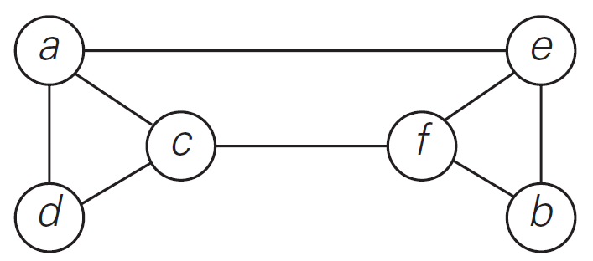
BFS Example (1 of 2)
Watch this video to understand the detailed operation of BFS for the graph below.
  http://y2u.be/-n-nyIVyUWA

Slide 6
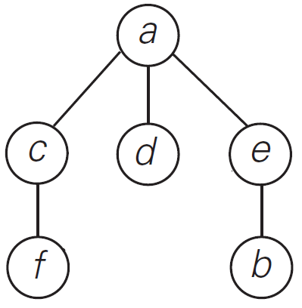
BFS Example (2 of 2)
Sequence of vertices visited
  a → c → d → e → f → b
BFS tree with “tree edges”.

Slide 7
BFS – Time Efficiency
The time efficiency of the BFS algorithm depends on the data structure used to represent the graph.
  For the adjacency matrix representation, the traversal time is in Θ(|V |²).
  For the adjacency list representation, it is in Θ(|V | + |E|) where |V | and |E| are the number of the graph’s vertices and edges, respectively.
The time efficiency of the BFS algorithm is similar to the DFS algorithm.

Slide 8
Applications of BFS
Same as DFS applications
  Checking connectivity
  Checking acyclicity of a graph
  Finding connectivity components
  etc.
We can also find paths from a vertex to all other vertices with the smallest number of edges.

Slide 9
<<< Course Instruction >>>
Read pages 125-128 of the textbook to completely understand the operation of BFS.
  Our textbook describes the concepts of “BFS forest”, “tree edges”, and “cross edges”.
  But we will focus on the “tree edges” in the class.

Slide 10
Exercise
Starting at the vertex a, conducting the BFS algorithm for the graph below.
  Then, present the result of mark array and draw a BFS tree with “tree edges”.
Do not see the answer immediately.
  Try to solve it by yourself.
a
b
c
d
e
f
g
h

Slide 11
Exercise Solution
BFS Tree
a
1
a
b
2
c
6
b
e
f
d
8
e
3
g
f
4
g
5
c
h
h
7
Mark Array
d

Slide 12
BFS Implementation in C++
Go to
  https://repl.it/@YBYUN/BFS
Run the program with the following input graph data
      3
      2
      0 1
      1 2
  The program will run the BFS algorithm and display the mark array.

Slide 13
Input Graph Format
1st line: Number of vertices
2nd line: Number of edges
All following lines includes the edge data with a starting vertex and an ending vertex.
Example
    3
    3
    0 1
    0 2
    1 2
0
1
➔
2

Slide 14
A Vector of “Vectors”
In the source program, we use a vector of “vectors” to represent the graph.
Example
  vector<vector<int>> graph;
Reference
  https://www.geeksforgeeks.org/2d-vector-in-cpp-with-user-defined-size/

Slide 15
<<< Course Instruction >>>
This lecture is over.
  When you are done, study the next lecture (week_4_5.ppt) on the iLearn.

