Slide 1
Week 4 (5) – Introduction to Divide and Conquer
CST370 – Design & Analysis of Algorithms
Dr. Byun
Computer Science

Slide 2
Lecture Objectives
After completion of this lecture, you will be able to
  explain the basic idea of divide-and-conquer technique.
  use the Master Theorem to determine the time efficiency of a divide-and-conquer algorithm.
Note that we cover Chapter 5 first. We will then cover Chapter 4.

Slide 3
Chapter 5: Divide-and-Conquer
5.1 Mergesort
5.2 Quicksort
5.3 Binary Tree Traversals and Related Properties
5.4 Multiplication of Large Integers and Strassen’s Matrix Multiplication
5.5 The Closest-Pair and Convex-Hull Problems by Divide-and-Conquer

Slide 4
Introduction to Divide and Conquer
Watch this video first
  https://youtu.be/_ZkJ3vtdg6Y
One of the best-known problem solving techniques.
  A problem is divided into several subproblems. Typically, it is divided into two subproblems.
  Subproblems are solved (recursively).
  If it’s necessary, the subproblems’ solutions are combined (or conquered) to get the solution of the original problem.

Slide 5
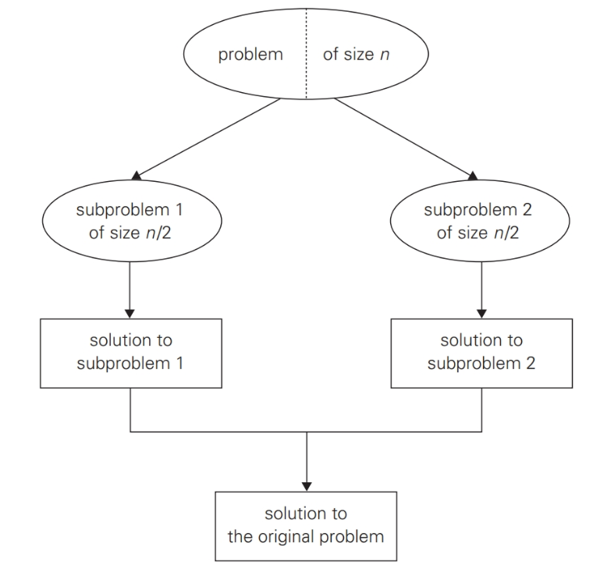
Divide-and-conquer technique – Typical Case

Slide 6
Divide and Conquer – Example
Assume that we want to calculate the sum of n numbers in an array of a₀, a₁, …, a_{n-1}.
  If n is 1, we return the number as a result.
  Otherwise, we divide the n numbers into two subproblems with (n/2) numbers and (n/2) numbers.
  The two subproblems are solved recursively.
  Then, we add the results of two subproblems.

Slide 7
Sample C++ Program
// https://repl.it/@YBYUN/sumdivNconqcpp
// Sum the array A from start to end indexes
int sum_div_N_conq(int A[ ], int start, int end) {
if (start == end)
return A[start];
else {
int sum1 = sum_div_N_conq (A, start, (start+end)/2);
int sum2 = sum_div_N_conq (A, (start+end)/2+1, end);
return(sum1 + sum2);
}
}
int main() {
int A[8] = {5, 3, 2, 7, 6, 1, 8, 4};
cout << sum_div_N_conq (A, 0, 7) << endl;
return 0;
}

Slide 8
<<< Course Instruction >>>
Read the following document named “Introduction to Divide-and-Conquer” to get the basic idea of divide-and-conquer.
  https://goo.gl/ySZavW

Slide 9
Time Efficiency of Divide and Conquer Algorithm
Watch this video first
  https://youtu.be/rjzS9r7dH98
A typical divide-and-conquer algorithm uses a recursive function.
Example
  int sum_div_N_conq (int A[ ], int start, int end) {
  if (start == end)
  return A[start];
  else {
  int sum1 = sum_div_N_conq (A, start, (start+end)/2);
  int sum2 = sum_div_N_conq (A, (start+end)/2+1, end);
  return(sum1 + sum2);
  }
  }
We will use Master Theorem to get the time efficiency of a divide-and-conquer algorithm.

Slide 10
Informal Usage of Master Theorem (1 of 2)
To apply Master Theorem for a divide and conquer algorithm, we have to know three items named b, a, and d.
  b: number of subproblems.
  a: number of subproblems to be solved.
  d is the number in Θ(n^{d}) in which Θ(n^{d}) is the time to divide and conquer (or combine) the original problem of size n.

Slide 11
Informal Usage of Master Theorem (2 of 2)
Example
  int sum_div_N_conq (int A[ ], int start, int end) {
  if (start == end)
  return A[start];
  else {
  int sum1 = sum_div_N_conq (A, start, (start+end)/2);
  int sum2 = sum_div_N_conq (A, (start+end)/2+1, end);
  return(sum1 + sum2);
  }
  }
b=2 (Number of subproblems)
a=2 (Number of subproblems to be solved)
d=0 (Time to divide and conquer is Θ(1). Note that Θ(1) is the same as Θ(n⁰))

Slide 12
Basic Idea of Master Theorem
Case 1: If a < b^{d}, then Θ(n^{d})
Case 2: If a = b^{d}, then Θ(n^{d} * log n)
Case 3: If a > b^{d}, then Θ(n^{log}bª)
Our example: a=2, b=2, d=0

Slide 13
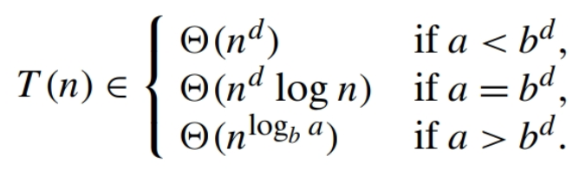
Exercise
Assume that we have a divide and conquer algorithm with three numbers like this:
  a = 4, b = 2, d = 2.
Present the time complexity of the algorithm.
  This is the Master Theorem for your reference.

Slide 14
Master Theorem
So far, we talk about the Master Theorem briefly.
Read the following document to get the basic idea of the theorem more formally.
  https://goo.gl/zktCvU

Slide 15
Exercise
Assume that we have a divide and conquer algorithm with the recurrence relation like below
  T(n) = 2*T(n/2) + 5*n³+7*n
Present the time complexity of the algorithm.
Do not see the answer immediately on the next page.

Slide 16
Solution
The answer is Θ(n³).
  It’s obvious that a is 2 and b is 2.
  Since the time for dividing and combining is 5*n³+7*n, d should be 3.
  Because a is 2, b is 2, and d is 3, we know that it’s the first case of the Master Theorem .

Slide 17
<<< Course Instruction >>>
Read pages 169-171 of the textbook.
  Basic concept of divide-and-conquer must be clearly understood.
  Master theorem is very useful to analyze the time efficiency of divide-and-conquer algorithms. You should be able to use it to get the time complexity of a divide-and-conquer algorithm.

Slide 18
Puzzle: Predicting a Finger Count
A little girl counts from 1 to 1000 using the fingers of her left hand as follows.
  She starts by calling her thumb 1, the first finger 2, middle finger 3, ring finger 4, and little finger 5.
  Then she reverses direction, calling the ring finger 6, middle finger 7, the first finger 8, and her thumb 9, after which she calls her first finger 10, and so on.
If she continues to count in this manner (to 1000), on which finger will she stop?

Slide 19
Important Note
Do not see the answer immediately on the next page.
Hint
  Reenact the girl’s count long enough to see a pattern that makes the answer obvious.

Slide 20
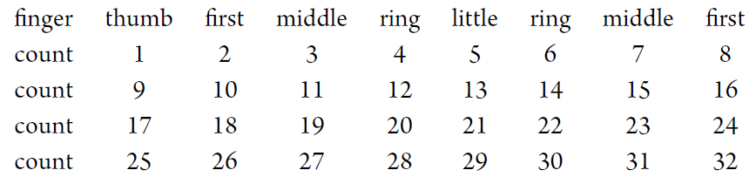
Solution
She will stop on her first finger.
Here is how the finger count starts:
It is easy to see that the counting falls on the same finger every eighth number called. Therefore to answer the question, all one needs is to find the remainder of the division of 1000 by 8, which is equal to 0.
This implies that when the girl reaches 1000, she will be on her first finger (moving from the middle finger), the same one she will be on while calling any number divisible by 8.

Slide 21
<<< Course Instruction >>>
This lecture is over.
  The deadline of homework 4 is Tuesday, May 19 at 11:55 pm.
  Next week's lecture notes (= week five) will be available on May 20 (Wed) around 10:00(AM).
Note that there’s a midterm on May 23 (Sat) from 10:00(AM) to 12:30(PM).

