Slide 1
Week 5 (1) – Merge Sort
CST370 – Design & Analysis of Algorithms
Dr. Byun
Computer Science

Slide 2
Lecture Objectives
After completion of this lecture, you will be able to
  use the divide-and-conquer technique to perform the merge sort.
  partition n numbers in an array into two groups with negative numbers and positive numbers.

Slide 3
Chapter 5: Divide-and-Conquer
5.1 Mergesort
5.2 Quicksort
5.3 Binary Tree Traversals and Related Properties
5.4 Multiplication of Large Integers and Strassen’s Matrix Multiplication
5.5 The Closest-Pair and Convex-Hull Problems by Divide-and-Conquer

Slide 4
Question – Merging Two Sorted Arrays
Assume that you have two sorted arrays like below
  1st array: 23, 47, 50, 81, 95
  2nd array: 7, 14, 39, 56, 62, 74
How will you merge them to create a sorted array like below?
  Final array: 7, 14, 23, 39, 47, 50, 6, 62, 74, 81, 95
Think about your idea and then move to the next slide.

Slide 5
Merging Two Sorted Arrays
To get the basic idea of merging two sorted arrays, watch this video from the beginning to 2:34.
  http://y2u.be/GCae1WNvnZM
  Note that the video also present the basic idea of merge sort.

Slide 6
Merge Sort – Basic Idea
Watch this video first
  https://youtu.be/WMaH0-G4G4A
Merge sort uses the divide and conquer technique.
  Split an array A[0..n-1] into two halves and make copies of each half to the arrays B and C.
  Sort the arrays B and C recursively.
  Merge B and C into A.

Slide 7
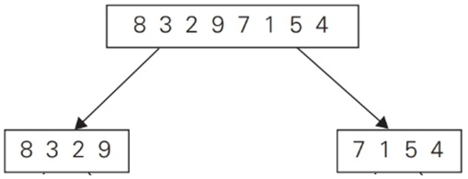
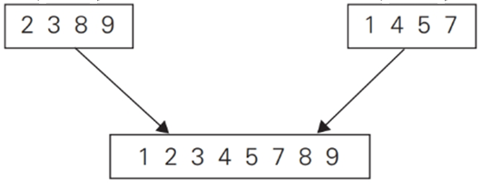
Merge Sort – Example (1 of 2)
Solve the first subproblem recursively.
Solve the second subproblem recursively.

Slide 8
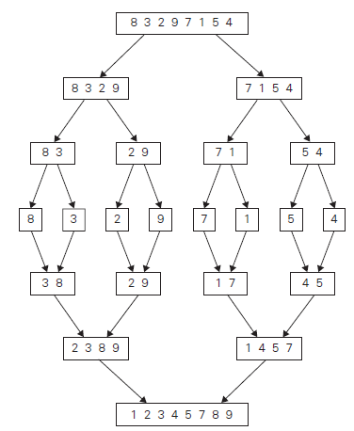
Merge Sort – Example (2 of 2)

Slide 9
<<< Course Instruction >>>
Read pages 172-174 of the textbook.
  You should clearly understand the divide-and-conquer operation of the merge sort.
  You should also know how you can apply the Master Theorem to identify the time efficiency of the merge sort algorithm.

Slide 10
Exercise
Assume that you have a list of numbers “5 3 1 9 8 2 4 7”
  Draw a merge sorting operation for the list, as shown in Figure 5.2 of the textbook.
Do not see the answer immediately.
  Try to draw it by yourself.

Slide 11
Exercise Solution (1 of 2)
5 3 1 9 8 2 4 7
5 3 1 9
8 2 4 7
5 3
1 9
8 2
4 7
5
3
1
9
8
2
4
7

Slide 12
Exercise Solution (2 of 2)
5
3
1
9
8
2
4
7
3 5
1 9
2 8
4 7
1 3 5 9
2 4 7 8
1 2 3 4 5 7 8 9

Slide 13
Puzzle: Partition Numbers
Suppose you have an array with n numbers with negative and positive numbers mixed.
  Present an idea of putting all negative numbers in front of the positive numbers in the array.
Example
  Input: 8, -7, -4, 5, 4, -3, 9, 1, -5, -1
  Output: -7, -4, -1, -5, -3, 9, 1, 8, 5, 4
  // The output in the example is one possible result of
  // many other possibilities.
  // The important thing is that all negative numbers
  // must come first, and then all positive numbers
  // should follow them.

Slide 14
Important Note
Do not immediately see the answer on the next page.
Hint
  There may be several different ideas to solve the puzzle.
  Think of a very efficient idea in terms of speed and memory.

Slide 15
Possible Solutions
Sorting
  As a simple approach, you can sort the input array.
  However, this approach requires O(n*logn) time complexity for the sorting.
Prepare an extra array and put negative numbers up from the first index and positive numbers down from the last index.
  This approach requires O(n) time complexity.
  But it requires an extra array.

Slide 16
Best Solution
Read the following document for O(n) time complexity without an extra array.
  https://bit.ly/3cvxh0m
  In fact, this is the basic idea of the quick sort algorithm which we’ll cover later.

Slide 17
<<< Course Instruction >>>
This lecture is over.
  When you are done, study the next lecture (week_5_2.ppt) on the iLearn.

