Slide 1
Week 6 (4) – Topological Sorting
CST370 – Design & Analysis of Algorithms
Dr. Byun
Computer Science

Slide 2
Lecture Objectives
After completion of this lecture, you will be able to
  perform the topological sorting to a directed acyclic graph (DAG) using Kahn’s algorithm.

Slide 3
Chapter 4: Decrease-and-Conquer
4.1 Insertion Sort
4.2 Topological Sorting
4.3 Algorithms for Generating Combinatorial Objects
4.4 Decrease-by-a-Constant-Factor Algorithms
4.5 Variable-Size-Decrease Algorithms

Slide 4
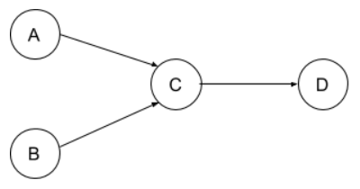
Topological Ordering
Watch this video first
  https://youtu.be/Sf3aEzNHuEE
A topological ordering (or topological sort) of a directed graph is a linear ordering of its vertices.
  For every edge from vertex u to vertex v, u should come before v in the ordering.
Example

Slide 5
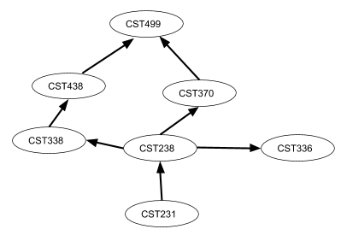
Topological Ordering – Another Example
Assume that you should take the following courses to get a CS degree.
  In which order should you take them?

Slide 6
<<< Course Instruction >>>
Study the document named “Introduction to Topological Sorting” at
  https://goo.gl/JfuYWU
This document introduces the definition of topological ordering of a directed graph called DAG.
  Then, it explains an algorithm to get the topological order using a source removal approach.

Slide 7
Exercise
Is this a DAG?
  Note that there are five vertices (= A, B, C, D, E) in the graph.
Do not see the answer immediately.
  Try to solve it by yourself.
  If you are not sure, remember that a DAG is a directed graph without cycles.
B
E
C
A
D

Slide 8
Solution
Yes, it’s a DAG because there’s no cycle in the graph.
  Note that there are five vertices (= {A, B, C, D, E}) and four edges (= {(A,B), (A,C), (B,C), (D,E)} in the graph.
B
E
C
A
D

Slide 9
Exercise
Present the topological ordering of the following graph using the source removal algorithm.
Do not see the answer immediately.
  Try to solve it by yourself.
B
E
C
A
D

Slide 10
Solution
B
E
C
A
D
A is a source vertex in the graph.
  So, the topological ordering is A→ B → D → C → E.

Slide 11
Kahn’s Algorithm (1 of 2)
Kahn’s algorithm finds a topological order using the source removal approach.
  It repeatedly identifies and removes a vertex with no incoming edges.
Reference
  https://www.geeksforgeeks.org/topological-sorting-indegree-based-solution/

Slide 12
Kahn’s Algorithm (2 of 2)
This is basic operation of Kahn’s algorithm.
  Calculate the “in-degree” of each vertex.
  Push the vertices with “in-degree” zero into a queue.
  Remove a vertex from the queue.
    Decrease “in-degree” by 1 for its neighboring vertices.
    If the “in-degree” of a neighboring vertex is reduced to zero, add the vertex to the queue.
  Repeat the above step until the queue is empty.

Slide 13
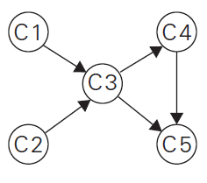
Example
Watch this video first
  https://youtu.be/2-W9RKf6wEM
C1
C2
C3
C4
C5
“in-degree”
Queue:

Slide 14
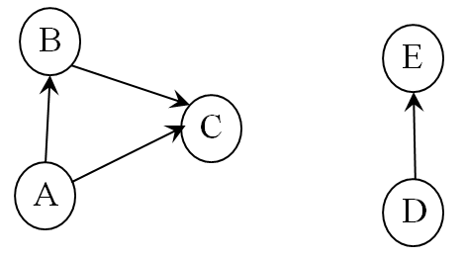
Exercise
Present the topological ordering of the following graph using the Kahn’s algorithm.
Do not see the answer immediately.
  Try to solve it by yourself.

Slide 15
Solution
A
0
B
1
C
2
D
0
E
1
Initial value of
“in-degree”
The queue sequence will be like below
  Queue: A, D, B, E, C
  Thus, the topological ordering is A → D → B → E → C

Slide 16
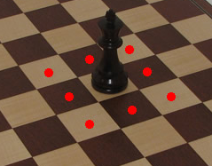
Puzzle: A King’s Reach (1 of 2)
In the chess game, a king piece can move to a horizontally, vertically, or diagonally adjacent square.
  For example, a king piece can move from a position to eight different squares as shown below.
http://www.chessusa.com/chess-rules.html

Slide 17
Puzzle: A King’s Reach (2 of 2)
Suppose there is an infinite chessboard and a king piece is in the center.
  Then, how many different squares can the king stay after n moves?

Slide 18
Important Note
Do not immediately see the answer on the next page.
Hints
  “n moves” is too large. Decrease the size to a smaller number.
  We know that after 1 move, the king can stay in 8 different squares.
  How about after 2 moves? This is a critical step to solve this puzzle.
  Note that a king piece can visit the same square more than once.

Slide 19

Solution (1 of 4)
For n is 1, a king can stay 8 different squares.
  See the following diagram where the king begins to move in the center.
  The king can not go back to the starting square after 1 move.
X
X
X
X
X
X
X
X

Slide 20
Solution (2 of 4)
For n is 2, the king can stay 25 different squares.
  See the following diagram where the king begins to move in the center.
  The king can go back to the starting square after 2 moves.
X
X
X
X
X
X
X
X
X
X
X
X
X
X
X
X
X
X
X
X
X
X
X
X
X

Slide 21
Solution (3 of 4)
For n is 3, the king can stay 49 different squares.
  See the following diagram where the king begins to move in the center.
X
X
X
X
X
X
X
X
X
X
X
X
X
X
X
X
X
X
X
X
X
X
X
X
X
X
X
X
X
X
X
X
X
X
X
X
X
X
X
X
X
X
X
X
X
X
X
X
X

Slide 22
Solution (4 of 4)
Based on the results of n = 1, 2, and 3, we can infer the following formula:
  (2*n + 1)² for n > 1
  8 for n = 1.

Slide 23
<<< Course Instruction >>>
This lecture is over.
  When you are done, study the next lesson (week_6_5.ppt) on the iLearn.

