Slide 1
Week 1 (1) – Orientation and Course Overview
CST370 – Design & Analysis of Algorithms
YoungJoon Byun
Computer Science

Slide 2
Lecture Objectives
After completion of this lecture, you will be able to
  identify general policy of the course.
  understand how to submit a sample homework assignment on the iLearn.

Slide 3
Course Information
Course number and title
  CST 370: Design and Analysis of Algorithms
Credits: 4.0
Prerequisites
  CST 238 or instructor's consent
Refer to Course Syllabus for details
  http://ilearn.csumb.edu

Slide 4
Instructor
YoungJoon Byun, Ph.D.
Email: ybyun@csumb.edu
Phone: (831)582-3602
Zoom
  https://csumb.zoom.us/j/4457737239
Office hours
  Monday: 5:00P – 6:00P (through zoom)
  Thursday: 4:30P – 5:30P (through zoom)

Slide 5
TA
Name: Andy Kor
Email: akor@csumb.edu
Zoom
  https://csumb.zoom.us/j/5899432988
Office Hours: TBA (To Be Announced)

Slide 6
Email Contact
Email is always welcome.
  Put [Online370] at the beginning of subject line
Sample
  To: ybyun@csumb.edu
  Subject: [Online370] Homework1 solution?
  Content:
  Dr. Byun,
  At the class, you said that you posted the solution of homework 1 on the iLearn. But I can’t find it. Where is the solution?
  [Your name]

Slide 7
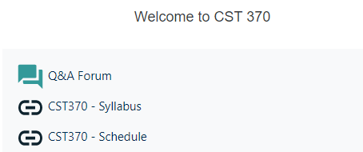
Course Web Site
http://iLearn.csumb.edu/
  Additional course information and announcements will be posted here.
  If you have something to announce or share with all students, post it in the “Q&A Forum”.
Notes:
Tour of web site!

Slide 8

Required Textbook
Author: Anany Levitin
Title: Introduction to the Design and Analysis of Algorithms, 3rd Edition
Publisher: Addison Wesley, 2011
ISBN-13: 978-0-13-300136-5
  (This is eTextBook. But a paper book is also fine.)

Slide 9
Main Objectives
Acquire algorithm design techniques
  Brute force
  Divide-and-conquer
  Greedy method
  etc.
Learn important data structures
  Hash, heap, tree, graph, etc.
Analyze efficiency of algorithms
Notes:
80X86 means

Slide 10
Main Topics
Review of fundamental data structures
Analysis of algorithm efficiency
Brute-force algorithm design technique
Divide-and-conquer
Decrease-and-conquer
Transform-and-conquer
Space and time tradeoffs
Graph algorithms
Dynamic programming
Greedy method
Advanced topics, if time permitted

Slide 11
Class ID Number
To process the homework and exam more efficiently, we require you to choose your class ID number.
  The number can be a four-digit integer number.
  We will use the number for only the class.
  If there are duplicated numbers chosen by two students, I will ask a student to choose a different number.

Slide 12
<<< Course Instruction >>>
Send an email to me (ybyun@csumb.edu) with your class ID number by April 27 (Monday), 11:55(PM).

Slide 13
Exams
Midterm
  May 23 (Sat), 10:00(AM) ~ 12:30(PM).
Final exam
  June 20 (Sat), 10:00(AM) ~ 12:30(PM).
Mark your calendar.
Details will be provided later.

Slide 14
Homework
Problem solving and programming will be assigned throughout the semester.
No late submission will be accepted.
Details will be explained later.

Slide 15
Grading Policy
Grade
A+ | 100 | 94 ≥
A | 94 < | 90 ≥
A- | 90 < | 87 ≥
B+ | 87 < | 84 ≥
B | 84 < | 80 ≥
B- | 80 < | 77 ≥
C+ | 77 < | 73 ≥
C | 73 < | 67 ≥
D | 67 < | 57 ≥
F | 57 < | 0
Midterm | 20%
Final Exam | 20%
Homework | 60%
D is a passing grade, but F is not a passing grade.

Slide 16
Overall Course Schedule
Refer to the course schedule on the iLearn.

Slide 17
Note to Students with Disabilities
Students with disabilities who may need accommodations
  Please see me as soon as possible during the office hour or make an appointment
Also, contact:
  Student_Disability_Resources@csumb.edu
  Building 47, Student Services, First Floor
  Phone: 831/582-3672 voice, or 582-4024 fax/TTY
  http://csumb.edu/sdr

Slide 18
Academic Integrity Policy
Cheating of any kind will not be tolerated.
  You are responsible for your own original work on all assignments, homework, quizzes, exams, and all programming code.
  Two or more students who submit extremely similar code will receive a zero score on the assignment.
  Furthermore, the students will be reported to the academic dishonesty board.
  There are continual checks of the assignments to be sure that everyone is handing in original code.
  https://csumb.edu/policy/academic-integrity-policy

Slide 19
Study Guide
Start from my power point file.
  There will be several videos and Google docs in the file.
  If there’s a “Watch the video first”, “<<< Course Instruction >>>”, or “Exercise” in the file, follow the instruction on the slide.

Slide 20
“Video” Example
Watch the video first
  https://youtu.be/qU_pPObygz8
An algorithm is a sequence of unambiguous instructions for solving a problem, i.e., for obtaining a required output for any legitimate input in a finite amount of time.

Slide 21
“<<< Course Instruction >>>” Example
Before proceeding to the next slide, read from the page 1 through the page 7 of our textbook.
  Even if you don't understand some parts of the textbook, read it first.
  After that, go to the next slide.

Slide 22
“Exercise” Example
Calculate the gcd (40, 56) using the Euclid’s algorithm.
  // Do not move directly to the next slide.
  // First, solve this problem yourself.
  // Then, compare your answer with the solution
  // on the next slide.

Slide 23
Algorithmic Puzzles
In the course, we will talk about a few algorithmic puzzles that are interesting problems related to algorithms.
  They are important parts of our lectures.
  Also, the puzzles are frequently mentioned at a technical job interview.

Slide 24
A River Crossing Puzzle
A farmer finds himself on a riverbank with a wolf, a goat, and a head of cabbage.
  He needs to transport all three to the other side of the river in his boat.
  However, the boat has room for only the farmer himself and one other item (either the wolf, the goat, or the cabbage). In his absence, the wolf would eat the goat, and the goat would eat the cabbage.
  Solve this problem for the farmer or prove it has no solution.

Slide 25
Solution

Slide 26
River Crossing Puzzle: Advanced Version
There are four people who want to cross a bridge. You have 17 minutes to get them all across to the other side.
  It is night, and they have one flashlight.
  A maximum of two people can cross the bridge at one time. Any party that crosses must have the flashlight with them.
  Person A takes 1 minute to cross the bridge, person B takes 2 minutes, person C takes 5 minutes, and person D takes 10 minutes.
  A pair must walk together at the rate of the slower person’s pace. For example, if person A and person D walk across together, it will take 10 minutes to get to the other side of the bridge.

Slide 27
Solution

Slide 28
Sample Homework
Typically, a homework assignment will be composed of a problem solving part and a programming part.
As a sample, go to “Homework 0” on the iLearn
  Download the “hw0.doc” file in “Homework 0” and read it carefully to understand the general structure of the homework in CST370.

Slide 29
Problem Solving Questions
Example question
  In CST370, there will be three exams (= two midterms and one final exam) in the class. (True/False)
Write your answer to the problem solving questions on a PDF file.
  Then, submit it on the iLearn.
  Don’t forget to write your name and class ID at the top of your homework document.

Slide 30
Homework Programming Part
In the class, I will use C++ as a main language for teaching purpose.
However, you can use either C++ or Java for the homework programming.

Slide 31
Programming Part
Example: hw0_1.cpp (or hw0_1.java) should read input data from an end user and display the correct result on the screen.
Sample run
  Input
    1 1 2
    1 -5 -9
    9
  Output
    3
    -14

Slide 32
Programming Steps for Homework
Read the homework description carefully
Develop the program using your favorite software development tool.
Test at hackerrank.com
Submit your code on the iLearn

Slide 33
repl.it
You can use any software tool(s) for your programming.
For the teaching purpose, I will use repl.it in the course.
  If you want to use it, go to https://repl.it and create an account.
Example repl
  https://repl.it/@YBYUN/HelloCST370

Slide 34
Test at hackerrank.com (1 of 9)
After you finish the development at your software tool, go to the HackerRank.com to test your program to all test cases of the assignment.
This is a link for the homework 0.
  https://www.hackerrank.com/cst370-su20-hw0

Slide 35
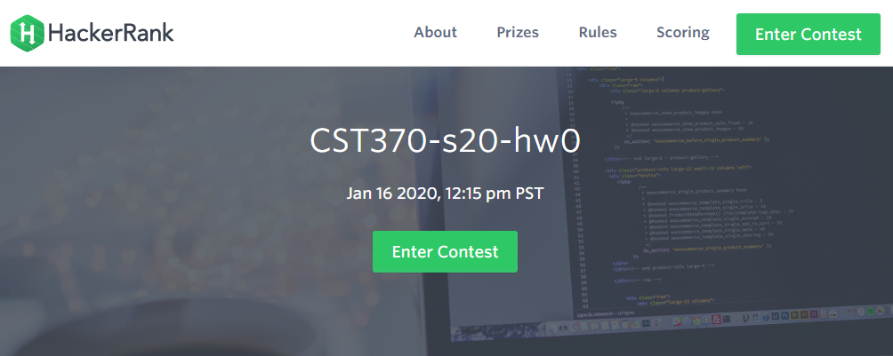
Test at hackerrank.com (2 of 9)
https://www.hackerrank.com/cst370-su20-hw0

Slide 36
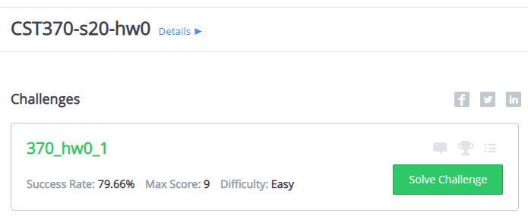
Test at hackerrank.com (3 of 9)

Slide 37
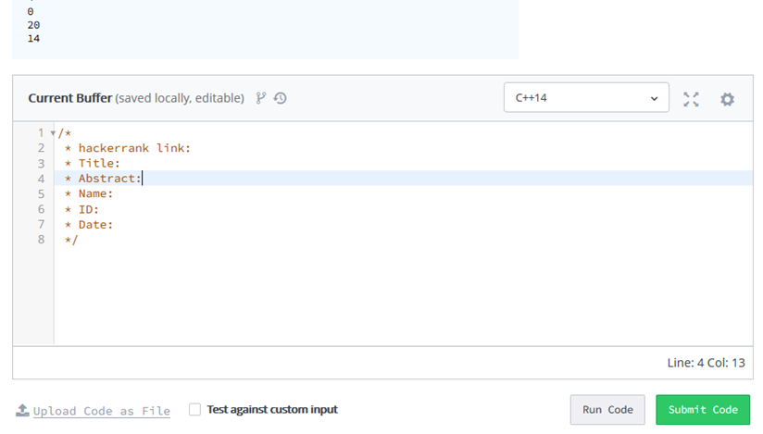
Test at hackerrank.com (4 of 9)

Slide 38
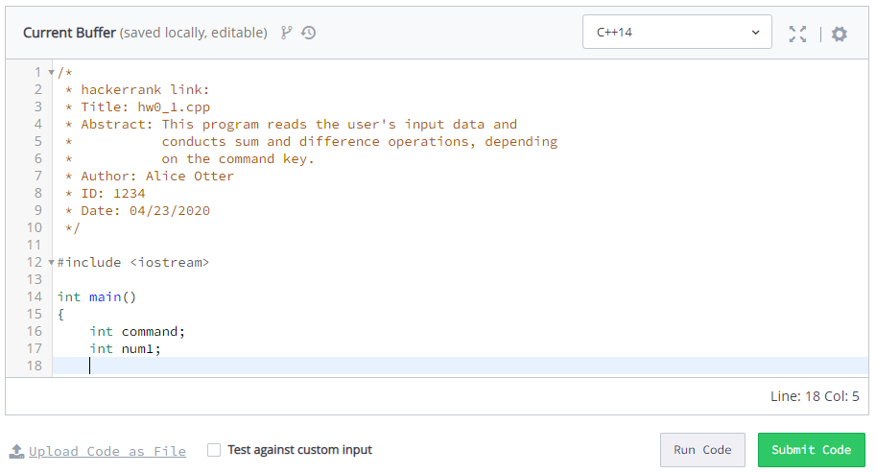
Test at hackerrank.com (5 of 9)

Slide 39
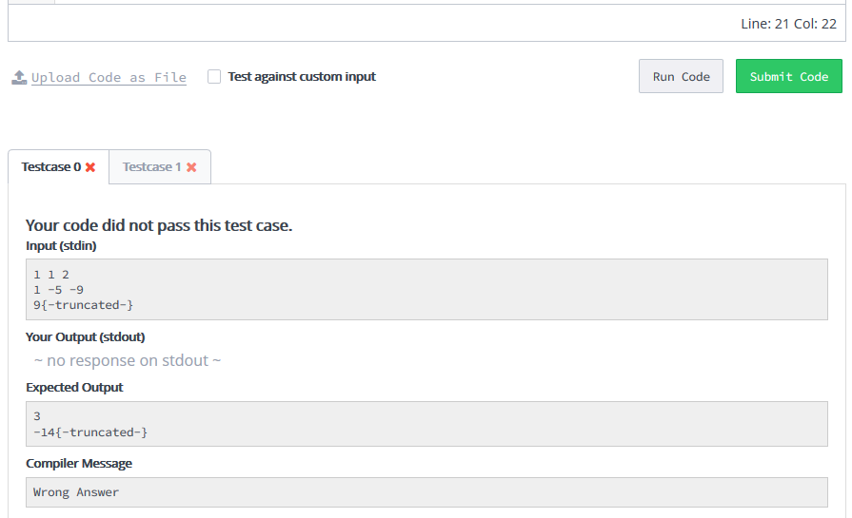
Test at hackerrank.com (6 of 9)

Slide 40
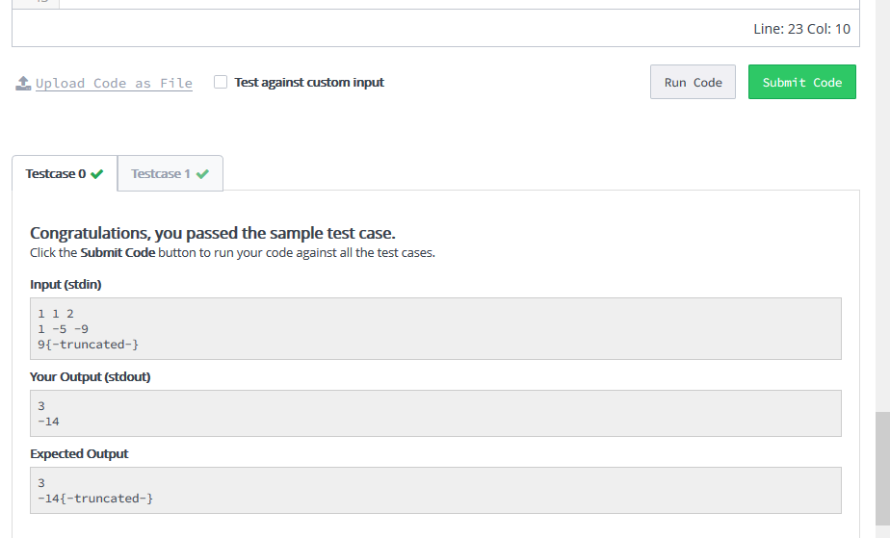
Test at hackerrank.com (7 of 9)

Slide 41
Test at hackerrank.com (8 of 9)

Slide 42
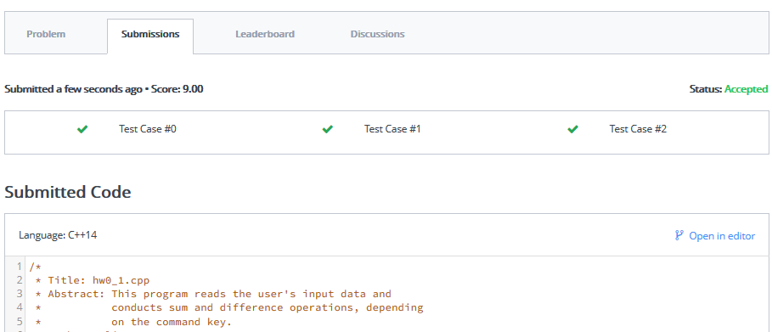
Test at hackerrank.com (9 of 9)

Slide 43
Submit your code on the iLearn
After finishing the test at hackerrank.com, submit your source code on the iLearn.
  In the source code, you have to include the hackerrank link of your code.
  And also, you should include the head comment such as “Title”, “Abstract”, “ID”, “Name”, and “Date”.

Slide 44
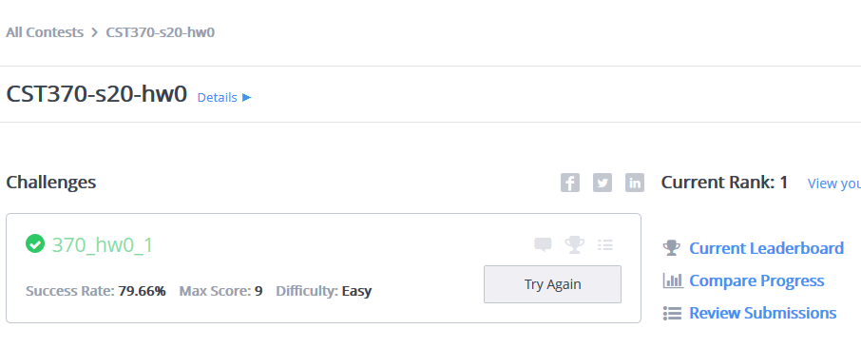
hackerrank link of your source code (1 of 4)

Slide 45
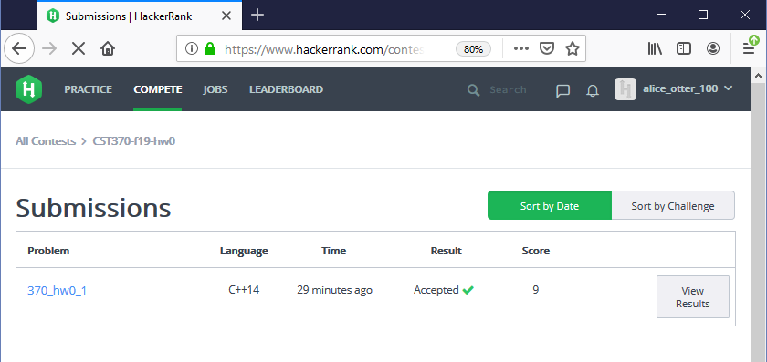
hackerrank link of your source code (2 of 4)

Slide 46
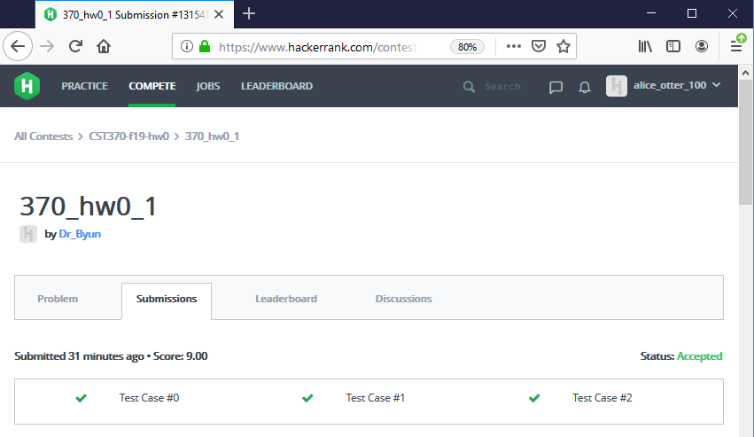
hackerrank link of your source code (3 of 4)

Slide 47
hackerrank link of your source code (4 of 4)
The link will look like this:
  https://www.hackerrank.com/contests/
  cst370-su20-hw0/challenges/370-hw0-1/
  submissions/code/1315417852
Don’t forget to include this link in your source code.
  You will get a lot of penalty if you miss it.
Also, include the head comment.
  You will get the penalty for this as well.

Slide 48
Sample Program of the iLearn Submission
/*
* HackerRank link: https://www.hackerrank.com/contests/cst370-su20-hw0/challenges/370-hw0-1/submissions/code/1315408386
* Title: hw0_1.cpp
* Abstract: This program reads the user's input data and
* conducts sum and difference operations, depending
* on the command key.
* Author: Bob Otter
* ID: 8899
* Date: 04/23/2020
*/
#include <iostream>
using namespace std;
int main()
{
cout << "Hello World!\n";
return 0;
}

Slide 49
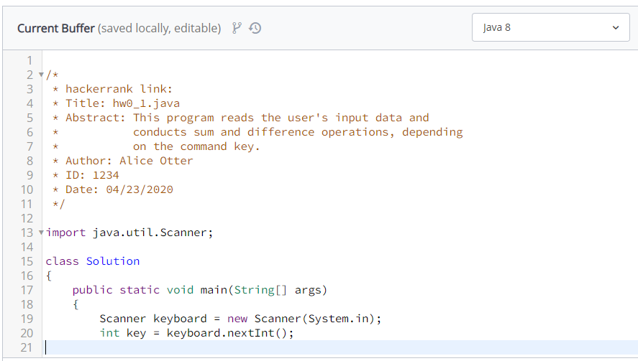
Java Code Test at hackerrank.com

Slide 50
Homework Submission Summary
Write your answer to the problem solving questions on a PDF file.
For the programming, submit your C++ or Java source files.
  Pay attention to the file name (e.g., hw0_1.cpp).
  Don’t forget the hackerrank link and head comment.
Due is 11:55(PM).
  Submit it early.

Slide 51
<<< Course Instruction >>>
This is the end of orientation.
  Please let me know if there is anything you don't understand in the orientation.
After this lecture, study the next lecture (week_1_2.ppt) on the iLearn.
  Don't forget that the due of homework 1 is April 29 (Wed) (11:55 PM).

