Slide 1
Week 2 (2) – Fundamental Data Structures
CST370 – Design & Analysis of Algorithms
Dr. Byun
Computer Science

Slide 2
Lecture Objectives
After completion of this lecture, you will be able to
  recall the important linear data structures such as an array and a linked list.
  explain basic terminologies of a graph and represent it using two different representations.

Slide 3
Chapter 1: Introduction
1.1 What is an Algorithm?
1.2 Fundamentals of Algorithmic Problem Solving
1.3 Important Problem Types
1.4 Fundamental Data Structures

Slide 4
<<< Course Instruction >>>
Before moving on to the next slide, read page 25 – 28 (before "graph") of the textbook.
  In this section, you will review the basic linear data structures such as an array, a linked list (= singly linked list and doubly linked list), a stack, and a queue.
  Because you already took a data structures course before, this topic will be straightforward.

Slide 5
Introduction to Graphs
Watch the video first
  https://youtu.be/2HPgDfJDSBY
A graph is composed of nodes (= vertices) and lines (= edges).
  They are used for modeling many real-life applications such as transportation, communication networks, project scheduling, etc.
Example
CHI
Paris
SFO
JFK
LAX

Slide 6
Graph Example: Undirected Graph
B
A
C
D
The graph has 4 vertices and 5 undirected edges.
  V = {A, B, C, D }
  E = {(A, B), (A, D), (B, C), (B, D ), (C, D)}

Slide 7
Graph Example: Directed Graph
B
A
C
D
The graph has 4 vertices and 5 directed edges.
  V = {A, B, C, D }
  E = {(B, A), (B, C), (B, D), (C, B ), (C, D)}

Slide 8
Graph Representation: Adjacency Matrix
Example
B
A
C
D
Graph
Adjacency Matrix

Slide 9
Graph Representation: Adjacency List
Example
B
A
C
D
Graph
Adjacency List

Slide 10
<<< Course Instruction >>>
Read pages 28 – 30 (before “Weighted Graphs”) in the textbook before moving on to the next slide.
  Graphs are an important data structure in Computer Science.
  We will cover many different graph algorithms for the entire semester.

Slide 11
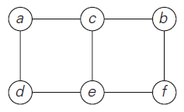
Graph Definition (1 of 2)
Formally, a graph G = <V,E> is defined by a pair of two sets: a finite nonempty set V of items called vertices and a set E of pairs of these items called edges.
Example: Undirected graph
  It has six vertices and seven undirected edges:
  V = {a, b, c, d, e, f }
  E = {(a, c), (a, d), (b, c), (b, f ), (c, e), (d, e), (e, f )}

Slide 12
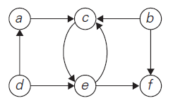
Graph Definition (2 of 2)
Example: Directed graph (or Digraph)
  It has six vertices and eight directed edges:
  V = {a, b, c, d, e, f }
  E = {(a, c), (b, c), (b, f ), (c, e), (d, a), (d, e), (e, c), (e, f )}

Slide 13
Question
Are the figure (i) and (ii) graphs?
a
a
b
c
b
c
(i)
(ii)

Slide 14
Answer
Both are graphs.
  Figure (i) has three vertices and two undirected edges:
  V = {a, b, c }
  E = {(a, b), (a, c)}
  Figure (ii) has three vertices and zero edges:
  V = {a, b, c }
  E = { }

Slide 15
Question
How about the figure (iii), (iv), and (v)?
  Are they graphs?
a
a
a
b
c
a
c
b
c
(iii)
(iv)
(v)

Slide 16
Answer
Figure (v) is a graph. But figure (iii) and (iv) are not graphs.
  Figure (iii) has duplicated edges:
  E = {(a, b), (a, b), (a, c)}
  Figure (iv) has duplicated vertices:
  V = {a, a, c }
  Since V and E are sets in the graph definition, they can’t have duplication.
  However, figure (v) is fine because the edge (a, b) and (b, a) indicate different edges in the directed graph.

Slide 17
<<< Course Instruction >>>
Conventionally, we enumerate a set’s elements using a non-decreasing order.
  For example, in the digraph on slide number 8, the sets V and E are shown as follows:
  V = {a, b, c, d, e, f }
  E = {(a, c), (b, c), (b, f ), (c, e), (d, a), (d, e), (e, c), (e, f )}
  When expressing these sets, the sequence is not important. However, we enumerate the elements in alphabetical order (from a to z) in this class.
  You must always follow this convention when you are doing homework or at exams.

Slide 18
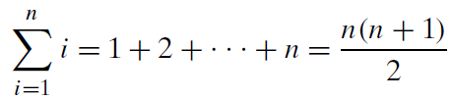
Useful Formula for the Analysis of Algorithms
Watch the video first
  https://youtu.be/qrvcWgdkGi8
You will use the following formula multiple times in the algorithm analysis.
  As a CS major, you must memorize this formula.
Example
  1 + 2 + … + 10 = (10*11)/2 = 55

Slide 19
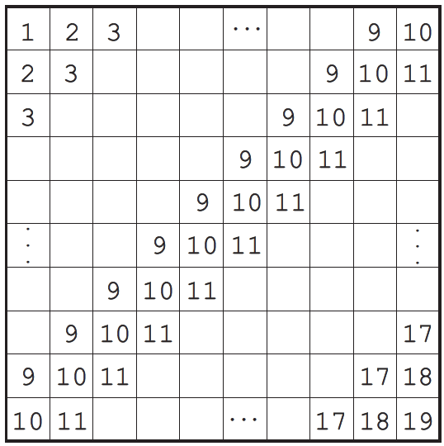
Puzzle: Add numbers in a table
A 10 × 10 table is filled with repeating numbers on its diagonals as shown below.
  Calculate the total sum of the table’s numbers.

Slide 20
Important Note
Do not see the answer immediately on the next page.
  Also do not use a calculator.
Hint
  It is not a good idea to add all the numbers one by one without a systematic approach.
  Remember the formula 1 + 2 + 3 + … + n.
  There are at least two different ways to calculate this sum efficiently.

Slide 21
Solution 1
You can compute the sum row by row (or column by column).
  The sum in the first row is equal to (10*11)/2 = 55.
  The sum of the numbers in second row is 55+10 since each of the numbers is larger by 1 than their counterparts in the row above.
  The same is true for all the other rows as well.
  Hence the total sum is equal to
  55+(55+10)+(55+20)+· · ·+ (55+90)
  = 55*10 + (10+20+· · ·+90)
  = 1000.

Slide 22
Solution 2
Another approach is based on the observation that the sum of any two numbers in the squares symmetric with respect to the diagonal connecting the lower left and upper right corners is equal to 20 such as “1 + 19”, “2 + 18”, “2 + 18”, and so on.
  Since there are (10*10 − 10)/2 = 45 such pairs (we subtracted the number of the squares on that diagonal from the total number of the squares), the sum of the numbers outside that diagonal is equal to 20*45 = 900. With 10*10 = 100 on the diagonal, the total sum is equal to 900 + 100 = 1000.

Slide 23

Remaining Topics in the Graph
Study the textbook to understand the following formula:
Also, understand the following terms:
  Complete graph
  Dense graph
  Sparse graph

Slide 24
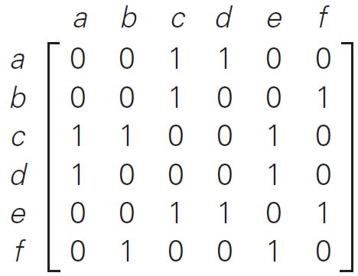
Graph Representation: Adjacency matrix
Example
Graph
Adjacency Matrix

Slide 25
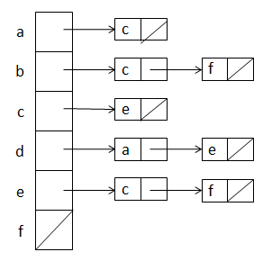
Graph Representation: Adjacency list
Example
Graph
Adjacency List

Slide 26
Exercise
Represent the following graph in adjacency matrix and adjacency list.
  Again, do not see the answer immediately. Try to solve it first.
a
b
c

Slide 27
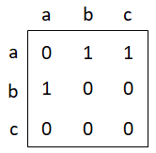
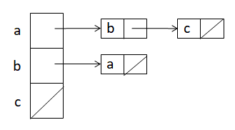
Solution
Adjacency Matrix
Adjacency List

Slide 28
<<< Course Instruction >>>
This lesson is over.
  If you do not understand any part in the lecture, study it again or ask it to the instructor.
When you are done, study the next lecture (week_2_3.ppt) on iLearn.

