Slide 1
Week 2 (3) – Fundamental Data Structures
CST370 – Design & Analysis of Algorithms
Dr. Byun
Computer Science

Slide 2
Lecture Objectives
After completion of this lecture, you will be able to
  understand the basic terminologies of weighted graphs and trees in computer science.

Slide 3
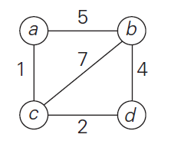
Weighted Graphs
Watch this video first
  https://youtu.be/9r2yyJgFQxU
A weighted undirected graph and a weighted directed graph are graphs with numbers (or cost) assigned to their edges.
Example

Slide 4
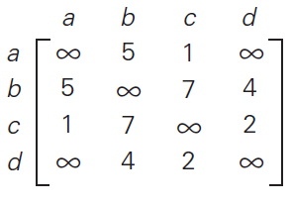
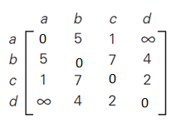
Weighted Graphs Representation –
Adjacency Matrix
➔
➔
// You can put 0’s on the main diagonal.

Slide 5
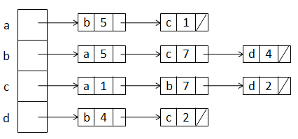
Weighted Graphs Representation –
Adjacency List
➔

Slide 6
<<< Course Instruction >>>
Read pages 30 – 31 (before “Trees”) in the textbook before moving on to the next slide.
  There are many terminologies of graphs in the section.
  Read the section carefully to get the accurate meaning of the terminologies.

Slide 7
Exercise
Represent the graph in adjacency matrix and adjacency list.
2
a
d
5
8
b
c
4

Slide 8
Important Note
Do not see the solution immediately on the next page.

Slide 9
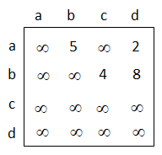
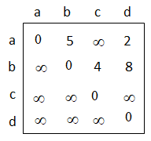
Solution (1 of 2)
Adjacency matrix
OR

Slide 10
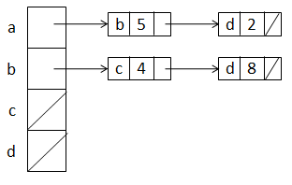
Solution (2 of 2)
Adjacency list
Note our convention of alphabetical order.
  For example, the vertex a has two edges to the vertexes b and d. When we represent it, we put the vertex b first and then put the vertex d.

Slide 11
Paths and Cycles
Recall the terminologies mentioned in the textbook such as
  Path
  Length
  Simple path
  Connected
  Connected component
  Cycle
  Acyclic graph

Slide 12
Question
Is the graph connected? No.
e
a
b
c
d

Slide 13
Question
Is the graph connected? Yes.
e
a
b
c
d

Slide 14
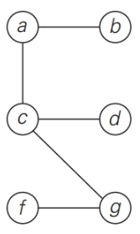
Trees
Watch this video first
  https://youtu.be/3n09brVylNI
Note that a tree is actually a graph (= connected acyclic graph).
Example

Slide 15
Free Tree, Rooted Tree, and Ordered Tree
There are several different trees in computer science theory such as (free) trees, rooted trees, and ordered trees.
  Our main interest in the class is the binary tree and binary search tree.
  However, it would be great for you to know the general terminologies of trees mentioned in the textbook as a computer scientist.

Slide 16
<<< Course Instruction >>>
Read pages 31 – 35 (before “Sets and Dictionaries”) in the textbook before moving on to the next slide.
  You don’t need to understand the “first child-next sibling representation” in the textbook page 35. If you want, you can skip that part.

Slide 17
Puzzle: Palindrome Checking
Let’s assume that you have a very long character array.
How can you determine if the character array is a palindrome or not?
  Of course, your algorithm should be efficient.
Example
  racecar // Yes, it’s a palindrome.
  abcdefghijihgfedcba // Yes, it’s a palindrome.
  CSUMB //No, it’s not a palindrome.

Slide 18
Important Note
Do not see the answer immediately on the next page.

Slide 19
Solution
You can use two indexes i and j.
  i starts from the index 0 (= first character).
  j starts from the index n-1 (= last character).
  Check the characters in the index i and j.
  If they are not the same, return false.
  Otherwise, i increases by 1 and j decreases by 1 and check again.
  This way, you can keep checking the characters of i and j until they meet.
  If they meet, the array is a palindrome.

Slide 20
<<< Course Instruction >>>
This lesson is over.
  If you do not understand any part in the lecture, study it again.
  Otherwise, start the “week_2_4.ppt” to study the next topic.

