Slide 1
Week 2 (4) – Analysis Framework
CST370 – Design & Analysis of Algorithms
Dr. Byun
Computer Science

Slide 2
Lecture Objectives
After completion of this lecture, you will be able to
  explain the concept of “orders of growth" or “categories of time complexities” for algorithm analysis.
  distinguish the difference between a general “operation” and a “basic operation” in the algorithm description.
  understand the difference between “best case analysis” and “worst case analysis”.

Slide 3
Chapter 2: Fundamentals of the Analysis of Algorithm Efficiency
2.1 The Analysis Framework
2.2 Asymptotic Notations and Basic Efficiency Classes
2.3 Mathematical Analysis of Nonrecursive Algorithms
2.4 Mathematical Analysis of Recursive Algorithms

Slide 4
Introduction to Algorithm Analysis
Watch this video first
  https://youtu.be/CR34s-PIT4k
Algorithm analysis is to determine the efficiency of an algorithm.
  It measures the amount of resources, typically time and memory, necessary to execute the algorithm.
Our main focus is time efficiency.
  It’s also called time complexity.

Slide 5
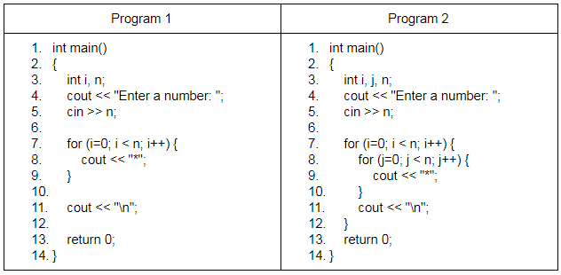
Two Sample Programs in C++
Which one looks fast and how much?
  Assume that n is a very big number.

Slide 6
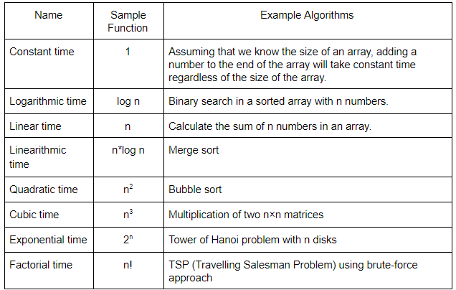
Eight Common Time Complexities

Slide 7
<<< Course Instruction >>>
Read the document named “Introduction to Algorithm Analysis” at
  https://goo.gl/VKeErt
In the document, you will learn three topics.
  Basic idea of algorithm analysis
  Concept of operations and basic operation
  Best case and worst case

Slide 8
Algorithm Analysis
Simply, algorithm analysis is to identify the category of an algorithm among eight categories.
Example
  Algorithm SequentialAdd (A[0..n-1])
  sum ← 0
  i ← 0
  while ( i < n ) do
  sum ← sum + A[i]
  i ← i + 1
  return sum

Slide 9
Operations and Basic Operation
“Operation” are all operations in the algorithm such as +, -, *, /,%, >, <, return, etc.
“Basic operation” is the most frequently performed operation among all operations.
Example
  Algorithm SequentialAdd (A[0..n-1])
  sum ← 0
  i ← 0
  while ( i < n ) do
  sum ← sum + A[i]
  i ← i + 1
  return sum

Slide 10
Worst-Case, Best-Case, and Average-Case Efficiencies
Some algorithms can have different execution times.
Example
  Search a number in an array.
When we analyze an algorithm, we sometimes need to consider the best-case, average-case, and worst-case separately.

Slide 11
<<< Course Instruction >>>
Again, read the document named “Introduction to Algorithm Analysis” at
  https://goo.gl/VKeErt
The concepts in the document will be used throughout the whole semester.
  So, you should understand the concepts clearly before moving to the next slides.

Slide 12
Exercise
Present the eight most popular time complexity categories in the algorithm analysis.
If your program takes n² and your classmate’s program takes n*log n, which program is faster?

Slide 13
Important Note
Do not see the answer immediately on the next page.

Slide 14
Solution
Eight most popular time complexity categories are
  1 (= constant), log n, n, n*log n, n², n³, 2^{n}, n!
For the second question, “n*log n” is faster than n²

Slide 15
Exercise
For the following pseudocode FindMax, identify operations and a basic operation.
  Algorithm FindMax (A[0..n-1])
  // Input: An array A from the index 0 to n-1
  // Output: Determine the max number in the array A
  maxvalue ← A[0]
  i ← 1
  while ( i < n ) do
  if (A[i] > maxvalue
  maxvalue ← A[i]
  i ← i + 1
  return maxvalue

Slide 16
Important Note
Do not see the answer immediately on the next page.
  To solve this exercise, you should know the difference between “operation” and “basic operation” in pseudocode.

Slide 17
Solution
Operation
  There are four operations (<, >, +, and return) in the pseudocode.
Basic operation
  Among the four operations, the < operation in the line number 6 is the basic operation.
  However, we can say that either > or + operation in the line number 7 and 9 can be the basic operation because the execution difference is very small.

Slide 18
Puzzle: Choosing Balls in the Dark
Suppose you have three jars, A, B, and C, in a room.
  Jar A has five large black balls, four large red balls, and two large green balls.
  Jar B has five small black balls, four small red balls, and two small green balls.
  Jar C is empty.
  Now you will pick some balls from the jars A and B in the dark and place them in the jar C. In other words, the color of the selected balls can’t be confirmed because the surroundings are dark. However, by touching with the hand, the size of the balls can be known by feeling.
  Once you're done, you can turn on the lights in the room and see the balls in the jar C.

Slide 19
Best Case Analysis
Assuming the best case occurs, what is the minimum number of balls you have to choose to get a matching pair?
  Here, a matching pair means that there must be one large ball and one small ball of the same color in the jar C. But the color itself of the pair is not important.
Hint: The answer is very obvious. Typically, best case analysis is simple and straightforward.

Slide 20
Solution
Best case: 2 balls.
  This is a lucky situation (or best case), so you can select one from each of the jars A and B to match.

Slide 21
Worst Case Analysis
Let's go back to the beginning of this puzzle.
Assuming the worst case occurs, what is the minimum number of balls you have to choose to get a matching pair?
  Again, the color of the pair itself is not important. However, one matching pair must be guaranteed.
This is a very challenging puzzle. Consider the worst case situation very carefully.

Slide 22
Important Note
Do not see the answer immediately on the next page.

Slide 23
Solution
Worst case: 11 balls.
  Note that the worst case means very unlucky situations keep happening when you pick balls.
  Thus, you should select 10 balls in the jar A to make sure that you have each color ball.
    In the very unlucky situation, you have to pick 10 balls because you could pick five large black balls, four large red balls, and one large green ball.
  After that, you need to pick just one ball from the jar B, which guarantees one matching pair even though it’s very unlucky situation.

Slide 24
<<< Course Instruction >>>
Note that this is an optional reading.
  Read pages 41 ~ 49 (before the last paragraph).
  This section is one of the most difficult and important section of the entire book.
  Even though the Google document (= https://goo.gl/VKeErt) is good enough for the class, read the textbook if you want more formal knowledge of the topic.

Slide 25
<<< Course Instruction >>>
This lecture is over.
  If you do not understand any part in the lecture, study it again.
When you are done, study the next lesson (week_2_5.ppt) in iLearn.

