Slide 1
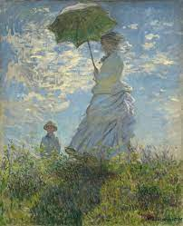
DCGAN: Application in Unsupervised Representation Learning
Tiancheng (Robert) Shi | COMS 4995 Final Project
Notes:
Woman with a Parasol (Monet)

Slide 2
Content Overview
Introductions
AI Art Paintings
Impressionism (Art Style)
Methods
Generative Adversarial Network
Deep Convolutional GAN
Experiments
Sample Results
Future Work
Demo

Slide 3
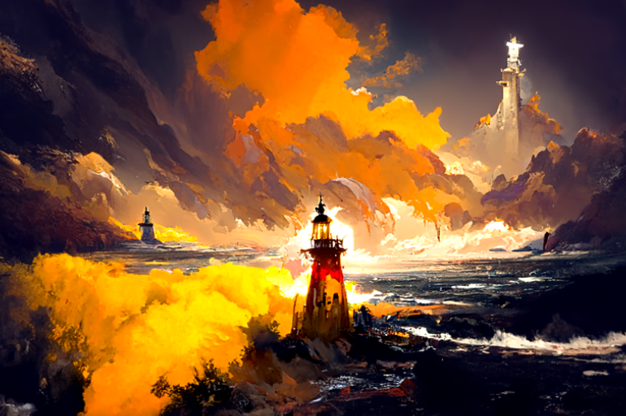
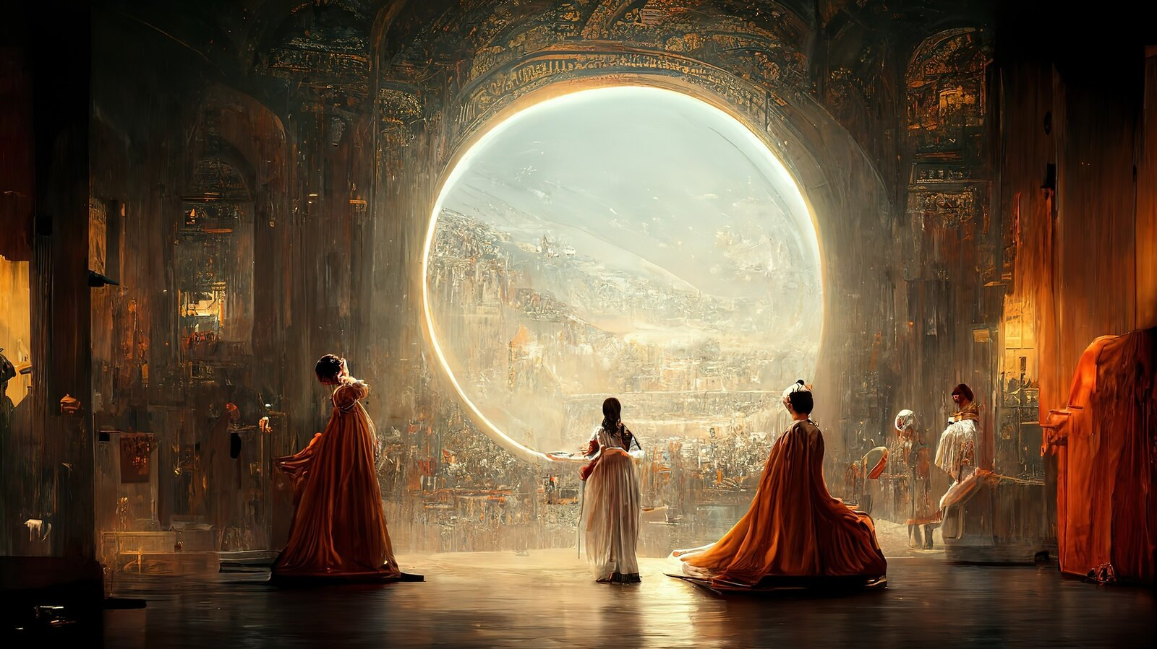
AI Image Generator
DALL-E 2 by OpenAI, Midjourney, Disco Diffusion, Wombo Dream, etc.
Disco Diffusion Midjourney

Slide 4
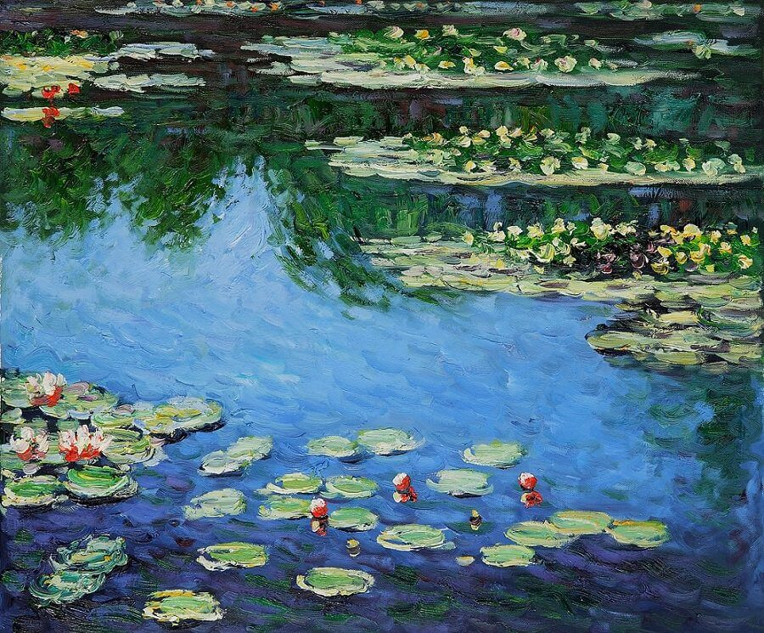
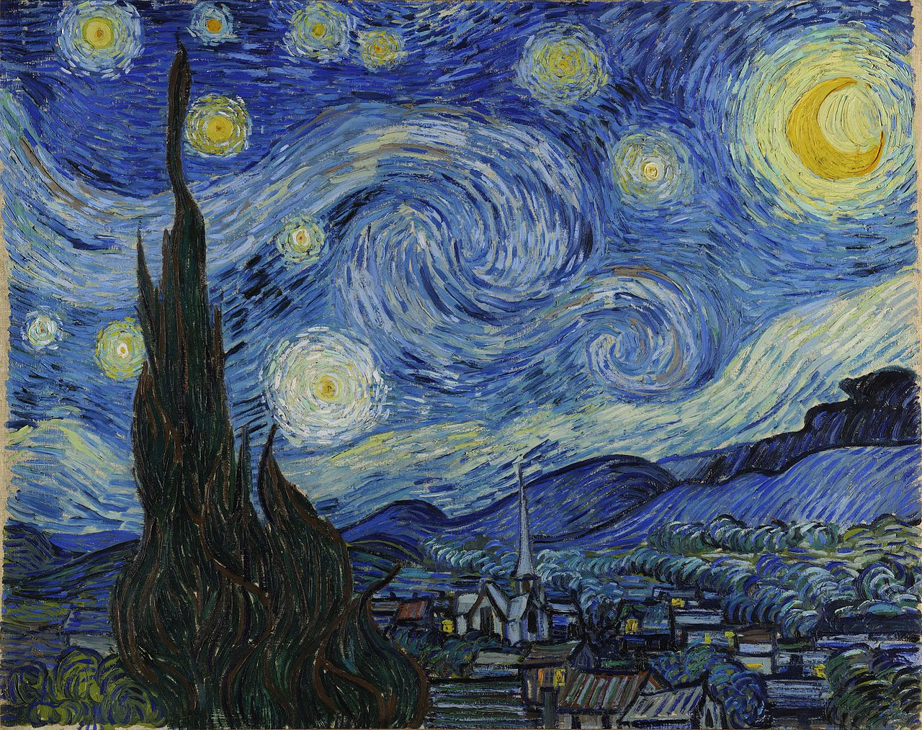
Impressionism
Prominence in 19th century, with characteristics including relatively small, thin, yet visible brush stroke; accurate depiction of light in its changing qualities; etc.
Water Lily (Monet) Starry Night (Van Gogh)
Notes:
Water Lily (Monet)
Starry Night (Van Gogh)

Slide 5
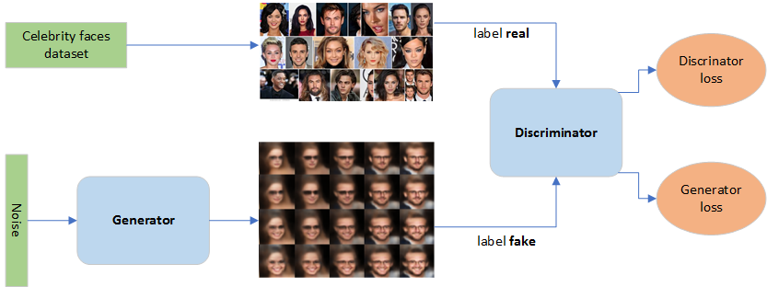
Generative Adversarial Network
Main Idea: 2 components work against each other (optimize in opposite directions)
Generator: Generating new data from a given noise (seed)
Discriminator: Classifying sources of given data – true distribution or generator
Notes:
https://towardsdatascience.com/generative-adversarial-network-gan-for-dummies-a-step-by-step-tutorial-fdefff170391

Slide 6
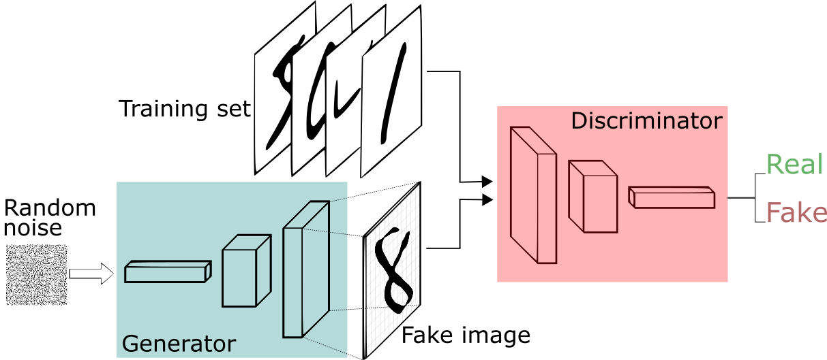
Deep Convolutional GAN
Main Idea: Using Convolutional and Transposed Convolutional layers (instead of FC)
Notes:
https://sthalles.github.io/intro-to-gans/

Slide 7
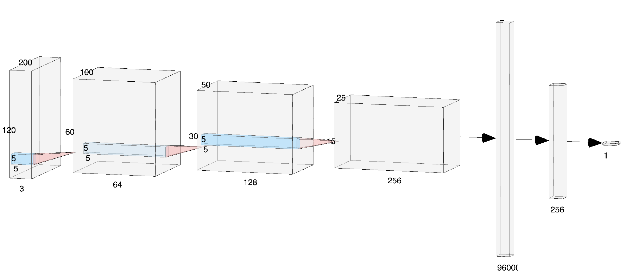
Architectures and Techniques
Convolution and Transposed Convolution layers instead of Dense layers
Convolution with stride 2 instead of Max Pooling
Batch Normalization everywhere (except for input and output layers)
ReLU activation in Generator and Leaky ReLU activation in Discriminator
Notes:
http://alexlenail.me/NN-SVG/AlexNet.html

Slide 8
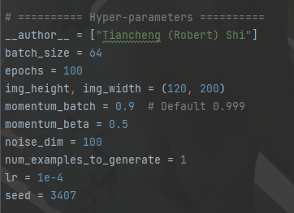
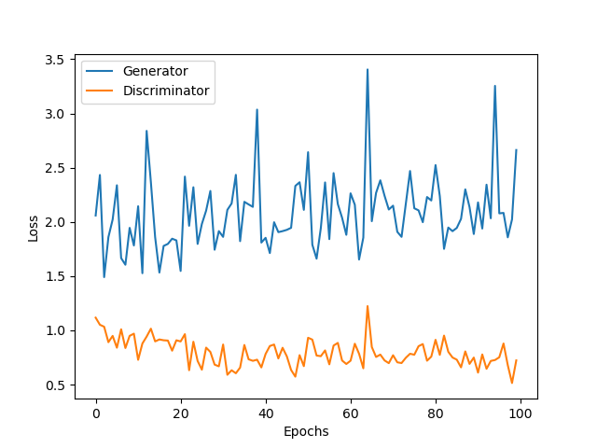
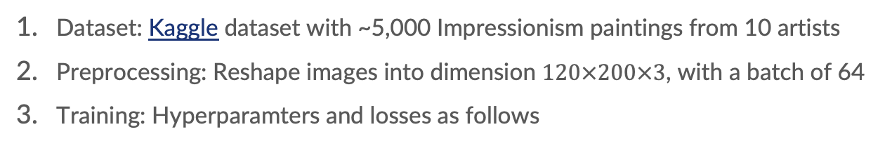
Training Session
Dataset: Kaggle dataset with ~5,000 Impressionism paintings from 10 artists
Preprocessing: Reshape images into dimension $120×200×3$, with a batch of 64
Training: Hyperparamters and losses as follows
Notes:
https://www.kaggle.com/datasets/delayedkarma/impressionist-classifier-data

Slide 9
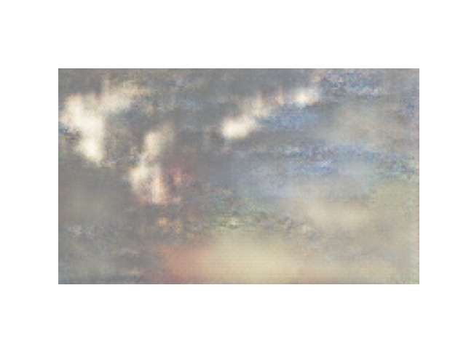
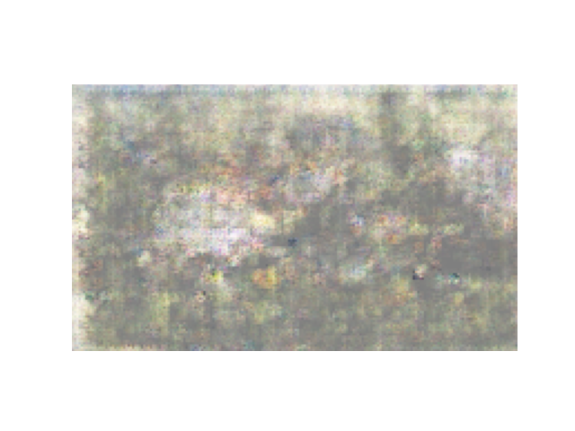
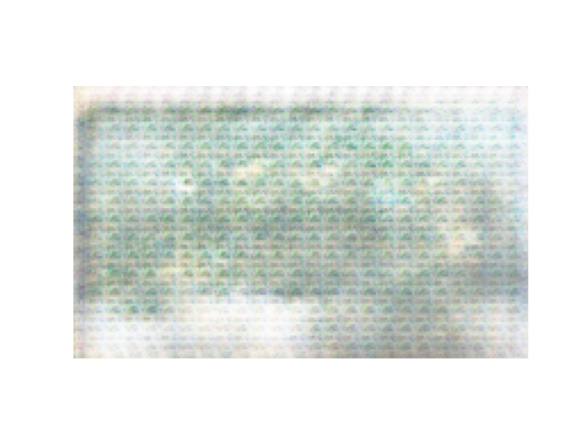
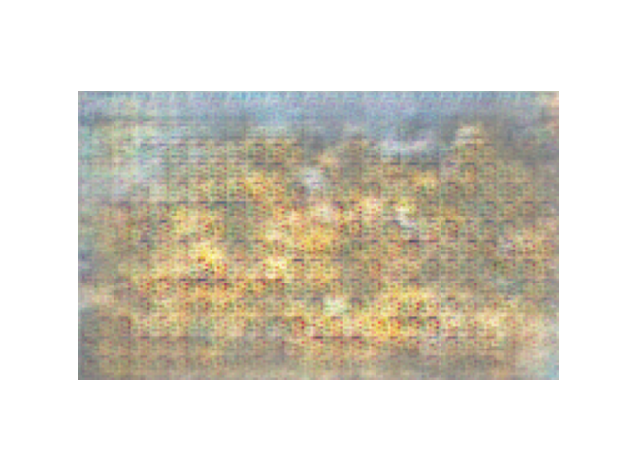
Sample Results
Water Lily?
Garden?
Window?
Farm?

Slide 10
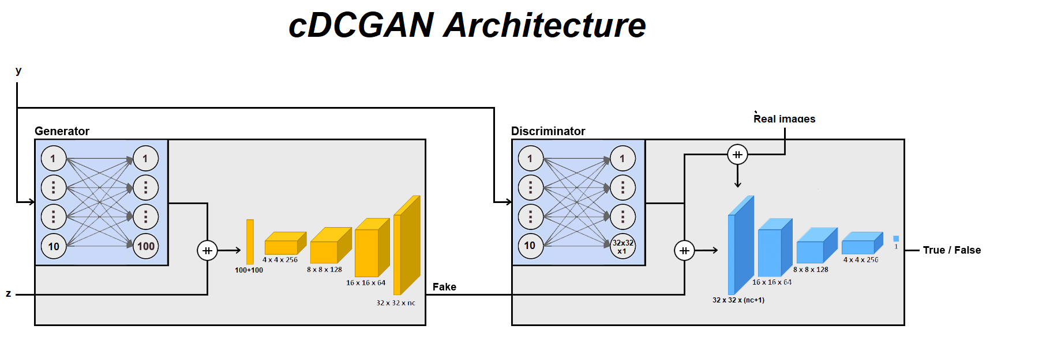
Future Work
With more labelled data – e.g., color theme or object of an image – apply cDCGAN (Conditional DCGAN) to learn clearer patterns of similar paintings.
Such cDCGAN model can allow users to enter specific prompts like “water lily in blue style” to Generators.
Notes:
https://discuss.pytorch.org/t/conditional-dcgan-generate-the-same-number-for-each-column/106139

Slide 11
Demo
Tiancheng (Robert) Shi

Slide 12
Appendices
Generative Adversarial Networks https://dl.acm.org/doi/abs/10.1145/3422622
Unsupervised Representation Learning with Deep Convolutional Generative Adversarial Networks https://arxiv.org/abs/1511.06434
https://towardsdatascience.com/generative-adversarial-network-gan-for-dummies-a-step-by-step-tutorial-fdefff170391
https://sthalles.github.io/intro-to-gans/
https://discuss.pytorch.org/t/conditional-dcgan-generate-the-same-number-for-each-column/106139

