Slide 1
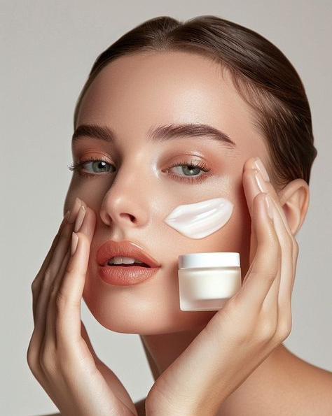
Smart skin smart skin
Smart skin​
Smart skin solution solution solution solution
Your Skin Your Perfect Match​

Slide 2
objective
Objective objective
To develop a data-driven machine learning model that recommends personalized skincare products based on individual user characteristics such as skin type, skin tone, and specific concerns. By leveraging classification techniques, the system aims to deliver accurate, tailored product suggestions that enhance customer satisfaction, support beauty brands in optimizing marketing strategies, and ultimately promote effective skincare routines.
​

Slide 3
Overview Steps
Dataset Creation
Data preprocessing
Training the Dataset
Using different machine learning models
Model Evaluation
Selecting model with best score
Deployment and Prediction

Slide 4
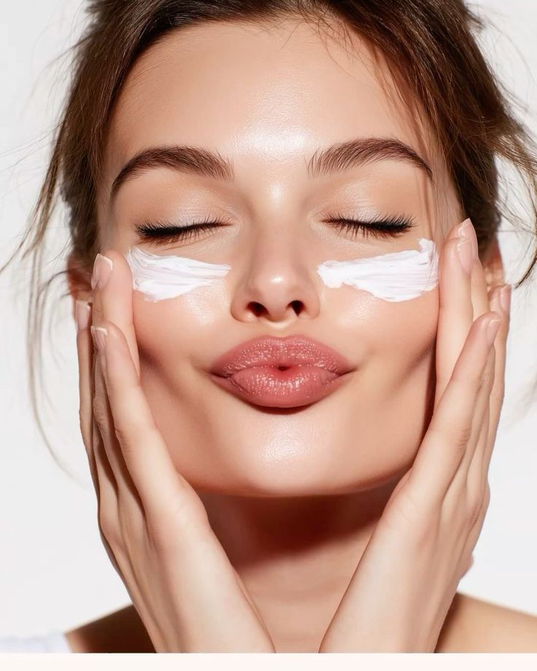
Skin care
Recommendation

Slide 5
Choosing dataset
Dataset was created by using Python code and ChatGPT.
A Python function was created to classify recommended skincare products based on the range of user feature values.
A Python dictionary was defined to map skincare conditions such as skin type, skin tone, and concerns to suitable product categories.
A for loop was then used to generate random values for each of the features and stored them into a list.
The list was converted into a DataFrame, which was then saved as a CSV file.
Brief Description – The dataset includes generated samples for personalized skincare recommendations, with each sample containing values such as skin type, skin tone, skin concerns, preferences, and active compounds. This structured data helps in analyzing user profiles and classifying the most suitable skincare products

Slide 6
Features
Target
Skin Type
Skin Tone
Skin Concerns
Preferences
Gender
Brand
Ratings
Active Compounds
Cleanser + Toner + Serum + Moisturizer
Serum + Sunscreen
Serum + Moisturizer + Sunscreen
Serum + Moisturizer
Toner + Serum + Sunscreen
Number of rows in the dataset are 44062

Slide 7
Understanding the problem
Problem Definition
Inaccurate or incomplete understanding of individual skin characteristics often leads to suboptimal
skincare choices and ineffective beauty routines. This lack of precise personalization results in
unsuitable product usage, recurring skin issues, wasted expenses, and reduced customer satisfaction.
There is a need for a comprehensive and accurate skincare recommendation system to address these
issues and provide users with tailored solutions that improve skin health and confidence.
Importance
Accurate skincare product recommendation is essential for improving skin health, enhancing customer
trust, and ensuring long-term satisfaction. It enables precise product selection based on skin type,
tone, and concerns, while also helping brands personalize offerings and optimize their marketing
strategies. Ultimately, it improves user experience, promotes healthy skin outcomes, and supports
sustainable beauty practices by reducing product wastage and mismatches.

Slide 8
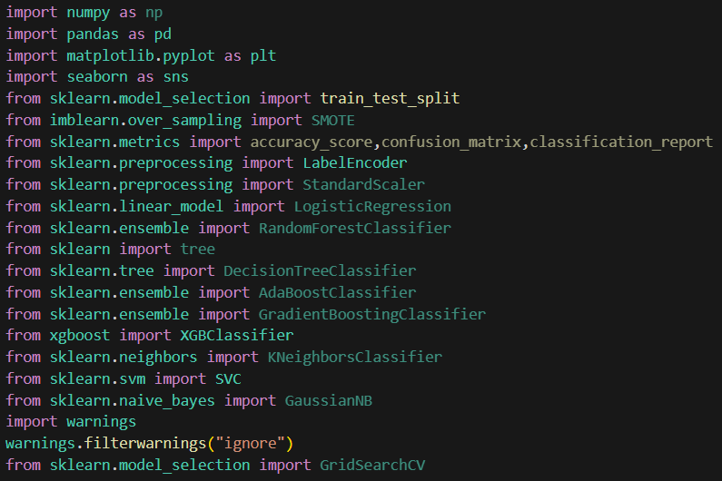
Importing Required libraries
Before building and executing the machine
learning model, it is essential to import the
necessary libraries. These libraries provide
pre-built functions and tools for data
manipulation, visualization, preprocessing,
and model development.

Slide 9
Data preprocessing
Data Cleaning
The dataset was checked for missing values. Columns such as Ratings and Active_Compounds
contained null values.
Ratings (numerical) were filled using the median value to handle skewness in distribution.
Missing values in the Active_Compounds categorical feature were imputed using the mode
to preserve distributional integrity and minimize bias.
.
Data Transformation : LabelEncoding,Mapping
Applied to categorical features such as Skin_Type, Skin_Tone, Gender,Preference,Brand,Concerns
to convert them into numerical form required by machine learning models. Performed on categorical
values where domain knowledge was applied to assign meaningful numerical scores

Slide 10
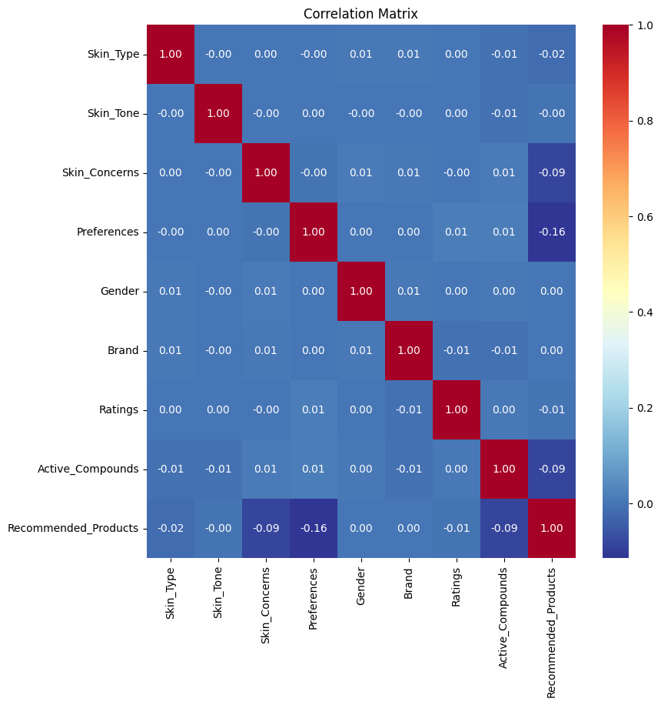
exploratory data analysis
Correlation Insights
Low Linear Correlation Across Features
Correlation is measuring only linear relationships.
Since the dataset is mostly categorical (encoded as numbers)
and the target is a class label, Linear correlation is not meaningful.
Real-world skincare recommendations depend on non-linear
interactions (e.g., oily skin + acne concern → salicylic acid product)
These interactions won’t appear in a simple correlation matrix
but can be captured by tree-based or boosting models.

Slide 11
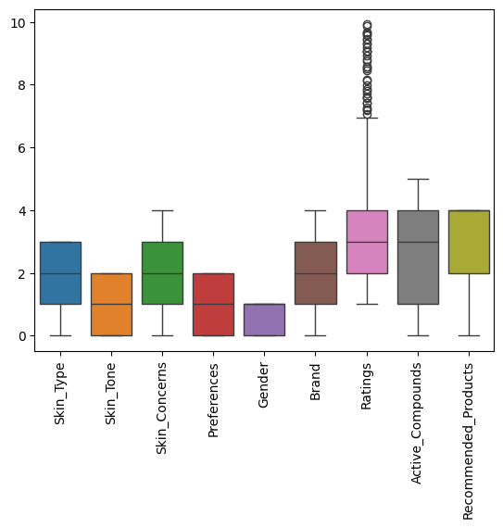
Boxplot Analysis for Outlier detection
Ratings Show High Variability
The Ratings category has the widest spread and the most outliers.
This suggests that customer satisfaction is highly variable across products, brands, and user profiles

Slide 12
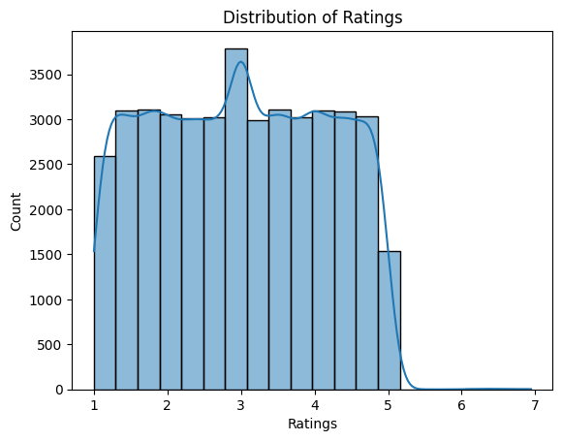
Distribution of Product Ratings
Peak around rating 3
Gradual decline after 5
Sparse values at 6 and 7
Distribution is not perfectly normal, but not heavily skewed either.

Slide 13
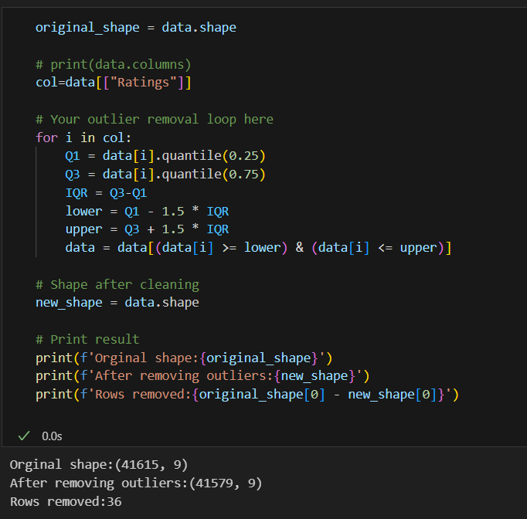
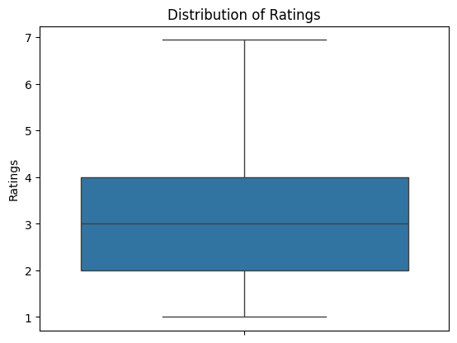
Removing Outliers
Outliers in the Ratings feature were removed using the IQR method, which defines a robust range
based on the interquartile spread.

Slide 14
Data analysis techniques
Techniques Used
Descriptive Statistics:
Summary statistics and frequency counts were applied to understand user demographics, skin types,
and skincare concerns.
Data Visualization:
Histograms, boxplots, and scatterplots were used to explore the distribution of skincare features
(e.g., age, skin type, sensitivity levels) and identify patterns or outliers in user preferences.
Modelling
Classification Models:
Implemented multiple models such as Logistic Regression, Decision Trees, Random Forest, KNN, SVM,
Naïve Bayes, and Ensemble Classifiers to predict the most suitable skincare product or routine.
Training and Testing:
The dataset was divided into training and test sets to validate model performance in recommending
personalized skincare solutions.

Slide 15
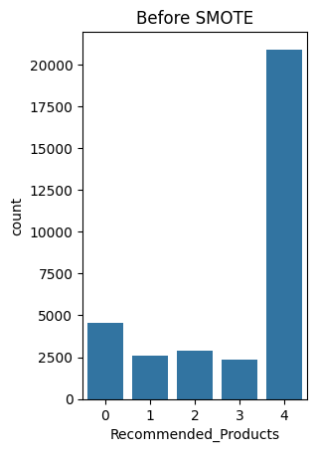
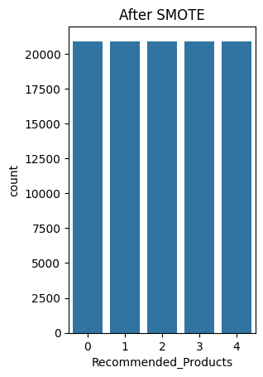
Smote
Applying SMOTE to balance the training data and ensure all skincare routines are fairly learned
and recommended.

Slide 16
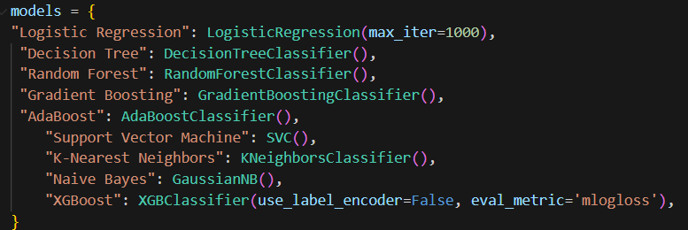
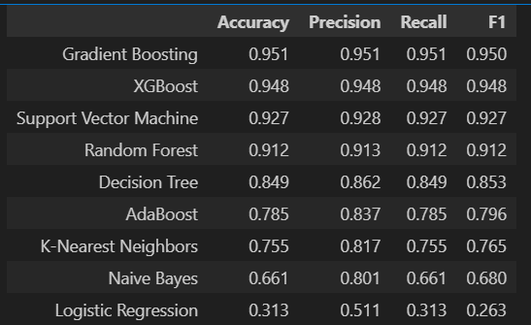
Selecting best model
After evaluating multiple classification algorithms using key performance metrics
—Accuracy, Precision, Recall, and F1 Score, Gradient Boosting is selected as the best model
as it consistently outperform other models across all metrics

Slide 17
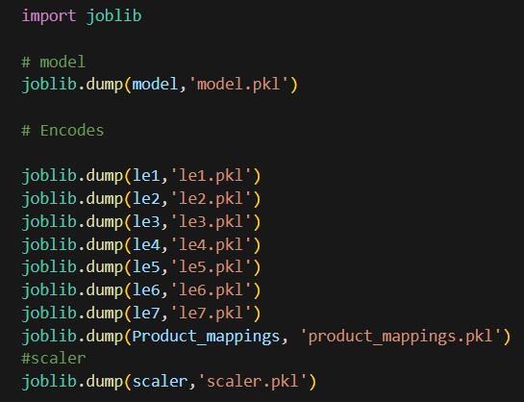
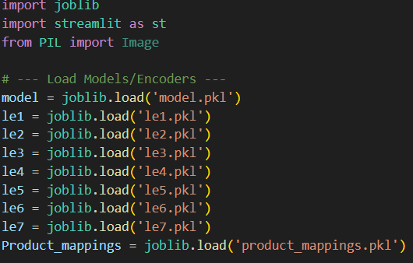
Model dumping and Loading
Trained the optimal skincare recommendation model and saved it along with the encoder using joblib
for modular deployment and were loaded into a Python script powering a Streamlit web app with a
customized user input interface.User data is processed in real time to predict their ideal skincare products
enabling seamless, personalized recommendations.

Slide 18
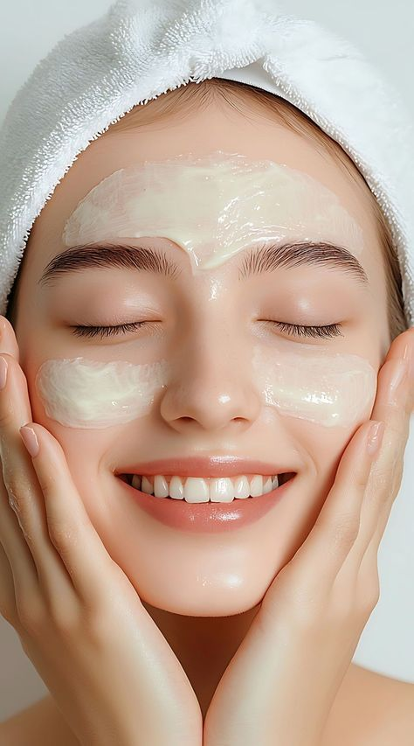
Conclusion
The project successfully developed a highly accurate skincare
recommendation model, achieving near-perfect scores in accuracy,
precision, and recall, with robust performance validated through
cross-validation. A well-balanced and diverse dataset—capturing
skin types, concerns, and lifestyle factors—played a key role in the
model’s effectiveness. Reflecting on the process, the project
underscored the importance of high-quality data and meticulous
model tuning, while addressing challenges like generalizability
across user profiles and managing feature balance.
For future enhancements, we recommend expanding the dataset
with more user samples and dermatological features, experimenting
with advanced algorithms (e.g., hybrid recommenders), and
validating performance through external user testing.
Implementing continuous feedback loops will help refine
recommendations and ensure long-term relevance and personalization.

Slide 19
Anena PP anenapp2002@gmail.com www.linkedin.com/in/anena-pp-bab012366
Thank
thank
Thank
You
You
You
you
Thank you

