Slide 1
Image Inpainting For Object Removal
GROUP-12
Sakina Jambughodawala | AU2340114
Prina Patel | AU2340040
Aneri Maniar | AU2340080
Nidhee Adesara | AU2340196

Slide 2
INTRODUCTION
Problem Statement:
The aim of image inpainting is to reconstruct the damaged or unwanted regions so the output looks visually natural and consistent with the surroundings.
Method we opted: Telea’s fast marching method - combined with anisotropic diffusion
Telea’s method fills missing areas by propagating boundary information inward, preserving structure and continuity.
→ It uses weighted averages of nearby known pixels, giving higher importance to pixels that are closer and aligned with image edges.
Perona–Malik anisotropic diffusion smooths the image while protecting important edges by controlling the amount of diffusion based on gradient strength.
This hybrid approach successfully reconstructs random missing patches with improved visual quality.

Slide 3
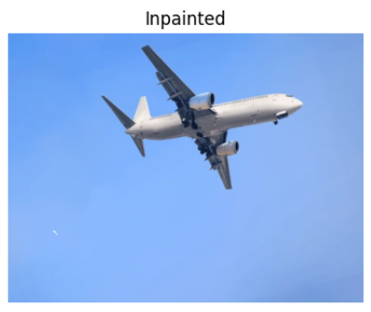
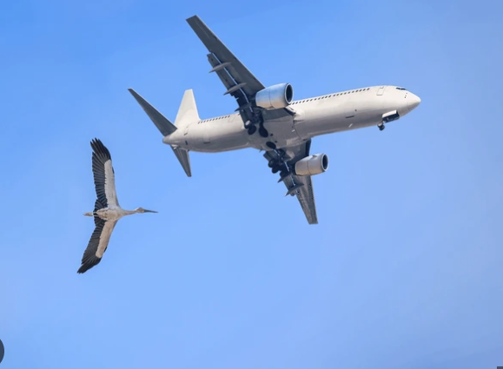
INTRODUCTION
Bird to be removed
Inpainted result

Slide 4
CONCLUSIONS (BEFORE MID-SEM)
Our initial method relied on only basic PDE diffusion, where missing pixels were filled by averaging the values of neighbouring pixels.
Calculated boundary gradients (isophotes) and applied PDE-based diffusion to propagate structure smoothly into the damaged region.
Observed that pure diffusion produced overly smooth results and failed to preserve important edges.
Then we explored Navier–Stokes and Telea methods for improvement, and selected Telea’s method due to better structure continuation and performance.
Combined Telea’s fast marching with anisotropic diffusion refinement to achieve clearer, more natural inpainted outputs.

Slide 5


UPDATED METHODOLOGY
Mathematical model
1.Image Representation
→ The input image be → The damaged region is → An unpainted image
I : Ω → R³ D ⊂ Ω. Ĩ(x) = I(x) for all x ∉ D,
where Ω is the set of all pixel coordinates (x, y)
2. Binary mask: M(x) = 1 → missing pixel (x ∈ D)
M(x) = 0 → known pixel (x ∉ D)
3. Distance Transform (Fast Marching Order: Euclidean distance map is computed: d(x) = DistanceTransform(M)
4. Telea’s Inpainting Model: 4.1 Direction Vector - where, p = unknown pixel & q = known neighboring pixel
4.2 Image Gradient at q -

Slide 6





4.3 Telea’s Directional Weight 4.4 Pixel Update Rule
This weight prefers:
closer pixels and neighbors whose gradient
points toward p (structure continuation).
5. PDE Refinement (Perona–Malik Anisotropic Diffusion)
It refines textures and preserves edges.
5.1 Gradient Magnitude 5.2 Conductivity Function: K controls edge preservation:
5.3 Discrete PDE Update
Using 4-connected neighbors N, S, E, W:
Final update:
For each color channel c: If weights<0:
I_c(p) = median of neighbor values.
|∇I| > K → diffusion stops → edge preserved
|∇I| < K → diffusion continues → smooth region

Slide 7
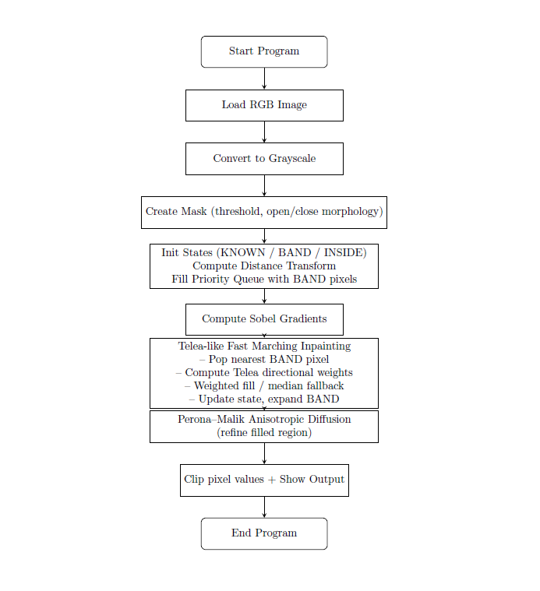
UPDATED METHODOLOGY
Algorithm and Flowchart
Convert image to grayscale; create mask M.
Label missing=INSIDE, known=KNOWN, find BAND.
Compute distance transform; push BAND in queue.
Compute Sobel gradients gx, gy.
Display smallest-distance BAND pixel from priority queue.
Compute weights w = ((px–qx)gx + (py–qy)gy)/(r²·r).
Use positive-weight fill or neighbor median.
Mark pixel KNOWN; promote INSIDE to BAND.
Apply anisotropic diffusion c = exp(–(|∇I|/κ)²) iterations.

Slide 8
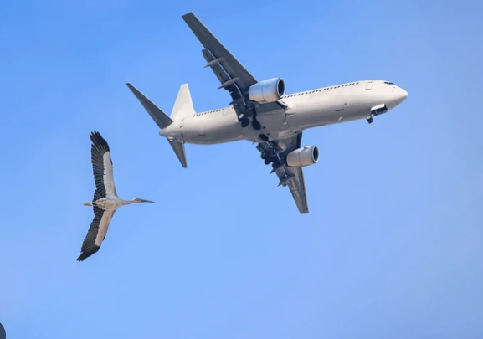
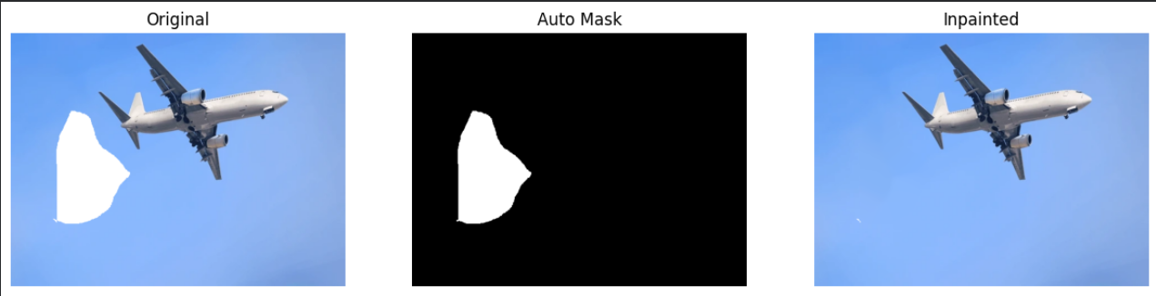
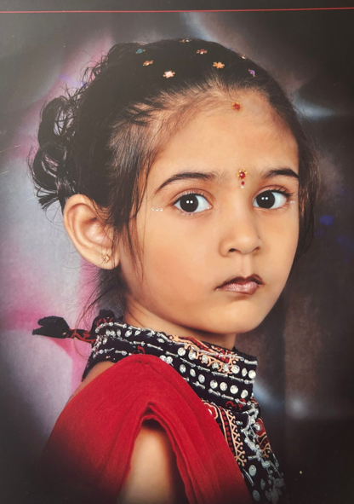
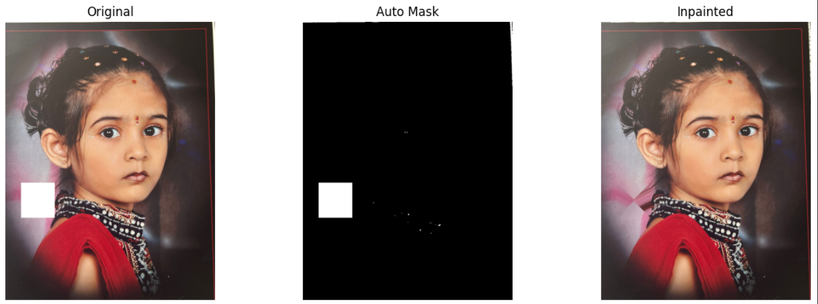
Results

Slide 9
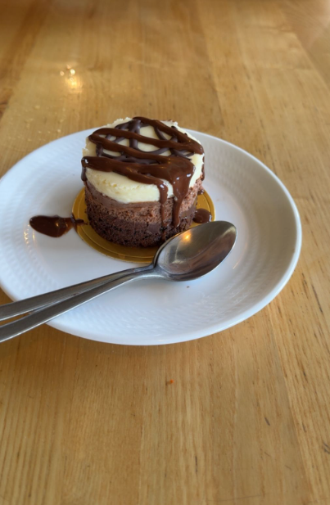
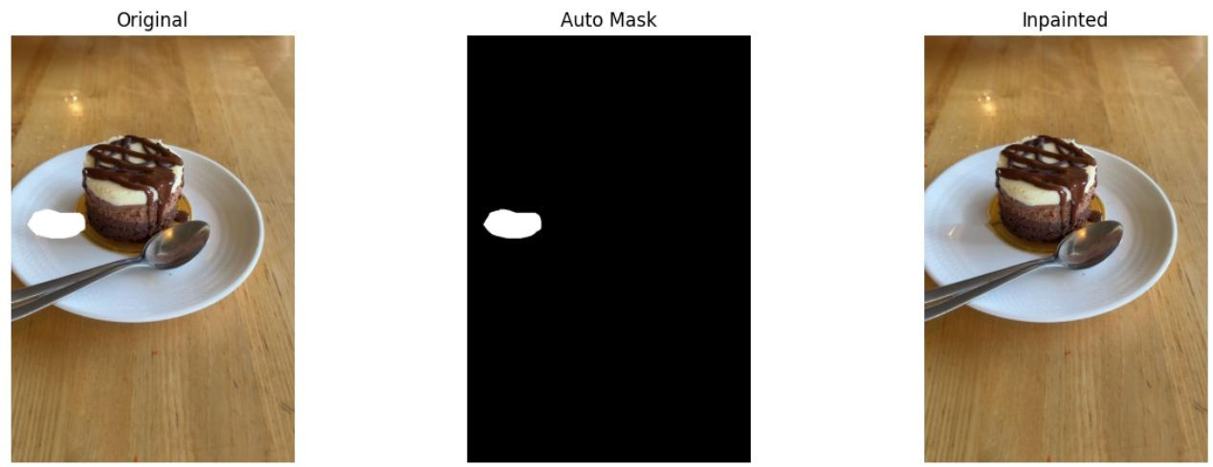
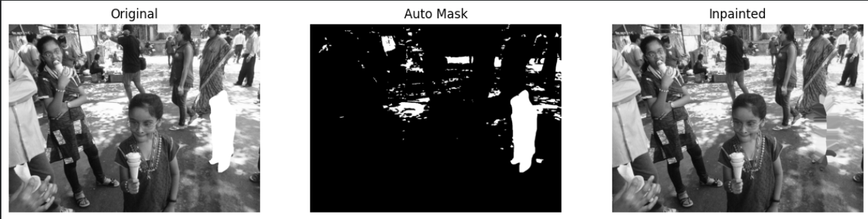
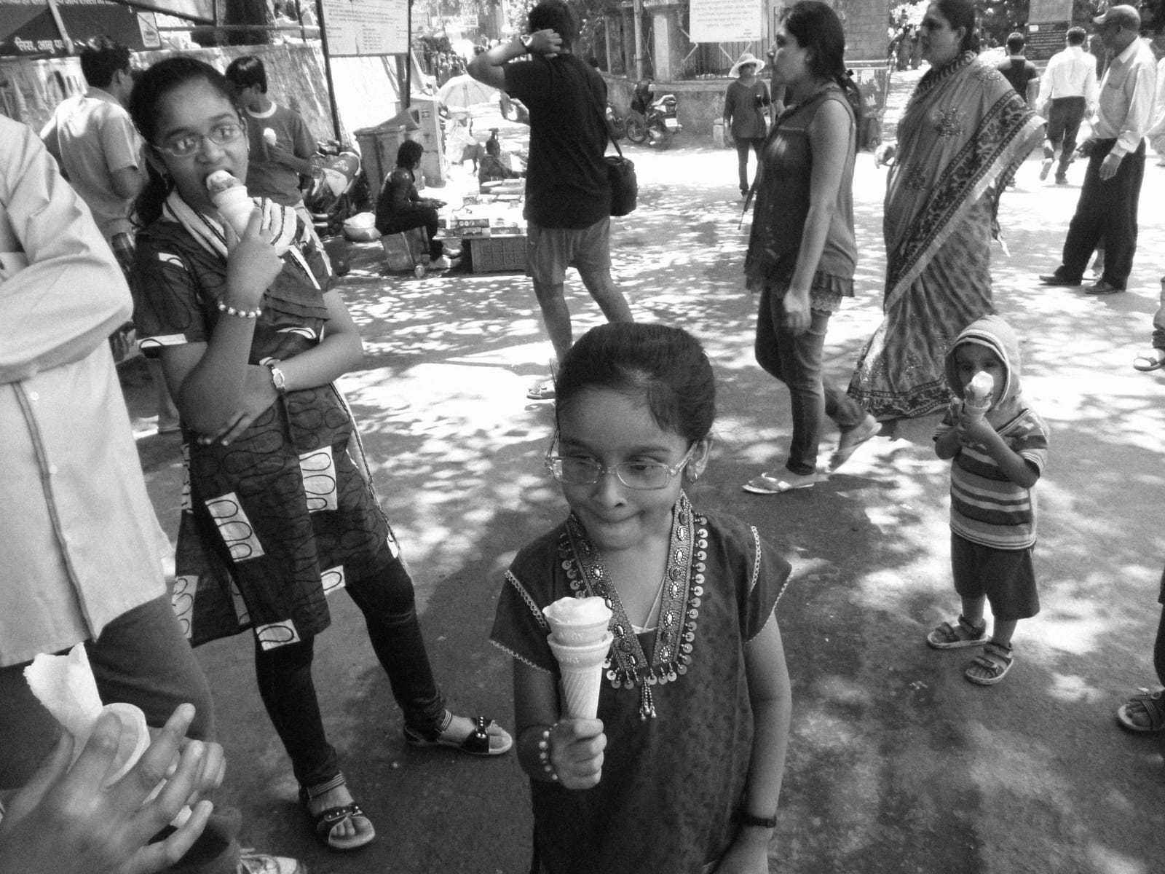
Results

Slide 10
CONCLUSION
The method integrates Telea’s fast marching and Perona–Malik anisotropic diffusion to restore missing regions.
The distance transform and gradient-based weighting guide the filling process, ensuring smooth propagation of edges, textures, and isophotes from known areas.
Anisotropic diffusion preserves important edges while smoothing homogeneous regions.
The combined use of gradient information, geometric continuation, and PDE refinement ensures the final inpainted image looks seamless and visually consistent.
DRAWBACKS:
For image which has white background, this approach considers it too as a damaged part and also texture recovery is not proper.

Slide 11
REFERENCES
(PDF) an image inpainting technique based on the Fast Marching Method. (n.d.-a). https://www.researchgate.net/publication/238183352_An_Image_Inpainting_Technique_Based_on_the_Fast_Marching_Method
Utah. (n.d.). https://www.sci.utah.edu/~gerig/CS7960-S2010/materials/Perona-Malik/PeronaMalik-PAMI-1990.pdf
https://www.shutterstock.com/search/birds-airplane-sky

