Slide 1
Image Inpainting For Object Removal
GROUP-12
Sakina Jambughodawala | AU2340114
Prina Patel | AU2340040
Aneri Maniar | AU2340080
Nidhee Adesara | AU2340196

Slide 2
INTRODUCTION
Problem Statement:
The aim of image inpainting is to reconstruct the damaged or unwanted regions so the output looks visually natural and consistent with the surroundings.
Different methods which exist:
Exemplar based: Patch based
Diffusion based: PDE(Partial differential equations).
Method we opted:
The focus of our work is on structure-preserving restoration using mathematical diffusion models.

Slide 3
LITERATURE REVIEW
Filling in by joint Interpolation of vector Field and Gray Levels:
The reference paper explains diffusion-based image inpainting using PDEs, and we are using their methodology of isotropic and anisotropic diffusion that jointly interpolates image gray-levels and edge directions to smoothly fill missing regions while preserving structures.
Morphologically Invariant PDE Inpainting:
The paper reviews several PDE-based image inpainting models, including transportation, total variation, curvature-driven diffusion, and elastica models, unifying them under common principles. It introduces a new class of third-order PDEs that maintain morphological and rotational invariance. The authors note that these models are best suited for non-texture image inpainting, while texture restoration requires separate synthesis approaches.

Slide 4
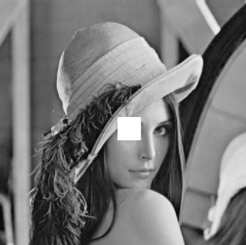
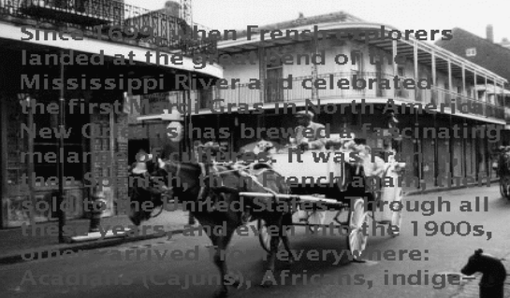
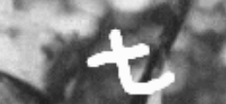

Dataset

Slide 5
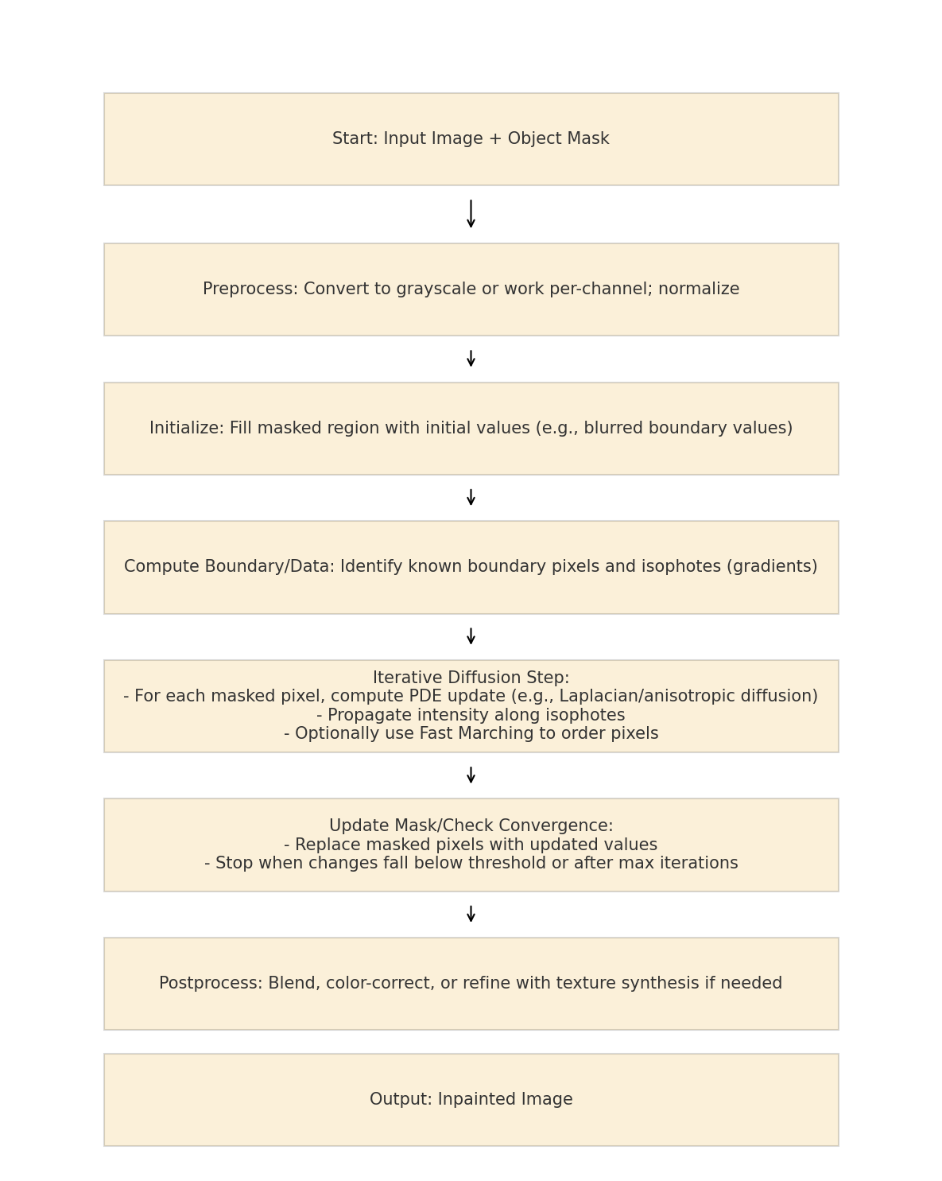
Methodology
Diffusion based method:
Input: Original Image and mask
Convert to grayscale; normalize pixel intensities.
The masked area is given initial values, by interpolating or blurring nearby pixels.
Identify boundary pixels and calculate isophotes (gradient directions) from known regions.
Apply PDE-based updates (e.g., Laplacian or anisotropic diffusion) to spread pixel values smoothly along isophotes into the masked region.
Iteratively update pixel values until changes become minimal or a maximum iteration is reached.
Output: Unpainted image

Slide 6
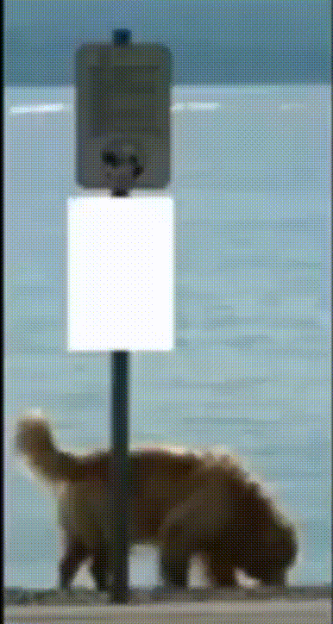
Methodology

Slide 7
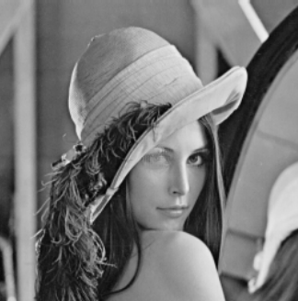
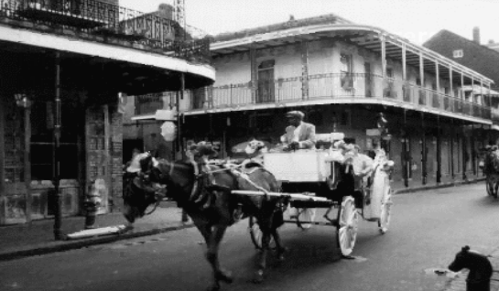
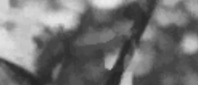
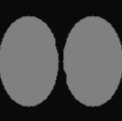
Results

Slide 8
CONCLUSION
This project demonstrates the effectiveness of diffusion-based inpainting for digital image restoration.
By doing pixel diffusion through PDEs, we achieved smooth and natural filling of small damaged regions.
The technique is efficient, edge-preserving, and suitable for applications such as scratch removal, text erasing, and old photo repair.

Slide 9
NEXT SET OF WORK
Optimize the inpainting algorithm for higher precision and strong quality.
Extend its functionality to include an object removal module that identifies and masks unwanted regions before reconstruction.
Apply diffusion separately on RGB channels to enhance color consistency and visual quality.

Slide 10
REFERENCES
C. Ballester, M. Bertalmio, V. Caselles, G. Sapiro and J. Verdera, "Filling-in by joint interpolation of vector fields and gray levels," in IEEE Transactions on Image Processing, vol. 10, no. 8, pp. 1200-1211, Aug. 2001, doi: 10.1109/83.935036.
keywords: {Interpolation;Digital images;Partial differential equations;Art;Engineering profession;Associate members;Topology;Image restoration;Layout;Painting}
2. Chan, Tony F.; Shen, Jianhong. (2001). Morphologically invariant PDE inpaintings. Retrieved from the University Digital Conservancy, https://hdl.handle.net/11299/3602.
3. Future Engineering Journal Future Engineering Journal Volume 2 issue 2. (n.d.-a). https://digitalcommons.aaru.edu.jo/cgi/viewcontent.cgi?article=1019&context=fej

