Slide 1
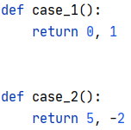

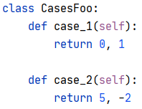

test_foo.py
test_foo_cases.py
test_foo.py
(anywhere)
Notes:
This is an example of a Text Slide. Reference the different layout options in the Slide Master (under the View tab) for different variations. Remember, our new Brand Guidelines call for clean and simple messages and design. Reference the PowerPoint Guidelines on the Brand Book for tips and useful information on creating effective presentations.

Slide 2
P=[-1,1]
A
legend
d
e
P=[0,1]
A
auto-use
c
p
@parametrize
P=[‘x’,’z’]
a
f
@fixture
2
P=[‘x’,’z’]
t
def test(…)
b
requires
1

Slide 3
P=[-1,1]
A
legend
d
e
P=[0,1]
A
auto-use
c
p
@parametrize
P=[‘x’,’z’]
a
f
@fixture
2
P=[‘x’,’z’]
t
def test(…)
b
requires
fixture closure
1

Slide 4
P=[-1,1]
A
legend
d
e
P=[0,1]
A
auto-use
c
p
@parametrize
P=[‘x’,’z’]
a
f
@fixture
2
P=[‘x’,’z’]
t
def test(…)
b
requires
alternative requirement (union)
u
1

Slide 5
legend
P=[-1,1]
A
auto-use
A
p
@parametrize
d
e
P=[0,1]
f
@fixture
c
t
def test(…)
P=[‘x’,’z’]
a
requires
2
P=[‘x’,’z’]
alternative requirement (union)
b
u→a
alternative fixture closure induced by union
u→b, b→a
u
u→b, b→c
1

