Slide 1
Notes:
This is an example of a Title Slide. We need to convey Life Is On in everything we do, so try to lead with compelling images that are vibrant, authentic, and human. The human element should be apparent and within the context of a segment that we touch.
To keep this PowerPoint template file size reduced, we included a small library of image choices in the Slide Master (under View). You can also get them from the SE Asset Library: https://schneiderelectric.telescopeondemand.com

Slide 2
Notes:
Agenda slide

Slide 3
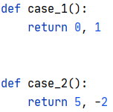

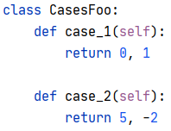

test_foo.py
test_foo_cases.py
test_foo.py
(anywhere)
Notes:
This is an example of a Text Slide. Reference the different layout options in the Slide Master (under the View tab) for different variations. Remember, our new Brand Guidelines call for clean and simple messages and design. Reference the PowerPoint Guidelines on the Brand Book for tips and useful information on creating effective presentations.

Slide 4
Notes:
Section title with image slide

Slide 5
Notes:
Closing slide

