Slide 1

© 2026 Somnistics Research Labs.

Slide 2
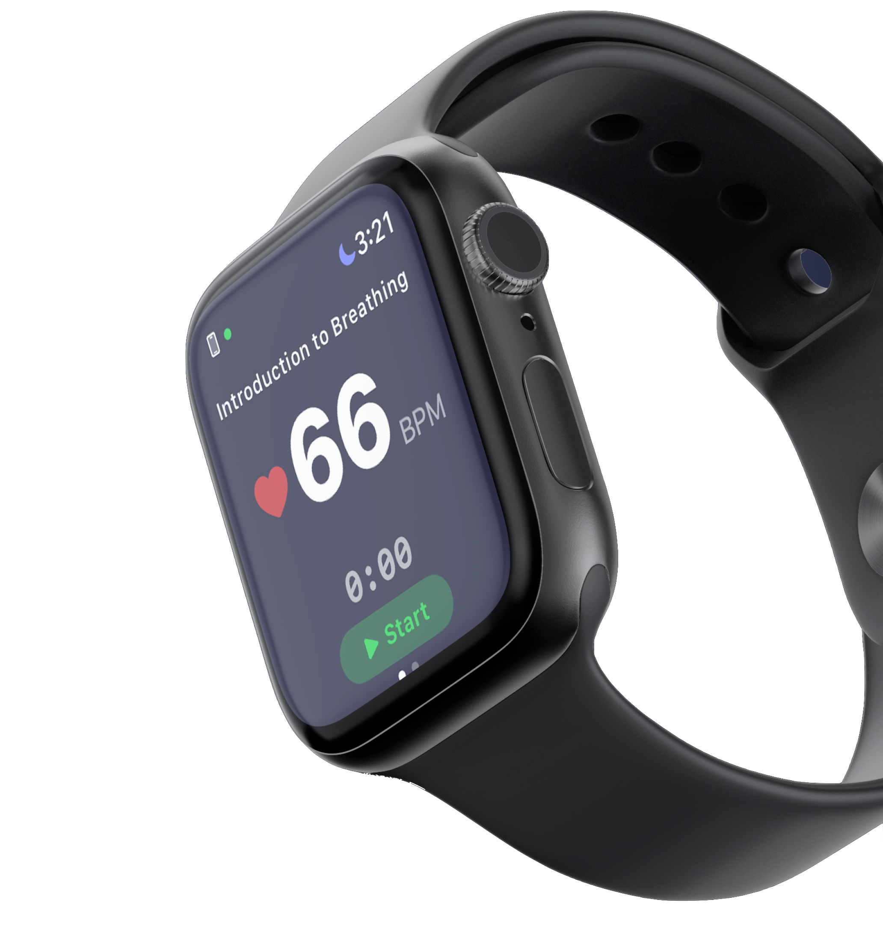
SRL Knowledge Vault
State of the Graph, March 2026
A detailed review of all concepts, evidence, observations, audiences, and outputs in the Somnistics Research Labs living knowledge graph.
© 2026 Somnistics Research Labs.
2

Slide 3
Vault at a Glance
Total notes across all layers of the knowledge graph
41
98
130+
Concept Notes
Evidence Notes
Observations
SKOS-linked atomic ideas
Dublin Core sourced studies
Embodied clinical knowledge
14
9
222+
Output Artifacts
Audience Profiles
Provenance Edges
Decks, courses, toolkits
Calibrated messaging targets
Evidence-to-claim links
© 2026 Somnistics Research Labs.
3

Slide 4
Quality Gate Pipeline
Every note passes through draft, review, and canonical status gates
Canonical (31)
Review (19)
Draft (240+)
Highest confidence. Peer-reviewed, cross-referenced. 31 concepts at canonical status including: Gap Moment Training, Interoception, Neurogating, Polyanchora, Vagal Tone, Resonant Breathing Frequency, NeuroMinute, Minimum Effective Dose, Titration to Effect, Kosha Architecture, Hemispheric Rebalancing, and 20 more.
Undergoing editorial and scientific review. 4 concepts: Commoncog Operating Principles, GMT Career Arc, Somnistics Certification, Trauma-Informed Design. 13 evidence notes including Balban 2023, Porges 2011, Van der Kolk 2014. 2 outputs: Consciousness Engineering, ReadyScore.
Active working notes, pending promotion. 6 draft concepts including Gamma-State Binding, NeuroEpistemic Layer, Nonlocal Consciousness. 80+ draft evidence notes. 130+ draft observations spanning clinical, strategic, and product domains.
© 2026 Somnistics Research Labs.
4

Slide 5
Layer 1: Concepts
SKOS-linked atomic ideas forming the intellectual backbone
© 2026 Somnistics Research Labs.
5

Slide 6
31 Canonical Concepts
Fully validated, cross-referenced, and peer-reviewed knowledge nodes
Anterocept
Hemispheric Rebalancing
Neuro-Ouroboros
Self-Remembering
Autonomic Regulation
Interoception
Neurogating
Somnistics
Clinician Durability
Interoceptive Literacy
NeuroHarmonics
SomnoAffinity
Co-Regulation
Kosha Architecture
NeuroMinute
State Transition
Cognitive Variability Analysis
Market Intelligence
Polyanchora
Titration to Effect
Diaphragmatic Blindness
Minimum Effective Dose
Polyvagal Theory
TransMetachora
ExterOryx
Multi-Phase Interoceptive Coupling
Relevance Realization
Vagal Tone
Gap Moment Training
Neural Transition Failure
Resonant Breathing Frequency
© 2026 Somnistics Research Labs.
6

Slide 7
Concepts in Pipeline
Review and draft concepts advancing toward canonical status
In Review (4 Concepts)
Draft (6 Concepts)
Commoncog Operating Principles SRL's execution operating system derived from Cedric Chin's frameworks. GMT Career Arc: Seeding, Healing, Fortifying Three-phase longitudinal model for clinician career deployment. Somnistics Certification Prehabilitative mental hygiene standard for credentialing. Trauma-Informed Design Foundational design principle for trauma-safe interventions.
Career-Longitudinal GMT Extended arc model for full career deployment. Finesse vs. Force Core clinical distinction: precision regulation over brute-force overrides. Gamma-State Binding Neural binding via gamma oscillations as integrated awareness substrate. NeuroEpistemic Layer Knowledge architecture bridging neuroscience and epistemology. Nonlocal Consciousness Frontier exploration beyond local brain activity. Retrocausal Presentiment Pre-stimulus physiological responses in advanced practitioners.
© 2026 Somnistics Research Labs.
7

Slide 8
Layer 0: Evidence Base
Dublin Core sourced studies, papers, and books
© 2026 Somnistics Research Labs.
8

Slide 9
98 Evidence Notes
Peer-reviewed research anchoring every SRL claim to published science
Breathing & HRV (28)
Interoception & Body (18)
Meditation & Neuro (22)
Balban 2023, Zaccaro 2018, Lehrer 2000/2020, Gerritsen 2018, Little 2025/2026, HRV biofeedback meta-analyses, humming breathing.
Craig 2009, Critchley 2017, Mehling 2012 (MAIA), Farb 2019, Patapoutian 2025 NIH atlas, maternal touch, MAIA-2C validation.
Sacchet Lab jhana (7T fMRI), Shinozuka 2025, Holzel 2011, Tang 2015, ENIGMA consortium, neurofeedback, gamma coherence.
Clinical & Burnout (14)
Polyvagal & Autonomic (10)
Wearables & Tech (6)
Putnam 2025, Cole 2022, Horvath 2021, Wilbanks 2025, Marcucci 2007, Ruskin 2015, mindfulness nurse burnout RCTs.
Porges 2011/2007, Grossman 2026 critique, Thayer-Lane 2009, Siegel 2012, Van der Kolk 2014, vagal stimulation reviews.
Elgendi 2026, flow state detection 2025, Chung 2021, Lief 2024, JMIR wearable systematic review 2026.
© 2026 Somnistics Research Labs.
9

Slide 10
Evidence Highlights: 2025-2026
Cutting-edge research reinforcing the SRL thesis
$14.2M
7T fMRI
64%
NIH Interoception Atlas
Jhana Brain Reorganization
Substance Use Reduction
Patapoutian 2025
Sacchet Lab 2025
Lief 2024 RCT
38
RCT
1.8M
Scholars Debate Polyvagal
Breathwork for Paramedicine
HRV Coherence Sessions
Grossman 2026
Little 2026
Global study 2025
© 2026 Somnistics Research Labs.
10

Slide 11
Observations and Outputs
Clinical knowledge, strategic intelligence, and delivered artifacts
© 2026 Somnistics Research Labs.
11

Slide 12
130+ Observations
Embodied clinical knowledge, competitive intelligence, and product insights
Clinical Practice (25+)
Product & Technology (20+)
Strategy & Business (20+)
Diaphragmatic blindness (28/30 fail), 30-40 gap moments per shift, state transition mastery, co-regulation in OR, error archetypes.
Anterocept four-layer architecture, VagalBeats 8-layer slider, multimodal biofeedback, NeuroMinute family deck, AI co-regulation.
F&F SAFE round ($5.5M cap), Lead Edge gap analysis, three horizons x seven powers, competitive moat is latency.
Market Intelligence (15+)
Science & Research (15+)
Curriculum & Content (15+)
Daily competitive briefings, newsletter digests, X signals, CE marketplace landscape, TAM keyword intelligence.
MAIA-2 pedagogical mapping, polyvagal under fire 2026, computational interoception, Harvard NeuroSkill integration.
Gap Moment Codex (11 rituals), foundation breathing scripts, NeuroMinute IFS/IPNB design, somnistics seven principles.
© 2026 Somnistics Research Labs.
12

Slide 13
14 Output Artifacts
Generated deliverables advancing the Five Red Arrows
21-Day NeuroMinute Curriculum Progressive 21-session training program
Weekly Competitive Briefing March 15, 2026 with real-time signals
CE Course: MAIA-2 Mapped Category A CE with interoceptive training
NeuroMinute Web App Simulator Micro-simulator for crisis training
CRNA Clinical Resilience Toolkit Clinical reference with Harvard evidence
Annotated NeuroMinute The Sustaining Breath with full rationale
Competitive Landscape Deck March 2026 investor-ready analysis
Consciousness Engineering Framework for awareness states (review)
State of the Market Report March 2026 market analysis
ReadyScore Composite clinician readiness metric (review)
TAM / SAM / SOM Analysis Full market sizing for Pausality
GMT Evidence Chain Updates Evidence classification proposals
Investor Competitive Responses Objection handling quick-response sheet
Vault Dashboard: Gaps Missing data and promotion audit
© 2026 Somnistics Research Labs.
13

Slide 14
Audiences and Five Red Arrows
9 audience profiles calibrated; progress against strategic priorities
9 Audience Profiles
Five Red Arrows (Priority Filter)
CRNA (primary beachhead) Emergency Department Nurse Pediatric Surgeon Corporate Executive / Enterprise Buyer Investor / SAFE Holder Academic / Clinical Researcher Family / Consumer (B2C) Law Student (BLIP Clinic) Yoga / Breathwork Practitioner Each profile includes evidence depth, language register, and calibrated messaging frameworks.
1. Clinical Credibility to Consumer Downloads
COMPLETE
2. Consumer Traction to Enterprise Proof
IN PROGRESS
3. Enterprise Pilot to Enterprise Contract
NEXT
4. Enterprise Data to Clinical LLM Moat
PLANNED
5. Platform + CEU to Multi-Stream $1M ARR
TARGET
© 2026 Somnistics Research Labs.
14

Slide 15
Thank you
Randy Graybeal
randy@somnistics.com
Jason Fields
jason@somnistics.com
pausality.health
Somnistics Research Labs, Inc.
Seattle, WA
© 2026 Somnistics Research Labs.
15

