Slide 1
IBM University Engagement Project Submission
“Exploring the Power of Agentic AI with IBM Granite and IBM Bob”

Slide 2

Project Tile – CareerPilot AI
Domain of Project – Education & Career Development
Student Name | Recent Passport Photo | Email ID | Mobile number [WhatsApp]
ANET COLIN ROCKEY |  | anetrockey04@gmail.com | 7736711725

Slide 3
Problem Statement -
Problem Statement : CareerPilot AI
The Challenge – Students often struggle to make informed career decisions due to fragmented access to guidance, limited self-awareness of academic strengths, and rapidly evolving industry landscapes. Traditional counseling methods lack personalization and scalability, leading to missed opportunities and career mismatches. The challenge is to develop an intelligent, autonomous agent that continuously monitors student performance, evolving interests, and real-time labor market trends to deliver tailored career pathway suggestions. This would empower students to make confident, future-ready decisions with minimal dependency on manual intervention.
Objective
To develop an AI-powered agentic career counseling system that analyzes a student's academic background, skills, interests, projects, and career goals to provide personalized career recommendations, identify skill gaps, and generate an actionable learning roadmap for achieving their target career.
Key Objectives
Analyze the student's academic and technical profile.
Recommend suitable career paths using AI.
Identify skill gaps between the student's current abilities and target career.
Generate a personalized, phased learning roadmap.
Improve career readiness through actionable guidance.
Leverage IBM Granite and agentic AI to automate the career counseling process.

Slide 4
Proposed Solution -
Proposed Solution: CareerPilot AI
CareerPilot AI is an AI-powered agentic career counseling platform that provides personalized career guidance by analyzing a student's academic profile, skills, interests, projects, and target career. The system uses a multi-agent workflow powered by IBM Granite to transform this information into career recommendations, skill-gap analysis, and a personalized learning roadmap.
The system collects information such as degree, semester, technical skills, interests, projects, and target careers and processes it through a sequence of specialized AI agents
Powered by IBM Granite.
The system takes:
Academic Profile + Skills + Interests + Projects + Career Goal
and transforms them into:
Career Recommendations + Skill Gaps + Learning Roadmap
Core Approach
A multi-agent workflow divides career counseling into specialized tasks, allowing each agent to focus on a specific aspect of the student's career journey.

Slide 5
Proposed Solution -
Proposed Solution: CareerPilot AI
Student Profile Collection The student enters their degree, semester, skills, interests, projects, and target career.
Profile Analysis Agent Analyzes the student's current strengths, interests, and background.
Career Recommendation Agent Identifies suitable career paths and provides reasons for the recommendations.
Skill Gap Analysis Agent Compares the student's existing skills with the requirements of the target career and identifies priority skill gaps.
Roadmap Generation Agent Creates a structured, phased learning roadmap to help the student overcome the identified gaps.
IBM Granite Intelligence IBM Granite through watsonx.ai provides the generative AI capabilities used by the specialized agents.
Personalized Career Report The system presents a career readiness score, recommendations, skill gaps, and learning roadmap, with an option to download the report as a PDF.

Slide 6
Technology Used
Frontend
React.js – Used to build the interactive user interface.
Vite – Used as the frontend development and build tool.
CSS – Used for styling and responsive UI design.
React Markdown – Used to display AI-generated content in Markdown format.
jsPDF – Used to generate downloadable career reports in PDF format.
html2canvas – Used to capture the report interface for PDF generation.
Backend
Python – Main programming language for the backend and AI workflow.
FastAPI – Provides the REST API and handles requests from the frontend.
Pydantic – Used for data validation and structured request/response models.
Uvicorn – Used to run the FastAPI application.
Reporting
jsPDF
Html2canvas

Slide 7
Technology Used
AI & IBM Technologies
IBM Bob – Visual development and orchestration of the agentic workflow
IBM Granite – Generative AI model for natural language understanding, reasoning and personalized career guidance
IBM watsonx.ai – AI platform for accessing and running Granite models
IBM Cloud – Cloud infrastructure and AI services
Sequential Multi-Agent Workflow – Four specialized agents work sequentially:
Profile Analysis Agent
Career Recommendation Agent
Skill Gap Agent
Learning Roadmap Agent
Deployment & Development
GitHub – Version control and source-code management
Vercel – Frontend deployment
Render – Backend deployment

Slide 8
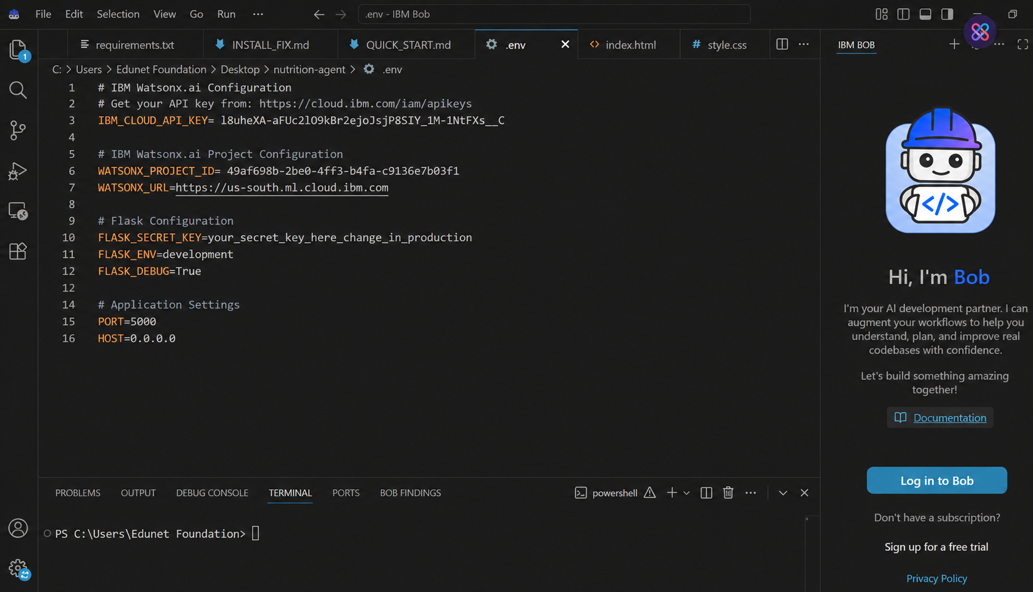
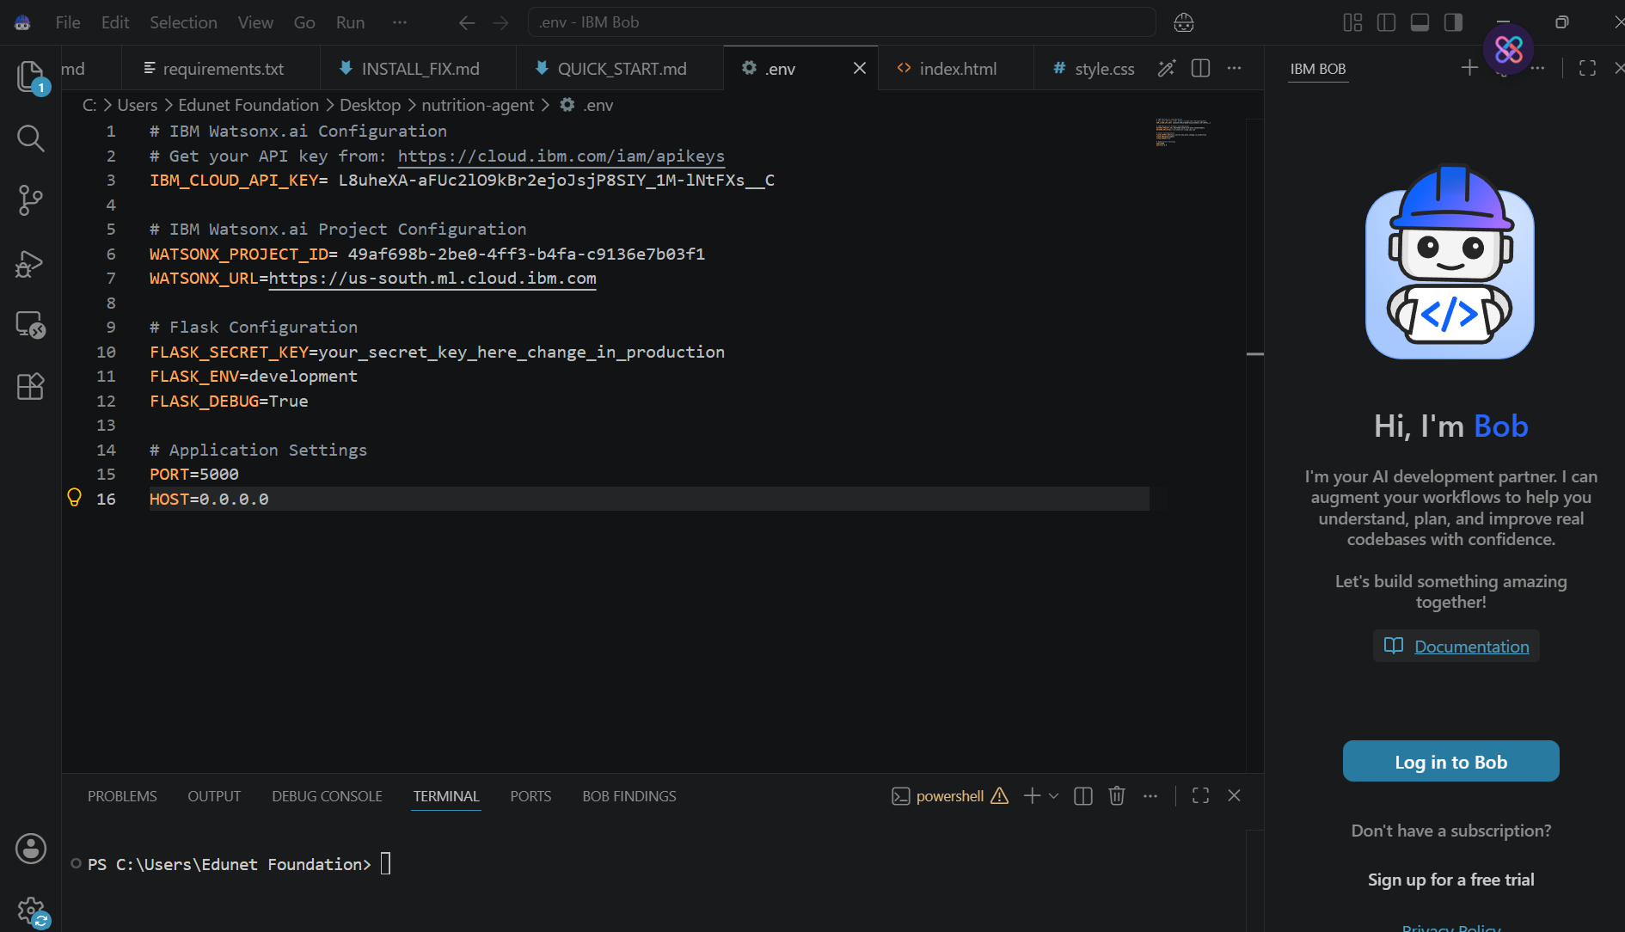
Required Files created using IBM bob -
App.py
Requirements.txt
Style.css
.env
Index.html

Slide 9
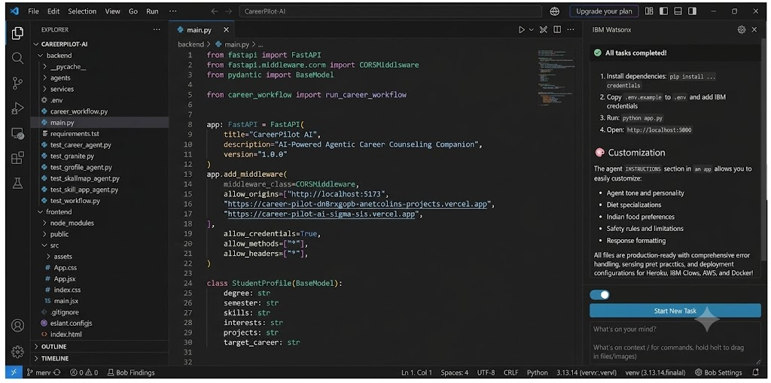
IBM Bob Screenshots:

Slide 10
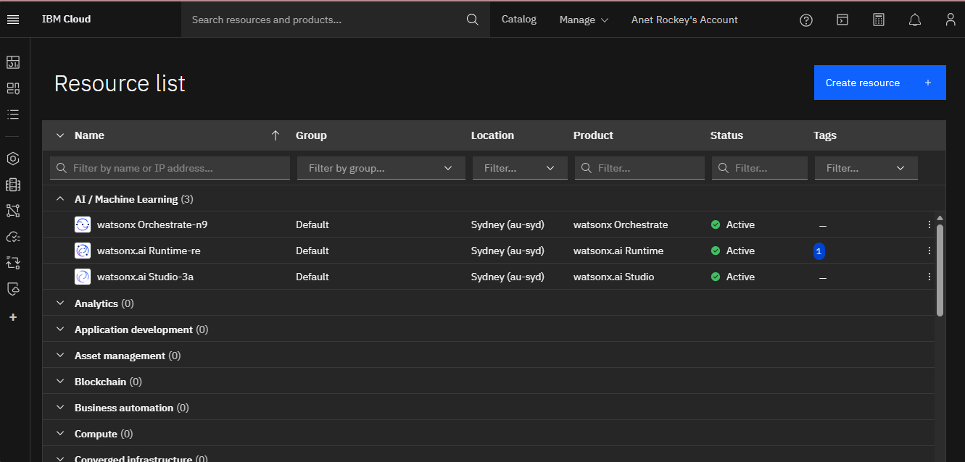

Slide 11
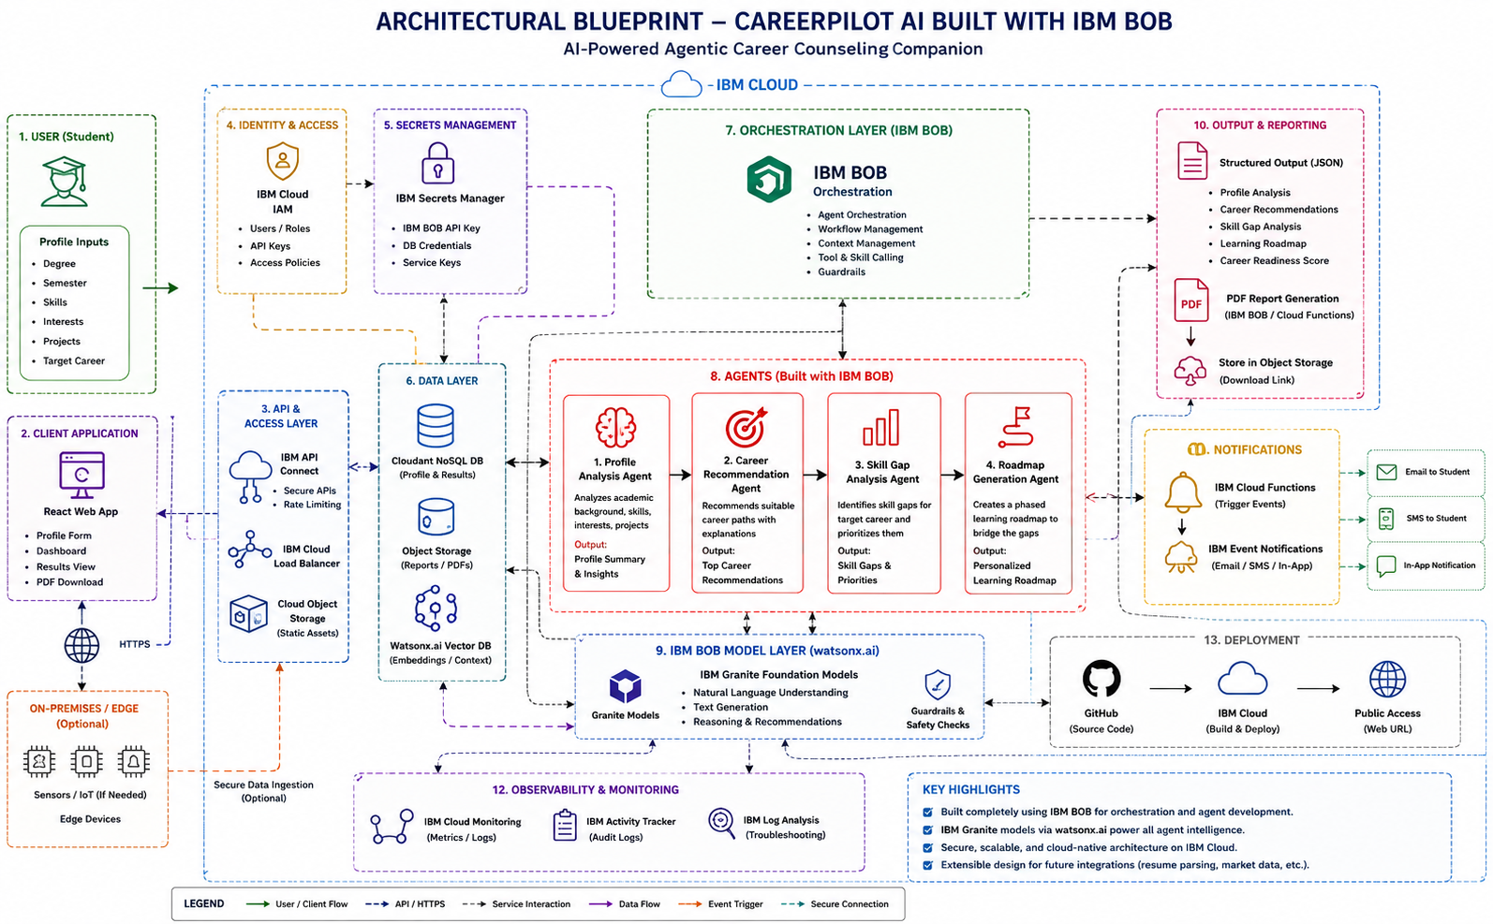
Architecture blueprint for IBM bob:

Slide 12

Role of Agentic AI in the solution
Role of Agentic AI in CareerPilot AI
Agentic AI plays a central role in CareerPilot AI by dividing the career-guidance process into multiple specialized AI agents. Instead of providing a single generic response, each agent performs a specific task and passes its output to the next agent, creating a structured career-planning workflow.
.
The Profile Analysis Agent first analyzes the student’s academic background, skills, interests, and projects, after which the Career Recommendation Agent suggests suitable career paths. The Skill Gap Agent then identifies the skills the student needs to develop for the selected career, and the Learning Roadmap Agent creates a personalized step-by-step learning plan. By coordinating these agents and passing the output of one stage to the next, Agentic AI transforms student information into personalized, actionable career guidance, making the system more efficient, structured, and scalable.

Slide 13
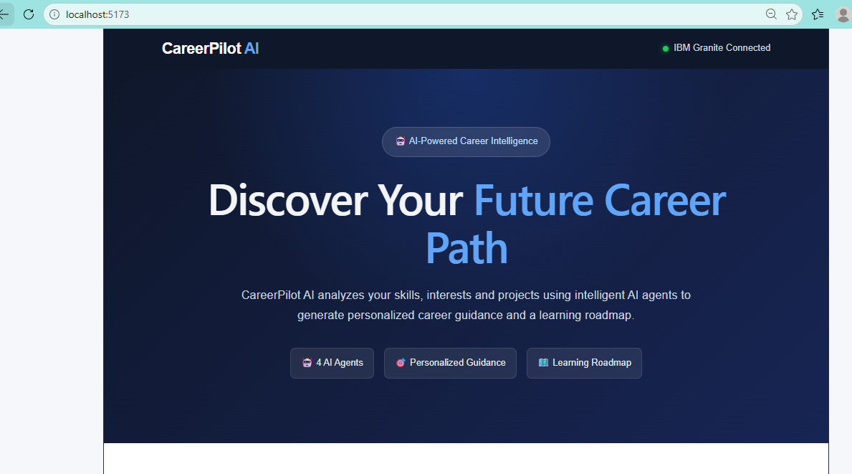
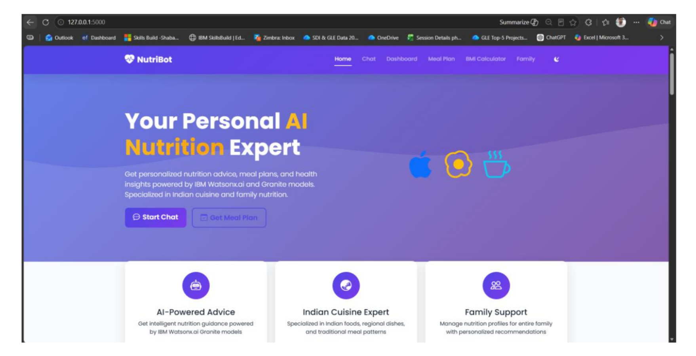
Project Output Screenshot
Please put IBM Bob output screenshots with 2-3 prompts.
You can take 2-3 more slides for each screenshot
·
·
·

Slide 14
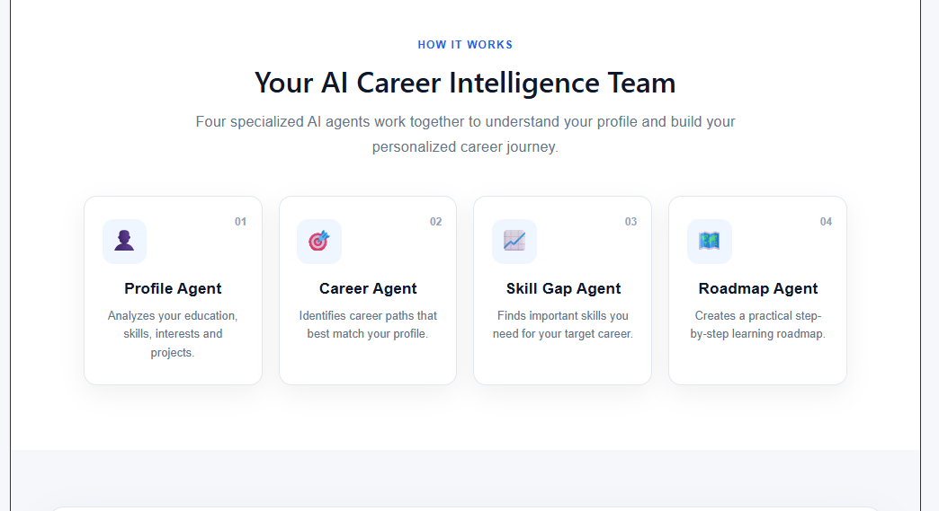
Project Output Screenshot
Please put IBM Bob output screenshots with 2-3 prompts.
You can take 2-3 more slides for each screenshot
·
·
·

Slide 15
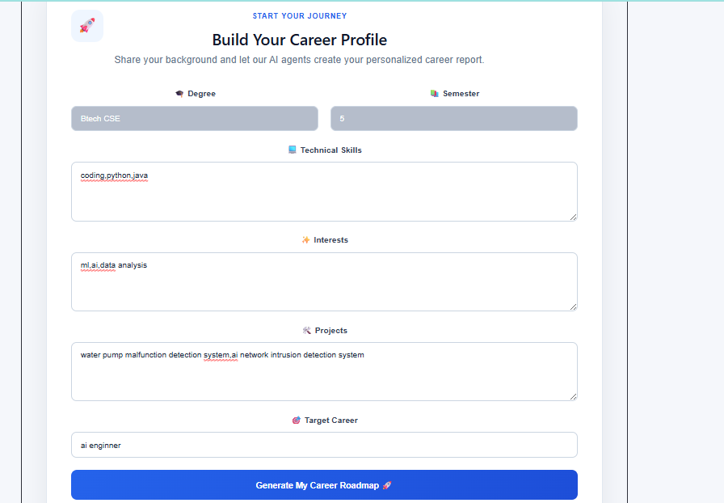
Project Output Screenshot
Please put IBM Bob output screenshots with 2-3 prompts.
You can take 2-3 more slides for each screenshot
·
·
·

Slide 16
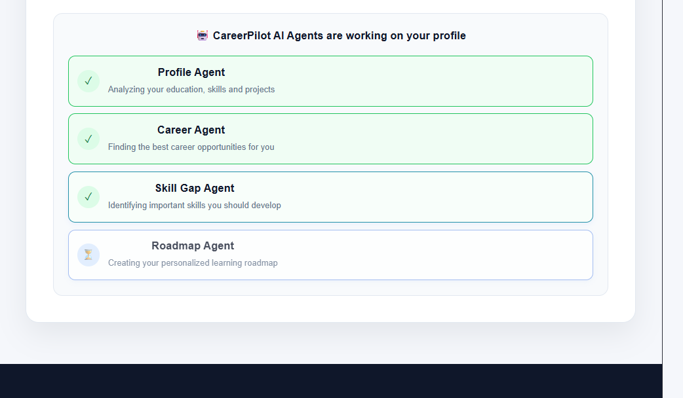
Project Output Screenshot
Please put IBM Bob output screenshots with 2-3 prompts.
You can take 2-3 more slides for each screenshot
·
·
·

Slide 17
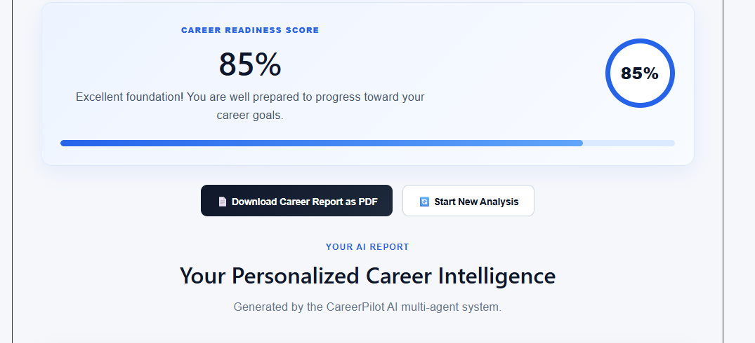
Project Output Screenshot
Please put IBM Bob output screenshots with 2-3 prompts.
You can take 2-3 more slides for each screenshot
·
·
·

Slide 18
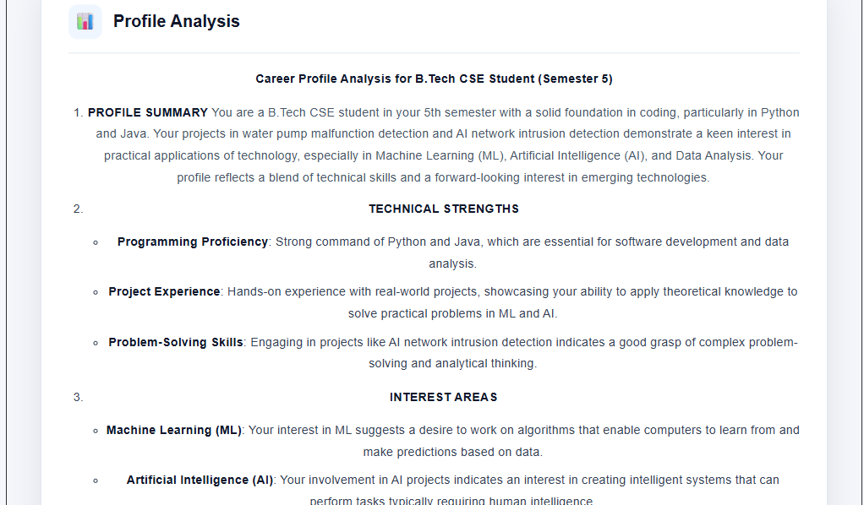
Project Output Screenshot
Please put IBM Bob output screenshots with 2-3 prompts.
You can take 2-3 more slides for each screenshot
·
·
·

Slide 19
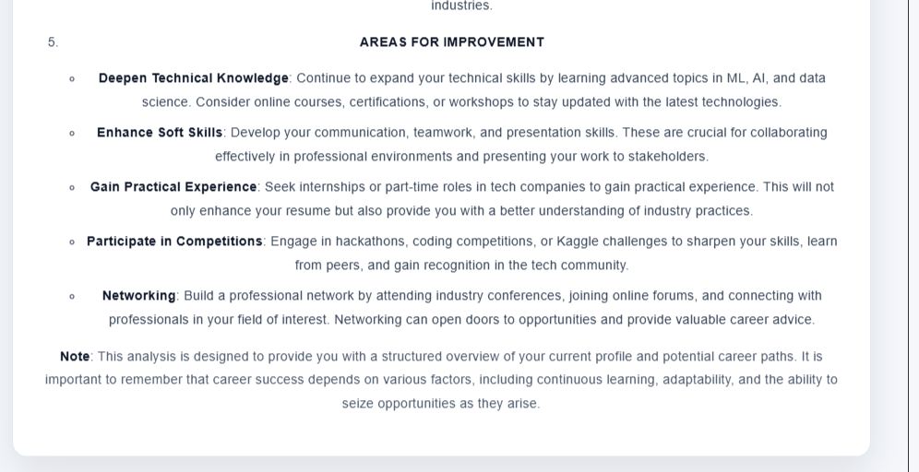
Project Output Screenshot
Please put IBM Bob output screenshots with 2-3 prompts.
You can take 2-3 more slides for each screenshot
·
·
·

Slide 20
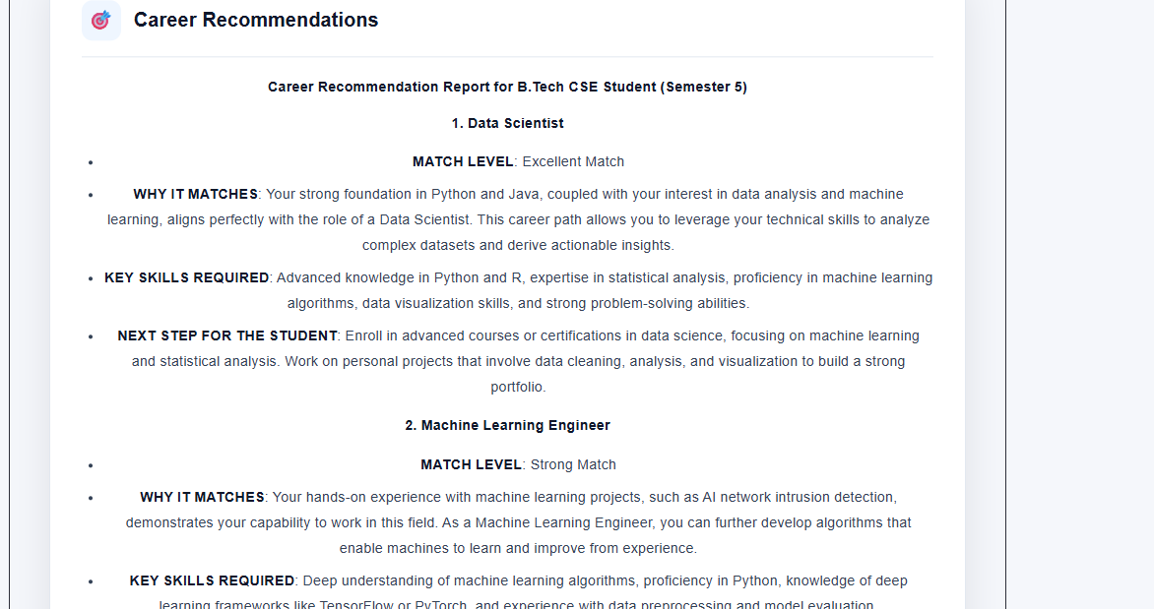
Project Output Screenshot
Please put IBM Bob output screenshots with 2-3 prompts.
You can take 2-3 more slides for each screenshot
·
·
·

Slide 21
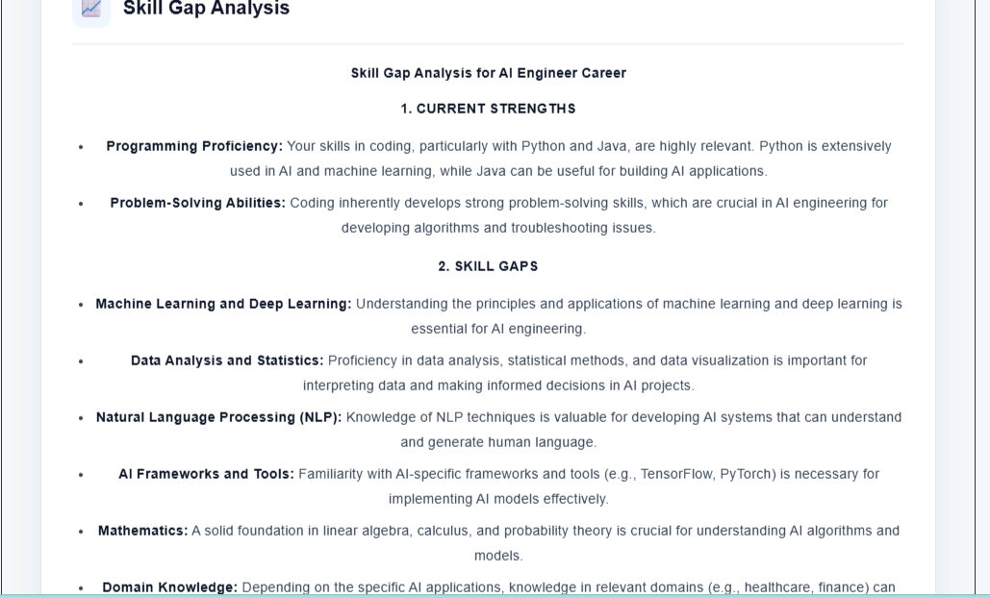
Project Output Screenshot
Please put IBM Bob output screenshots with 2-3 prompts.
You can take 2-3 more slides for each screenshot
·
·
·

Slide 22
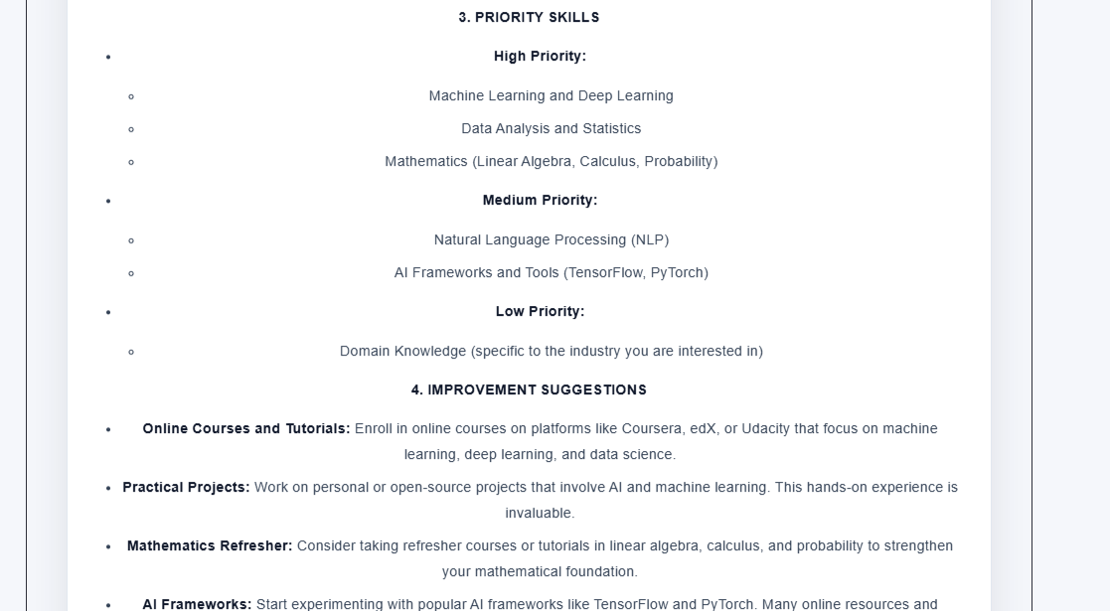
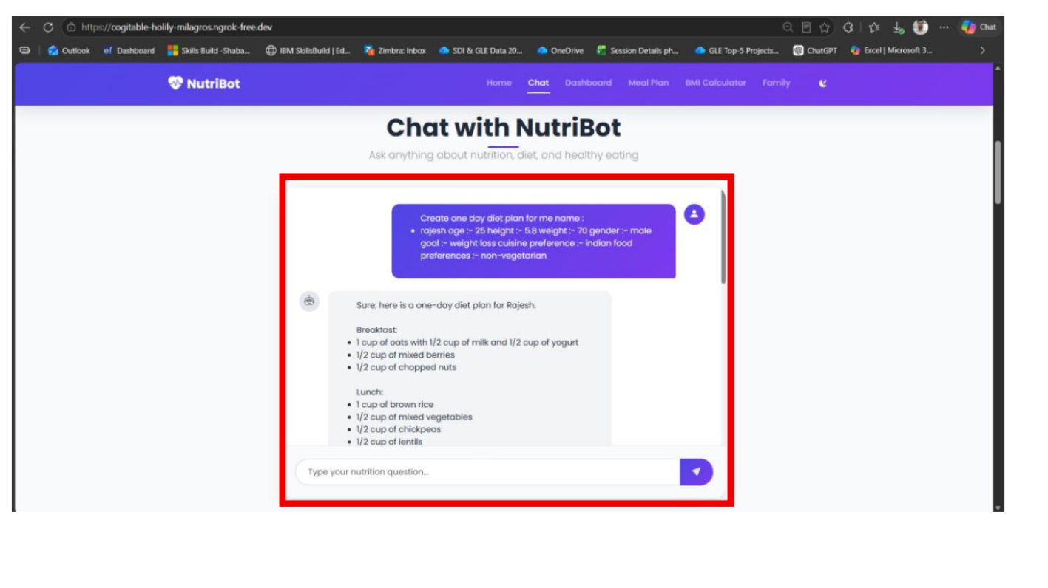
Project Output Screenshot
Please put IBM Bob output screenshots with 2-3 prompts.
You can take 2-3 more slides for each screenshot
·
·
·

Slide 23
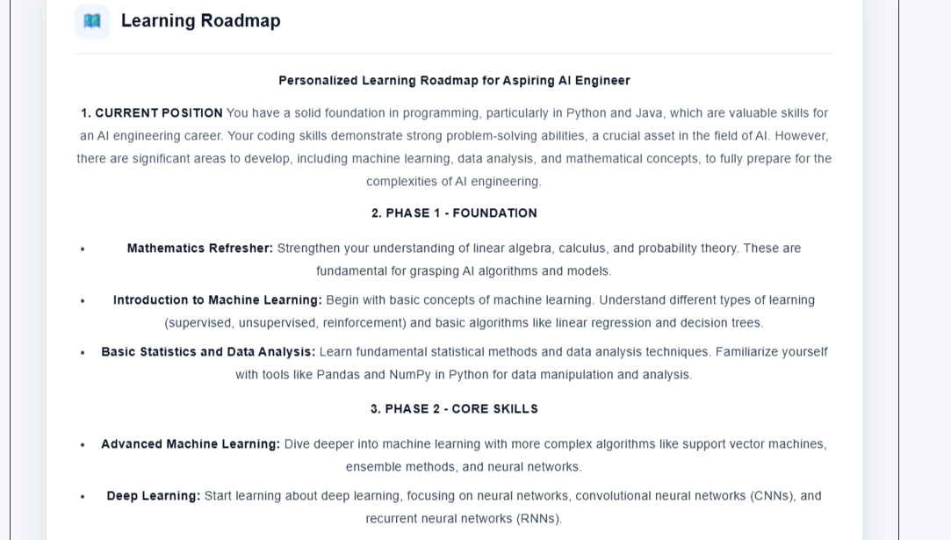
Project Output Screenshot
Please put IBM Bob output screenshots with 2-3 prompts.
You can take 2-3 more slides for each screenshot
·
·
·

Slide 24
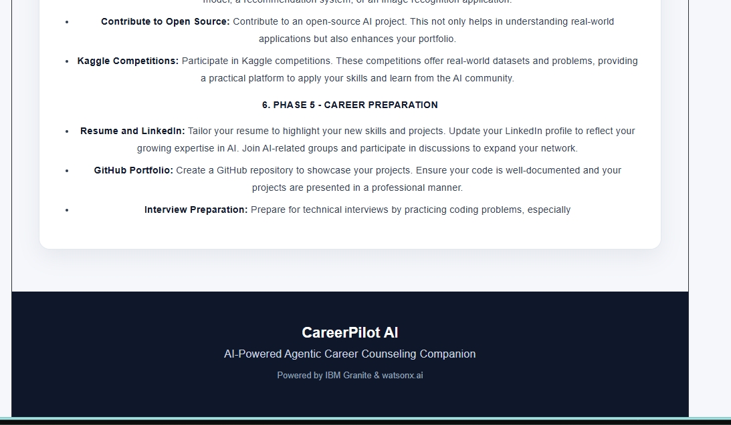
Project Output Screenshot
Please put IBM Bob output screenshots with 2-3 prompts.
You can take 2-3 more slides for each screenshot
·
·
·

Slide 25
Novelty and Uniqueness
Multi-Agent AI Approach – Uses specialized AI agents for different career-planning tasks.
Personalized Career Guidance – Recommendations are based on individual skills, interests, education, and projects.
Automated Skill-Gap Analysis – Identifies missing skills required for the target career.
Personalized Learning Roadmap – Converts skill gaps into a structured, step-by-step development plan.
End-to-End Career Planning – Integrates profile analysis, career selection, skill assessment, and learning guidance in one system.
Career Readiness Assessment – Provides an overall indication of the student's current career preparation.
Action-Oriented Guidance – Moves beyond generic career suggestions to provide clear and practical next steps.

Slide 26
Git Hub Link
GitHub: https://github.com/AnetColin/CareerPilot-AI.git
Backend API: https://careerpilot-ai-backend-uydp.onrender.com/
Frontend: https://career-pilot-dn8rxgopb-anetcolins-projects.vercel.app/
·
·
·

Slide 27
Future Scope
Real-Time Job Market Integration – Use live job data to align recommendations with current industry demand.
Resume & Portfolio Analysis – Analyze resumes, GitHub profiles, and portfolios to assess career readiness.
Advanced Career Matching – Match students with specific job roles based on skills and experience.
Progress Tracking – Monitor learning progress and dynamically update career roadmaps.
Smarter Agent Collaboration – Introduce feedback and validation between agents for more reliable recommendations.
Course Recommendation – Suggest relevant courses, certifications, and learning resources.
AI Career Mentor – Provide continuous conversational guidance and personalized feedback.
Industry & Regional Personalization – Adapt recommendations based on location, industry trends, and career opportunities.
Continuous Learning – Automatically update recommendations as the student's skills, interests, and goals evolve.
·
·
·

Slide 28
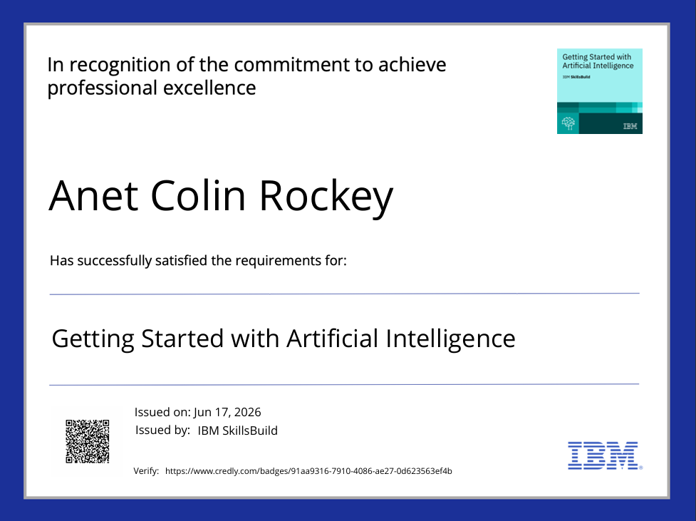
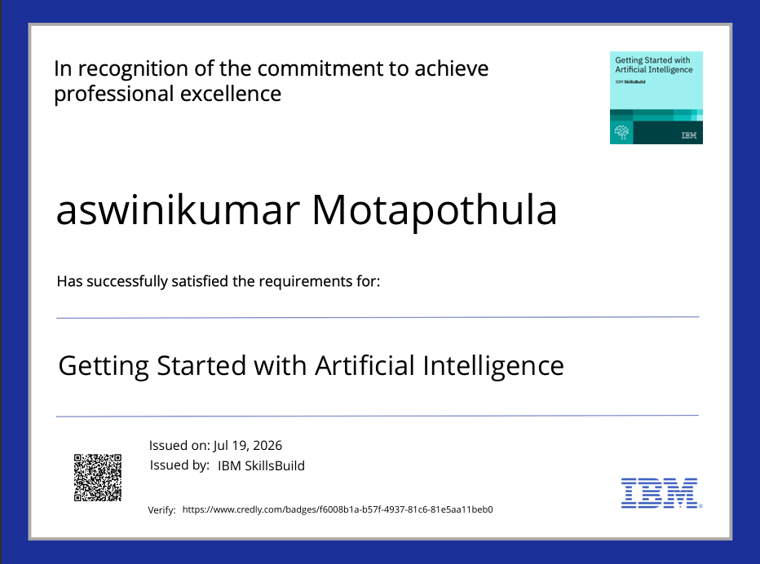
Certificates Earned:
Please add your credly certificate(Getting Started with Artificial Intelligence)

Slide 29
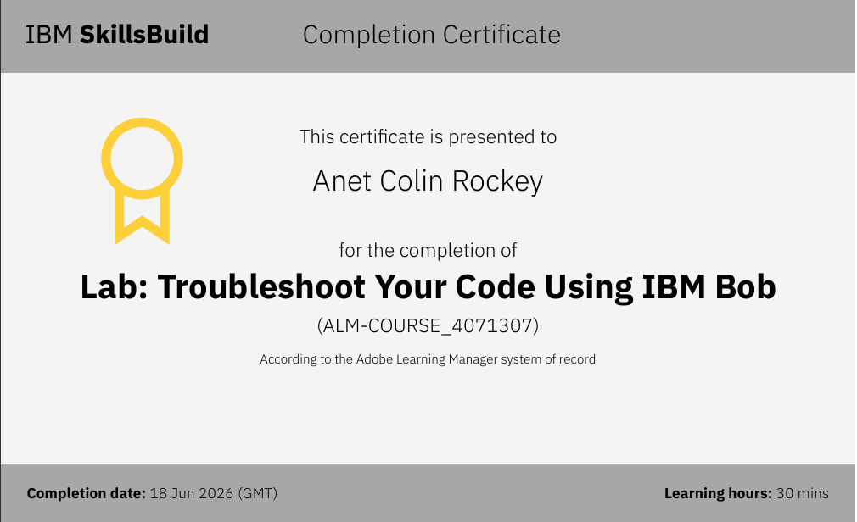
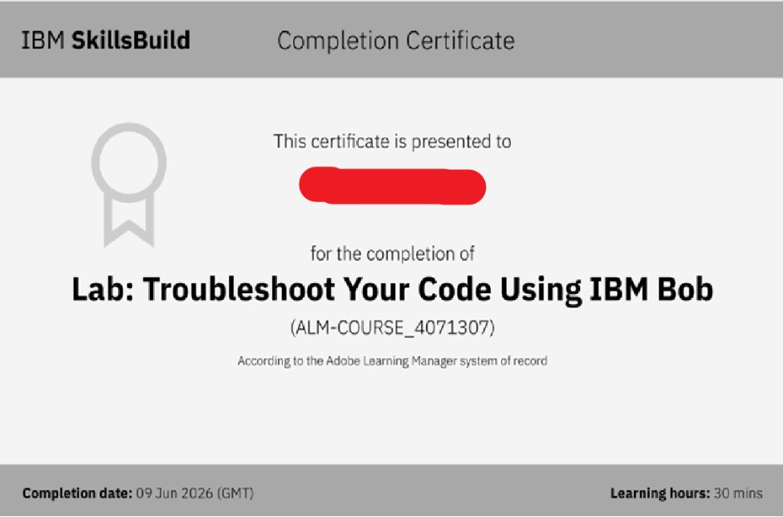
Certificates Earned:​
Add your IBM BOB Certificate

Slide 30


