Slide 1

Healthcare Analytics for Doctor Visits_TIRTC
Anet Colin Rockey
Christ College Of Engineering
STU686369929ab881751345554

Slide 2

PROBLEM STATEMENT
Healthcare utilization varies among individuals based on factors such as age, gender, income, illness, general health status, and access to healthcare services. Understanding these factors is important for identifying patterns in doctor visits and gaining insights into healthcare-seeking behavior.
The project aims to analyze a healthcare dataset containing information about individuals and their number of doctor visits. By examining demographic, socioeconomic, health, insurance, and chronic-condition-related factors, the project seeks to identify patterns and relationships associated with healthcare utilization.
The analysis will use exploratory data analysis and statistical techniques to understand how factors such as age, gender, illness, income, health status, and insurance coverage are associated with the frequency of doctor visits. The insights obtained can help in understanding healthcare utilization patterns and identifying the factors that may be associated with higher or lower doctor visit frequency.

Slide 3
Project Description
Healthcare Analytics for Doctor Visits is a data analytics project focused on understanding the factors associated with the frequency of doctor visits among individuals. The project uses a healthcare dataset containing demographic, socioeconomic, health-related, insurance, and chronic-condition information along with the number of doctor visits.
The project begins with data exploration and preprocessing to understand the structure, characteristics, and quality of the dataset. Exploratory data analysis is then performed using statistical summaries and visualizations to study the distribution of doctor visits and examine relationships between doctor visits and variables such as age, gender, illness, and health status.
Different visualizations are used to identify patterns and compare healthcare utilization across demographic and health-related groups. The analysis aims to provide meaningful insights into how individual characteristics and health conditions are associated with doctor visit frequency.
Overall, the project demonstrates how data analytics and visualization techniques can be applied to healthcare data to discover patterns in healthcare utilization and support better understanding of patient visit behavior.

Slide 4

WHO ARE THE END USERS?
Healthcare Administrators – Can use the insights to understand patterns in doctor visits and healthcare utilization.
Hospitals and Clinics – Can analyze patient visit patterns and demographic or health-related factors associated with healthcare usage.
Healthcare Analysts and Researchers – Can use the analyzed data to study relationships between demographic, socioeconomic, and health factors and doctor visits.
Healthcare Planners and Policymakers – Can use aggregated analytical insights to understand healthcare utilization patterns and support healthcare planning.
Data Analysts and Students – Can use the project as an example of applying data analysis, statistics, and visualization techniques to healthcare data.

Slide 5

Technology Used
Python – Main programming language used for data analysis.
Jupyter Notebook – Development environment used to perform and document the analysis.
Pandas – Used for data loading, manipulation, cleaning, and analysis.
NumPy – Used for numerical operations and data processing.
Matplotlib – Used for creating graphs and visualizations.
Seaborn – Used for statistical data visualization and relationship analysis.
CSV Dataset – Used as the source of healthcare and doctor-visit data.

Slide 6
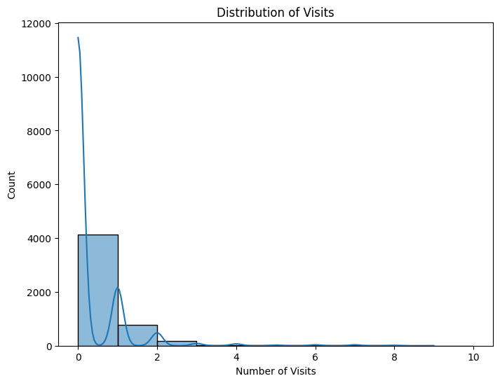
RESULTS
[Add screen shots of your code ]
Demo Link

Slide 7
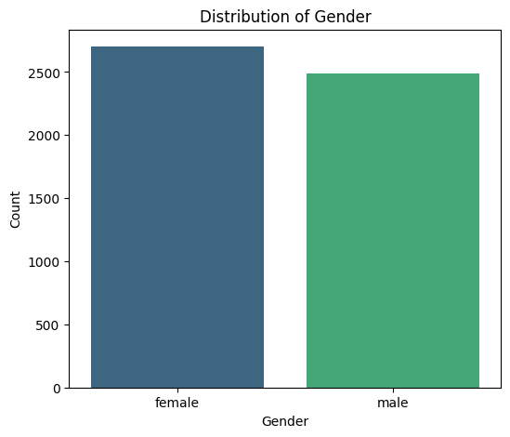
RESULTS
[Add screen shots of your code ]
Demo Link

Slide 8
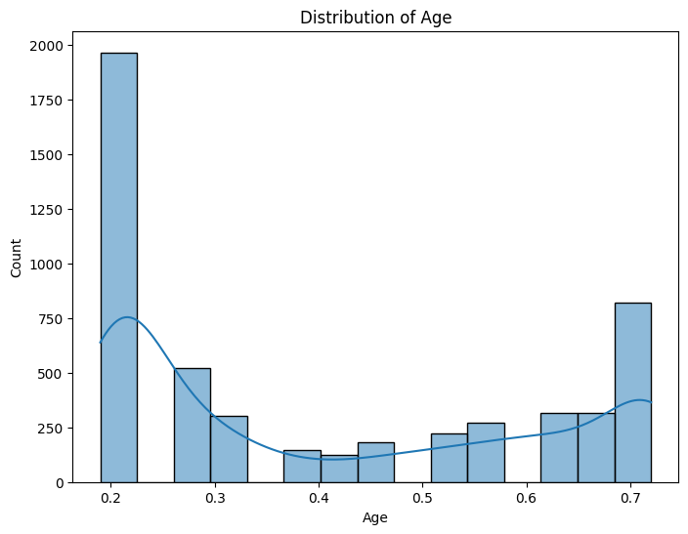
RESULTS
[Add screen shots of your code ]
Demo Link

Slide 9

RESULTS
[Add screen shots of your code ]
Demo Link

Slide 10

RESULTS
[Add screen shots of your code ]
Demo Link

Slide 11
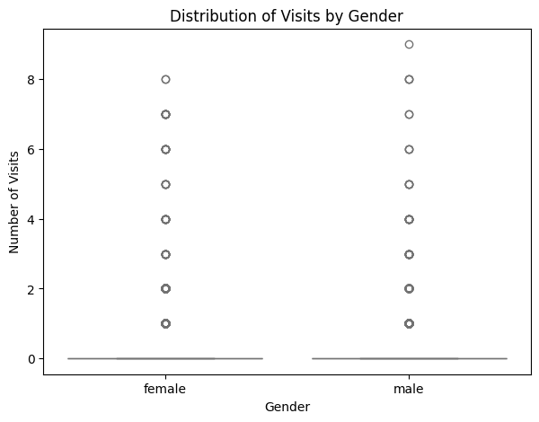
RESULTS
[Add screen shots of your code ]
Demo Link

Slide 12
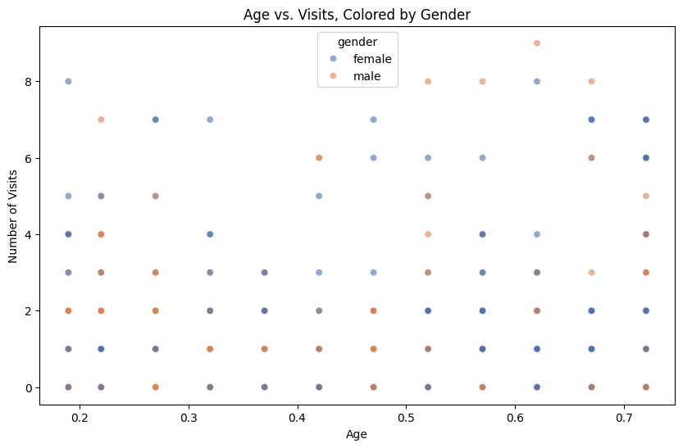
RESULTS
[Add screen shots of your code ]
Demo Link

Slide 13
RESULTS
GIT HUB LINK:
https://github.com/AnetColin/Healthcare-Analytics-for-Doctor-Visits_TIRTC.git
Demo Link

Slide 14
Thank you
.
.

