Slide 1

Seasonal Agriculture Performance Analysis
Anet Colin Rockey
Christ College Of Engineering
STU686369929ab881751345554

Slide 2

PROBLEM STATEMENT
Agricultural activities are influenced by seasonal variations in environmental conditions, farming practices, resource availability and market conditions. As a result, agricultural performance may differ from one season to another. However, raw agricultural data does not clearly explain how agricultural performance changes across seasons or what patterns can be observed in different seasonal conditions. The problem is to analyze the given agricultural dataset and investigate seasonal differences in agricultural performance by identifying meaningful patterns, trends, relationships and variations within the available data.

Slide 3
Project Description
The goal of the Seasonal Agriculture Performance Analysis project is to use data analytics techniques to understand how agricultural performance varies across different seasons, crops, geographical regions, farming conditions, and irrigation methods.
The project focuses on analyzing important agricultural and economic indicators such as crop yield, production, revenue, cost, profit, water usage, water efficiency, rainfall, temperature, humidity, soil moisture, fertilizer usage, and pest/disease risk. By examining these factors together, the project aims to identify patterns and differences in agricultural performance and understand which combinations of farming conditions are associated with better outcomes.
A major focus of the project is to compare the Kharif, Rabi, and Zaid seasons and determine how agricultural productivity and profitability differ between them. The analysis also evaluates individual crops and their performance across seasons, compares agricultural outcomes across different states, and examines how irrigation methods such as Drip, Flood, Rainfed, and Sprinkler are associated with yield, profitability, and water efficiency.

Slide 4
Project Description
The project further applies exploratory data analysis, data visualization, correlation analysis, statistical testing, and Crop–Season–Irrigation combination analysis to discover meaningful relationships and performance patterns. Statistical techniques are used to determine whether observed differences between groups are statistically significant rather than relying only on visual or descriptive comparisons.
Ultimately, the project aims to provide evidence-based insights for agricultural planning and decision-making. These insights can help identify high-performing crop and irrigation combinations, recognize potentially underperforming conditions, understand resource-use patterns, and support better planning of crops, irrigation, and seasonal farming activities.

Slide 5

WHO ARE THE END USERS?
1. Farmers
Farmers can use the insights to understand how different crops, seasons, and irrigation methods are associated with yield, water efficiency, and profitability.
2. Agricultural Planners
Agricultural planners can use the analysis to support seasonal crop planning, resource allocation, and irrigation planning based on observed performance patterns.
3. Government & Agricultural Departments
Government agencies can use the findings to understand regional agricultural performance and support agricultural development programs and resource planning.
4. Irrigation & Water Resource Managers
The analysis of water usage and irrigation methods can help identify patterns related to water efficiency and resource utilization.

Slide 6
WHO ARE THE END USERS?
5. Agricultural Researchers
Researchers can use the dataset and analytical framework to study relationships between environmental conditions, crop performance, irrigation, and economic outcomes.
6. Agricultural Businesses & Agribusinesses
Agricultural companies can use the insights for crop planning, profitability assessment, resource management, and identifying promising crop–season combinations.
7. Students & Data Analysts
The project can serve as a practical example of applying Python, Exploratory Data Analysis, data visualization, correlation analysis, and statistical testing to a real-world agricultural problem.
8. Agricultural Decision-Makers
Decision-makers can use the analysis as a data-driven reference when comparing seasonal, regional, crop, and irrigation performance.
Primary End Users
Farmers, agricultural planners, government agricultural departments, irrigation managers, agricultural researchers, and agribusinesses are the primary potential users of the insights generated by this project.

Slide 7

Technology Used
Python
Jupyter Notebook
Pandas
NumPy
Matplotlib
Seaborn
SciPy
Statsmodels
CSV Dataset

Slide 8
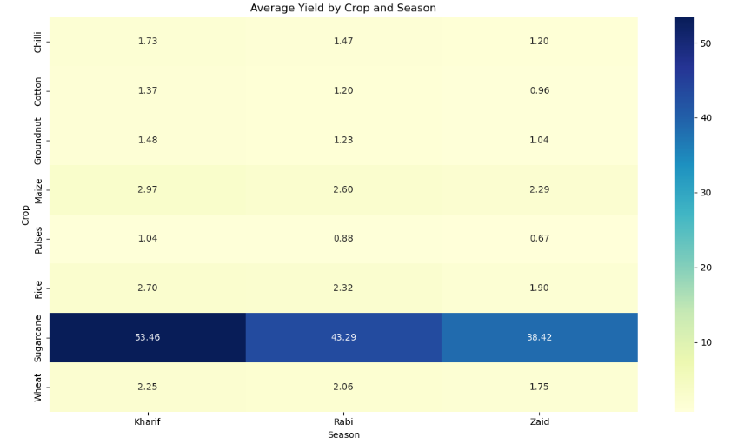
RESULTS
[Add screen shots of your code ]

Slide 9
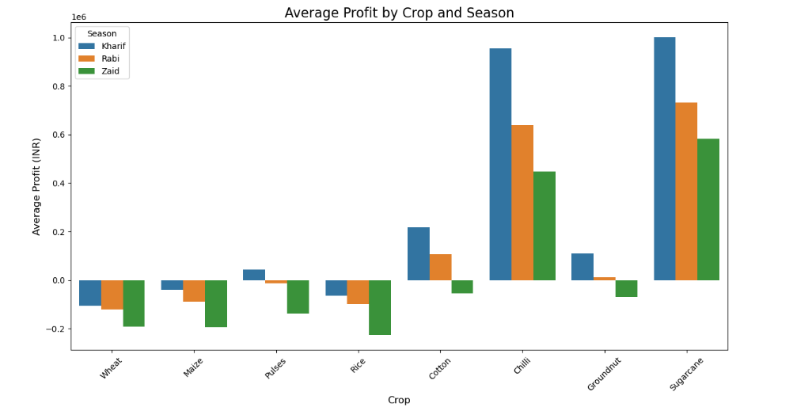
RESULTS
[Add screen shots of your code ]

Slide 10
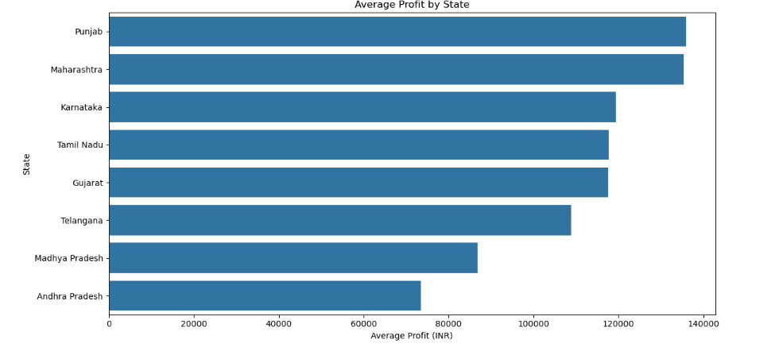
RESULTS
[Add screen shots of your code ]

Slide 11
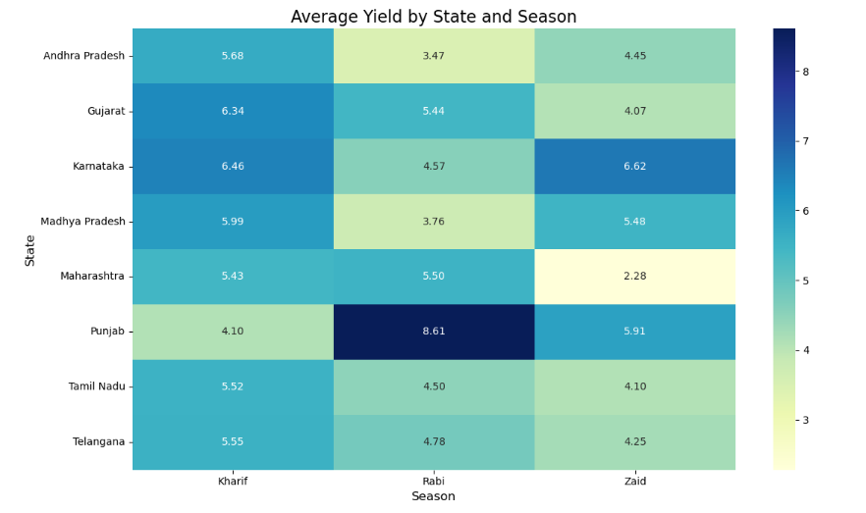
RESULTS
[Add screen shots of your code ]

Slide 12
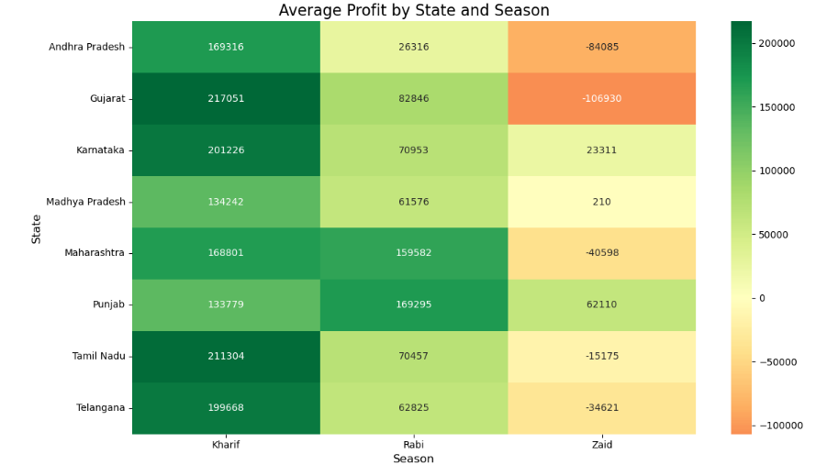
RESULTS
[Add screen shots of your code ]

Slide 13
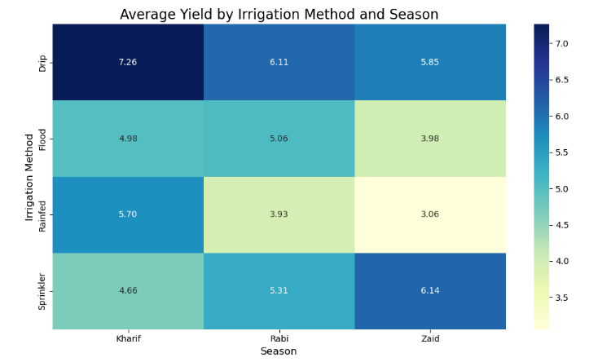
RESULTS
[Add screen shots of your code ]

Slide 14
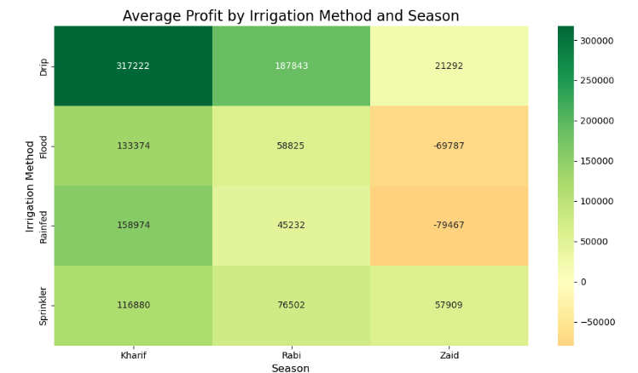
RESULTS
[Add screen shots of your code ]

Slide 15
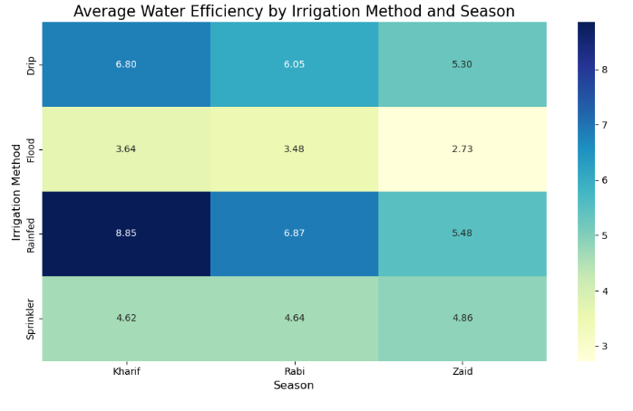
RESULTS
[Add screen shots of your code ]

Slide 16
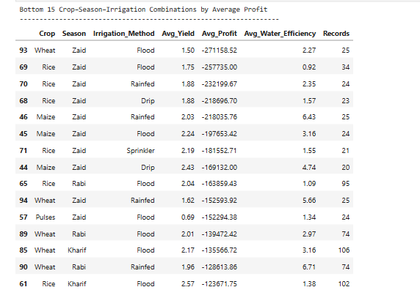
RESULTS
[Add screen shots of your code ]

Slide 17
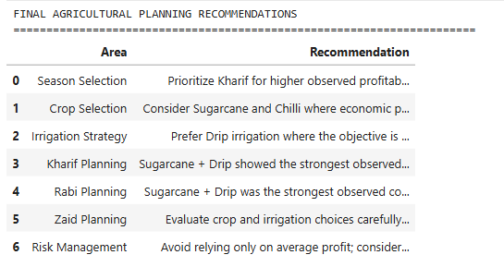
RESULTS
[Add screen shots of your code ]

Slide 18
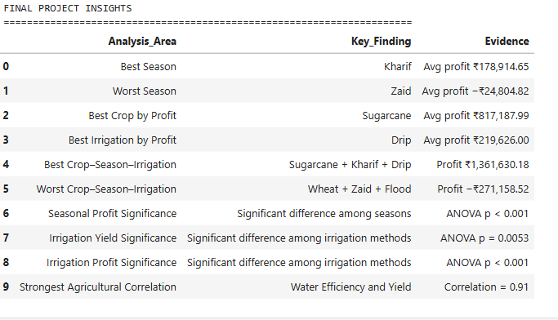
RESULTS
[Add screen shots of your code ]

Slide 19
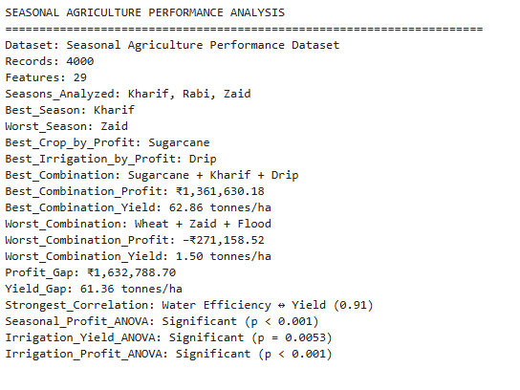
RESULTS
[Add screen shots of your code ]

Slide 20
Future scope
1. Crop Yield Prediction
Machine Learning models such as Linear Regression, Random Forest, XGBoost, or Gradient Boosting can be developed to predict crop yield based on rainfall, temperature, soil conditions, fertilizer usage, irrigation method, and other agricultural factors.
2. Profit Prediction
A predictive model can be developed to estimate the expected revenue, production cost, and profit for a particular crop and season. This can help farmers evaluate potential economic outcomes before making cultivation decisions.
3. Weather-Based Analysis
Future versions can integrate real-time and historical weather data to study the impact of changing rainfall, temperature, humidity, and extreme weather conditions on agricultural performance.
4. Smart Irrigation Recommendations
The project can be extended into an intelligent irrigation recommendation system that suggests suitable irrigation strategies based on crop type, soil moisture, rainfall, season, and water availability.
5. Geographical Analysis
More detailed geographical analysis can be performed using GIS and interactive maps to identify high-performing and low-performing agricultural regions and understand regional patterns.
6. Interactive Dashboard
The analysis can be converted into an interactive dashboard using Power BI, Tableau, or Streamlit, allowing users to dynamically filter results by crop, season, state, irrigation method, and other parameters.

Slide 21
Future scope
7. AI-Based Decision Support System
An AI-powered agricultural decision-support system could combine historical agricultural data, weather information, crop performance, and economic indicators to provide personalized planning suggestions.
8. Time-Series Analysis
If multi-year historical data becomes available, time-series forecasting can be used to study long-term trends in crop yield, prices, production, rainfall, and profitability.
9. Sustainability Analysis
Future analysis can focus more strongly on water conservation, fertilizer usage, pesticide usage, and resource efficiency to identify farming practices that provide better productivity while reducing resource consumption.
10. Risk and Anomaly Detection
Machine Learning techniques can be used to detect unusual yield, profit, weather, or resource-use patterns and identify potentially risky agricultural conditions.
11. Advanced Statistical Analysis
Future studies can use multivariate regression, mixed-effects models, or interaction analysis to control for multiple factors simultaneously and better understand the relationships between season, crop, region, and irrigation.
12. Real-World Deployment
The complete solution could eventually be deployed as a web or mobile application where farmers or agricultural planners can enter their farming conditions and receive data-driven insights and recommendations.

Slide 22
GitHub Link
GitHub Repo Link: https://github.com/AnetColin/Seasonal_Agriculture_Performance_Analysis.git

Slide 23

VOIS Course completion certificate - Course name- Data Visualization

Slide 24
Thank you
.
.

