Slide 1
Solving the mistery of the center of mass
CS260 Image Processing, Fall 2020

Slide 2

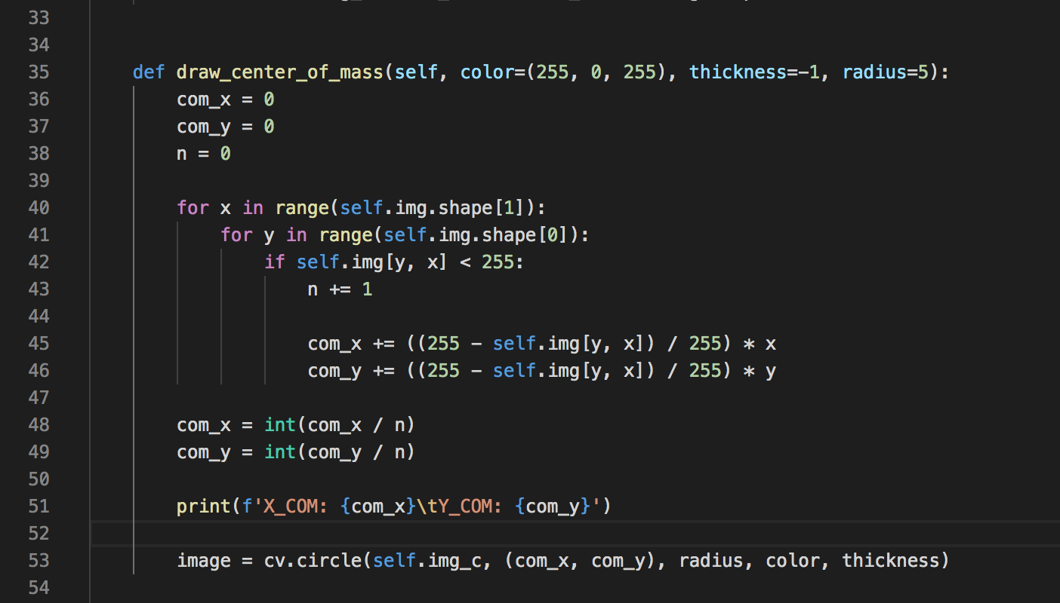
Python comes to help!
To be sure that the center of mass is calculated in the way I expected, I decided to take the binarized versions of the plates from the previous entry (entry 2) and write a function to claculate the weighted center of mass.
Although the function is very unefficient, as it uses for loops, it calculates the weighted mean of all non-white pixels, where the weights are the nomalized grayscale color values.
Here is the code snippet. You can find all the code in ImageHandler.py and 3-to-4-center-of-mass.py.

Slide 3
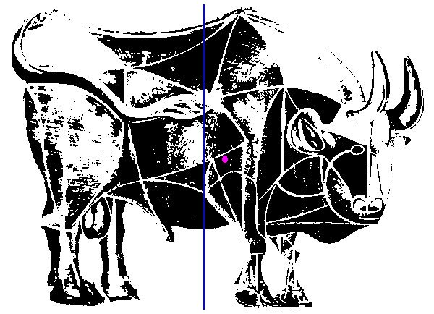
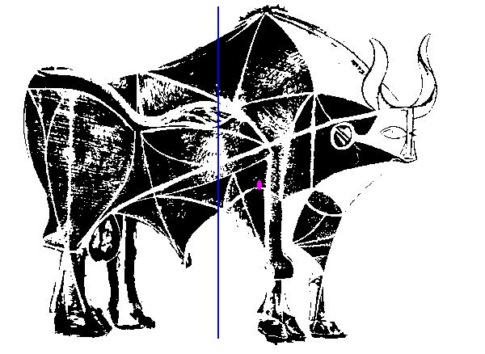
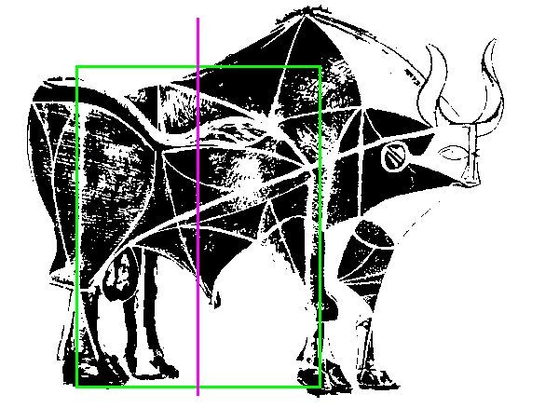
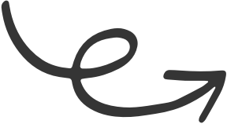
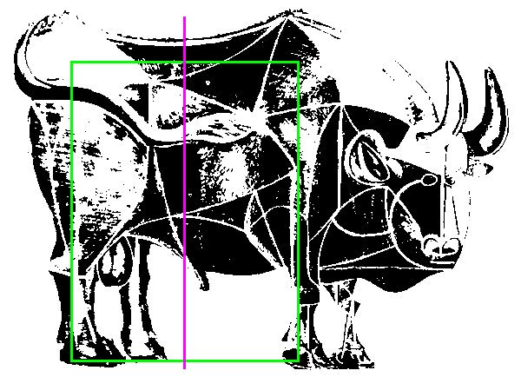
Vertical axis
Another update that I deed was changing the vertical reference line.
After staring at the bulls for several minutes, I realized that the my brain does NOT perceive the inclination of the bull against the pure midpoint line of the whole body of the bull.
Instead, the reference line I am taking is the middle of the front and back legs, as the animal, in fact, balances itself on its four legs.
Thus, my next step was to update the vertical reference line.

Slide 4
Calculating the center of mass over removals
Notice also how the point is being “lifted” to come
closer to the ellipsoidal axis of the body.

Slide 5
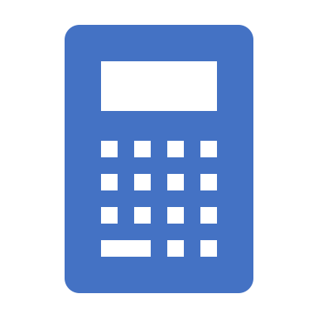
In numbers
If we talk in numbers, and plot the distance of the weighted center of mass from the reference line, we will notice exactly what we expected.
At first, when we remove the tail part, the bull will “lean” forward and the distance will increase.
Then, by reproducing Picasso’s actions, we will gradually correct the balance and the distance will decrease and become closer to that of plate 4.

Slide 6
