Slide 1


Anete Rudzite
Data Analytics
Amsterdam, 2019

Slide 2
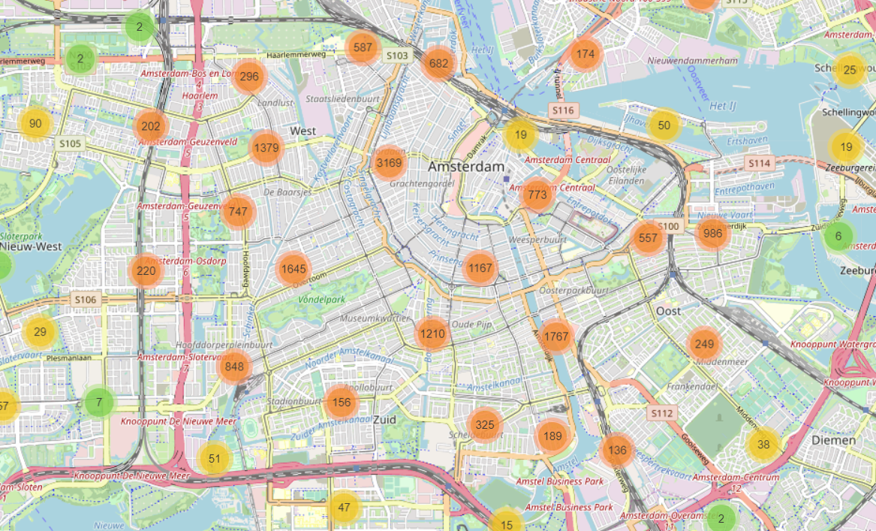
Data
20 000 Airbnb listings in Amsterdam as of December 6th, 2018
Source: Kaggle
> 80 variables (neighborhood, price, host response time, amenities, etc.)
431 830 reviews for 17624 apartments

Slide 3
Questions
Q1: Is it possible to predict the price per night?
Q2: Exploratory analysis of reviews: what are the most important factors for guests?
Q3: Is it possible to predict the review sentiment?

Slide 4
DATA EXPLORATION

Slide 5
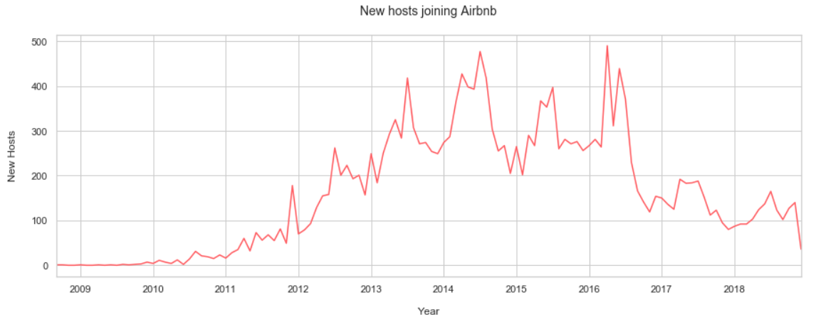
Data exploration I

Slide 6
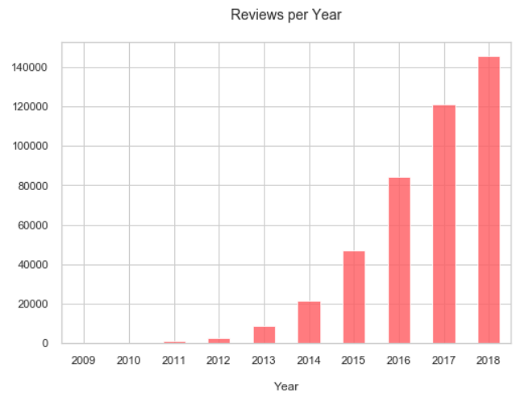
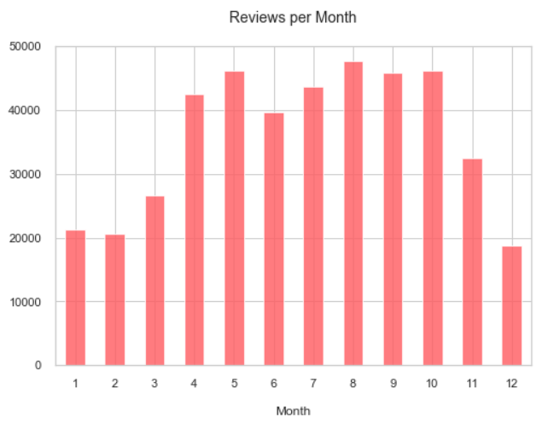
Data exploration II

Slide 7
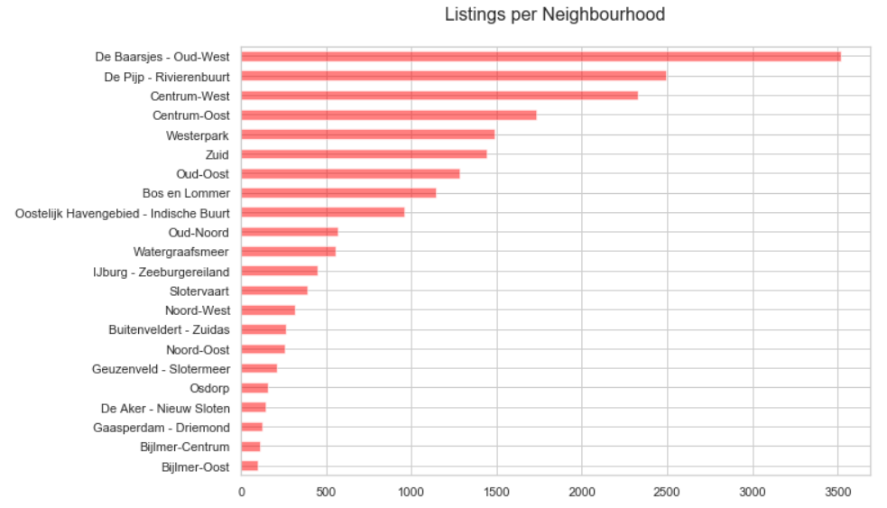
Data exploration III

Slide 8
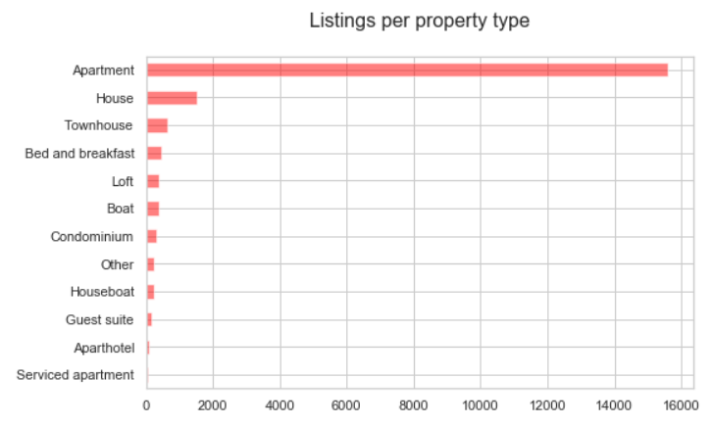
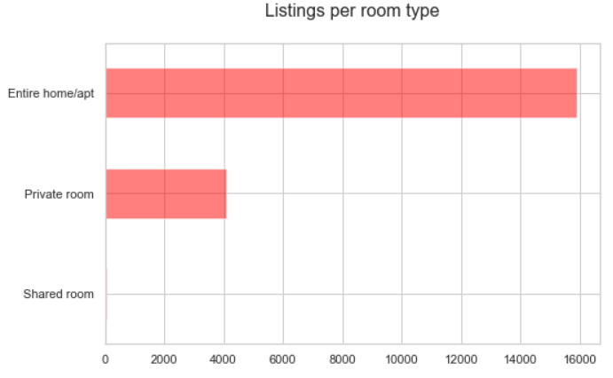
Data exploration IV

Slide 9
Q1: Is it possible to predict the price per night?

Slide 10
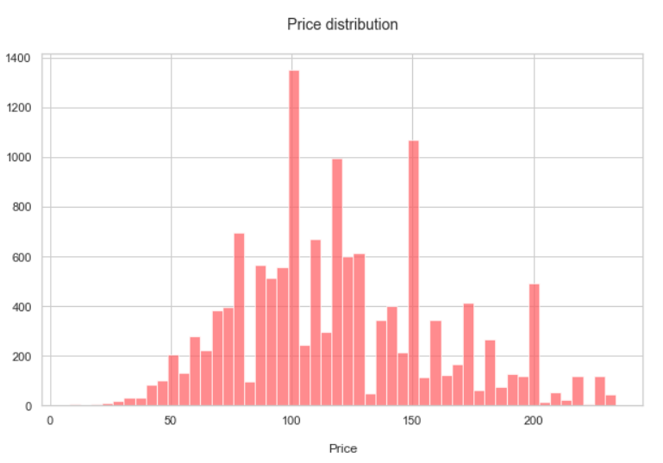
Q1. Predicting the price

Slide 11
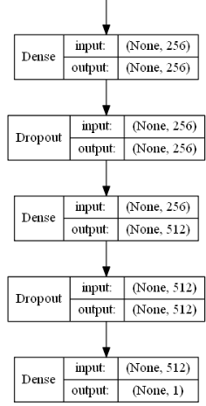
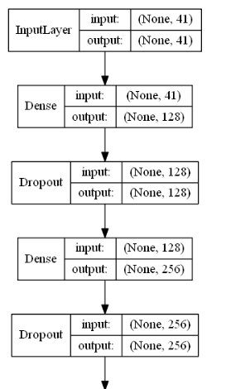
Q1. Predicting the price
Notes:
Sequential model
5 Dense layers
4 Dropout layers – to minimize the overfitting
ReLU (Rectified Linear Unit) Activation Function

Slide 12
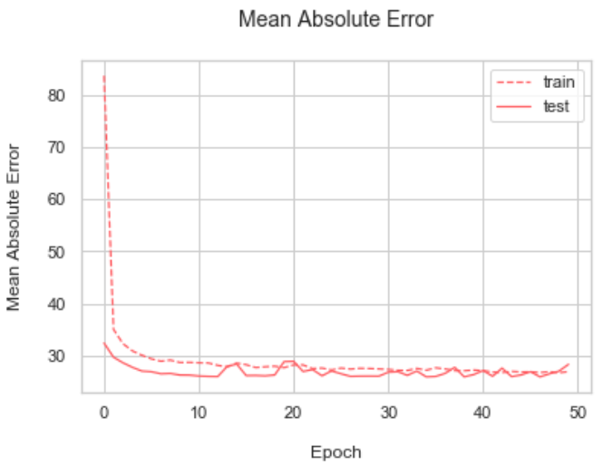
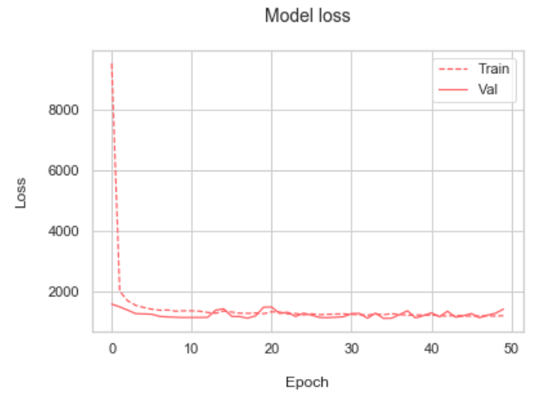
Q1. Predicting the price
MAE: 27.5

Slide 13
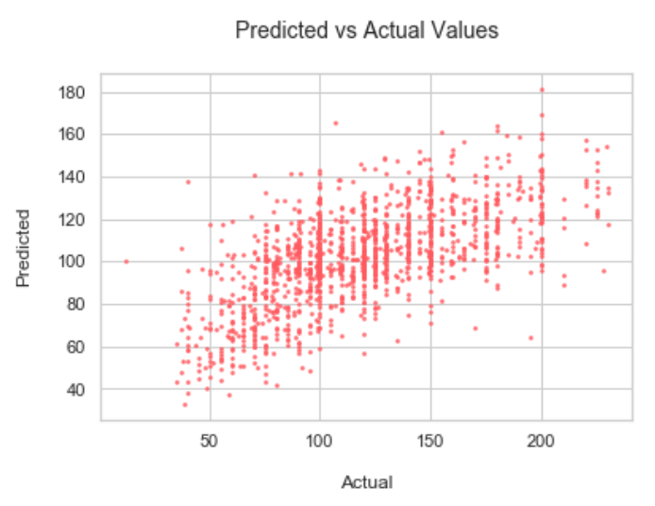
Q1. Predicting the price

Slide 14
Q2: Exploratory analysis of reviews: what are the most important factors for guests?

Slide 15
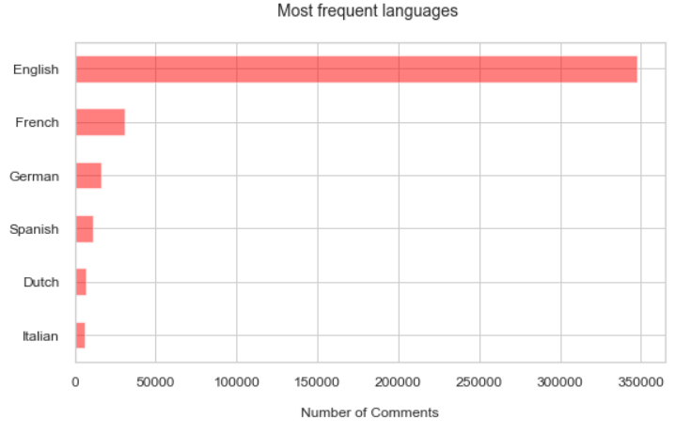
Q2. Exploratory analysis of reviews

Slide 16
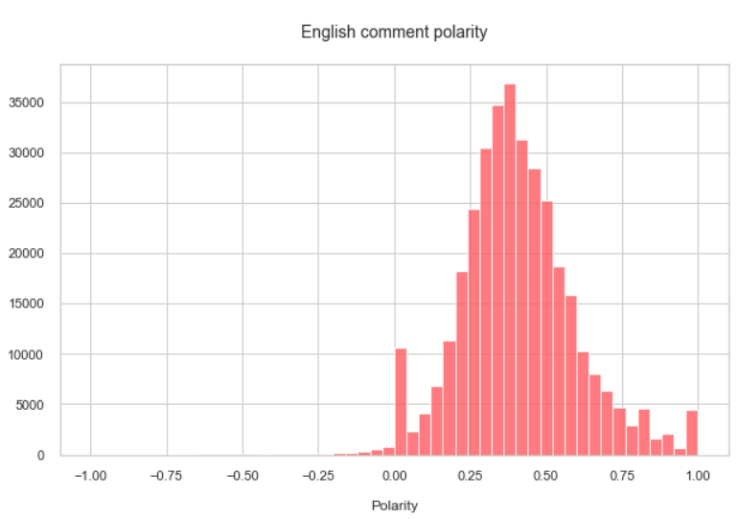
Q2. Exploratory analysis of reviews

Slide 17
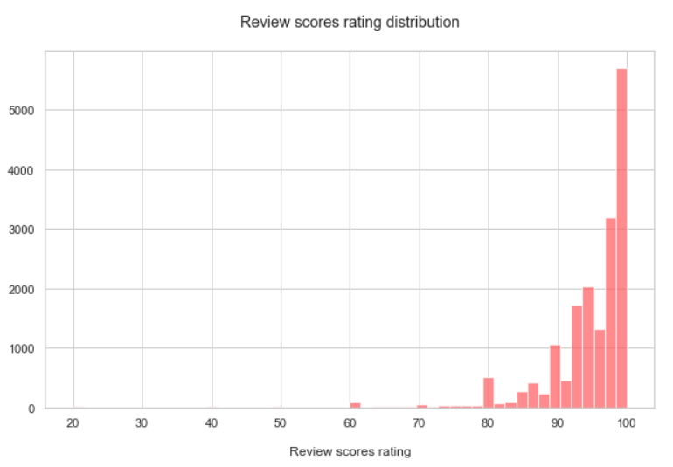
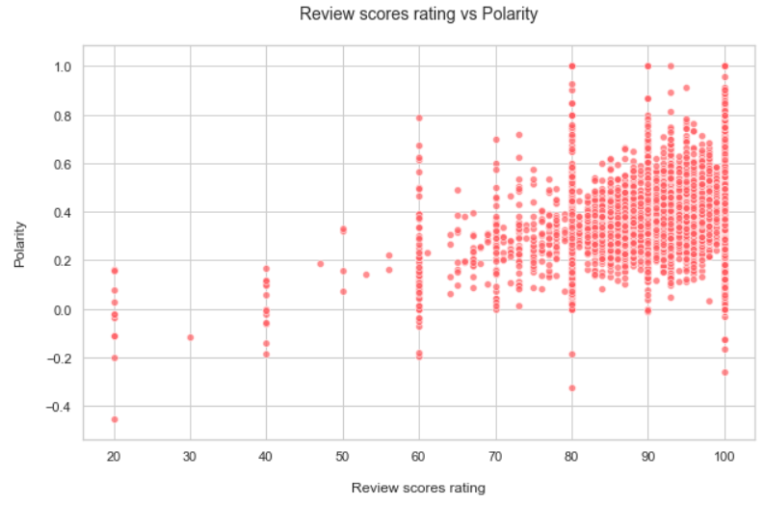
Q2. Exploratory analysis of reviews
r: 0.3

Slide 18

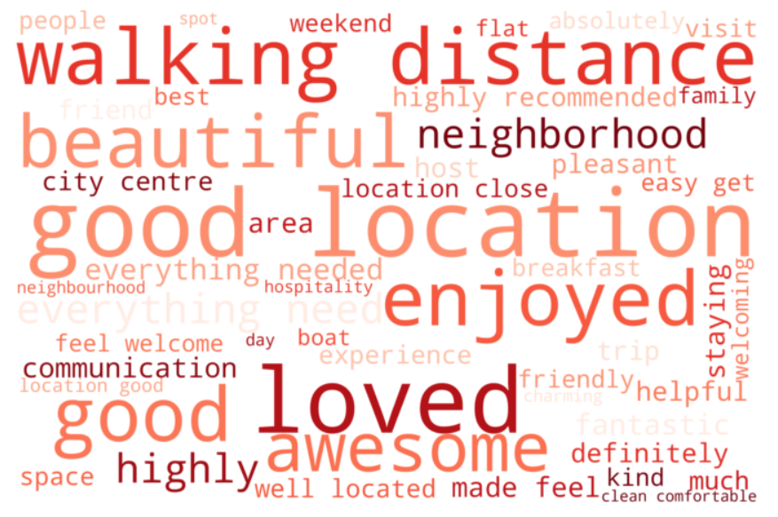
Q2. Exploratory analysis of reviews
“My stay was great!”
“Perfect apartment in a perfect location. And jitske is the nicest host ever.”
“Awesome houseboat with a great location!”
“Great experience! Consigliato!”
“Had a great stay! Everything was as described und Maikel was the perfekt host. I'd definetely recommend this apartment.”

Slide 19

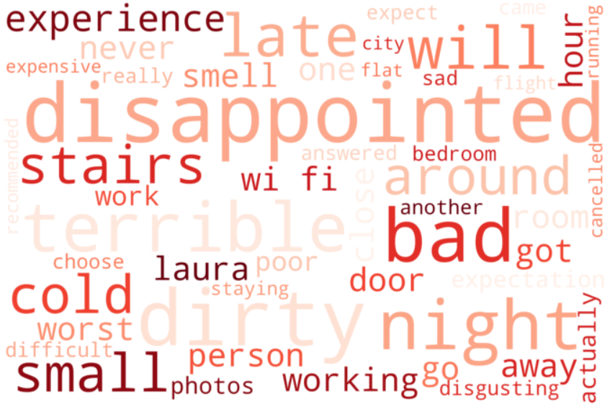
Q2. Exploratory analysis of reviews
“Worst experience ever due to bad wifi that host promised to fix but never did. Add a rodent running around the kitchen and late night bar noise ... and we were very disappointed !”
“It’s so bad home”
“The place is in disrepair and very dirty.”
“Her behavior was terrible. no polite. and the house inside the dirt”

Slide 20
Q3: Is it possible to predict the sentiment of reviews?

Slide 21
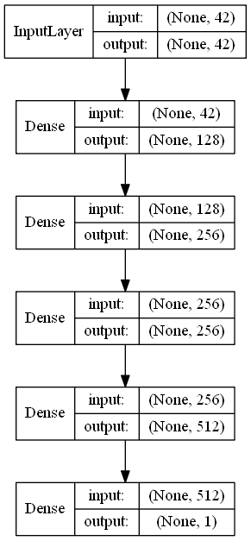
Q3. Predicting the average review polarity

Slide 22
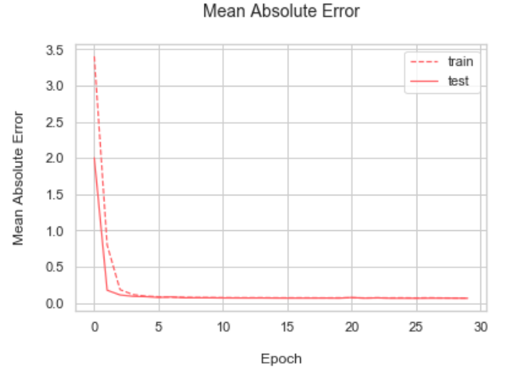
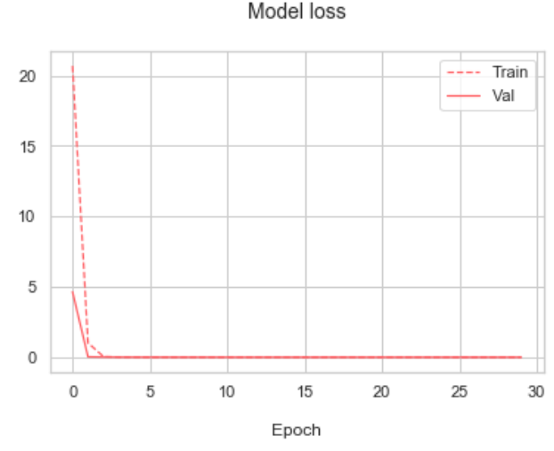
Q3. Predicting the average review polarity
MAE: 0.07

Slide 23
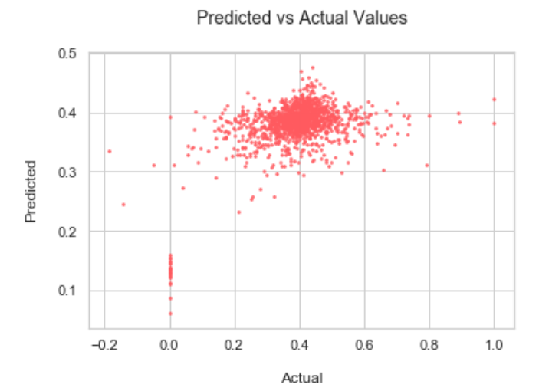
Q3. Predicting the average review polarity

Slide 24
CONCLUSIONS

Slide 25
Conclusions I
The price per night can be predicted with the Mean Absolute Error of 27.5
There could be other factors that affect the price (for example, the quality of photos)
The average review polarity can be predicted with the Mean Absolute Error of 0.07

Slide 26
Conclusions II
The most important factors for Airbnb guests:
Location, accessibility
Cleanliness
Breakfast included
Communication
Wifi
Price

Slide 27
THANK YOU

