Slide 1

MOST RATED BOARD GAMES
BoardGameGeek Ratings

Slide 2
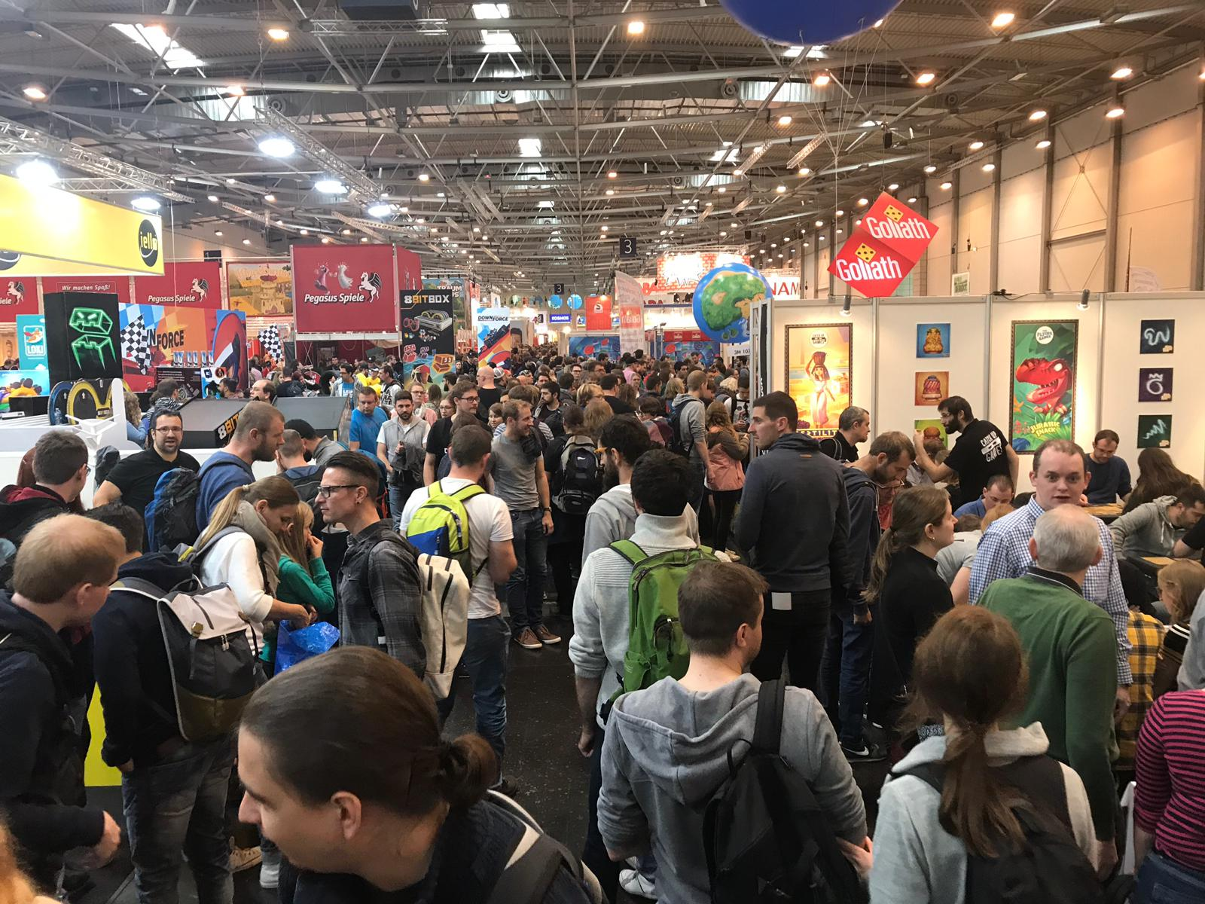
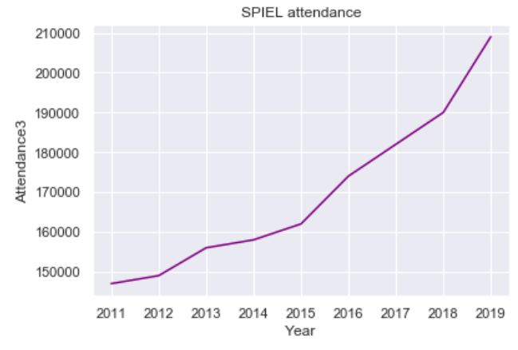
Why board games?
‘The global playing cards and board games market size is anticipated to reach USD 21.56 billion by 2025, according to a new report by Grand View Research, Inc.’¹ - Bloomberg, Oct. 9, 2019
SPIEL / Essen Game Fair (Germany) has seen an increase in attendees
Board games are fun!
¹ www.bloomberg.com

Slide 3
But sometimes…

Slide 4


Data
13M ratings from BoardGameGeek online forum
17k games
2.6M comments
Source: Kaggle.com
Text processing library: TextBlob

Slide 5
Questions
What is the correlation between the average rating of a game and the average comment length?
What is the correlation between the average rating and the average comment polarity?
What games attract most ratings in the ‘Family’ rank?

Slide 6
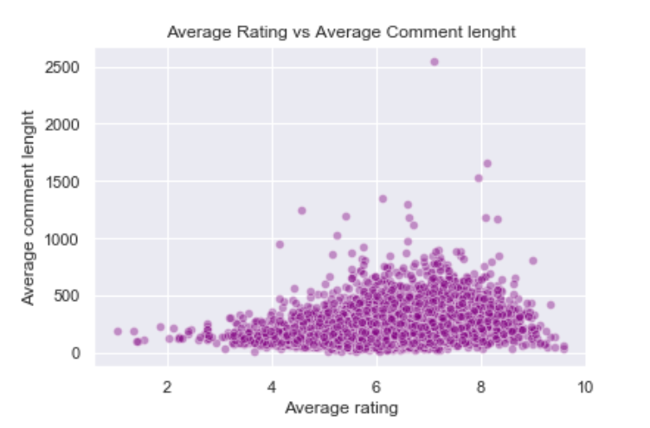
What is the correlation between the average rating of a game and the comment length?
r=0.34

Slide 7
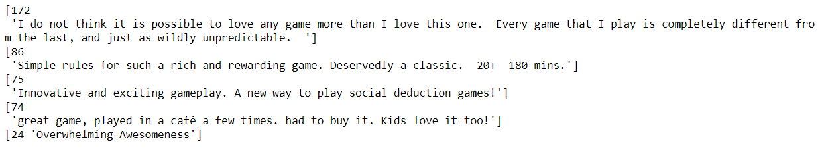
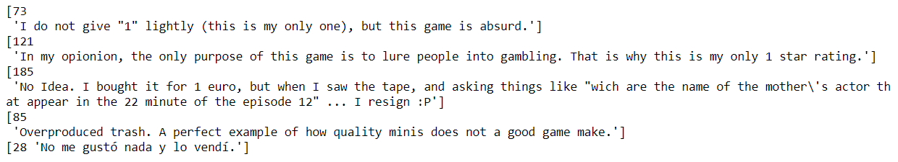
What is the correlation between the average rating of a game and the comment length?
Comment samples:
Rating: 10
Rating: 1

Slide 8
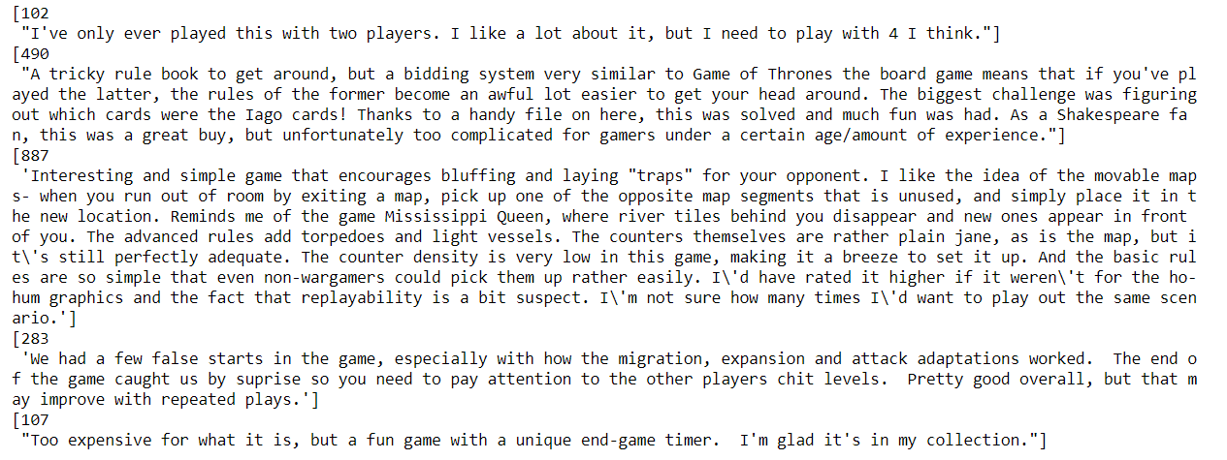
Do the highest and lowest rated games have longer comments?
Comment samples:
Rating: 7

Slide 9
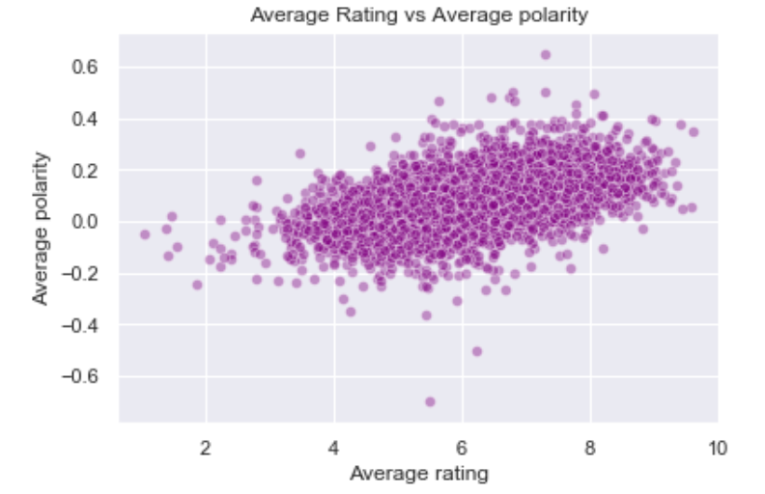
What is the correlation between the average rating and the average comment polarity?
r=0.5

Slide 10
What games attract most ratings in the ‘Family’ rank?
As the board game popularity increases, it is expected that more games will be designed for specific groups – for example, families, millennials¹
11% of the ranked BGG games are in the Family Game Rank
Defining the top ‘Family’ games (724):
Rated 6.0 or higher
Published since 2010
Features:
Game mechanics
Playing time
Weight (complexity)
Average of the number of players
Min age
Language dependency
¹ www.bloomberg.com

Slide 11
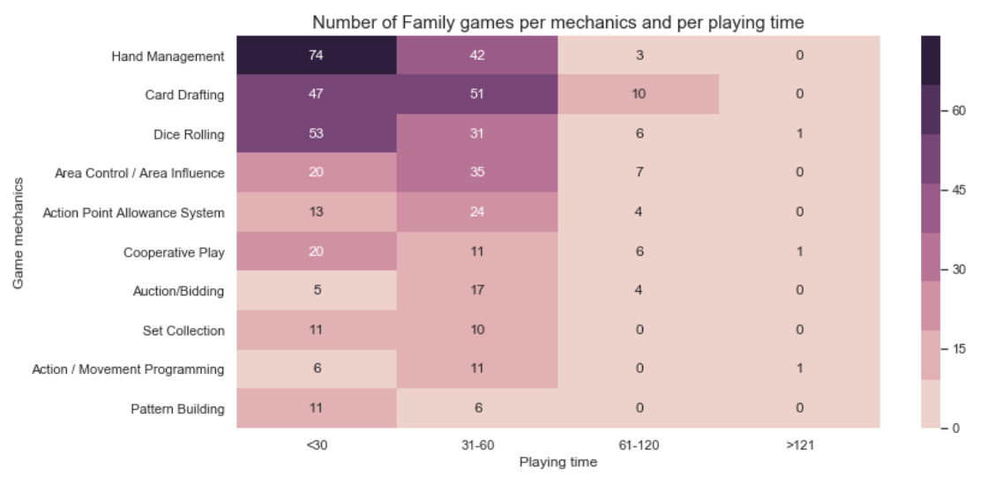
What games attract most ratings in the ‘Family’ rank?

Slide 12
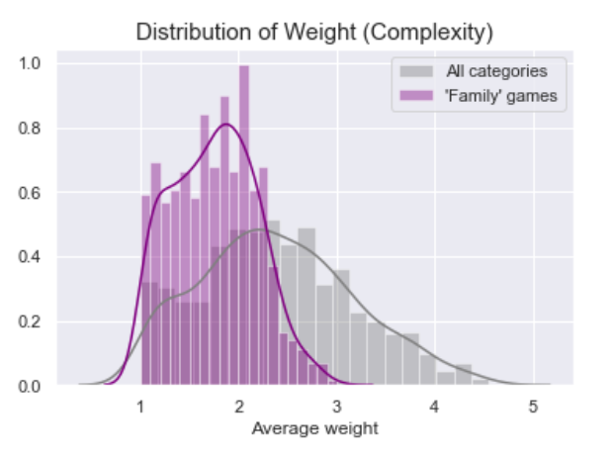
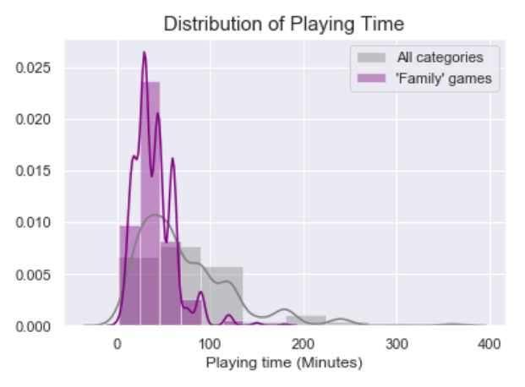
What games attract most ratings in the ‘Family’ rank?

Slide 13
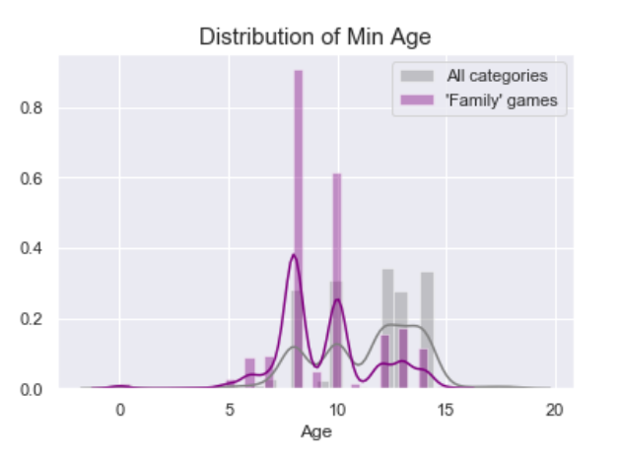
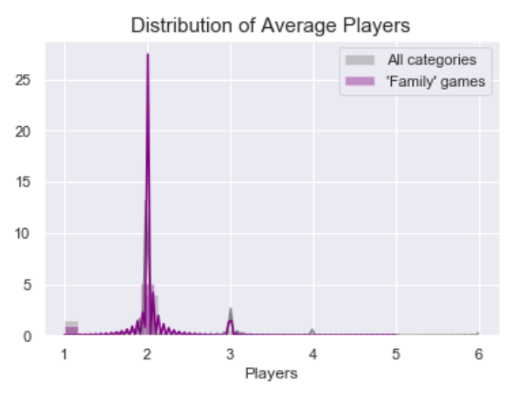
What games attract most ratings in the ‘Family’ rank?

Slide 14
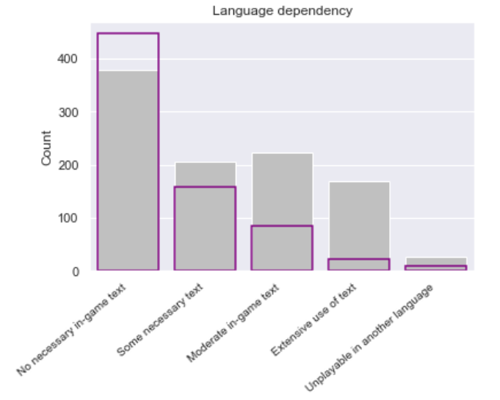
What games attract most ratings in the ‘Family’ rank?

Slide 15
Summary
Average rating and comment length have a weak positive linear correlation (r=0.34). Games that have been rated between 6 and 8 have the longest comments
There is a moderate positive correlation (r=0.5) between the rating and polarity of the comments
Most ‘Family’ games have:
‘Hand Management’ mechanics
playing time below 60 minutes
weight (complexity) of 2 (5-point scale)
average number of players of 2
min age of players below 10

Slide 16
THANK YOU!

