Slide 1

Absenteeism at work

Slide 2
Dataset
Categorical data
Month of absence
Reason for absence (28)
Day of the week (Monday (2) Tuesday (3), Wednesday (4), Thursday (5), Friday (6))
Seasons (summer (1), autumn (2), winter (3), spring (4))
Disciplinary failure (yes=1; no=0)
Education (high school (1), graduate (2), postgraduate (3), master and doctor (4))
Son (number of children)
Social drinker (yes=1; no=0)
Social smoker (yes=1; no=0)
Pet (number of pet)
Numerical data
Transportation expense
Distance from Residence to Work (kilometers)
Service time
Age
Weight
Height
Body mass index
Absenteeism time in hours

Slide 3
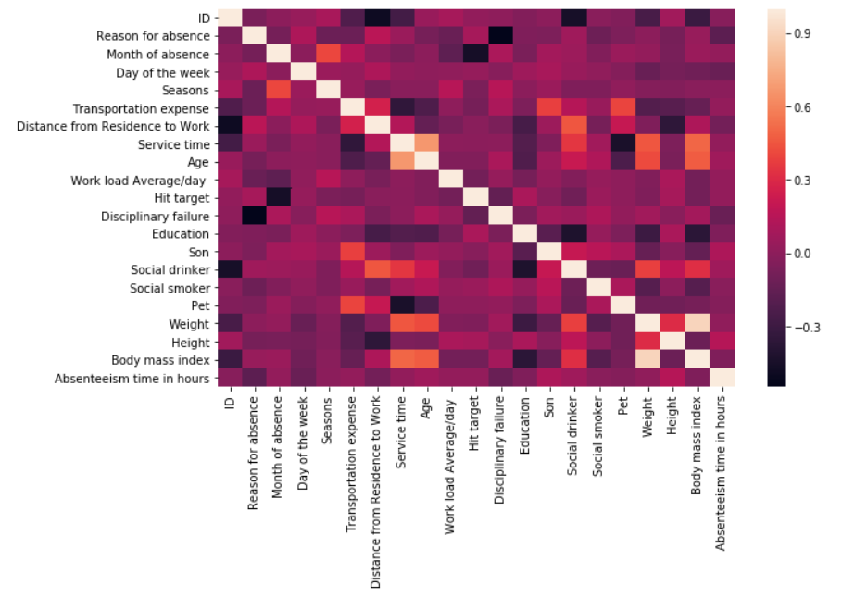
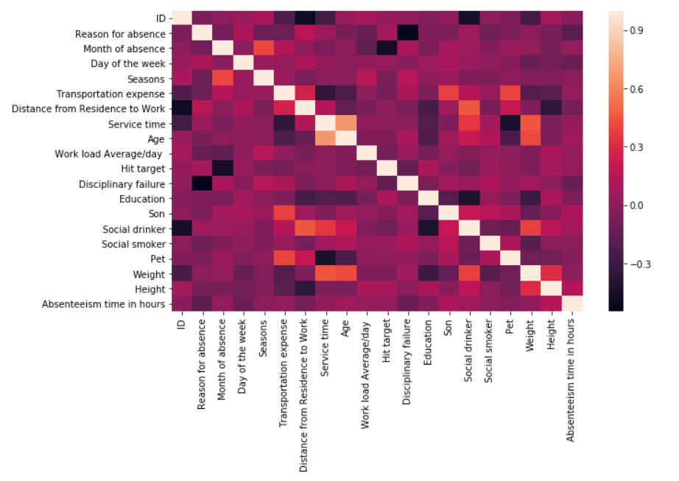
Cleaning the data

Slide 4
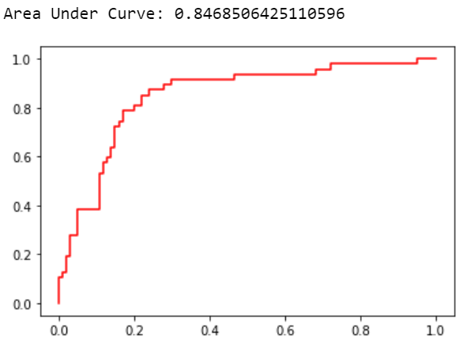
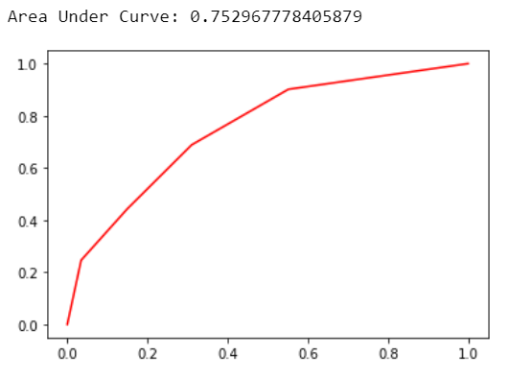
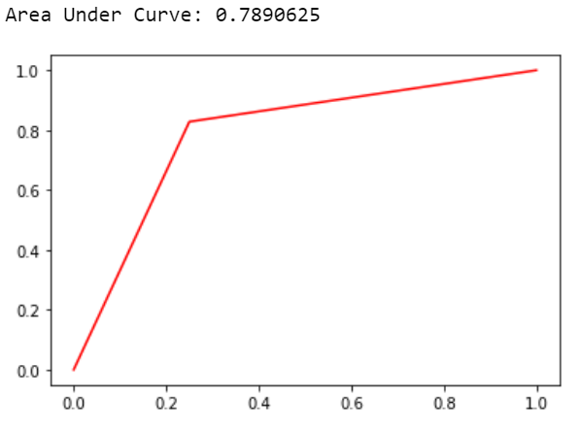
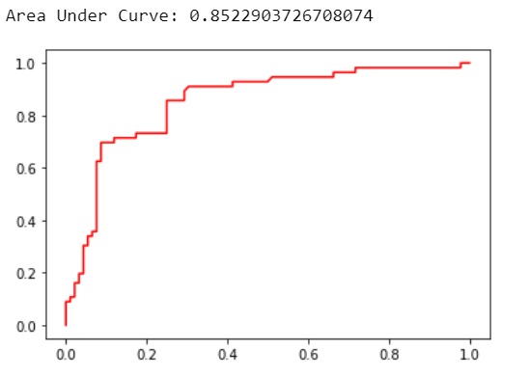
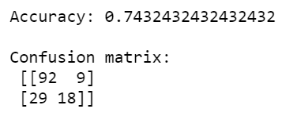
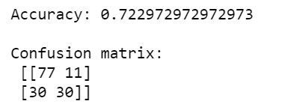
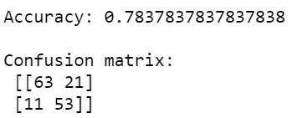
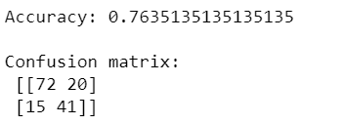
Predicting employee absenteeism
Support Vector Machine (SVM)
K-Neighbors Classifier
Decision Tree
Logistic Regression

Slide 5
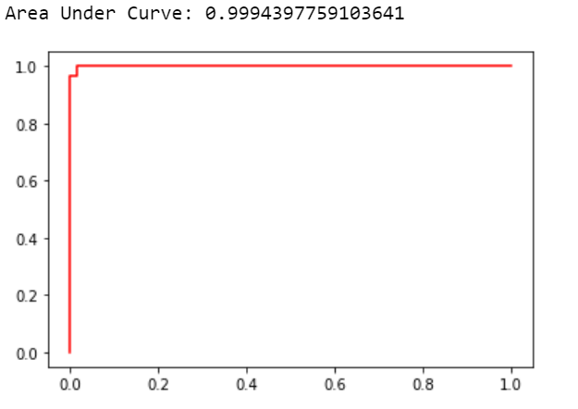
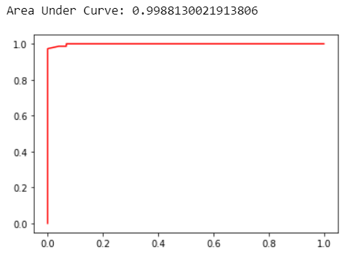
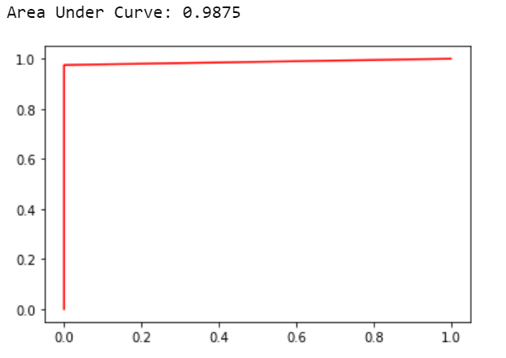
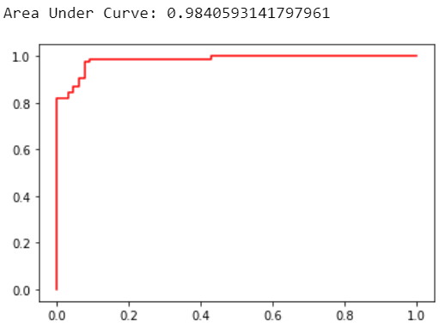
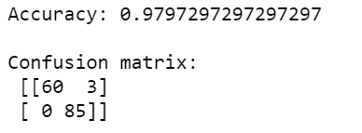
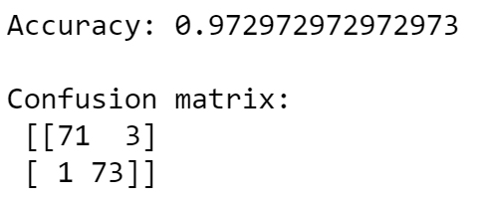
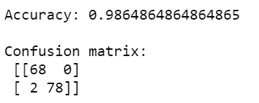
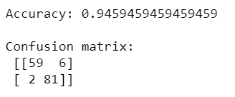
Predicting if employees are social drinkers
Support Vector Machine (SVM)
K-Neighbors Classifier
Decision tree
Logistic Regression

Slide 6
Conclusions
Logistic Regression is the best model to predict employee absenteeism (auc=0.98)
Support Vector Machine (SVM) is the best model for predicting if employees are social drinkers (auc=0.979)

Slide 7

Thank you!

