Slide 1
Pentium
Address Translation
Notes:
郭浩滨

Slide 2
Two parts
Segmentation
isolating individual modules (code, data, stack...)
multiple programs (or tasks) can run on the same processor without interfering with one another
when in protected mode, some form of segmentation must be used
Paging
implementing a demand-paged virtual memory system
sections of a program’s execution environment are mapped into physical memory as needed
Notes:
分页提供了一种实现分页请求的虚拟内存系统，程序执行环境的部分根据需要映射到物理内存。

Slide 3
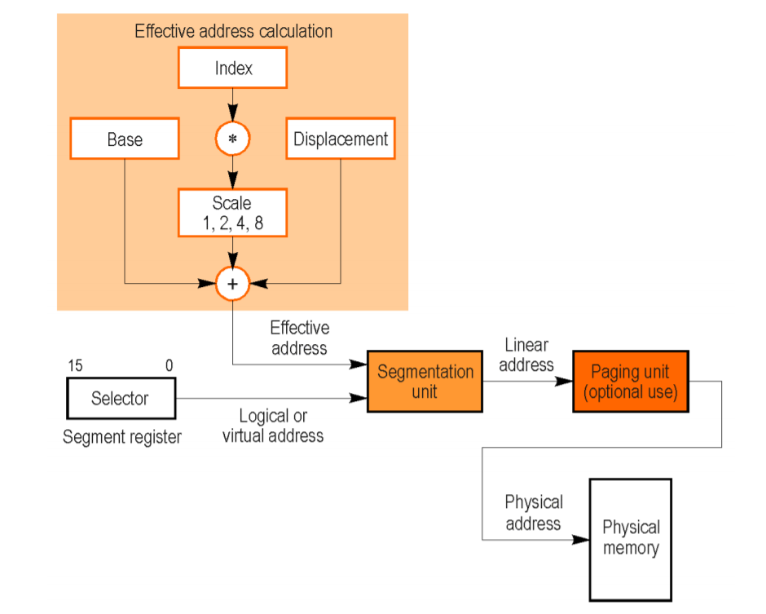
Address translation
virtual → linear → physical
selector : offset
segment descriptor
Effective Address = base + (index * scale) + displacement
Notes:
段单元将虚拟地址转化成一个线性地址，如果没有运用页式存储技术，线性地址就是物理地址，如果运用……
段选择器是一个段的识别符，包含了它在段描述符表中的位置
段描述符表定义了段的起始地址，空间大小，访问权限等属性

Slide 4
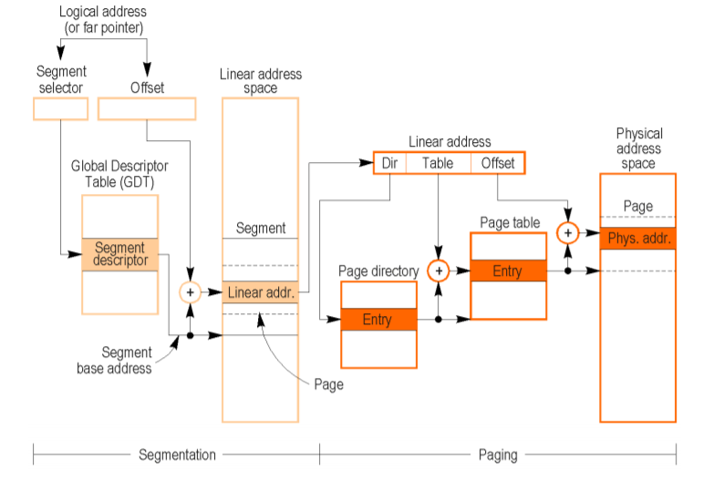
Segmentation and paging
Notes:
在多道程序设计中，处理器会建立这些段之间的边界，确保一个程序不会写到另一个程序段
段对内存有分割和保护的作用，在特定类型的段中，进程对其操作是收到相应限制的

Slide 5
Segmentation
used to implement a wide variety of memory systems
flat model
simplest
protected flat model
like flat model
segment limits are set
provides a minimum level of hardware protection
multi-segment model
each program is given its own table of segment descriptors and its own segments
access check
Notes:
平面存储器模型
The segments can be private to their assigned programs or shared among programs.
访问检查
Access checks can be used to protect not only
against referencing an address outside the limit of a segment, but also
against performing illegal operations in certain segments.

Slide 6
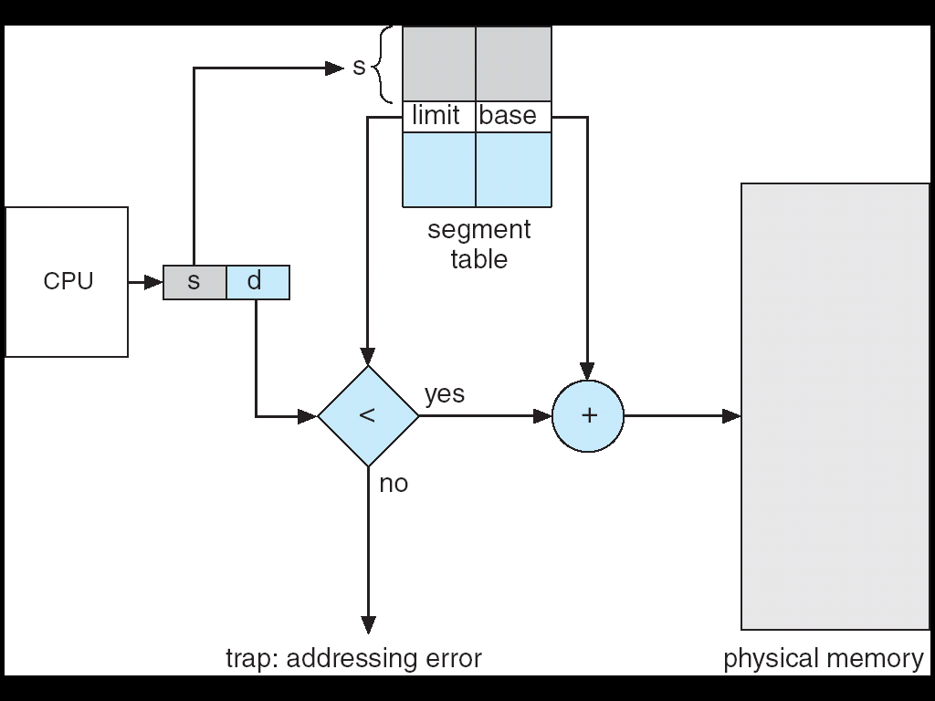
Segmentation
Logical address
segment-number
Offset
Segment table
base: starting physical address
limit: length

Slide 7
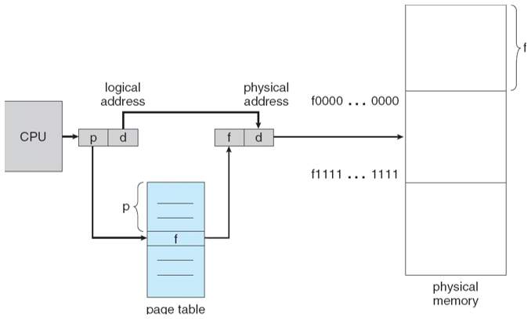
Paging
fixed size (different from segment)
mapping from virtual to physical
do not need to be contiguous
page-fault exception
Notes:
如果不在主存，处理器会发出一个中断，将磁盘的页读到内存中（可能会涉及到页面调度），然后继续执行程序
当用到页式存储技术时，每个段被分为几个页，可能存在物理内存，也可能会在辅存（磁盘）

Slide 8
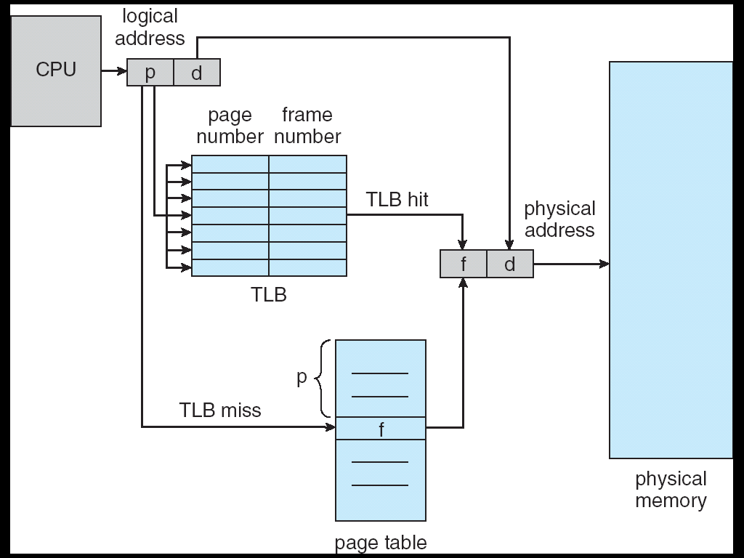
TLB
Problem: each data/instruction access requires two memory accesses
One for the page table and one for the data/instruction
In cache
Hit ratio
Notes:
To minimize the number of bus cycles required for address translation, the processor holds the most recently accessed page-directory and page-table entries in cache memories called translation look-aside buffers (TLBs)
translation look-aside buffers
转译后备缓冲区 快表
Address translation (p, d)
If page number is in associative register, get frame # out
Otherwise get frame # from page table in memory
命中率

Slide 9
Thanks!

