Slide 1
GitHub for Analytics and Data Teams
One-Day Training | ABUHB Business Intelligence

Slide 2
Agenda
Today's Sessions
09:00 - 09:30 | Why GitHub for Data Teams (30 minutes)
09:30 - 10:15 | Introduction to GIT (45 minutes)
10:15 - 11:00 | Branching and Sync Operations (45 minutes)
11:00 - 11:30 | GitHub Cloud Interface (30 minutes)
11:30 - 12:15 | Lunch
12:15 - 12:45 | Codespaces Workspace and File Management (30 minutes)
12:45 - 13:15 | VS Code Integration and Notebooks (30 minutes)
13:15 - 13:50 | Issues, Projects and Discussions (35 minutes)
13:50 - 14:35 | Codespaces and Copilot Hands-On (45 minutes)
14:35 - 15:00 | Group Exercises and Consolidation (25 minutes)
All hands-on work uses the training repository and synthetic data only. Never use real patient data in GitHub or Codespaces.

Slide 3
Why GitHub for Data Teams
Session 1 | 30 minutes
Notes:
Detail for this session: Training/01_Session_1_Why_GitHub_for_Data_Teams.md

Slide 4
What is GitHub?
Git — the engine
Version control system that tracks changes to files over time
Distributed — every user has a complete copy of the project history
Branching — separate lines of development for different pieces of work
GitHub — the platform
Web interface for working with Git repositories
Collaboration tools — issues, pull requests and project boards
Secure cloud hosting, with permissions and access control
Git is the engine. GitHub is the platform built around it.
Notes:
Detail for this session: Training/01_Session_1_Why_GitHub_for_Data_Teams.md

Slide 5
GitHub Enterprise Cloud: What We Use (Not GitHub Free)
ABUHB uses GitHub Enterprise Cloud
Our organisation is a paid Enterprise Cloud account, not a personal GitHub Free account
You sign in with your ABUHB identity and access is controlled through the organisation
Admins set the policies for repositories, Codespaces, Copilot and security
What the paid plan gives us that Free does not
Enforced branch protection and required reviews on private repositories
Organisation-wide access control, single sign-on and an audit log
Copilot Business licences and organisation controls for Codespaces
Advanced Security products for private repositories (covered in Session 7)
Do your NHS work only in the ABUHB organisation. Never use a personal Free account for it.
Notes:
Detail for this session: Training/01_Session_1_Why_GitHub_for_Data_Teams.md

Slide 6
Before You Start: Your Setup Checklist
You should already have
A GitHub account that is a member of the ABUHB organisation (Azure AD group ABB_BIU_GitHub_Users)
A browser that can open Codespaces (nothing else to install). GitHub Desktop and VS Code are optional
Signed in to GitHub, with single sign-on authorised for the organisation
Optional: access to the ndr-hb-abuhb-academy Google Cloud project, for the SQL extension at the end of the day
A GitHub personal access token, stored safely, if your trainer asks for one
If something is missing
Ask the GitHub admin team: ABB.BIU.GitHub.Admin@nhswales365.onmicrosoft.com
Every new repository needs an approved HALO ticket
Full step-by-step instructions are in Training/00_Setup_and_Access.md.
Notes:
Detail for this session: Training/01_Session_1_Why_GitHub_for_Data_Teams.md

Slide 7
Creating a Personal Access Token (PAT)
A token is a password for one job
Open GitHub, then Settings, Developer settings, Personal access tokens, Fine-grained tokens
Choose Generate new token, name it, and pick the ABUHB organisation as resource owner
Set a short expiry and select only the repositories you need
Give the least access: Contents and Pull requests read and write, Metadata read
Copy the token once and save it in your credential manager or password manager
Never put a token in code, a notebook, an issue or a Copilot prompt. If one leaks, revoke it at once.
Notes:
Detail for this session: Training/01_Session_1_Why_GitHub_for_Data_Teams.md

Slide 8
GitHub for Healthcare Analytics
Faster development
Remove technical barriers to collaborative work
Reuse shared code and resources instead of starting again
Enhanced security
Share code securely, within approved protocols
Controlled access and an audit trail for compliance
Improved insights
Efficient collaboration across teams and organisations
A change log for every modification, surfaced in pull requests
Notes:
Detail for this session: Training/01_Session_1_Why_GitHub_for_Data_Teams.md

Slide 9
Why GitHub for Data Teams?
Collaboration and auditability
SQL, Python and notebooks live in repositories — not email or personal folders
Every change is tracked, reviewed and documented
Notebooks gain version history and reproducibility
Single source of truth
One canonical repository per project or product
Protected main branch — only reviewed code reaches production
Tagged releases for specific versions (for example "Q1-2024-Report")
Notes:
Detail for this session: Training/01_Session_1_Why_GitHub_for_Data_Teams.md

Slide 10
Rollback and Traceability
Rollback
A production problem? Revert to the last working version
No manual restoring from backups
Traceability
Issue → Branch → Code → Tests → Pull Request → Review → Merge → Deploy → Issue closed
Supports regulatory audit, quality assurance and knowledge transfer
Notes:
Detail for this session: Training/01_Session_1_Why_GitHub_for_Data_Teams.md

Slide 11
Setting Up Repositories for Success
Repository structure
README.md for project overview and setup
sql/ for extracts, transforms and reports
python/ for source code, notebooks and tests
docs/ for methodology, results and compliance
Naming conventions
Branches — feature/new_api_onboarding, bugfix/measure_count, hotfix/urgent_data_sync
Commit messages — a clear summary line, then detail, then "Closes #123"
Notes:
Detail for this session: Training/01_Session_1_Why_GitHub_for_Data_Teams.md

Slide 12
Repository Governance
Why govern new repositories?
Consistent naming, and private by default
Confirms data classification and security requirements
Least-privilege access from day one
Links purpose → approval → configuration for audit
A repository request covers
Name, purpose and maintainers
Data classification and visibility
Team access levels and compliance notes
No patient data in GitHub — ever.
Notes:
Detail for this session: Training/01_Session_1_Why_GitHub_for_Data_Teams.md

Slide 13
How Access and New Repositories Work at ABUHB
Access
Access comes from the Azure AD group ABB_BIU_GitHub_Users
Questions go to the GitHub admin team
New repositories
Raise a HALO ticket with the name, purpose, data classification and access list
The admin team creates the repository once the ticket is approved
Notes:
Detail for this session: Training/01_Session_1_Why_GitHub_for_Data_Teams.md

Slide 14
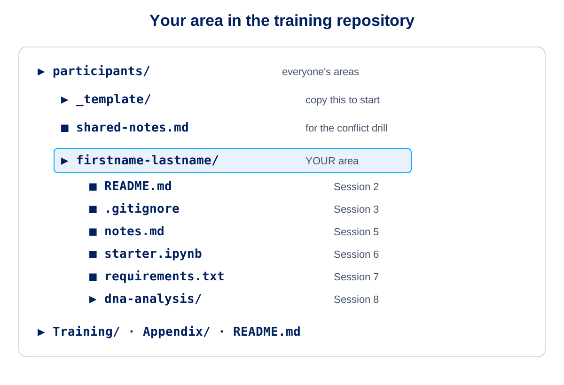
Your Area: Checkpoint 1
Find your area and open your workspace (5 minutes)
Sign in to GitHub with your ABUHB account and open the training repository
Open the participants folder and find your folder, named firstname-lastname
On the repository page choose Code, Codespaces, Create codespace on main: this is your workspace for the whole day
Check that the terminal and editor open
Your folder now contains
A running Codespace, and you know where your folder is: participants/<your-folder>
Notes:
Detail for this session: Training/01_Session_1_Why_GitHub_for_Data_Teams.md

Slide 15
Introduction to GIT
Session 2 | 45 minutes
Notes:
Detail for this session: Training/02_Session_2_Introduction_to_GIT.md

Slide 16
GIT vs GitHub
GIT
A distributed version control system, created in 2005
Fast — most operations are local
Data integrity — everything is checksummed before storage
Free and open source
GitHub
A cloud platform built on top of GIT
Adds pull requests, issues, projects, team management and Actions
GIT is the engine that manages version control. GitHub adds collaboration.
Notes:
Detail for this session: Training/02_Session_2_Introduction_to_GIT.md

Slide 17
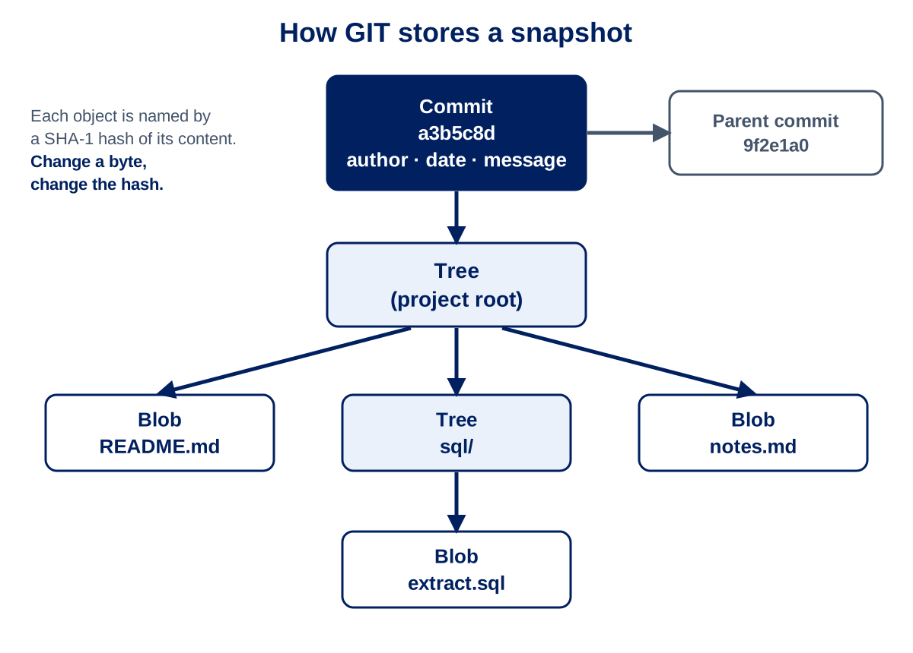
How GIT Stores Your Work
The object model
Blob — file content
Tree — directory structure
Commit — a snapshot with metadata
Tag — a named reference to a commit
Snapshots and integrity
GIT stores snapshots of the whole project, not differences
Objects are addressed by a SHA-1 hash — any change gives a different hash
Nothing changes or corrupts undetected
Notes:
Detail for this session: Training/02_Session_2_Introduction_to_GIT.md

Slide 18
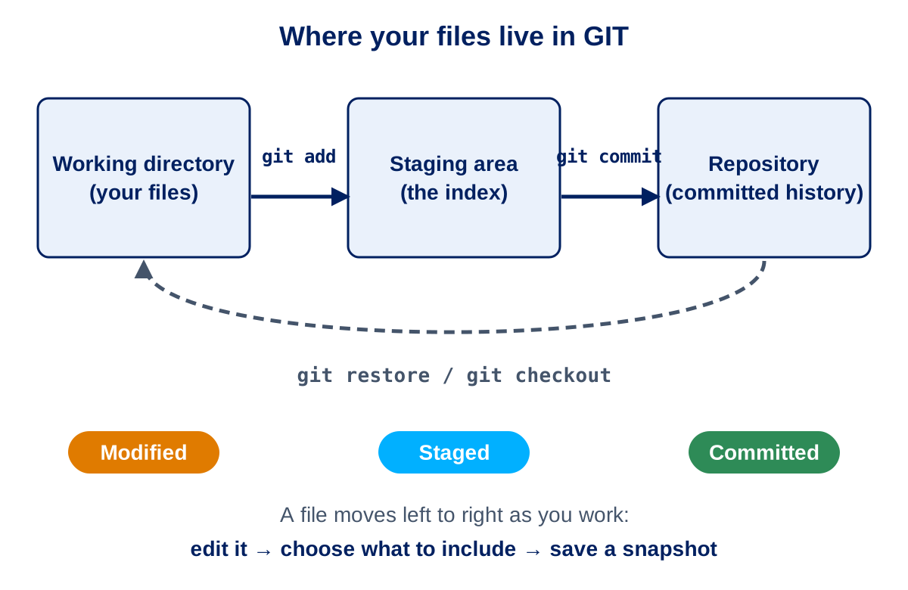
The Three-Tree Architecture
Three places your files live
Working directory — where you edit files
Staging area (index) — what will go into the next commit
Repository (HEAD) — the committed history
The three states of a file
Modified → Staged → Committed
Staging lets you choose exactly which changes belong in each commit.
Notes:
Detail for this session: Training/02_Session_2_Introduction_to_GIT.md

Slide 19
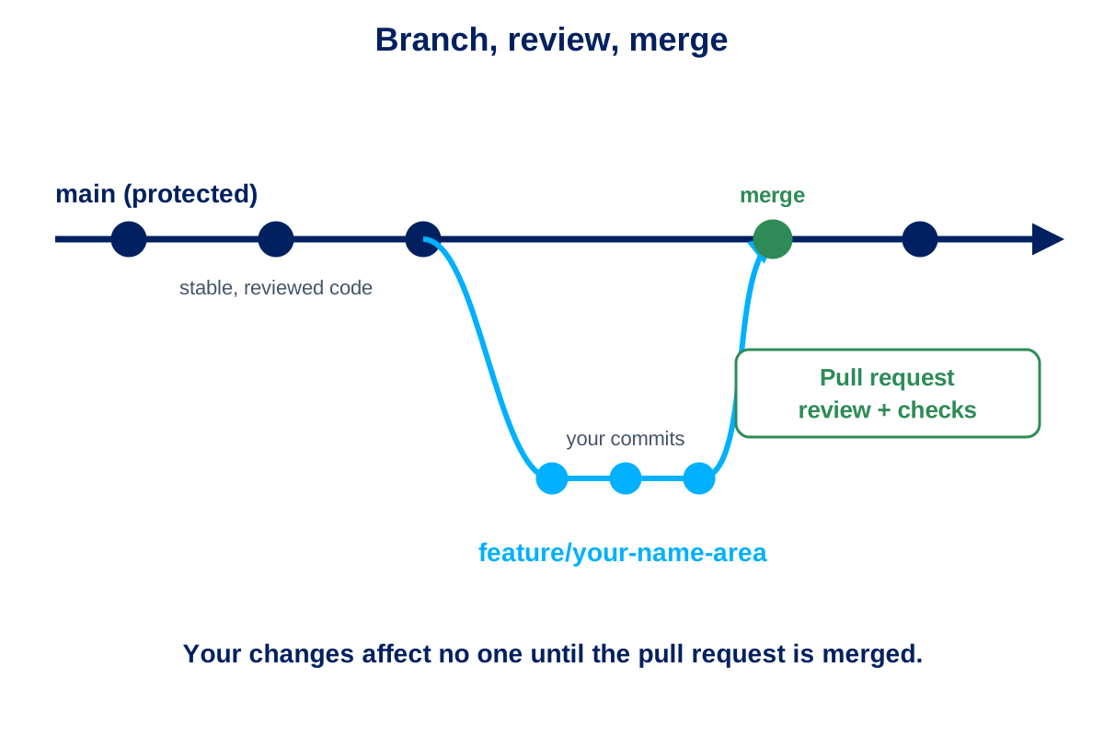
Commits, Branches and HEAD
Core concepts
Commit — the building block of history
Branch — a lightweight, movable pointer to a commit
Tag — a fixed pointer to a commit, used for releases
HEAD — your current position in the repository
Basic operations
init, add, commit and log
Branching creates a new line of work; merging brings it back together
Notes:
Detail for this session: Training/02_Session_2_Introduction_to_GIT.md

Slide 20
Why GIT's Design Matters for Data Teams
What you get
Data integrity — checksums protect history
Distributed reliability — every clone is a full backup
Speed — local operations
Safe experimentation — cheap branches
Complete history of every change
Everyone's laptop is a full copy of the project history.
Notes:
Detail for this session: Training/02_Session_2_Introduction_to_GIT.md

Slide 21
Your Area: Checkpoint 2
Create your branch and fill in your README (5 minutes)
In your Codespace terminal, create your branch: git switch -c training/<your-folder>
Open participants/<your-folder>/README.md (already created for you) and fill it in
Stage and commit with the message: Fill in my area README
Run git status and git log to see what you made
Your folder now contains
README.md filled in and committed on your own branch (local only for now)
Notes:
Detail for this session: Training/02_Session_2_Introduction_to_GIT.md

Slide 22
Branching and Sync Operations
Session 3 | 45 minutes
Notes:
Detail for this session: Training/03_Session_3_Branching_and_Sync_Operations.md

Slide 23
Branches and the Three-Stage Workflow
Branches
A branch is a safe draft — changes don't affect anyone until merged
Short-lived branches for focused pieces of analytics work
Working directory → staging area → commit
Stage only the files that belong together
Commit small, logical changes (atomic commits)
Write messages that say what changed and why, linked to an issue
Notes:
Detail for this session: Training/03_Session_3_Branching_and_Sync_Operations.md

Slide 24
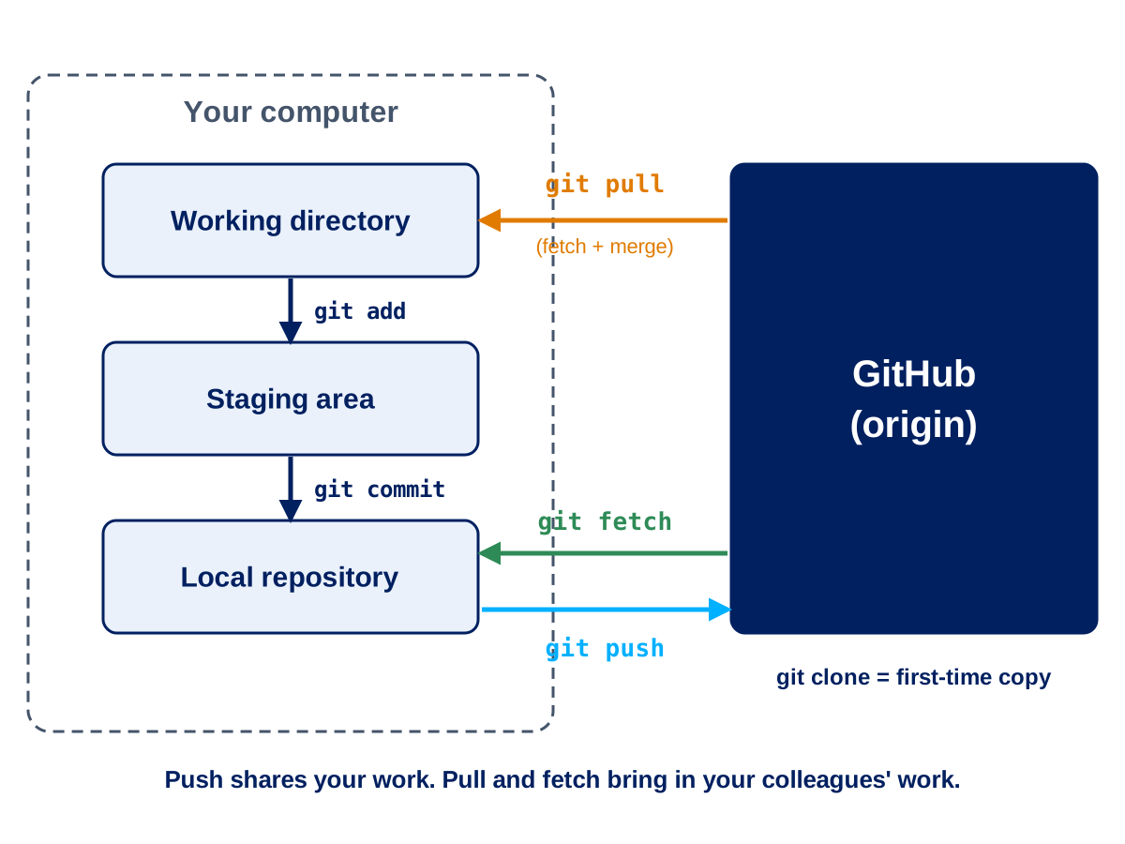
Remotes — Clone, Fork, Push, Pull and Fetch
Getting the code
Origin — the default name for the shared repository on GitHub
Clone — for team members
Fork — for external contributors
Keeping in sync
Push — send your commits to GitHub
Pull — bring in colleagues' changes
Fetch — download changes without merging, so you can look first
Your Codespace signs you in to GitHub, so syncing is just pull and push. More on the daily workflow in Session 5.
Notes:
Detail for this session: Training/03_Session_3_Branching_and_Sync_Operations.md

Slide 25
.gitignore — Keeping Data Out
Always exclude
Patient and sensitive data files
Credentials and connection files
Query result exports and local databases
Notebook checkpoints, Python caches and virtual environments
Make it a habit
Create .gitignore at the repository root on day one
Start from the team template and add project-specific exclusions
Never commit patient data.
Notes:
Detail for this session: Training/03_Session_3_Branching_and_Sync_Operations.md

Slide 26
Pull Requests and Review
The pull request workflow
Create branch → develop → open PR → automated checks → review → address feedback → approve and merge
What reviewers check
SQL — inclusion and exclusion criteria, date logic, aggregations, performance
Python — documented functions, error handling, stated assumptions, reproducible
Downstream impact on reports and dashboards
Notes:
Detail for this session: Training/03_Session_3_Branching_and_Sync_Operations.md

Slide 27
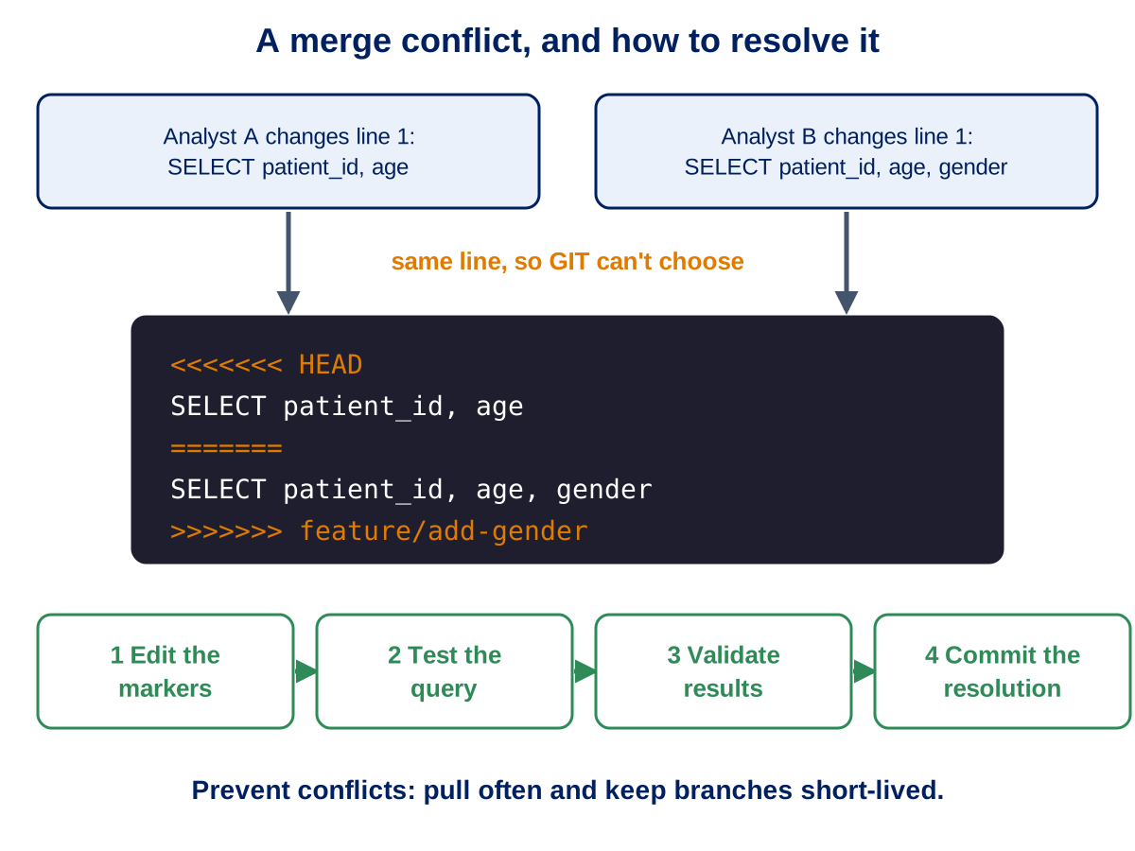
Conflicts and Rebasing
Why conflicts happen
Two people change the same lines of the same file
Notebooks conflict easily — JSON, metadata and outputs
Resolving safely
Pull often to prevent them
Edit the conflict markers, test the query, validate the results, then commit
Rebase to update your branch with the latest main
Notes:
Detail for this session: Training/03_Session_3_Branching_and_Sync_Operations.md

Slide 28
Protected Branches and Branching Strategy
Protect main
Pull request and review required before merging
Status checks must pass
No direct pushes and no force pushes
Keep it simple
Simplified Git flow — main plus short-lived feature, bugfix and hotfix branches
Smaller pull requests get faster, better reviews
No data is stored in GitHub — code only.
Notes:
Detail for this session: Training/03_Session_3_Branching_and_Sync_Operations.md

Slide 29
Your Area: Checkpoint 3
Add your .gitignore and share it (5 minutes)
Copy participants/_template/.gitignore into your folder and add one pattern of your own, for example *.log
Create notes.csv and check that git status does not list it
Commit, then push your branch (Codespaces signs you in for you)
Open a draft pull request into main (do not merge yet)
Your folder now contains
README.md and .gitignore on your pushed branch, with an open draft pull request
Notes:
Detail for this session: Training/03_Session_3_Branching_and_Sync_Operations.md

Slide 30
GitHub Cloud Interface
Session 4 | 30 minutes
Notes:
Detail for this session: Training/04_Session_4_GitHub_Cloud_Interface.md

Slide 31
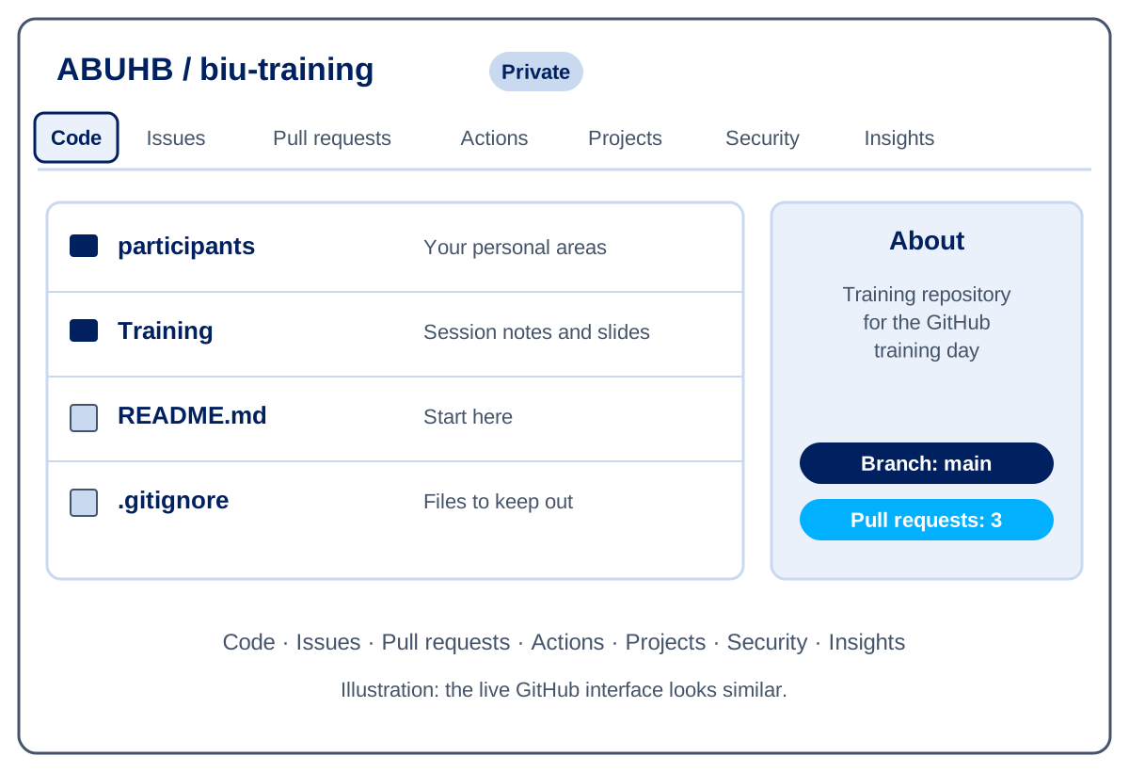
Finding Your Way Around a Repository
The main tabs
Code — browse SQL, notebooks and documentation
Issues — data requests, bugs and tasks
Pull requests — review changes before merging
Actions — automated workflows and checks
Projects — boards for planning and tracking
Insights — contributor and activity statistics
Notes:
Detail for this session: Training/04_Session_4_GitHub_Cloud_Interface.md

Slide 32
Commits, Branches and Diffs
Understanding change
Commit history — who changed what, when and why
Branches view — see and manage lines of work
Diffs — exactly what changed in a file or pull request
Blame — who last changed each line
Check a file's history before changing it.
Notes:
Detail for this session: Training/04_Session_4_GitHub_Cloud_Interface.md

Slide 33
Search and Navigation
Finding things fast
Repository search — code, issues, pull requests and commits
Global search across GitHub
File finder — press t inside a repository
Good daily habits
Check notifications for reviews and failed runs
Review diffs carefully in pull requests
Search for similar code before writing something new
Notes:
Detail for this session: Training/04_Session_4_GitHub_Cloud_Interface.md

Slide 34
Exercise: Repository Exploration
Steps
Clone the training repository and look at recent commits and pull requests
Create a branch named feature/yourname-exploration
Add a useful document or code snippet, then commit and push
Open a pull request and assign reviewers
Tick off each step on the checklist in the Session 4 notes.
Notes:
Detail for this session: Training/04_Session_4_GitHub_Cloud_Interface.md

Slide 35
Your Area: Checkpoint 4
See your work in the browser (3 minutes)
Open your branch and your folder on github.com
Find your commits and read the diff
Use the web editor to add a link to your pull request in your README, committing to your branch
Your folder now contains
README.md updated from the browser, with a link to your pull request
Notes:
Detail for this session: Training/04_Session_4_GitHub_Cloud_Interface.md

Slide 36
Codespaces Workspace and File Management
Session 5 | 30 minutes
Notes:
Detail for this session: Training/05_Session_5_Codespaces_Workspace_and_File_Management.md

Slide 37
Codespaces as Your Daily Workspace
Why Codespaces first
Nothing to install, so it works on locked-down NHS machines
Everyone gets the same Python tools and settings
Git is already signed in to your account
Your work stays on your branch in GitHub
A daily rhythm
Open your Codespace on your own branch and pull the latest main
Make small changes and commit often
Push before you finish, then stop the Codespace
Synthetic data only. A Codespace runs outside the Secure Data Environment.
Notes:
Detail for this session: Training/05_Session_5_Codespaces_Workspace_and_File_Management.md

Slide 38
GitHub Desktop (Optional)
A visual alternative
A point-and-click way to clone, branch, commit and sync
Useful if you prefer it or work on a local machine
Why we start with Codespaces
Fewer installs and sign-in problems on training day
The same Git skills apply in both tools
Notes:
Detail for this session: Training/05_Session_5_Codespaces_Workspace_and_File_Management.md

Slide 39
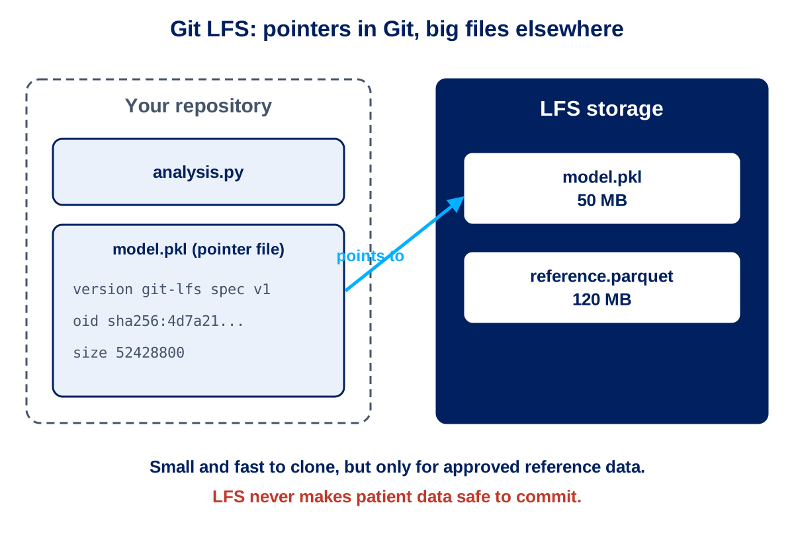
Large Files and Git LFS
The problem
GitHub recommends repositories under 1 GB, with a 100 MB limit per file
Datasets, models and reports quickly exceed this
Git LFS
Keeps small pointers in Git and the real file on a separate server
Use it for reference data and models
Never commit patient identifiable information — LFS does not change that.
Notes:
Detail for this session: Training/05_Session_5_Codespaces_Workspace_and_File_Management.md

Slide 40
Daily Workflow and Good Habits
A good day in a Codespace
Pull the latest main at the start of the day
Use focused feature branches
Commit often with descriptive messages
Review the diff in the Source Control view before committing
Push at the end of the day, then stop your Codespace
Managing files
Clear notebook outputs before committing
Document data sources and dependencies
Notes:
Detail for this session: Training/05_Session_5_Codespaces_Workspace_and_File_Management.md

Slide 41
Your Area: Checkpoint 5
Add notes from your Codespace (4 minutes)
Reopen your Codespace on your branch and run git pull to pick up the web edit
Copy Participant_Pack/04_My_Notes_Template.md into your folder as notes.md and fill in Sessions 1 to 5
Create data.csv with five made-up rows and check the Source Control view does not list it
Commit and push
Your folder now contains
notes.md added; data.csv is ignored and never appears as a change
Notes:
Detail for this session: Training/05_Session_5_Codespaces_Workspace_and_File_Management.md

Slide 42
VS Code Integration and Notebooks
Session 6 | 30 minutes
Notes:
Detail for this session: Training/06_Session_6_VS_Code_Integration_and_Notebooks.md

Slide 43
Why VS Code + GitHub
One window for everything
Code, issues and pull requests side by side
Integrated terminal and linting
Commits and reviews captured alongside the code
Easier to enforce team standards
Essential extensions
GitHub Pull Requests and Issues
Python and Jupyter
GitHub Copilot, if licensed
Notes:
Detail for this session: Training/06_Session_6_VS_Code_Integration_and_Notebooks.md

Slide 44
Quick Start Workflow
From clone to merge
Clone the repository and create a feature branch
Make small changes, then stage and commit with a message referencing the issue
Sync changes (or publish the branch the first time)
Open the pull request from the GitHub Pull Requests view
Address review comments, merge, then pull the latest main
Notes:
Detail for this session: Training/06_Session_6_VS_Code_Integration_and_Notebooks.md

Slide 45
Notebook Hygiene and Security Checks
Notebooks
Clear outputs before you commit
Keep paths in environment variables, not code
Move reusable logic into .py modules
Top security checks
No identifiable patient data pushed
Secrets in environment variables or GitHub secrets — never in code
Branch protection with required reviews
Keep dependencies updated
Notes:
Detail for this session: Training/06_Session_6_VS_Code_Integration_and_Notebooks.md

Slide 46
Codespaces vs Local
Prefer a Codespace when
Onboarding new joiners
Reviewing with identical tooling
You want least-privilege, scoped secrets
Prefer local when
Working with heavy compute or large datasets
The network is unreliable
We try Codespaces hands-on in Session 8.
Notes:
Detail for this session: Training/06_Session_6_VS_Code_Integration_and_Notebooks.md

Slide 47
Your Area: Checkpoint 6
Add a clean notebook (4 minutes)
Open the repository in VS Code on your branch
Create starter.ipynb with one cell that prints a greeting, then run it
Clear all outputs before you commit
Commit and push from the Source Control panel
Your folder now contains
starter.ipynb committed with its outputs cleared
Notes:
Detail for this session: Training/06_Session_6_VS_Code_Integration_and_Notebooks.md

Slide 48
Issues, Projects and Discussions
Session 7 | 35 minutes
Notes:
Detail for this session: Training/07_Session_7_Issues_Projects_and_Discussions.md

Slide 49
GitHub Issues
The team's to-do list
Track bugs, feature requests, data issues and project tasks
Assign owners, add labels and set milestones
Link to code: writing "closes #12" in a commit closes the issue on merge
Effective issues
Use templates — clinical context, description, acceptance criteria
Make the definition of done clear
Notes:
Detail for this session: Training/07_Session_7_Issues_Projects_and_Discussions.md

Slide 50
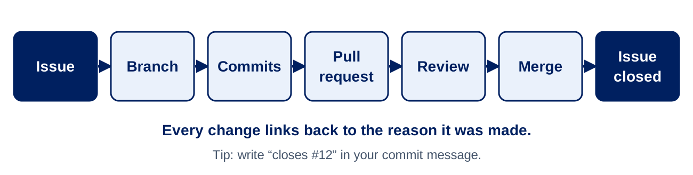
The Issue Lifecycle
From request to closure
Create and triage — categorise and assign
Investigate and plan — feasibility, data sources, governance review
Develop — feature branch linked to the issue, with review
Validate and deploy — stakeholder testing and data quality checks
Close — acceptance, documentation and lessons learned
Notes:
Detail for this session: Training/07_Session_7_Issues_Projects_and_Discussions.md

Slide 51
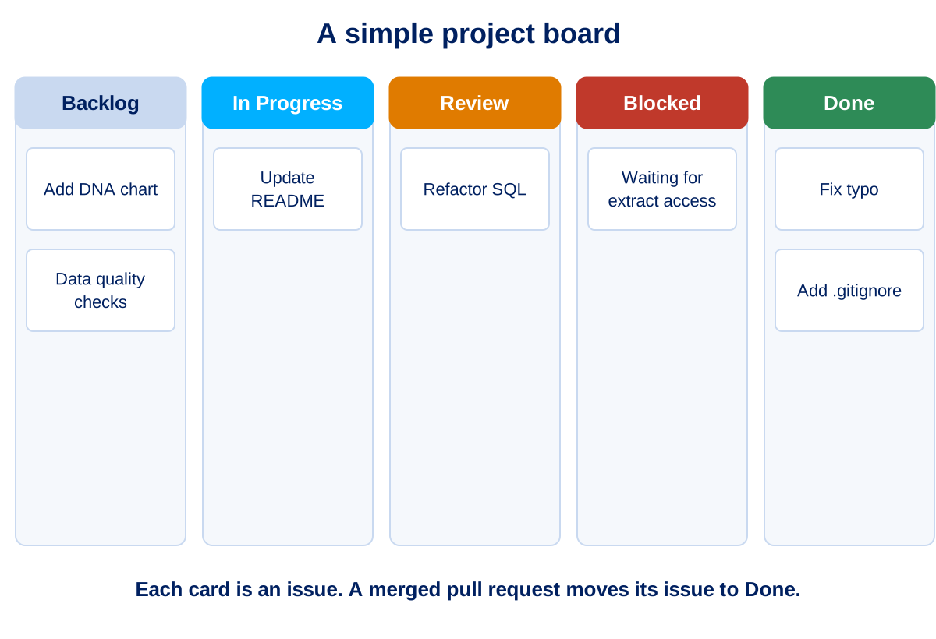
GitHub Projects: A Lightweight Board
Five-minute setup
Columns: Backlog, In Progress, Review, Blocked, Done
Fields: priority, target date and owner
Keep labels to about 12 in total
Simple automation
New labelled issues go to Backlog
A merged pull request moves its issue to Done
Notes:
Detail for this session: Training/07_Session_7_Issues_Projects_and_Discussions.md

Slide 52
GitHub Actions for Automation
What can be automated
Data quality and freshness checks
Scheduled monthly or quarterly reports
Unit tests for calculations
Notifications to Teams or email
Actions are workflow files stored in the repository, so automation is reviewed like any other code.
Notes:
Detail for this session: Training/07_Session_7_Issues_Projects_and_Discussions.md

Slide 53
GitHub Advanced Security: What It Is
Two products, both for private repositories on paid plans
Secret Protection — secret scanning, push protection and custom patterns
Code Security — code scanning with CodeQL, Copilot Autofix, dependency review
Available on every plan
Dependency graph, Dependabot alerts and Dependabot updates
Both products are available to ABUHB private repositories. The GitHub admin team switches them on per repository.
Notes:
Detail for this session: Training/07_Session_7_Issues_Projects_and_Discussions.md

Slide 54
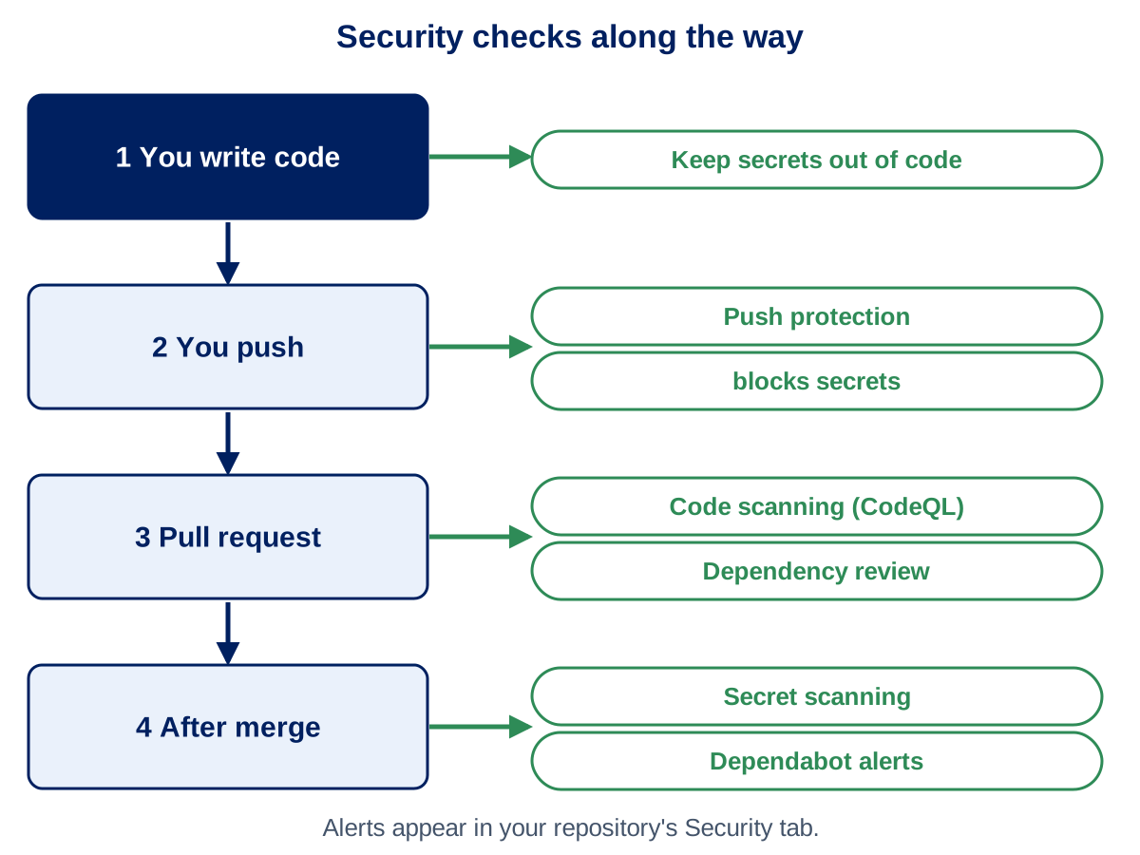
How Advanced Security Protects Your Work
At each step
Push protection stops a secret before it reaches GitHub
Code scanning and dependency review check every pull request
Secret scanning and Dependabot keep watching after merge
Why it matters to us
A pushed secret is exposed, so revoke it first
It helps keep credentials and patient data out of code
Notes:
Detail for this session: Training/07_Session_7_Issues_Projects_and_Discussions.md

Slide 55
Reading and Acting on Security Alerts
Where to look
The Security tab of the repository lists every alert, with severity
Pull request checks show new problems before they merge
What to do
Secret alert — revoke the secret, tell the admin team, then clean up
Code alert — read the explanation, fix it, or review a Copilot Autofix suggestion
Dependency alert — merge the Dependabot pull request after the tests pass
Dismiss only with a reason that a colleague could check
An alert is a prompt to act, not a verdict. A human decides.
Notes:
Detail for this session: Training/07_Session_7_Issues_Projects_and_Discussions.md

Slide 56
Your Area: Checkpoint 7
Raise an issue and pin your tools (5 minutes)
Open an issue titled Area: <your-folder> with a checklist of what you have added
Add requirements.txt listing pandas and matplotlib with the versions you choose
Link the issue from your pull request by writing Closes #<issue number>
Open the Security tab and note which alert types are switched on
Your folder now contains
requirements.txt added; your pull request linked to your issue
Notes:
Detail for this session: Training/07_Session_7_Issues_Projects_and_Discussions.md

Slide 57
Codespaces and Copilot Hands-On
Session 8 | 45 minutes
Notes:
Detail for this session: Training/08_Session_8_Codespaces_and_Copilot_Exercise.md

Slide 58
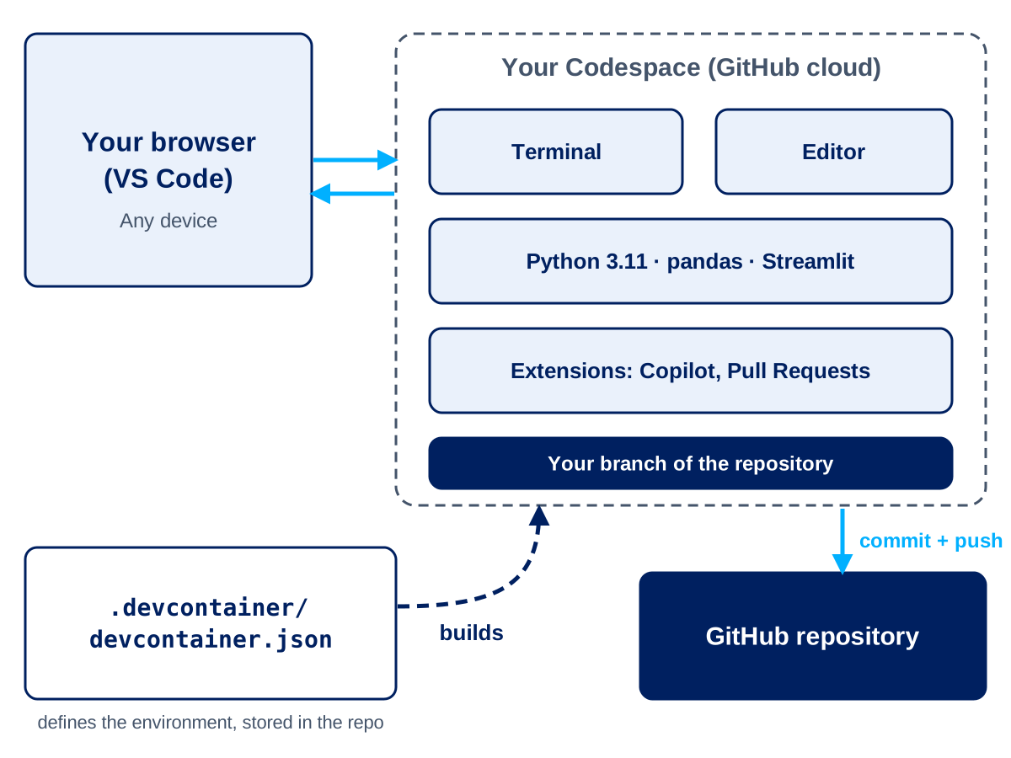
What is a GitHub Codespace?
VS Code in the cloud
A ready-to-use development environment, opened from a repository in your browser
Python, packages and extensions are installed for you
No local installation — start coding in minutes
Why use one?
Everyone gets the same environment — no "works on my machine"
Great for onboarding, quick fixes and reviewing pull requests
Your work is committed back to the repository with Git
Notes:
Detail for this session: Training/08_Session_8_Codespaces_and_Copilot_Exercise.md

Slide 59
Codespaces: Launching and Lifecycle
Launching
Repository → Code → Codespaces → Create codespace on main
Create a branch before you change anything
A 2-core machine is plenty for today
Lifecycle
Running → Stopped → Deleted
Stop it when you finish — stopped Codespaces don't use compute time
Commit and push first; uncommitted work is lost if a Codespace is deleted
Notes:
Detail for this session: Training/08_Session_8_Codespaces_and_Copilot_Exercise.md

Slide 60
Dev Containers: Same Environment for Everyone
One file defines the environment
.devcontainer/devcontainer.json lives in the repository
Sets the Python version, extensions, ports and setup commands
Change the file in a pull request, and everyone gets the new setup
Today's setup
Python 3.11 with pandas, matplotlib and Streamlit
Copilot and Pull Request extensions pre-installed
Port 8501 forwarded for the Streamlit app
Notes:
Detail for this session: Training/08_Session_8_Codespaces_and_Copilot_Exercise.md

Slide 61
What Belongs in a Codespace?
Safe to use
Code, documentation and notebooks with outputs cleared
Synthetic or fully anonymised sample data
Never use
Patient-identifiable data, extracts or NHS numbers
Passwords, tokens or keys in files — use Codespaces secrets
A Codespace runs in GitHub's cloud, outside the Secure Data Environment. Real data stays in the SDE.
Notes:
Detail for this session: Training/08_Session_8_Codespaces_and_Copilot_Exercise.md

Slide 62
GitHub Copilot: Suggest, Chat and Slash Commands
Inline suggestions
Write a comment or function name — Copilot suggests the code
Press Tab to accept, Esc to dismiss
Copilot Chat
Ask questions about your code, data or errors
/explain, /fix, /tests and /doc for common jobs
Shared repository instructions keep answers consistent (.github/copilot-instructions.md)
Notes:
Detail for this session: Training/08_Session_8_Codespaces_and_Copilot_Exercise.md

Slide 63
Prompting and Reviewing Copilot
Get better answers
Give context — the columns, the metric definition, the output you want
Work in small steps and iterate
Ask Copilot to explain code you don't understand
You are the reviewer
Never accept code you can't explain — Copilot can be confidently wrong
Check definitions, totals and invented functions, then test
No patient data or secrets in prompts
Notes:
Detail for this session: Training/08_Session_8_Codespaces_and_Copilot_Exercise.md

Slide 64
Exercise: Choose Your Track
The scenario
Which clinics and patient groups have the highest DNA (did not attend) rates, and is it changing through the year?
Synthetic outpatient dataset — 3,000 appointments
Pick one
Track A — Analysis. Python script that checks the data, calculates DNA rates and saves a chart
Track B — UI. A Streamlit app with filters, headline numbers and charts
DNA rate = DNA ÷ (Attended + DNA). Cancelled appointments are excluded.
Notes:
Detail for this session: Training/08_Session_8_Codespaces_and_Copilot_Exercise.md

Slide 65
Exercise: Build with Copilot (25 minutes)
Steps
Open a Codespace and create your own branch
Ask Copilot to explain the data columns
Build your track in small steps, reading every suggestion
Run it — python for Track A, streamlit run for Track B
Commit, push and open a pull request for a neighbour to review
Stop your Codespace
Full guide: Training/exercises/codespaces-copilot/README.md
Notes:
Detail for this session: Training/08_Session_8_Codespaces_and_Copilot_Exercise.md

Slide 66
Exercise: Review and Share Back
Check Copilot's work
Does the DNA rate exclude cancelled appointments?
Do the totals add up to 3,000 appointments?
Any invented columns or functions? Does it run?
Could you explain every line to a colleague?
Share back
Track chosen, and one thing Copilot did well
One thing Copilot got wrong or you had to fix
Would you use this at work?
Notes:
Detail for this session: Training/08_Session_8_Codespaces_and_Copilot_Exercise.md

Slide 67
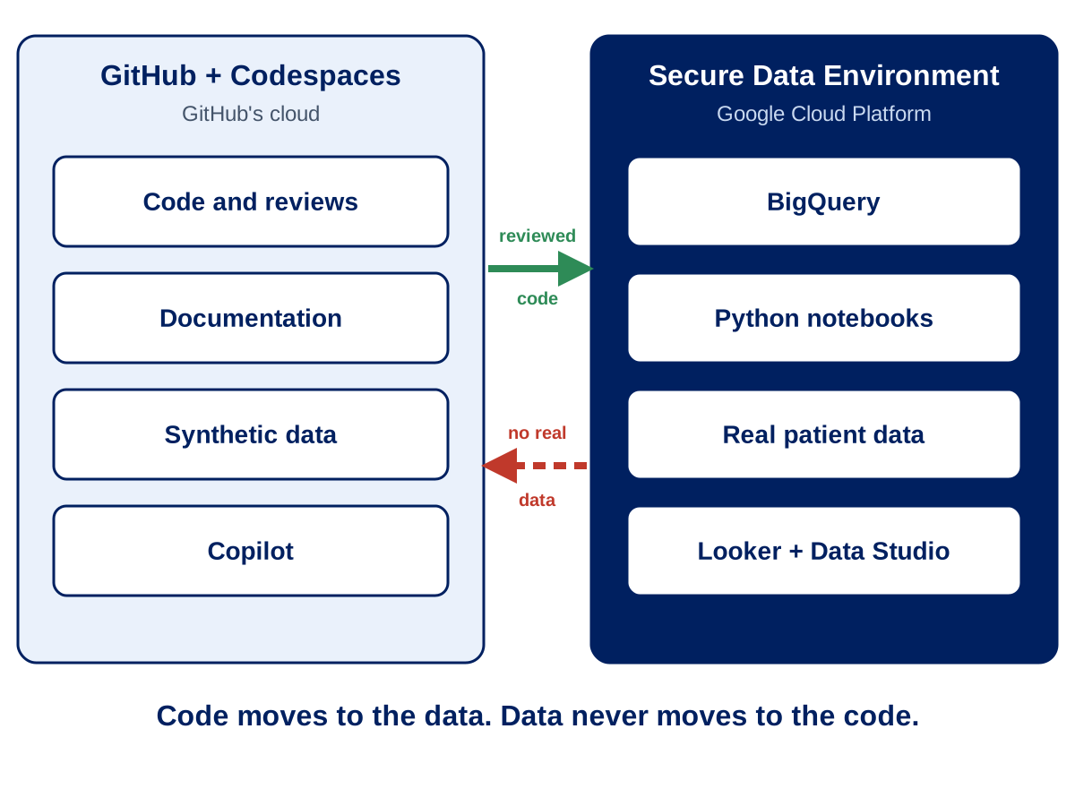
How This Fits with the Secure Data Environment
Two places, two jobs
GitHub and Codespaces — code, documentation and synthetic data
Secure Data Environment on GCP — real data, queries and notebooks
The path to real data
Develop and test with Copilot on synthetic data in a Codespace
Review through a pull request and merge to main
Run the reviewed code inside the SDE, against real data
Code moves to the data. Data never moves to the code.
Notes:
Detail for this session: Training/08_Session_8_Codespaces_and_Copilot_Exercise.md

Slide 68
Your Area: Checkpoint 8
Do the exercise in your own folder (25 minutes)
Open a Codespace on your branch training/<your-folder>
Create participants/<your-folder>/dna-analysis and work there
Commit at least twice with clear messages
Push when you have worked through the review checklist
Your folder now contains
dna-analysis with your code, a short README and a note of the Copilot prompts you used
Notes:
Detail for this session: Training/08_Session_8_Codespaces_and_Copilot_Exercise.md

Slide 69
Group Exercises and Consolidation
Session 9 | 25 minutes
Notes:
Detail for this session: Training/09_Session_9_Group_Exercises_and_Consolidation.md

Slide 70
What We've Covered Today
Foundations
Why GitHub, and how GIT works
Branching, pull requests and conflict resolution
The web interface, GitHub Desktop and VS Code
Collaboration and tools
Issues, Projects and Actions
Codespaces and Copilot
Notes:
Detail for this session: Training/09_Session_9_Group_Exercises_and_Consolidation.md

Slide 71
Group Exercise: Issue to Merge
In groups of three or four
Choose ONE small scenario — a README checklist, a typo fix or a SQL snippet in the docs
Create an issue using the template
Create a feature branch and make a small change that references the issue
Open a pull request — a teammate reviews with one comment and approves
Merge and check the issue closes
Use the provided training repository. No new repositories are needed.
Notes:
Detail for this session: Training/09_Session_9_Group_Exercises_and_Consolidation.md

Slide 72
Share Back
Each team tells us
Which scenario you chose
How long it took from issue to merge
One friction point
One suggested improvement
Notes:
Detail for this session: Training/09_Session_9_Group_Exercises_and_Consolidation.md

Slide 73
Next Steps
In the next week
Make sure your GitHub account and organisation access are set up
Explore repositories relevant to your work
In the next month
Practise the basic workflow regularly
Use GitHub for at least one real work project
Find a colleague to learn with
Notes:
Detail for this session: Training/09_Session_9_Group_Exercises_and_Consolidation.md

Slide 74
Your Area: Checkpoint 9
Merge your area (15 minutes)
Update your pull request description with a summary of what your area contains
Review a partner's pull request with the checklist and leave one useful comment
Resolve any conflicts and merge once approved
Check that your row in the participants README matches what you built
Your folder now contains
Everything merged into main: a complete record of your day's work
Notes:
Detail for this session: Training/09_Session_9_Group_Exercises_and_Consolidation.md

Slide 75
Optional Extension: SQL on the Academy Dataset
For anyone with time, or after the day
Needs access to the ndr-hb-abuhb-academy Google Cloud project, which is optional
Copy the SQL script into your folder as referrals.sql and run it in BigQuery
Preview with SELECT * and LIMIT, name your columns, then try SELECT DISTINCT
Why it belongs in Git
SQL is code, so changes are tracked, reviewed and reversible
BigQuery needs backticks round a table name with hyphens. Never commit results or data.
Notes:
Detail for this session: Training/09_Session_9_Group_Exercises_and_Consolidation.md

Slide 76
Thank You
Questions? Raise a GitHub issue or contact the GitHub admin team.

