Slide 1
TrustOTP: Transforming Smartphones into Secure One-Time Password Tokens
Presented by: Anfas Azeez
ACM SIGSAC CCS 2015

Slide 2
Introduction
What are OTPs?
Common OTP authentication methods
Security challenges

Slide 3
Motivation & Problem Statement
Security issues in software-based OTPs
Limitations of hardware OTP tokens
Need for a hybrid solution

Slide 4
Contributions of TrustOTP
1. Security: Uses ARM TrustZone to protect OTP generation.
2. Reliability: Works even if OS crashes.
3. Flexibility: Supports multiple OTP algorithms.

Slide 5
How TrustOTP Works
ARM TrustZone-based execution
Secure user interface for OTP display
Encrypted storage for OTP seeds

Slide 6
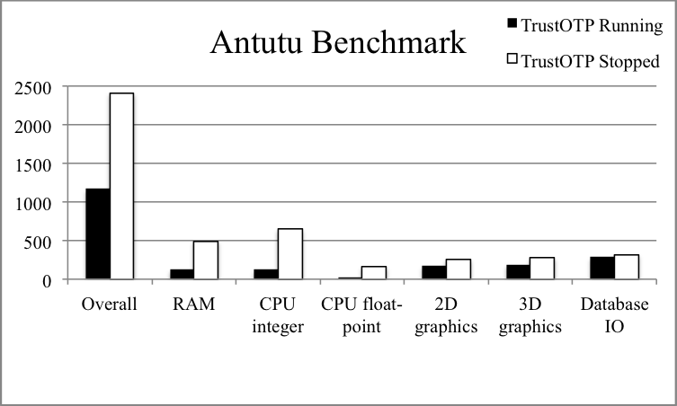
TrustOTP System Architecture
OTP Generator: Supports HOTP & TOTP
Secure Display Controller
Secure Touchscreen Driver

Slide 7
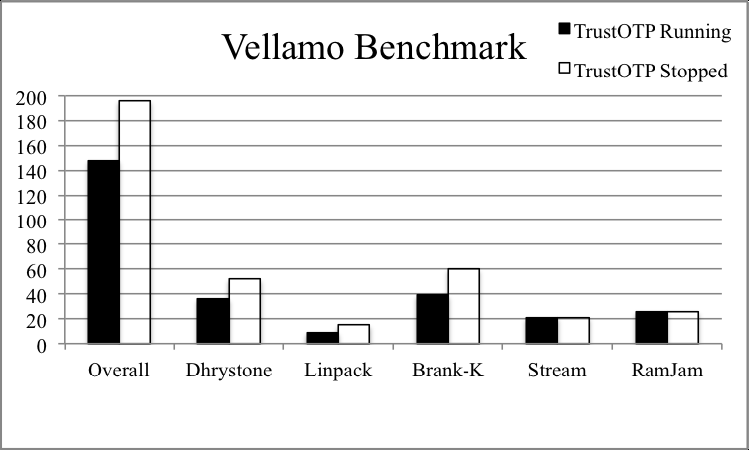
Experimental Results
Tested on Freescale i.MX53 QSB
OTP display latency under 80ms
Minimal power consumption impact

Slide 8
Security & Usability Evaluation
Protection against OS-based attacks
Comparison with traditional OTP methods
User experience improvements

Slide 9
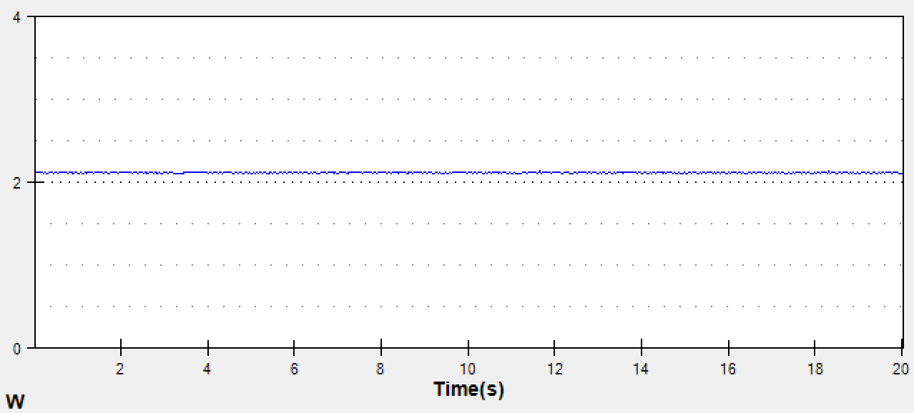
Limitations & Future Work
Requires ARM TrustZone-compatible smartphones
Potential risks from physical device theft
Future research: Enhancing biometric integration

Slide 10
Conclusion
TrustOTP improves OTP security and usability
Achieves hardware-token-level security
Potential for broader adoption in secure authentication

