Slide 1


A Comparative Study Between Traditional XAI Frameworks and 2026 Next-Gen Tools
Selected topics in computer science project
Project Team: Anfal, Atekah Submitted to: Dr. Hala Hamdoun

Slide 2

TABLE OF CONTENTS
01
05
02
06
03
07
04
08
Introduction & Problem Formulation
Implementation Details
Proposed Method / Approach
Results
System Design & Workflow
Discussion
Dataset & Experimental Setup
Conclusion

Slide 3

Introduction & Problem Formulation
Problem: Black‑box transparency gap in clinical AI.
Goal: Evaluate latency & efficiency of next‑gen XAI (Captum) vs. traditional (LIME, SHAP).
Task: Binary classification (Malignant / Benign) on tabular medical data.
Input: 30‑dimensional feature vector (Wisconsin Breast Cancer dataset).
Output: Diagnosis + local feature importance map.
Success criteria:
Accuracy > 90% (achieved 95.61%)
Interpretability latency ≤ 10 ms for real‑time decisions

Slide 4
Proposed Method / Approach
Primary classifier: Custom DNN with GELU activation & residual connections.
XAI frameworks compared:
SHAP (DeepExplainer) – game‑theory based
LIME (LimeTabularExplainer) – local surrogate model
Captum (DeepLIFT, Integrated Gradients) – gradient‑based, PyTorch
Why compare?
SHAP/LIME: perturbation‑based → many model evaluations → high latency (>90 ms)
Captum: native gradient attribution → single backward pass → low latency (<10 ms)

Slide 5
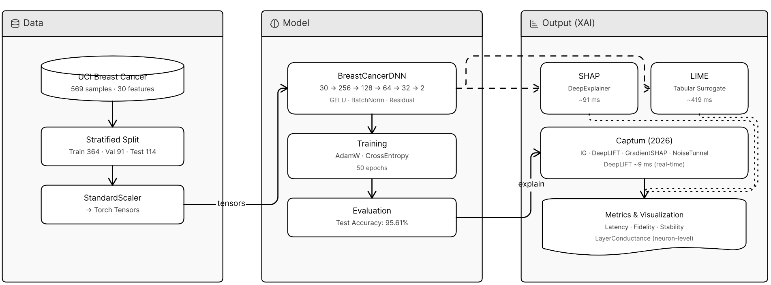
System Design & Workflow
Architecture diagram
Three main components:
Data: Breast Cancer dataset → train/val/test split → standardization → PyTorch tensors.
Model: Residual DNN (256→128→64→32 neurons) with GELU & BatchNorm.
Explanation engines: SHAP, LIME, Captum (including Layer Conductance for neuron‑level insight).
Step‑by‑step workflow:
Fetch data → train model (50 epochs, AdamW, label smoothing) → select patient sample → run XAI engines → measure latency & attribution quality.

Slide 6
Dataset & Experimental Setup
Dataset: Breast Cancer Wisconsin (Diagnostic), UCI.
569 samples, 30 features, 2 classes (Malignant/Benign).
Split: Train 364 (64%), Validation 91 (16%), Test 114 (20%).
Preprocessing: StandardScaler → zero mean, unit variance → PyTorch tensors (float32).
Experimental Setup:
Framework: PyTorch.
Model config: 4 residual blocks (256,128,64,32 neurons).
Training: 50 epochs, batch size = full batch (364), LR = 1e-3, Optimizer = AdamW (weight decay 1e-4), Loss = CrossEntropy with label smoothing (0.05).

Slide 7
Implementation Details
Model construction:
Advanced Residual DNN (PyTorch nn.Module).
Skip connection: projects output of first block to third block → preserves gradients, improves XAI attribution.
Activation: GELU, Normalization: BatchNorm.
Training process:
AdamW optimizer, learning rate 1e-3, weight decay 1e-4.
Label smoothing (0.05) → avoids over‑confident wrong predictions.
Testing & XAI inference:
Test accuracy: 95.61%.
Single sample (Patient #7) used for benchmarking all three XAI engines.

Slide 8
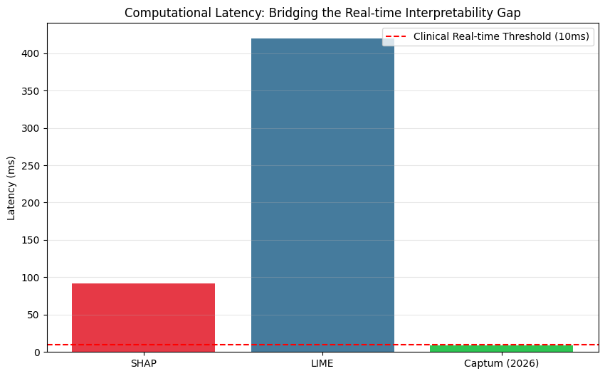
Result
The graph below compares the speed of XAI tools

Slide 9
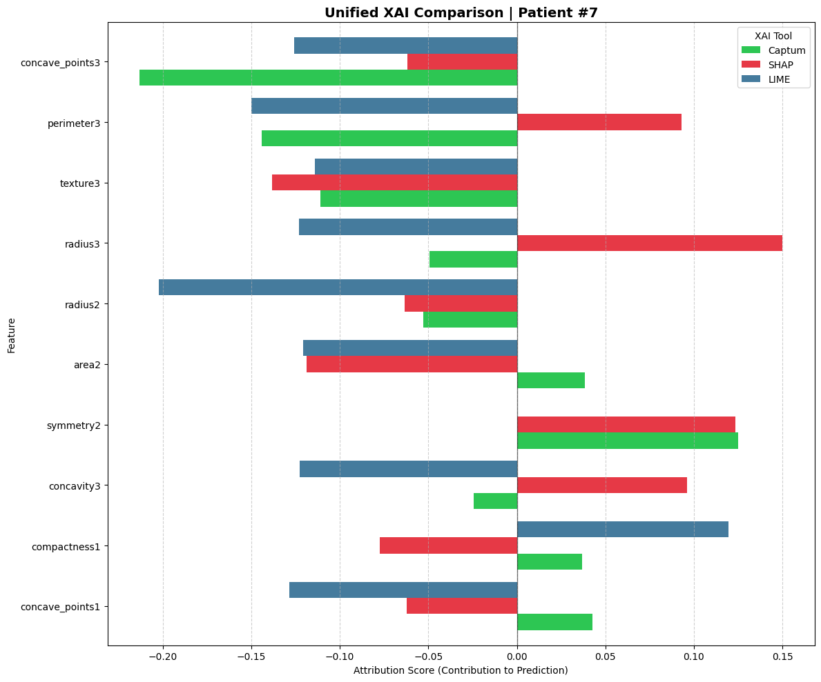
Cont..
compares the performance of different Explainable AI (XAI) tools in evaluating the key attributes for medical diagnosis
This chart shows that XAI tools do not always agree. For example, in features like radius3, SHAP suggests a strong positive impact, while LIME and Captum suggest a negative one. This proves that relying on a single explanation tool can be misleading in medical diagnosis.
When all three tools (SHAP, LIME, and Captum) agree on the direction of a feature, such as texture3, it provides 'High Confidence' in the explanation. This consensus helps doctors trust that these specific features are the true drivers behind the model's decision.

Slide 10
Cont..
This table below provides an overview attribution methods provided by the Captum library for Explainable AI (XAI). These methods are designed to interpret the process of DNN.
Method | Technical Mechanism | Key Benefit
Integrated Gradients (IG) | Computes the integral of gradients along the path from a baseline (e.g., zero input) to the actual input. | Completeness: Ensures the sum of all feature attributions equals the model's output prediction.
DeepLIFT | Compares the activation of each neuron to a reference activation and backpropagates the contribution scores. | Efficiency: Highly computationally efficient and fast, making it ideal for real-time explanations.
GradientSHAP | A gradient-based method to compute SHAP values by adding noise to the input and averaging the gradients. | Robustness: Provides a more stable and theoretically grounded estimation of feature importance.
IG + NoiseTunnel | Applies the IntegrateGradientsd method multiple times with added Gaussian noise to the input. | Clarity: Reduces visual noise and "artifacts" in attributions, highlighting the most significant features.
Layer Conductance | Evaluates the importance of internal neurons or layers rather than the raw input features. | Architecture Insight: Helps in understanding which specific hidden layers are most influential in the decision process.

Slide 11
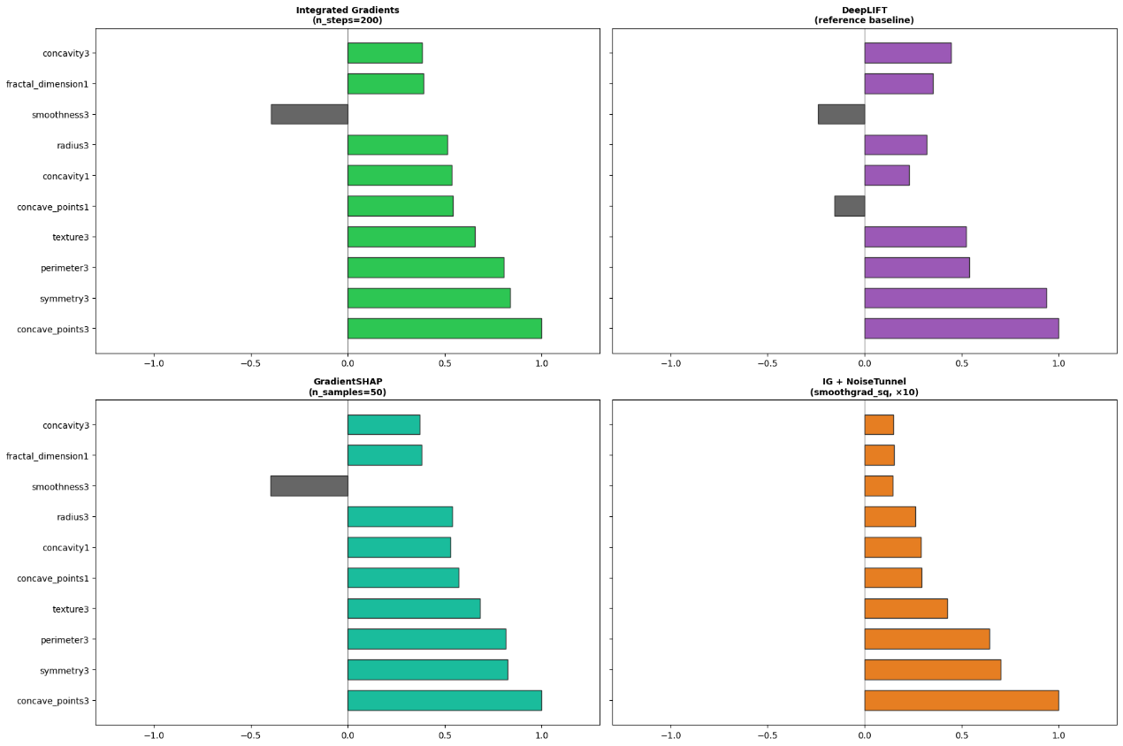
Cont..
It represent how different input features influence a specific model prediction:
Agreement: When multiple methods highlight the same top feature (e.g., concave_points3), it increases the reliability and confidence in the explanation.
Smoothing: Methods like NoiseTunnel provide a cleaner, more stable view by filtering out minor statistical fluctuations.

Slide 12
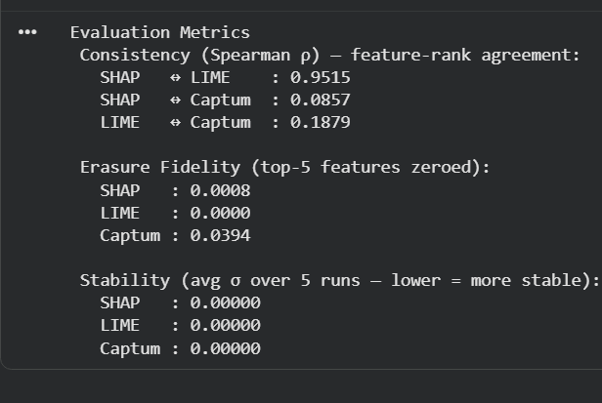
09 Disscussion
1. Consistency
SHAP ↔ LIME (0.9515): Very high agreement. This indicates that both tools provide nearly identical explanations.
SHAP/LIME ↔ Captum (Low agreement): Captum shows a very different ranking compared to the others.
This reveals that Captum interprets the Neural Network's logic differently. In the project, this suggests Captum might be capturing complex internal relationships that SHAP and LIME might miss.

Slide 13
09 Disscussion
2. Fidelity
This is a "What-if" test: we remove the top 5 features identified by each tool and observe the drop in model confidence. A higher score means the tool successfully identified the most critical features.
Captum (0.0394): Highest score
among the three.
3. Stability
This measures if the tool gives the same explanation when run multiple times (Lower = More Stable).
All Frameworks (0.00000): All tools are perfectly stable

Slide 14
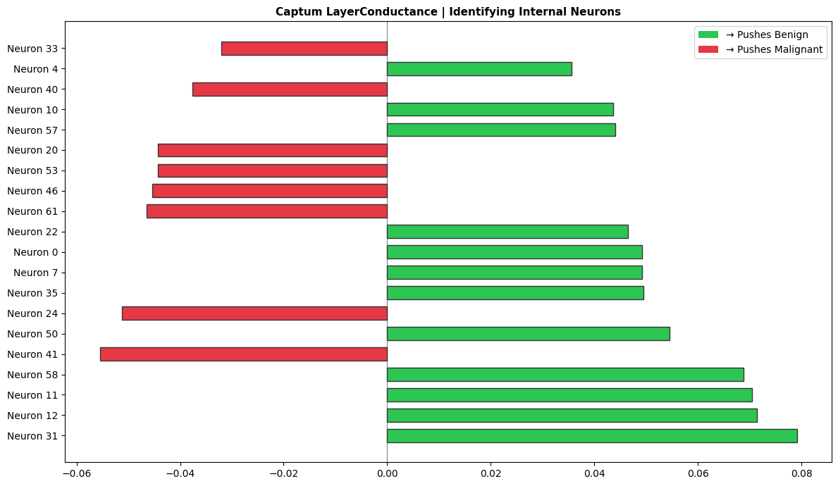
Cont..
Captum LayerConductance is an Explainable AI (XAI) tool used to analyze the contribution of individual neurons within model layers toward the final decision.
It helps the Developer to gain Insight:
Helps developers see which neurons are useless
Detecting Single-Neuron Dependency: If the decision relies on only one neuron, it reveals a model flaw.

Slide 15

Thank you for lisining

Slide 16

CONTENTS OF THIS TEMPLATES
Fonts
Colors
Thanks slide
Icons and infographics
To view this template correctly in PowerPoint, download and install the fonts we used
You can see on the link all the colors used in this presentation
You must keep it so that proper credits for our design are given
These can be used in the template, and their size and color can be edited
For more info: SLIDESGO | SLIDESGO AI TOOLS | BLOG | FAQs
You can edit the master slides easily. For more info, click here
You can visit our sister projects: FREEPIK AI TOOLS | FREEPIK LIBRARY RESOURCES
You can delete this slide when you’re done editing the presentation

Slide 17

THIS IS A LONG TITLE TO CAPTIVATE THE AUDIENCE ATTENTION DURING PRESENTATION
Mercury is the closest planet to the Sun and the smallest one in the entire Solar System

Slide 18

THESE ARE TWO IDEAS
This is about Saturn
This is about Venus
Saturn is a gas giant and has several rings. It’s composed mostly of hydrogen and helium. It was named after the Roman god of wealth and agriculture
Venus has a beautiful name and is the second planet from the Sun. Its atmosphere is extremely poisonous, primarily made up of carbon dioxide with clouds of sulfuric acid

Slide 19
A picture is worth a thousand words

Slide 20
THIS IS A TIMELINE
01
02
03
04
05
This is Venus
This is Earth
This is Mars
This is Jupiter
This is Saturn
Venus has a beautiful name and is the second planet from the Sun. It’s terribly hot, even hotter than Mercury
Earth is the third planet from the Sun and the only one that harbors life in the Solar System
Despite being red, Mars is actually a cold place. It’s full of iron oxide dust, which gives the planet its reddish cast
Jupiter is the fourth-brightest object in the night sky. It was named after the Roman god of the skies and lightning
Saturn is a gas giant and has several rings. It’s composed mostly of hydrogen and helium

Slide 21
THANK
YOU

Slide 22
Instructions for use
If you have a free account, in order to use this template, you must credit Slidesgo by keeping the Thanks slide
As a Free user, you are allowed to:
Modify this template
Use it for both personal and commercial projects
You are not allowed to:
Sublicense, sell or rent any of Slidesgo Content
Distribute Slidesgo Content unless it has been expressly authorized by Slidesgo
Include Slidesgo Content in an online or offline database or file
Offer Slidesgo templates (or modified versions of Slidesgo templates) for download
Acquire the copyright of
Slidesgo Content
For more information about editing slides, please read our FAQs or visit our blog

Slide 23
Instructions for use (premium users)
As a Premium user, you can use this template without attributing Slidesgo or keeping the Thanks slide
You are allowed to:
Modify this template
Use it for both personal and commercial projects
Share this template in an
editable format
Hide or delete the “Thanks” slide and the mention to Slidesgo in the credits
You are not allowed to:
Sublicense, sell or rent any of Slidesgo Content
Distribute Slidesgo Content unless it has been expressly authorized by Slidesgo
Use any of the elements that are part in a separated way
Register any of the elements as a trademark or logo in an intellectual property registry
For more information about editing slides, please read our FAQs or visit our blog

Slide 24
Fonts
Colors
This presentation has been made using the following fonts:
All the colors used in this presentation
Click on the button of the link to the fonts
#ffffff
#0b0f1a
#2dd4bf
Unbounded
Raleway
To view this template correctly in PowerPoint, download and install the fonts we used

Slide 25
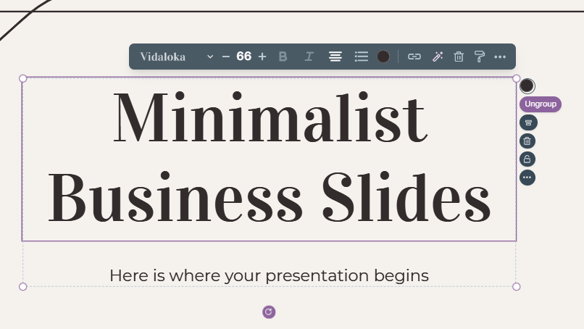
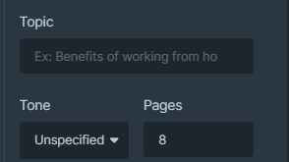
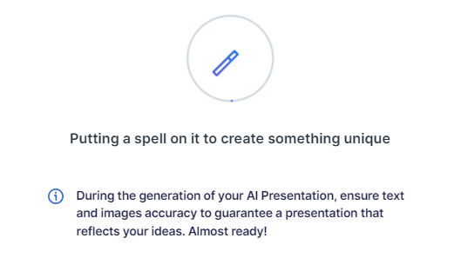
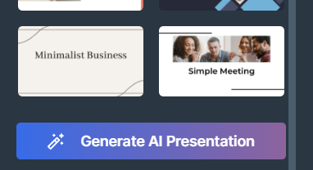
Presentation Maker
Slidesgo introduces its latest feature: the Presentation Maker. Enjoy two main functionalities - firstly, with a few clicks, create marvelous presentations with Artificial Intelligence that adapt to your needs. And it's completely free
Generate AI Presentation

Slide 26
Use our editable graphic resources...
You can easily resize these resources without losing quality. To change the color, just ungroup the resource and click on the object you want to change. You can also look for more infographics on Slidesgo

Slide 29
 | Jan | Feb | Mar | Apr | Jun
Task 1
Task 2
Task 3
 | No | Yes | Yes | No | Yes
 | Yes | No | Yes | No | Yes
 | Yes | Yes | No | Yes | No
 | Jan | Feb | Mar | Apr | Jun
Task 1
Task 2
Task 3

Slide 31
6/10 | 8/10 | 7/10 | 4/10

Slide 32
...and our sets of editable icons
You can resize these icons without losing quality
You can change the stroke and fill color; just select the icon and click on the paint bucket/pen
In Google Slides, you can also use Flaticon’s extension, allowing you to customize and add even more icons

Slide 33
Educational icons
Medical icons

Slide 34
Business icons
Teamwork icons

Slide 35
Help & support icons
Avatar icons

Slide 36
Creative process icons
Performing arts icons

Slide 37
Nature icons

Slide 38
SEO & marketing icons

Slide 39


