Slide 1
GENERATOR-LEVEL FINDING
A forward–backward asymmetry in the SUEP dark mesons
The dark mesons in the private SUEPs_Gen2 2024 samples are emitted preferentially towards lab −z. Traced to a one-character typo in the CMSSW SUEP shower, fixed upstream in CMSSW_15_0_15.
Ang Li · 29 July 2026 · ggH, mMed = 125 GeV, mDark = 2 GeV, cτ = 5 m · 60k events (T = 1, T = 2)
Notes:
Question raised: why is the LLP eta distribution asymmetric? Answer: it is real, it is in the gen record, and it looks like a generator bug.

Slide 2
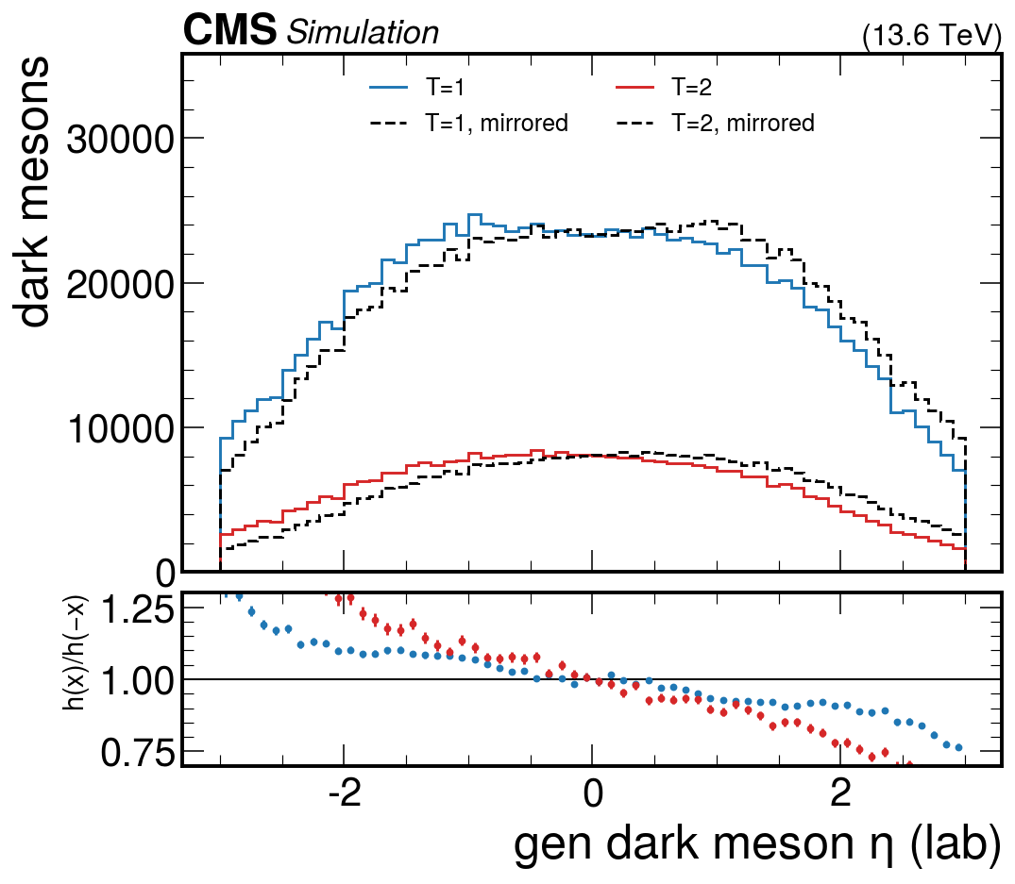
The observation
Gen dark mesons (SUEPGenPart, pdgId 999999) sit preferentially at negative η, in every file and at both temperatures.
Mirroring the histogram makes it plain: h(η)/h(−η) slopes from about 1.25 down to 0.75 across the range.
pp collisions have no preferred z direction, so this cannot be physical.
−0.158
−0.217
≥ 36σ
⟨η⟩, T = 1
⟨η⟩, T = 2
even counting each event as one measurement
Notes:
Blue/red are the two temperatures, black dashed is the same histogram mirrored about zero. The ratio panel is the asymmetry.

Slide 3
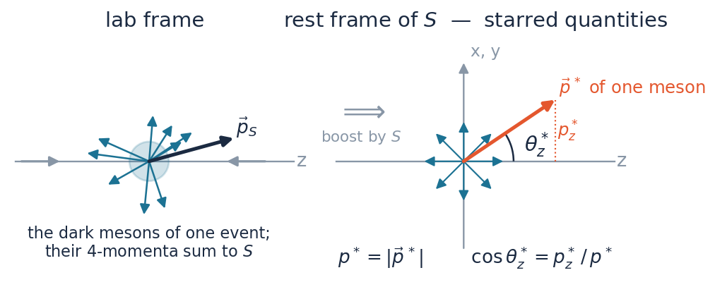
Notation: the starred quantities
S
the summed 4-momentum of all the dark mesons in an event — equal to the Higgs to 1.8 GeV rms.
star
measured in the rest frame of S. The boost is a pure boost, so the starred axes stay parallel to the lab ones.
p*
the momentum magnitude of one meson in that frame: how hard the meson is. ⟨p*⟩ = 3.4 GeV.
cosθ*_z = p*_z / p*
where that meson points relative to the beam. +1 along +z, 0 transverse, −1 along −z.
If the mesons were emitted isotropically, all three cosines would be flat on [−1, +1] and uncorrelated with p*. That is the null hypothesis every plot in this deck is tested against.
cosθ*_x , cosθ*_y
the same construction against the lab x and y axes — the control directions.
corr(p*, cosθ*_z)
Pearson coefficient over all 1.24M mesons: 0 means the direction tells you nothing about the momentum, ±1 means it fixes it.
Notes:
Everything starred lives in the rest frame of the meson system. The axes are still the lab axes — that is what makes a z-preference meaningful at all.

Slide 4
Six things that would have to be true
Each check below is a way the asymmetry could have been mundane. None of them survived.
1
2
3
Is the parent Higgs asymmetric?
Is 4-momentum conserved?
Is the decay isotropic at rest?
No — ⟨ηₕ⟩ = +0.004 ± 0.014
Yes — exactly, m = 124.9995 GeV
Only in x and y, not in z
4
5
6
Does the axis follow the parent?
Is |p*| tied to the direction?
Could it be a frame error?
No — it is the fixed lab z
Yes — strongly, corr = 0.72
No — nothing restores isotropy
Notes:
Roadmap for the next six slides.

Slide 5
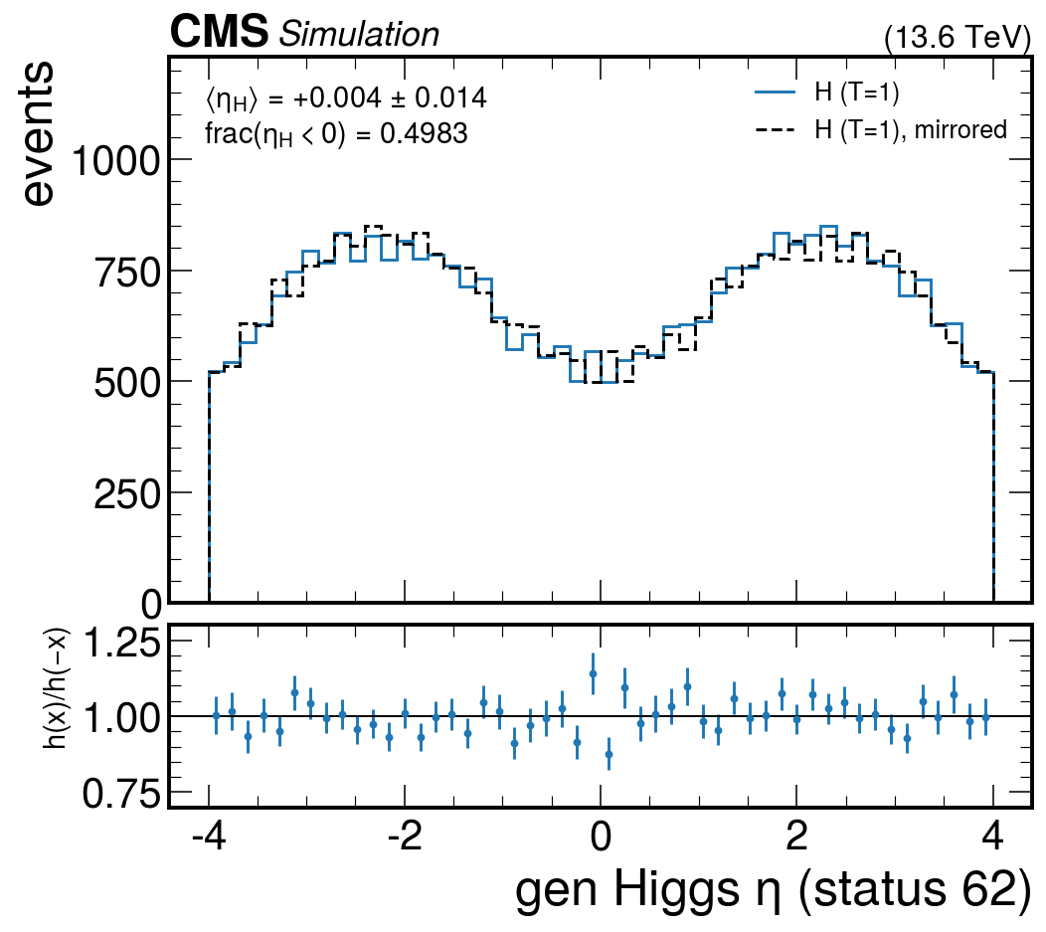
1
The parent Higgs is clean
The last-copy Higgs (status 62) is symmetric to the precision of the sample.
⟨ηₕ⟩ = +0.004 ± 0.014 and frac(ηₕ < 0) = 0.4983 — both consistent with zero.
So production is fine. Whatever happens, happens in the decay.
Rules out: a biased ggH production or a beam-configuration problem.
Notes:
Same mirror test as the previous slide, applied to the Higgs.

Slide 6
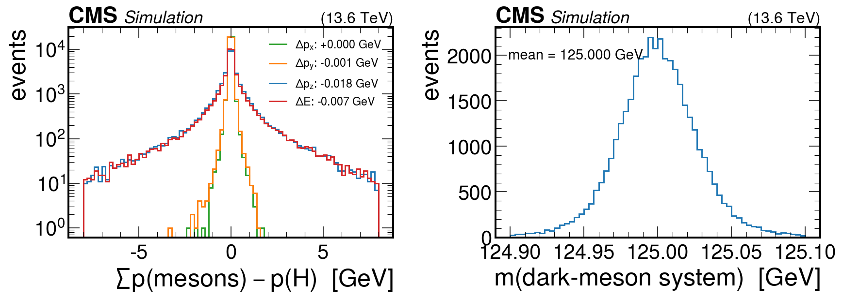
2
4-momentum closes exactly
Σᵢ pᵢ(mesons) − p(H) is consistent with zero in every component (⟨Δp_z⟩ = −0.019 GeV).
The invariant mass of the dark-meson system is 124.9995 GeV.
Rules out a broken boost, a truncated collection, or missing and double-counted mesons — the set we are looking at is complete.
Notes:
Left panel is log scale; all four residual components peak at zero.

Slide 7
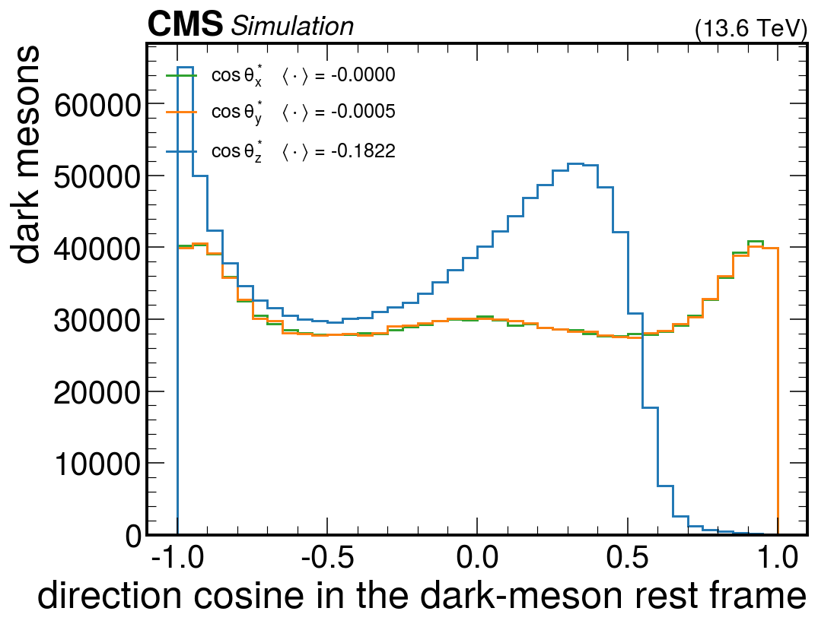
3
In the rest frame: isotropic in x and y, not in z
Boosting to the frame where the meson system is at rest, the direction cosines along x and y are flat and centred on zero.
Along z they are not: ⟨cosθ*_z⟩ = −0.1822, a 420σ departure.
The +z pole is essentially empty — 14691 mesons in the first bin against 15 in the last.
−0.1822
−0.0000
⟨cosθ*_z⟩
⟨cosθ*_x⟩, ⟨cosθ*_y⟩
Notes:
This is the core plot: the anisotropy singles out one axis.

Slide 8
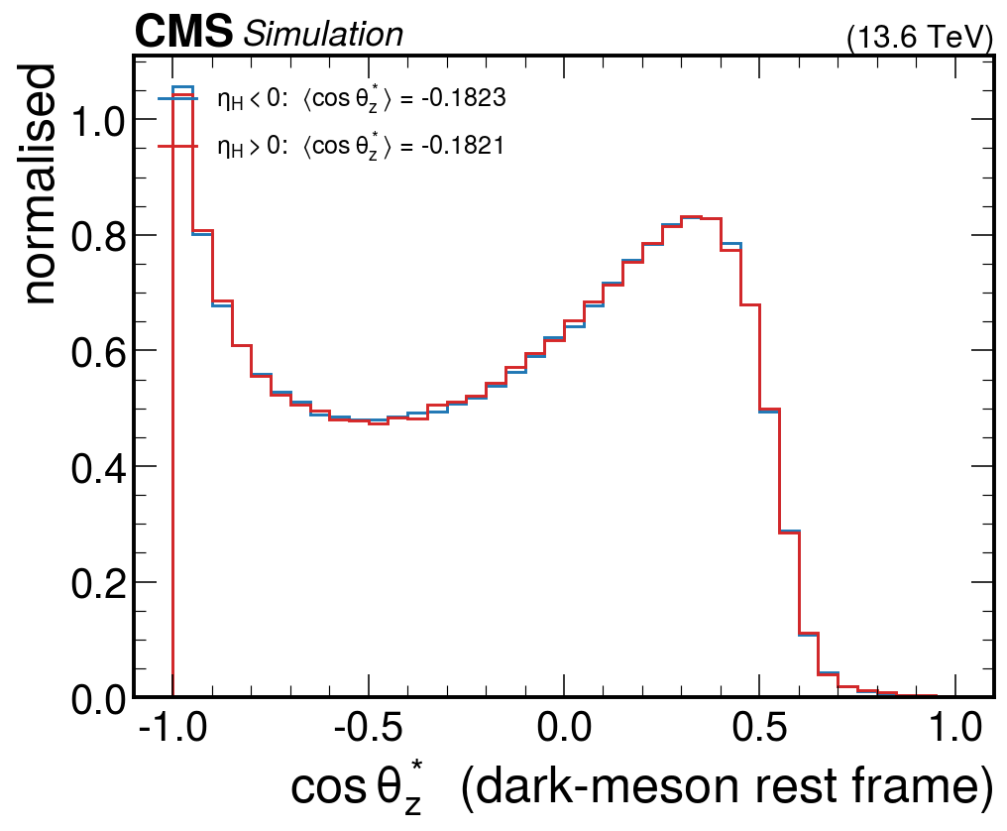
4
The axis is the fixed lab z, not the parent
Split the mesons by the sign of their own parent's rapidity.
ηₕ < 0 gives ⟨cosθ*_z⟩ = −0.1823; ηₕ > 0 gives −0.1821. Identical.
A physical decay asymmetry would have to flip with the parent. This one does not — it points at lab −z regardless.
This is the step that makes a physics explanation impossible: no decay can know about the laboratory z axis.
Notes:
The two curves lie on top of each other.

Slide 9
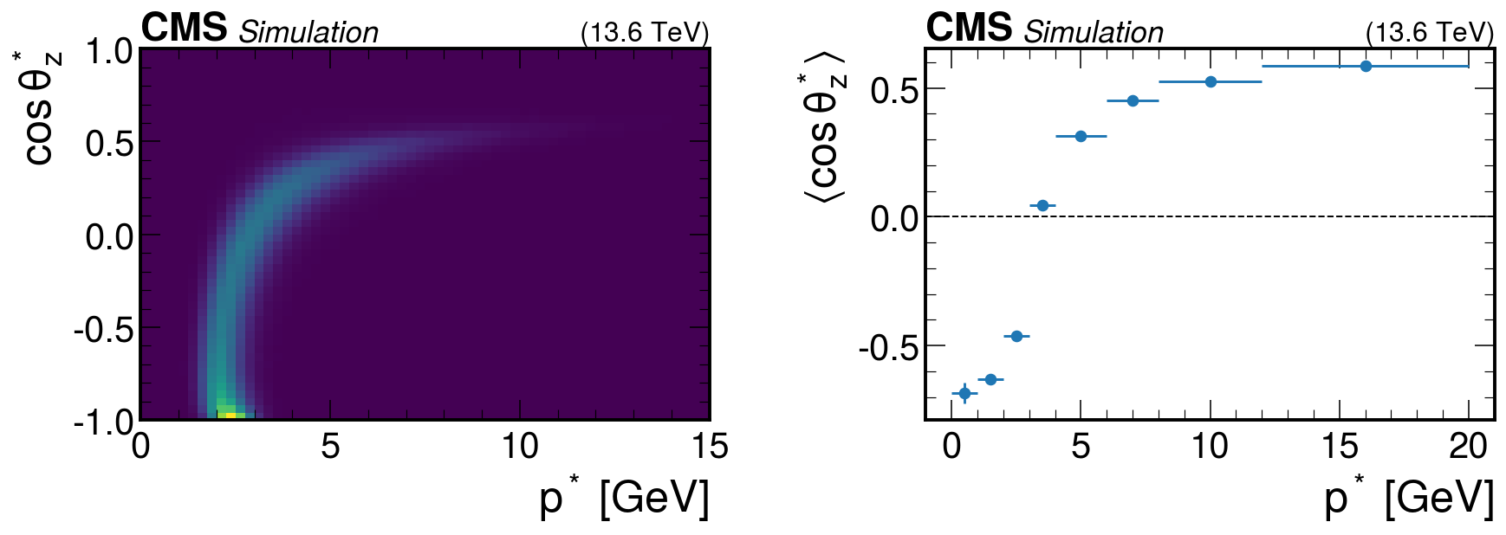
5
Soft mesons go −z, hard mesons go +z
|p*| and cosθ*_z are almost one-to-one: the profile runs from −0.68 at low p* to +0.59 at high p*, with a sharp edge near cosθ*_z ≈ 0.6.
The momentum-weighted ⟨cosθ*_z⟩ is 0.000000 — the momenta still balance. Over all mesons, corr(p*, cosθ*_z) = +0.72.
The imbalance is in the number of mesons, not in the momentum. That is why η is skewed while the total still adds up to the Higgs.
Notes:
Left: 2D density. Right: profile of the mean.

Slide 10
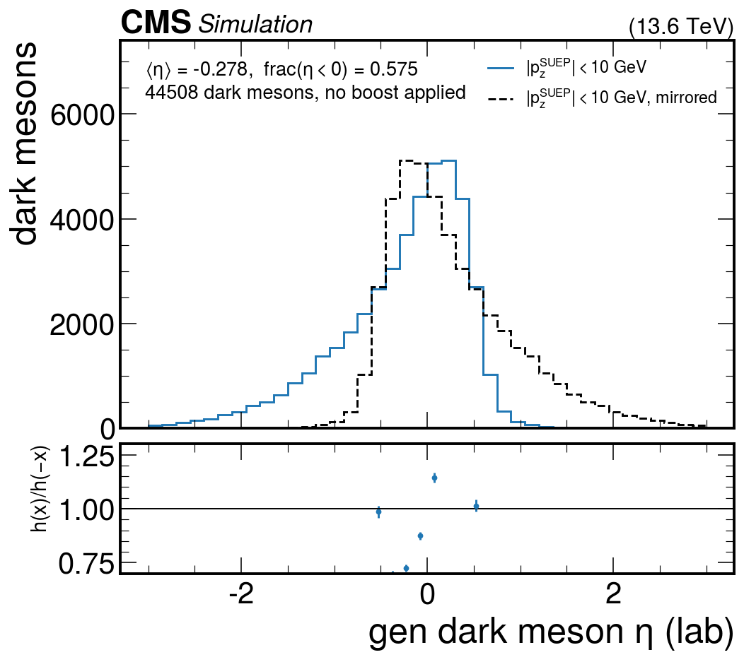
6
No boost needed to see it
Take only events where the meson system is already at rest along z, |p_z| < 10 GeV. The lab frame is then the rest frame.
With no boost applied anywhere, the raw lab η is still 57.5% negative, ⟨η⟩ = −0.278.
So the effect is not something our boost or our column code introduces.
Rules out: any suspicion that the asymmetry is manufactured by the rest-frame transformation used in the previous slides.
Notes:
The cleanest statement: raw numbers straight out of the file.

Slide 11
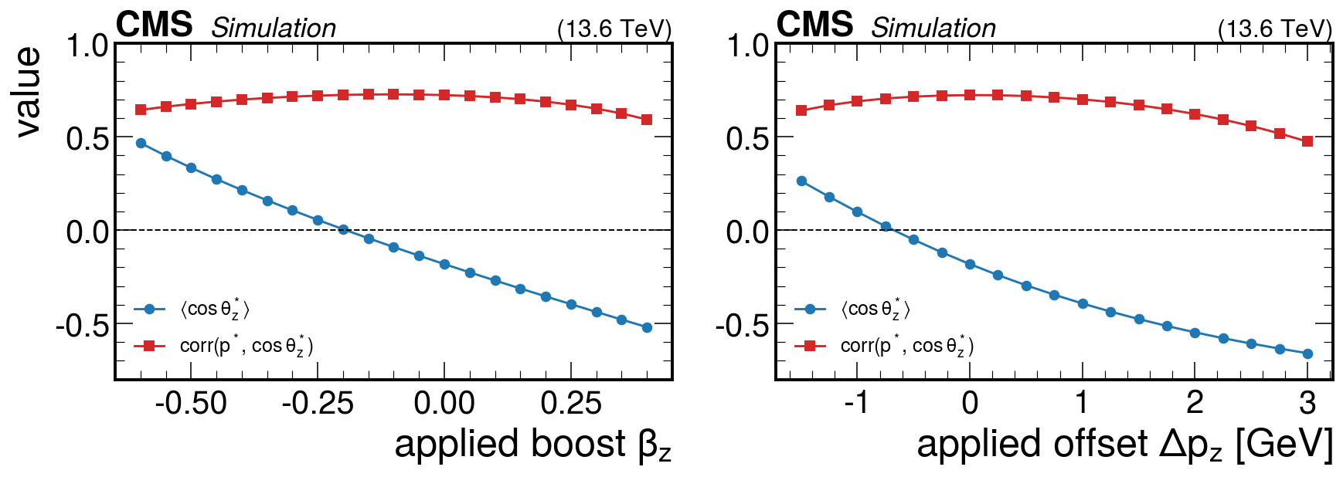
It is not a bookkeeping error
Scan a longitudinal boost β_z, and separately a longitudinal momentum offset Δp_z, applied to the rest-frame momenta.
⟨cosθ*_z⟩ can be driven to zero by either, but corr(p*, cosθ*_z) — how well a meson's direction predicts its momentum — never falls below about 0.47, and the distribution never becomes flat.
No choice of frame or shift makes the sample isotropic — the sampling of the meson directions is itself z-dependent.
Notes:
We tried to explain it away as a frame convention. It does not work.

Slide 12
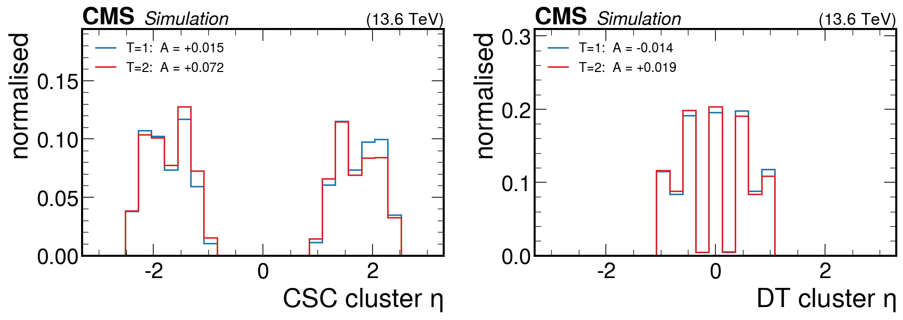
What it costs us
The reconstructed muon-detector clusters inherit the asymmetry directly.
Any per-endcap efficiency or acceptance from these samples is biased at the few-percent level. Folding into |η| is not a repair — see the next two slides.
+0.015
+0.072
−0.014
+0.019
CSC, T = 1
CSC, T = 2
DT, T = 1
DT, T = 2
Notes:
A = (N₋ − N₊)/(N₋ + N₊) quoted under each sample.

Slide 13
Root cause: one character in SuepShower.cc
The mediator decay is replaced by the SuepDecay Pythia hook, which calls SuepShower::generateFourVector() once per dark meson: draw a thermal |p|, then draw isotropic angles.
Already fixed upstream. The one-line patch landed in CMSSW_15_0_15 (1 Oct 2025) and in 15_1_0. Everything from 14_0_0 through 15_0_14 carries the bug — our samples were made with 15_0_2.
The z component of that 4-vector is built with sin(θ) where it should be cos(θ). Every meson is therefore generated with p_z ≥ 0.
generateShower() then subtracts the mean 3-momentum from every daughter, which pushes the bulk of them to negative p_z — and leaves the hard ones at +z. That is the whole effect.
GeneratorInterface/Pythia8Interface/src/SuepShower.cc : 158
− Vec4(p*cos(phi)*sin(theta), p*sin(phi)*sin(theta), p*sin(theta), en)
+ Vec4(p*cos(phi)*sin(theta), p*sin(phi)*sin(theta), p*cos(theta), en)
Notes:
A copy-paste slip: the transverse components are right, the longitudinal one repeats sin(theta). Note it also means the vector magnitude is not the sampled |p| — the momentum spectrum is distorted too, not only the angles.

Slide 14
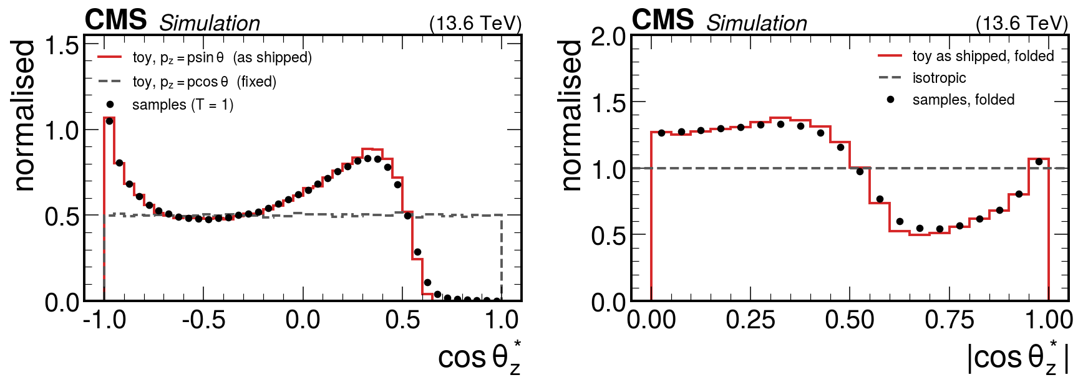
The typo reproduces the samples exactly
A toy re-implementation of SuepShower with the typo matches the samples bin for bin: ⟨cosθ*_z⟩ = −0.184 against −0.182 measured, multiplicity 31.0 against 31.0, ⟨p*⟩ = 3.42 against 3.41 GeV. With cos(θ) it gives −0.0003 and a flat distribution.
Folding into |η| removes the forward/backward asymmetry but not the distortion: the folded angular distribution is still wrong by up to 50%. These samples cannot be repaired after the fact — they need regenerating.
Notes:
Left: data points on top of the toy. Right: why |eta|-folding is a cosmetic fix only.

Slide 15
Where that leaves us
ESTABLISHED
OPEN FOR DISCUSSION
The asymmetry is real, gen-level, and about 5–10% in the meson yield.
When do we regenerate? Every point, or only what the analysis needs?
Cause: SuepShower.cc builds p_z with sin(θ) instead of cos(θ).
Move the GEN step to CMSSW_15_0_15+, or patch 15_0_2 in place?
A toy with that one line reproduces the samples bin for bin.
Which other SUEP samples — central productions, other analyses — were made with an affected release?
Fixed upstream in CMSSW_15_0_15; our samples used 15_0_2.
Anything already shown from these samples needs revisiting.
Diagnostics reproducible from the MDSNANO files: 3 files, 60k events, gen-level only. · Root cause confirmed against a toy of the generator.
Notes:
Ask the generator experts to look at the momentum-sampling step.

