Slide 1


ΕΥΕλικτες μεθοδολογιες ανΑπτυξης λογισμικοΥ υπολογιστικΗς νΕφους
ΔΕ3: ΣυνεχΗς ΟλοκλΗρωση και ΕυΕλικτος Ελεγχος
Cucumber BDD
πανεπιστημιο μακεδονιασ | Κεντρο επιμορφωσησ και δια βιου μαθησησ | βασιλησ πετρου | TEST AUTOMATION LEAD

Slide 2

Behaviour-Driven Development
Behavior Driven Development (BDD) is a methodology for developing software through continuous example-based communication between developers, QAs and BAs.
The primary purpose of BDD methodology is to improve communication amongst the stakeholders of the project so that each feature is correctly understood by all members of the team before development process starts.
This helps to identify key scenarios for each story and also to eradicate ambiguities from requirements.
πανεπιστημιο μακεδονιασ | Κεντρο επιμορφωσησ και δια βιου μαθησησ | βασιλησ πετρου | TEST AUTOMATION LEAD

Slide 3

Why Cucumber
Cucumber helps facilitate the discovery and use of a ubiquitous language within the team by giving the two sides of the linguistic divide a place where they can meet.
Cucumber tests interact directly with the developers’ code, but they’re written in a medium and language that business stakeholders can understand.
πανεπιστημιο μακεδονιασ | Κεντρο επιμορφωσησ και δια βιου μαθησησ | βασιλησ πετρου | TEST AUTOMATION LEAD

Slide 4
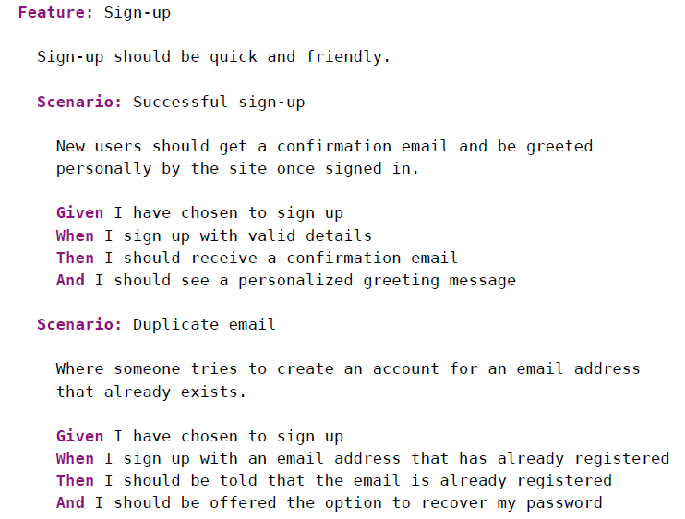
Example
πανεπιστημιο μακεδονιασ | Κεντρο επιμορφωσησ και δια βιου μαθησησ | βασιλησ πετρου | TEST AUTOMATION LEAD

Slide 5
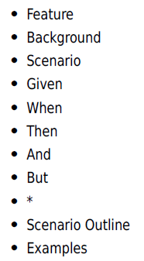
Format and Syntax
Gherkin files use the .feature file extension.
A Gherkin file is given its structure and meaning using a set of special keywords.
πανεπιστημιο μακεδονιασ | Κεντρο επιμορφωσησ και δια βιου μαθησησ | βασιλησ πετρου | TEST AUTOMATION LEAD

Slide 6
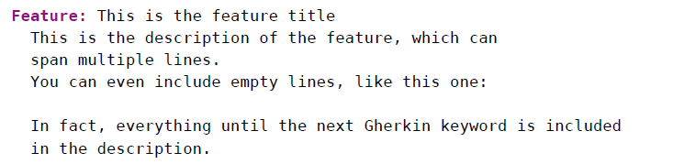
Feature
Each Gherkin file begins with the Feature keyword.
This keyword doesn’t really affect the behavior of your Cucumber tests at all; it just gives you a convenient place to put some summary documentation about the group of tests that follow.
πανεπιστημιο μακεδονιασ | Κεντρο επιμορφωσησ και δια βιου μαθησησ | βασιλησ πετρου | TEST AUTOMATION LEAD

Slide 7
Scenario
To actually express the behavior we want, each feature contains several scenarios.
Each scenario is a single concrete example of how the system should behave in a particular situation.
If you add together the behavior defined by all of the scenarios, that’s the expected behavior of the feature itself.
When Cucumber runs a scenario, if the system behaves as described in the scenario, then the scenario will pass; if not, it will fail.
We use scenarios to explore edge cases and different paths through a feature.
πανεπιστημιο μακεδονιασ | Κεντρο επιμορφωσησ και δια βιου μαθησησ | βασιλησ πετρου | TEST AUTOMATION LEAD

Slide 8
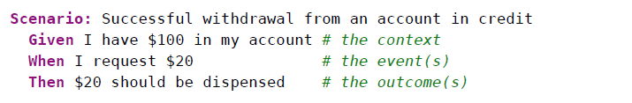
Given, When, Then
In Gherkin, we use the keywords Given, When, and Then to identify those three different parts of the scenario:
So, we use Given to set up the context where the scenario happens, When to interact with the system somehow, and Then to check that the outcome of that interaction was what we expected.
πανεπιστημιο μακεδονιασ | Κεντρο επιμορφωσησ και δια βιου μαθησησ | βασιλησ πετρου | TEST AUTOMATION LEAD

Slide 9
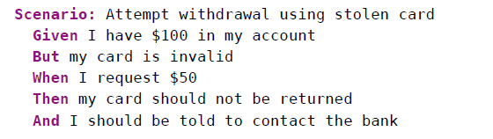
And, But
Each of the lines in a scenario is known as a step.
We can add more steps to each Given, When, or Then section of the scenario using the keywords And and But
πανεπιστημιο μακεδονιασ | Κεντρο επιμορφωσησ και δια βιου μαθησησ | βασιλησ πετρου | TEST AUTOMATION LEAD

Slide 10
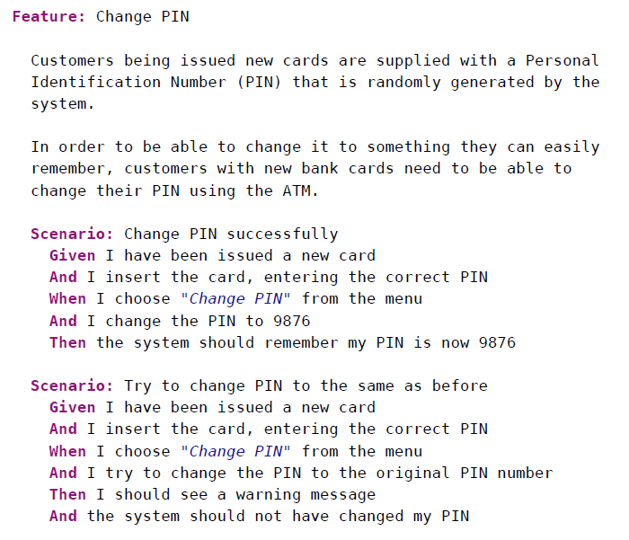
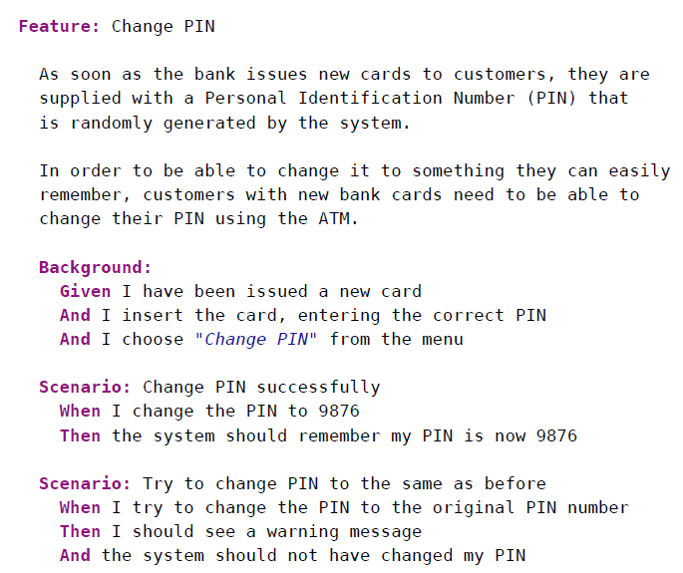
Background
A background section in a feature file allows you to specify a set of steps that are common to every scenario in the file.
πανεπιστημιο μακεδονιασ | Κεντρο επιμορφωσησ και δια βιου μαθησησ | βασιλησ πετρου | TEST AUTOMATION LEAD

Slide 11
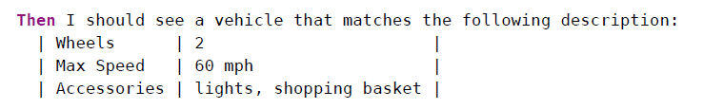
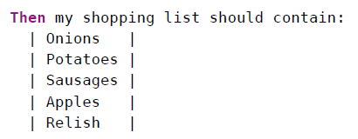
Data Tables
πανεπιστημιο μακεδονιασ | Κεντρο επιμορφωσησ και δια βιου μαθησησ | βασιλησ πετρου | TEST AUTOMATION LEAD

Slide 12
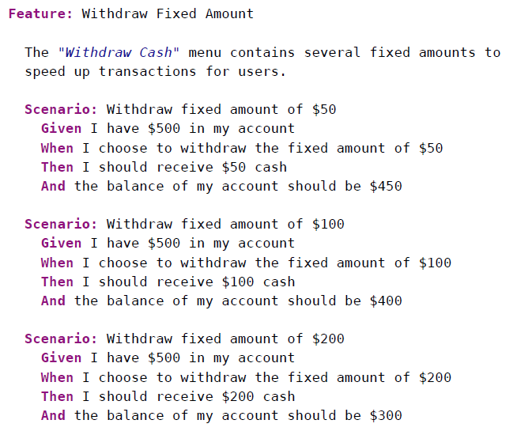
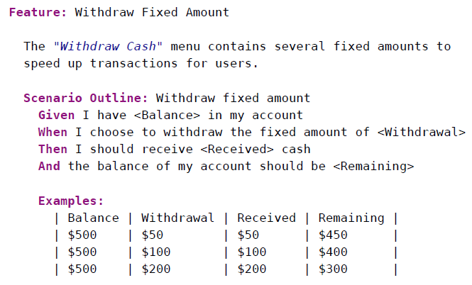
Scenario Outline
Sometimes we have several scenarios that follow exactly the same pattern of steps, just with different input values or expected outcomes.
πανεπιστημιο μακεδονιασ | Κεντρο επιμορφωσησ και δια βιου μαθησησ | βασιλησ πετρου | TEST AUTOMATION LEAD

Slide 13
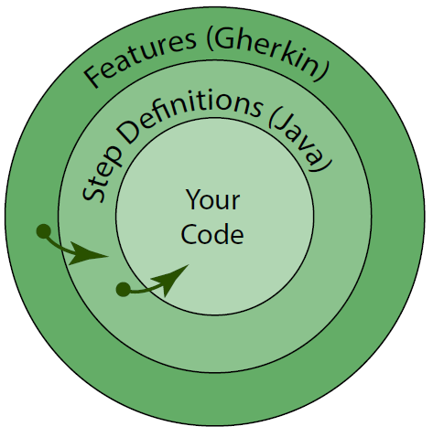
The main layers of a Cucumber test suite
We start with features, which contain our scenarios and steps.
The steps of our scenarios call step definitions that provide the link between the Gherkin features and the application being built.
πανεπιστημιο μακεδονιασ | Κεντρο επιμορφωσησ και δια βιου μαθησησ | βασιλησ πετρου | TEST AUTOMATION LEAD

Slide 14
Maven Project Archetype
mvn archetype:generate \
"-DarchetypeGroupId=io.cucumber" \
"-DarchetypeArtifactId=cucumber-archetype" \
"-DarchetypeVersion=5.6.0" \
"-DgroupId=com.testing.bdd" \
"-DartifactId=demo-bdd" \
"-Dpackage=com.testing.bdd" \
"-Dversion=1.0.0" \
"-DinteractiveMode=false"
πανεπιστημιο μακεδονιασ | Κεντρο επιμορφωσησ και δια βιου μαθησησ | βασιλησ πετρου | TEST AUTOMATION LEAD

Slide 15
thank you
questions?
πανεπιστημιο μακεδονιασ | Κεντρο επιμορφωσησ και δια βιου μαθησησ | βασιλησ πετρου | TEST AUTOMATION LEAD

