Slide 1


ΕΥΕλικτες μεθοδολογιες ανΑπτυξης λογισμικοΥ υπολογιστικΗς νΕφους
ΔΕ3: ΣυνεχΗς ΟλοκλΗρωση και ΕυΕλικτος Ελεγχος
User Stories & Use Cases
πανεπιστημιο μακεδονιασ | Κεντρο επιμορφωσησ και δια βιου μαθησησ | βασιλησ πετρου | TEST AUTOMATION LEAD

Slide 2

once upon a time in an IT company,
there was a great developer that was talking with a new customer...
“Don’t worry, I totally get it. I know what you need.”
πανεπιστημιο μακεδονιασ | Κεντρο επιμορφωσησ και δια βιου μαθησησ | βασιλησ πετρου | TEST AUTOMATION LEAD

Slide 3

…and after months where the implementation was completed by developer
the customer realized that developer didn't get it at all
application was not what customer meant.
πανεπιστημιο μακεδονιασ | Κεντρο επιμορφωσησ και δια βιου μαθησησ | βασιλησ πετρου | TEST AUTOMATION LEAD

Slide 4
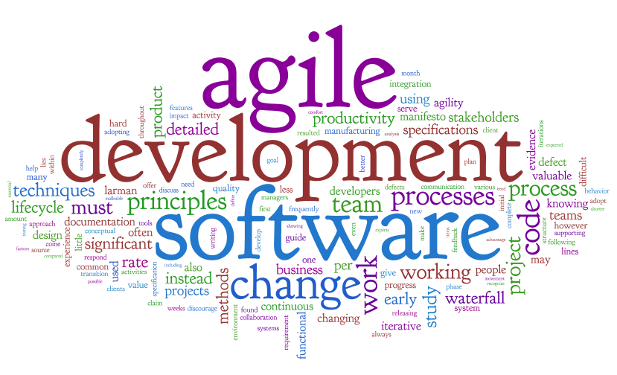
...and that's how Agile became a must
if developers had to start working with users throughout the project to understand their needs, then they would avoid the code-and-fix trap.
πανεπιστημιο μακεδονιασ | Κεντρο επιμορφωσησ και δια βιου μαθησησ | βασιλησ πετρου | TEST AUTOMATION LEAD

Slide 5
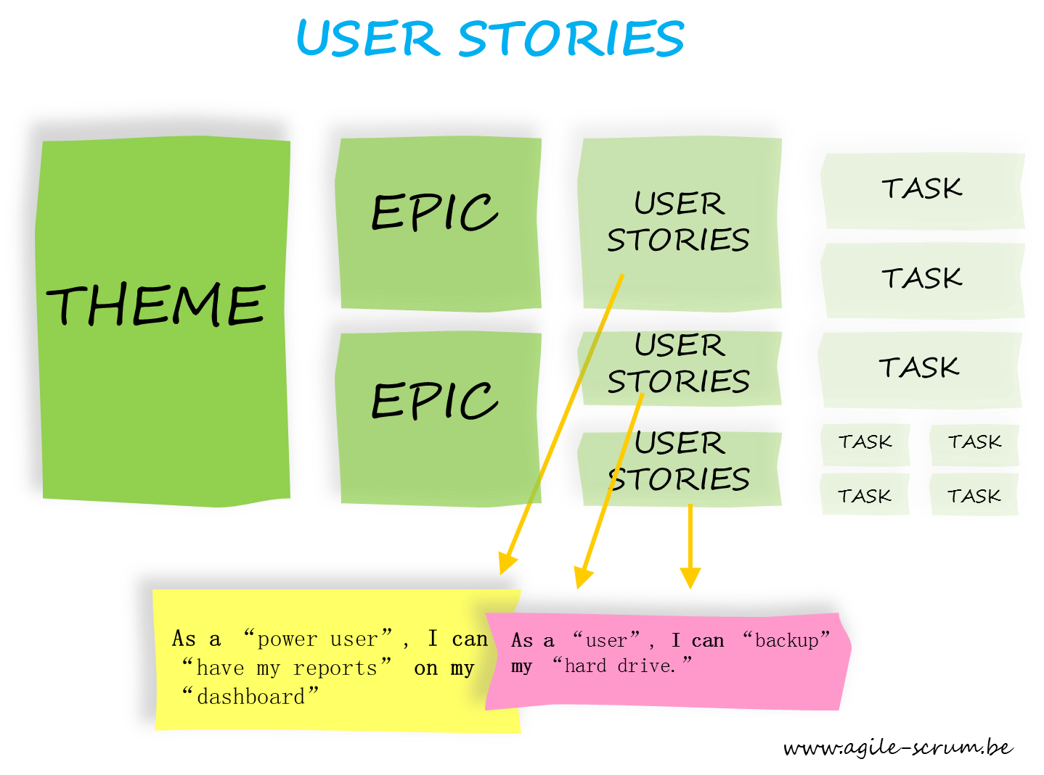
User Stories
πανεπιστημιο μακεδονιασ | Κεντρο επιμορφωσησ και δια βιου μαθησησ | βασιλησ πετρου | TEST AUTOMATION LEAD

Slide 6
User Story is one of the most useful tools to come out of the Agile movement.
some people call it a scenario
expresses one very specific need that a user has.
It’s usually written out as a couple of sentences.
Most user stories are written in the language of the users, so any user should be able to read a user story and immediately understand what it means.
A lot of time, user stories are written on index cards
πανεπιστημιο μακεδονιασ | Κεντρο επιμορφωσησ και δια βιου μαθησησ | βασιλησ πετρου | TEST AUTOMATION LEAD

Slide 7

User Story Example
A user realizes he miscapitallized a word everywhere in his document,
so he tells the word processor to search for all occurrences of it,
and replace them with the corrected word.
A good practice to follow with user stories is to use “he” or “she”, rather than try to be gender-neutral. It makes the user in the story easier to connect with by personifying him a bit. It also express a more conversational tone, which makes the user story friendlier and a bit easier to read and understand.
A typical user story will have enough information to help the user understand what it is the software needs to accomplish, but it’s not meant to be a complete description of how the software works.
πανεπιστημιο μακεδονιασ | Κεντρο επιμορφωσησ και δια βιου μαθησησ | βασιλησ πετρου | TEST AUTOMATION LEAD

Slide 8
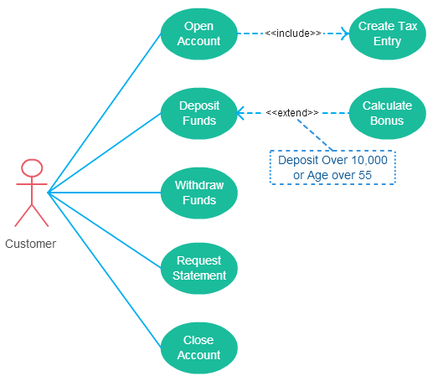
Use Cases
πανεπιστημιο μακεδονιασ | Κεντρο επιμορφωσησ και δια βιου μαθησησ | βασιλησ πετρου | TEST AUTOMATION LEAD

Slide 9
A Use Case is similar to a user story, because it also describes one specific interaction between the user and the software.
Organizes functional requirements.
Models the goals of system/actor interactions.
Records paths - called scenarios - from trigger events to goals.
Describes one main flow of events and various alternate flows.
Multi-level, so that one use case can use the functionality of another one.
πανεπιστημιο μακεδονιασ | Κεντρο επιμορφωσησ και δια βιου μαθησησ | βασιλησ πετρου | TEST AUTOMATION LEAD

Slide 10
Use Case Example (with an indicative template)
Name | UC1: Search and Replace
Summary | All occurrences of a search term are replaced with replacement text.
Rationale | While editing a document, many users find that there is text somewhere in the file being edited that needs to be replaced, but searching for it manually by looking through the entire document is time-consuming and ineffective. The search-and-replace function allows the user to find it automatically and replace it with specified text. Sometimes this term is repeated in many places and needs to be replaced. At other times, only the first occurrence should be replaced. The user may also wish to simply find the location of that text without replacing it.
Users | All users
Preconditions | A document is loaded and being edited.
Basic Course of Events | The user indicates that the software is to perform a search-and-replace in the document. The software responds by requesting the search term and the replacement text. The user inputs the search term and replacement text and indicates that all occurrences are to be replaced. The software replaces all occurrences of the search term with the replacement text.
Alternative Paths | In Step 3, the user indicates that only the first occurrence is to be replaced. In this case, the software finds the first occurrence of the search term in the document being edited and replaces it with the replacement text. The postcondition state is identical, except only the first occurrence is replaced, and the replacement text is highlighted. In Step 3, the user indicates that the software is only to search and not replace, and does not specify replacement text. In this case, the software highlights the first occurrence of the search term and the use case ends. The user may decide to abort the search-and-replace operation at any time during Steps 1, 2, or 3. In this case, the software returns to the precondition state.
Postconditions | All occurrences of the search term have been replaced with the replacement text.
πανεπιστημιο μακεδονιασ | Κεντρο επιμορφωσησ και δια βιου μαθησησ | βασιλησ πετρου | TEST AUTOMATION LEAD

Slide 11
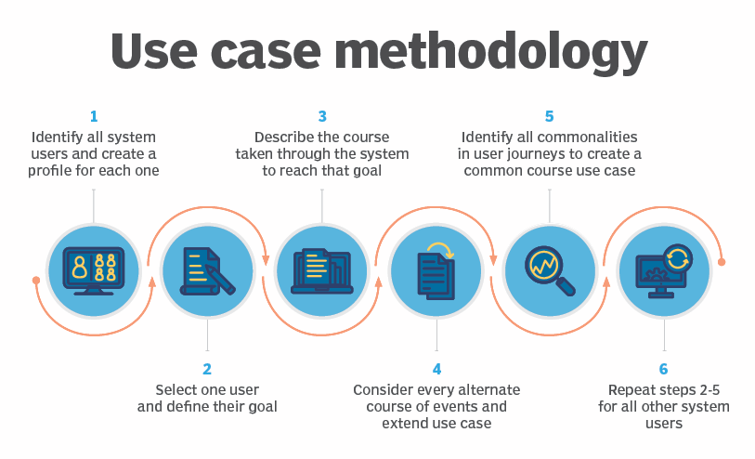
Use Case Methodology
πανεπιστημιο μακεδονιασ | Κεντρο επιμορφωσησ και δια βιου μαθησησ | βασιλησ πετρου | TEST AUTOMATION LEAD

Slide 12

Difference of
User Stories & Use Cases
πανεπιστημιο μακεδονιασ | Κεντρο επιμορφωσησ και δια βιου μαθησησ | βασιλησ πετρου | TEST AUTOMATION LEAD

Slide 13
The key differences between user stories and use cases, are:
User stories are about needs
Use cases are about the behavior you’ll build into the software to meet those needs
User stories are easy for users to read
Use cases describe a complete interaction between the software and users (and possibly other systems)
πανεπιστημιο μακεδονιασ | Κεντρο επιμορφωσησ και δια βιου μαθησησ | βασιλησ πετρου | TEST AUTOMATION LEAD

Slide 14
thank you
questions?
πανεπιστημιο μακεδονιασ | Κεντρο επιμορφωσησ και δια βιου μαθησησ | βασιλησ πετρου | TEST AUTOMATION LEAD

