Slide 1
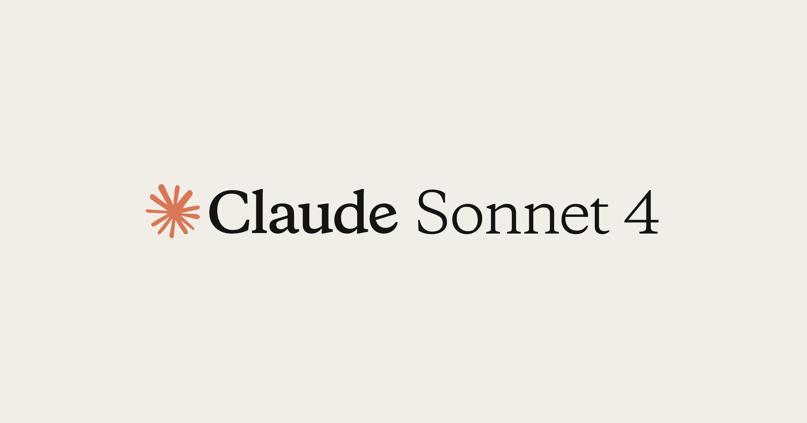
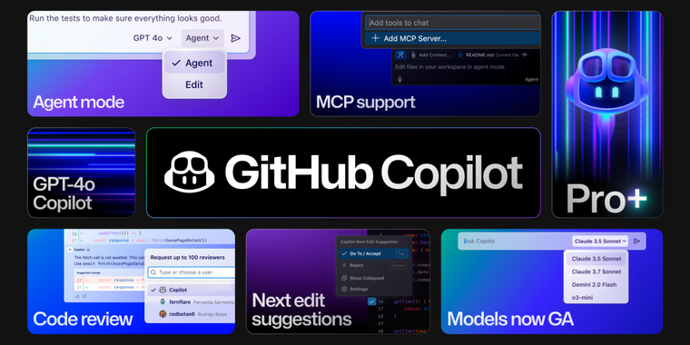
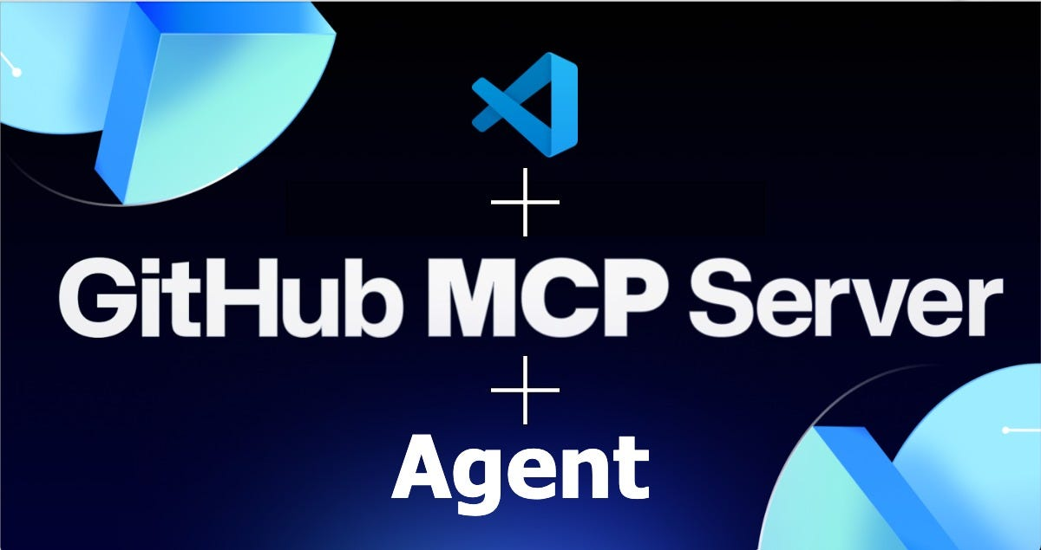
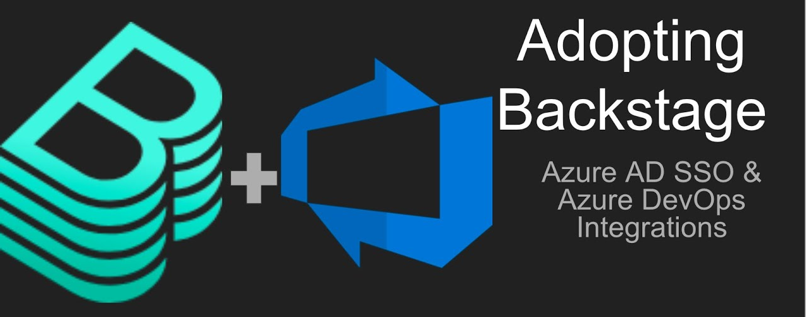




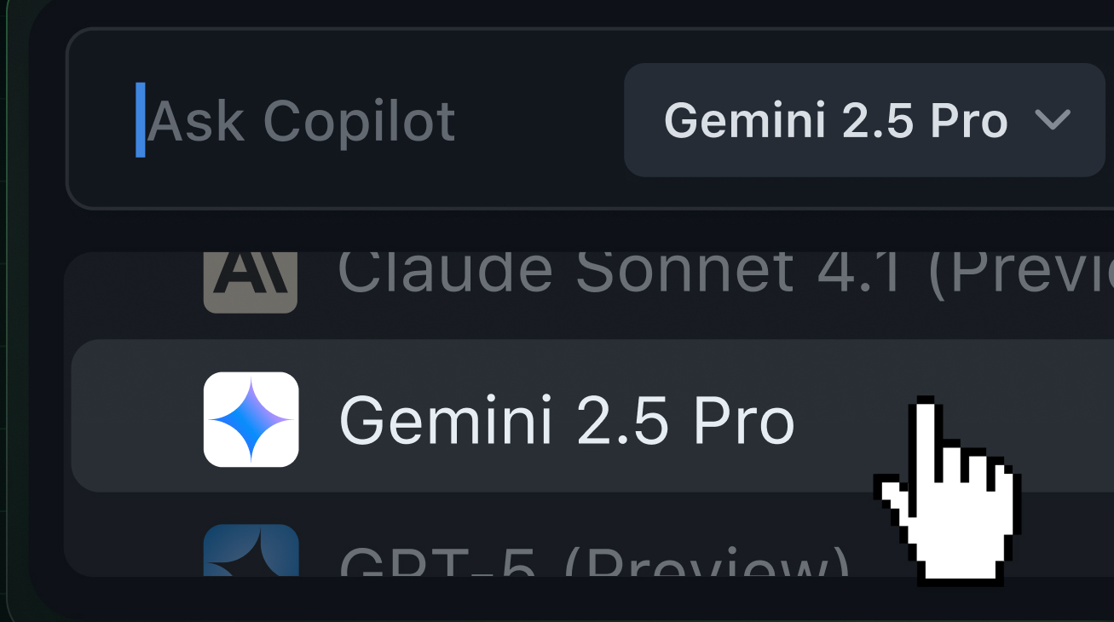
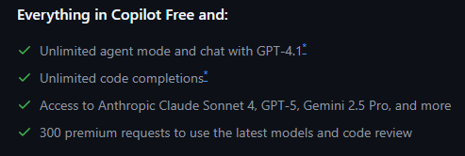

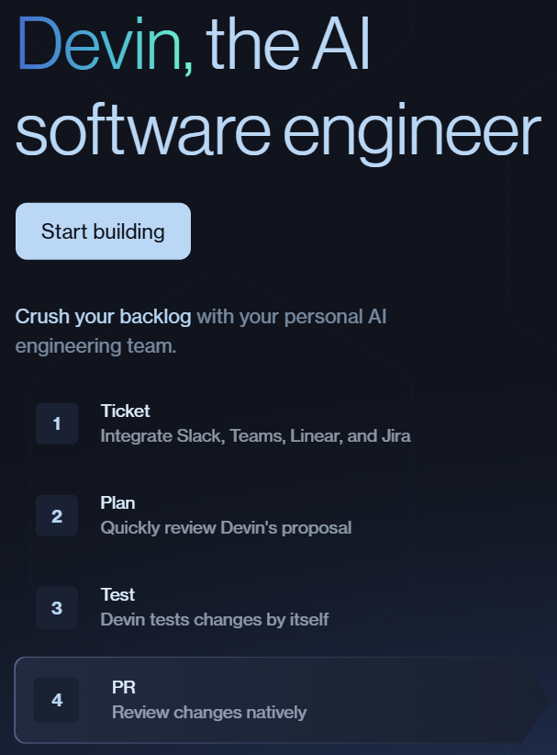


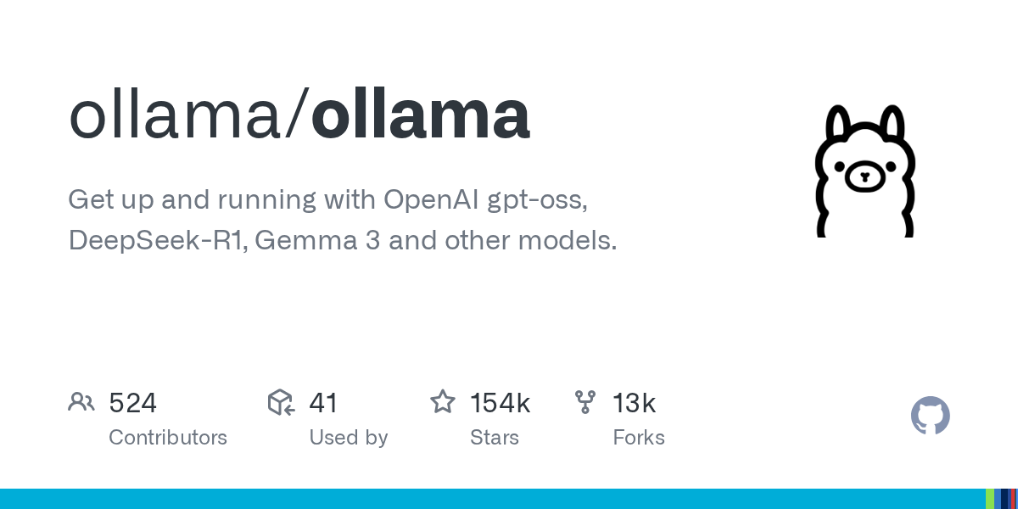

[01] Platform as a Product
Tools to improve maintenance service efficiency using Generative AI & Platform Engineering
GitHub Copilot: AI-powered coding assistant based on Generative AI (GenAI + Agentic capabilities [MCP Server & A2A protocol]).
Backstage: A single developer portal based on YAML templates that enables cataloging, documenting, and managing software components, with the ability to integrate tools such as CI/CD, monitoring, etc. in the future
YAML TEMPLATES
GEN AI + AGENTIC
REQUIREMENTS
CONTINUOUS TRAINING

