Slide 1
Thesis Proposal: Computational Methods for detecting Engram cells in unlabelled datasets
Angus Campbell
Master’s of Science in Bioinformatics

Slide 2
My CV in brief.
Bachelor of Science, Neuroscience (Sept 2010-May 2015)
Dalhousie University, Halifax, NS, Canada
Honor’s Thesis: Temporal properties of ChR2 depolarization in different RGC types. (May 2014 – May 2015)
Retina and Optic Nerve Research Laboratory, Under Dr. Steven Barnes
Research Assistant (May 2015-May 2016)
Haskin’s Laboratories, New Haven, CT, USA
Under Dr. David Ostry and Dr. Paul Gribble
Motor learning in perceptual cortex using psychophysics, fMRI, and EEG.
Master’s Student, Masters of Science in Bioinformatics (Sept 2020-Present)
University of British Columbia, Vancouver, BC, Canada
Courses so far: Topic in Mathematical Biology (A+), Topics in Bioinformatics (A+), Problem Solving in Bioinformatics(A+), Statistics for High Dimensional Biology (A-), Topics in Medical Genomics (A). Currently enrolled in a Directed Studies. Need to do professional development courses.
Notes:
Talk about your path through the masters.
Brain regions do not follow a uniform trajectory nor respond to exposures identically. (Vijayakumar et al., 2018; Pederson et al., 2014).
Sex differences emerge with age and are concentrated in regions associated with psychopathology (Ruigrok et al., 2014). Ethnic identity is a marker for different environmental exposures an individual may be subject to, for instance African-American have a disproportionate burden of lead exposure. (Cassidy-Bushrow et al., 2017).
Many studies examining these interactions have focused on a few brain regions often in cross sectional studies with too few subjects to have good power.

Slide 3
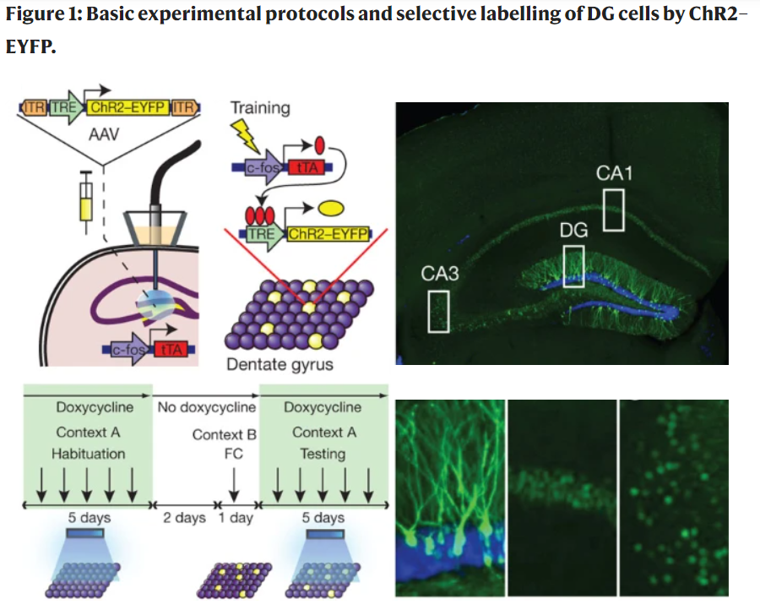
Engram Cells Accumulate at a background rate
Liu, X., Ramirez, S., Pang, P. T., Puryear, C. B., Govindarajan, A., Deisseroth, K., & Tonegawa, S. (2012). Optogenetic stimulation of a hippocampal engram activates fear memory recall. Nature, 484(7394), 381-385)
Notes:
Engram studies always do a control to show that while Engram cells are present in their control, they accumulate at a higher rate in the experimental group. Neverthe less there are still active cells.
READ THIS: Yap, E. L., & Greenberg, M. E. (2018). Activity-regulated transcription: bridging the gap between neural activity and behavior. Neuron, 100(2), 330-348.
https://www.sciencedirect.com/science/article/pii/S0896627318309012

Slide 4
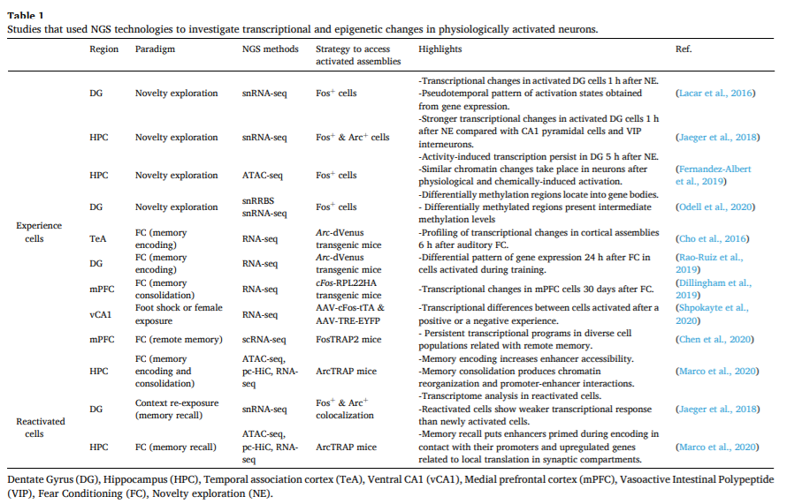
Studies of Sequencing Engram Labelled Cells
From: Fuentes-Ramos, M., Alaiz-Noya, M., & Barco, A. (2021). Transcriptome and epigenome analysis of engram cells: Next-generation sequencing technologies in memory research. Neuroscience & Biobehavioral Reviews
Notes:
This slide needs to go after a hypothesis.

Slide 5






Studies of Sequencing Engram Labelled Cells
From: Fuentes-Ramos, M., Alaiz-Noya, M., & Barco, A. (2021). Transcriptome and epigenome analysis of engram cells: Next-generation sequencing technologies in memory research. Neuroscience & Biobehavioral Reviews

Slide 6
Hypothesis
There should be low prevalence cell types within the DGC population of other datasets that express Engram Cell DEGs such as IEGs.
Notes:
Also want a timeline, want a list of human datasets or mouse datasets. We may need to justify the classifier. We need a hypothesis, https://lucid.app/lucidchart/32083739-9932-4627-860c-51388e80b49d/edit?from_internal=true

Slide 7
Hypothesis
There should be low prevalence cell types within the DGC population of other datasets that express Engram Cell DEGs such as IEGs. Will attempt an unsupervised method first then a supervised classifier.
Notes:
Also want a timeline, want a list of human datasets or mouse datasets. We may need to justify the classifier. We need a hypothesis, https://lucid.app/lucidchart/32083739-9932-4627-860c-51388e80b49d/edit?from_internal=true

Slide 8
Caveats
Engram Cells are already rare this could make them hard to find and will just intrinsically give us less data.
Previous studies have done highly controlled experiments so the cells are activated at the same time in the same behavioral context using the same label.

Slide 9
Secondary Objectives
Identify robust Engram DEGs for scRNA-seq
2) Cell (Sub)Type/State specific Engram DEG expression
3) Look for timepoint specific expression
4) Look for Reactivation signature
5) Relative Proportions within and between Cell states/Subtypes
Notes:
Also want a timeline, want a list of human datasets or mouse datasets. We may need to justify the classifier. We need a hypothesis, https://lucid.app/lucidchart/32083739-9932-4627-860c-51388e80b49d/edit?from_internal=true

Slide 10
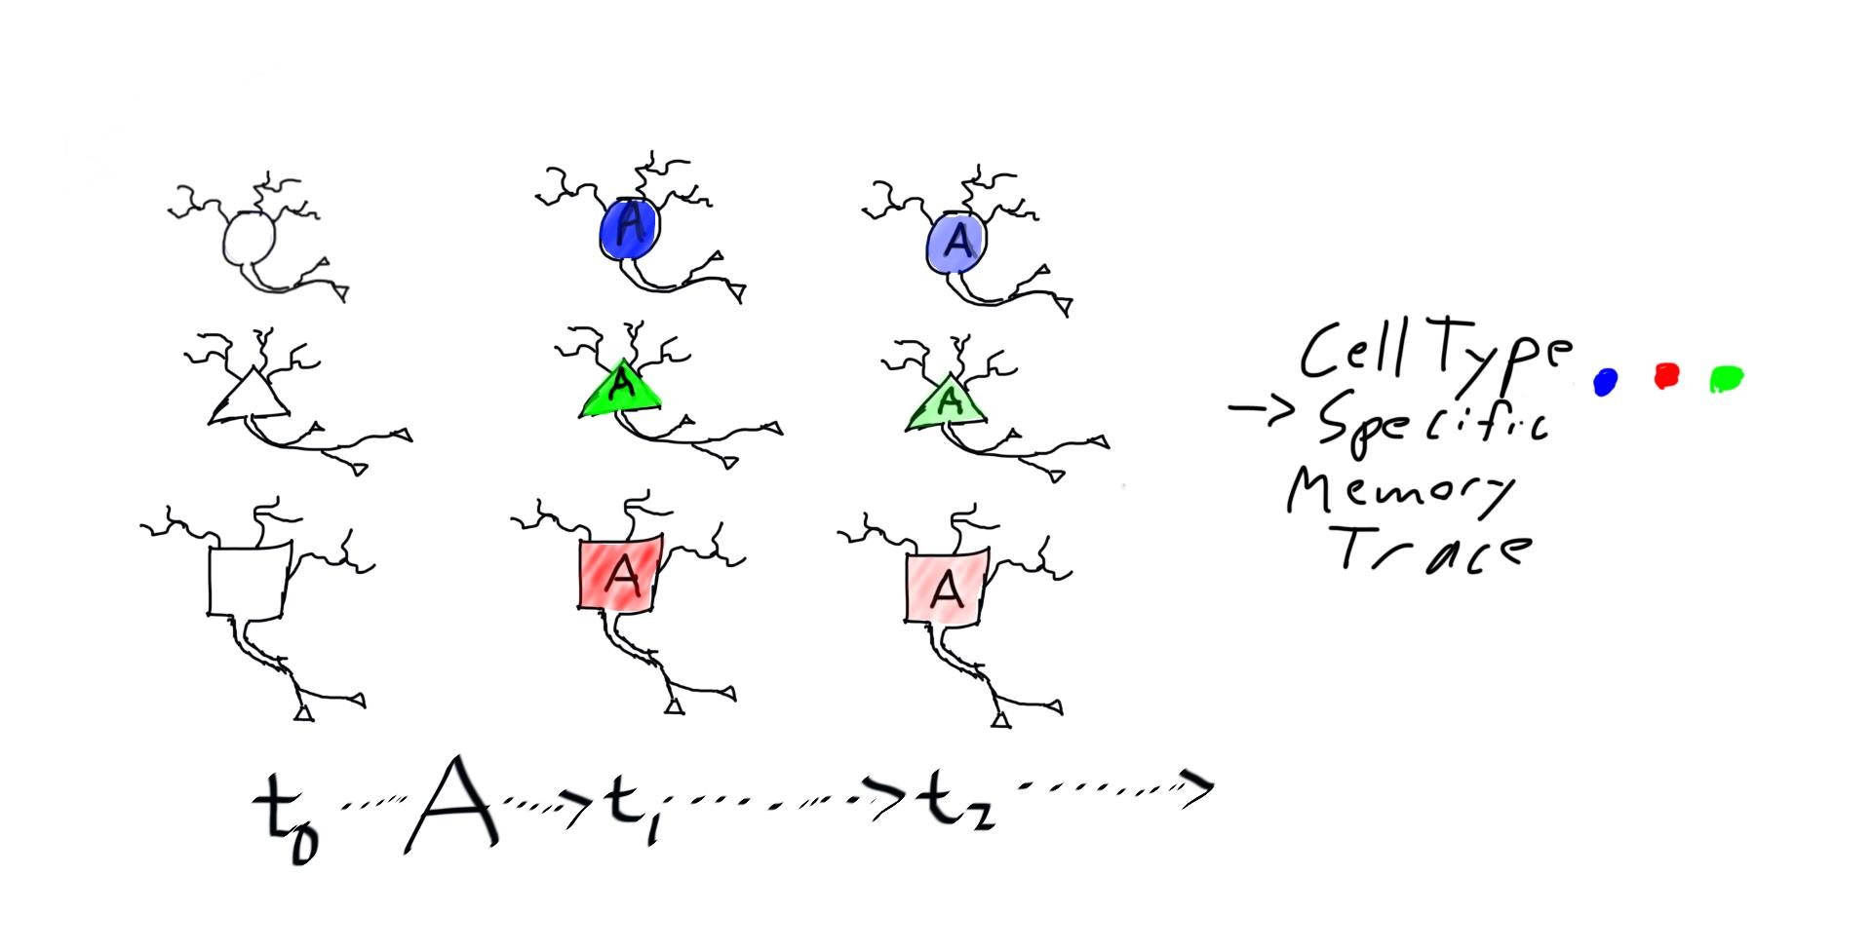
Caveats
Observed in mPFC (Chen et al. 2020), Hp (Jeager et al., 2018), and V1 (Hvartin et al. 2018).

Slide 11
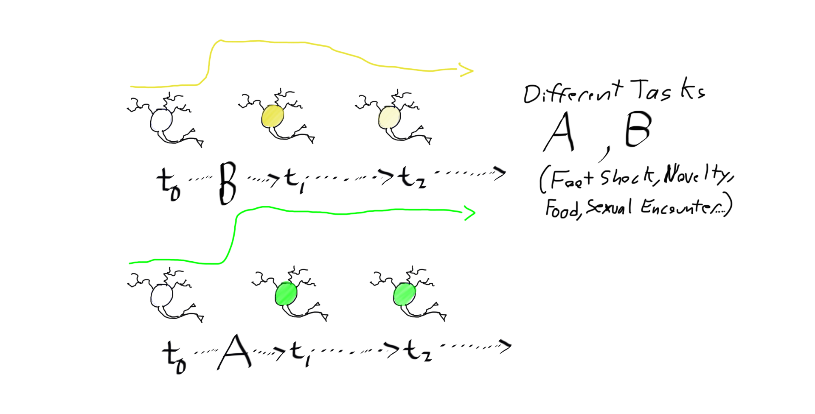
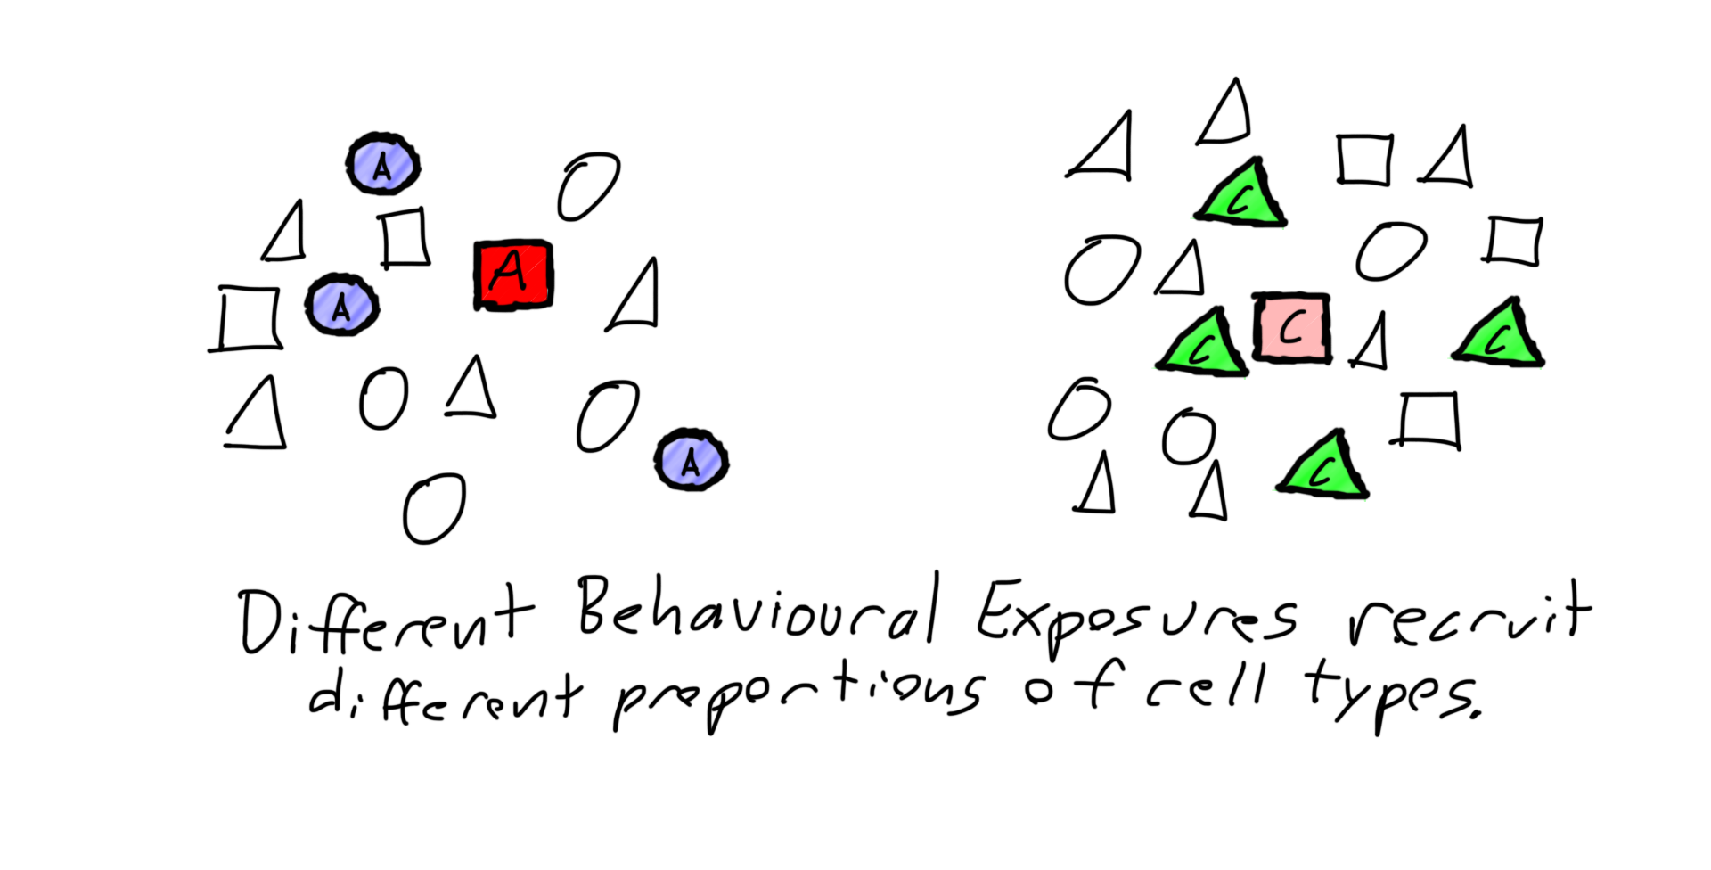
Caveats
Observed in Hp (Shpokayte et al., 2019) and mPFC (Chen et al. 2020).

Slide 12
Caveats
Observed in Chen et al. (2020) for broadly defined cell types (VIP, Pyramidal etc) so possible for subtypes as well.

Slide 13
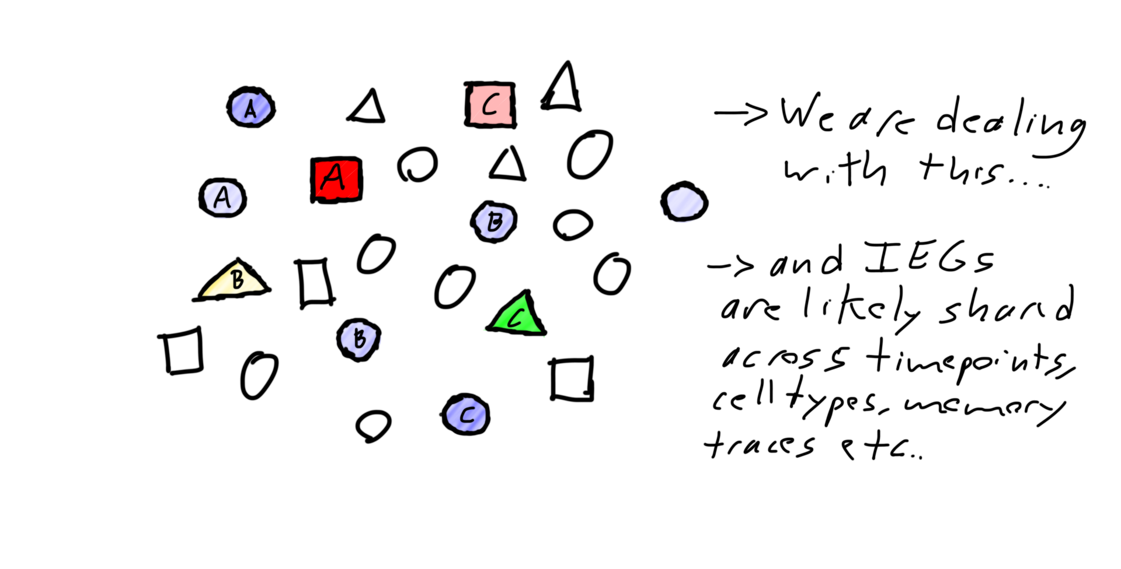
Caveats
Notes:
Don’t count this towards slide count, it will only be shown briefly

Slide 14
Terminology (for us at least) * Ask Paul about how to improve introducing this.
Possibly do a “..the brain is complex and make memories….”
Cell Types: Clusters from whole tissue samples or one containing unbiased abundances (i.e. have not been enriched for one type or another).
Cell Subtypes: Clusters within Cell types distinguishable by a stable unique marker.
Cell State: A transient change in expression and it’s dynamics.
Memory Trace: A cell state specific to the set of behaviorally and cell (sub) type specific DEGs.
Engram Cells: Cells exhibiting an IEG label.
Putative Engram Cells: Cells expressing DEGs identified from a scRNA-seq of Engram Cells

Slide 15
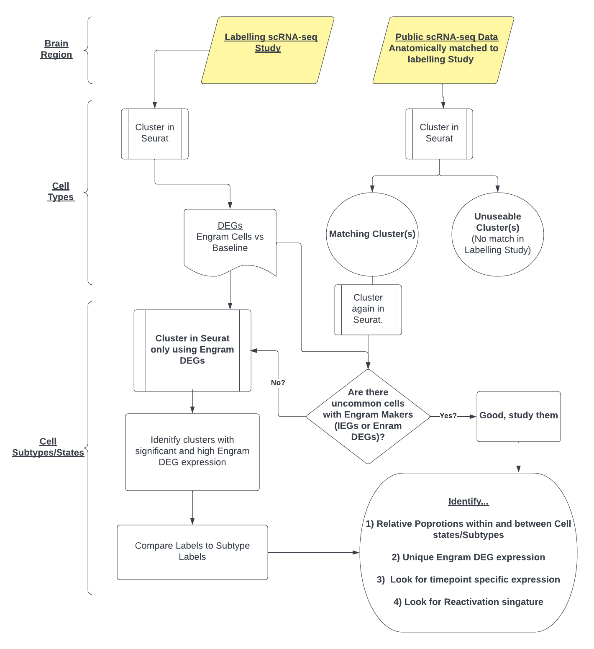
Unsupervised Workflow * Typos in Identify need fixing
Notes:
Also want a timeline, want a list of human datasets or mouse datasets. We may need to justify the classifier. We need a hypothesis, https://lucid.app/lucidchart/32083739-9932-4627-860c-51388e80b49d/edit?from_internal=true, add step 5 Identify robust Engram DEGs for scRNA-Seq

Slide 16
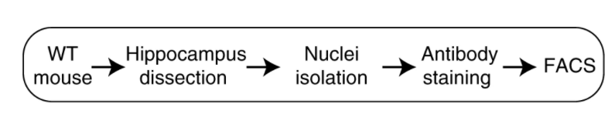
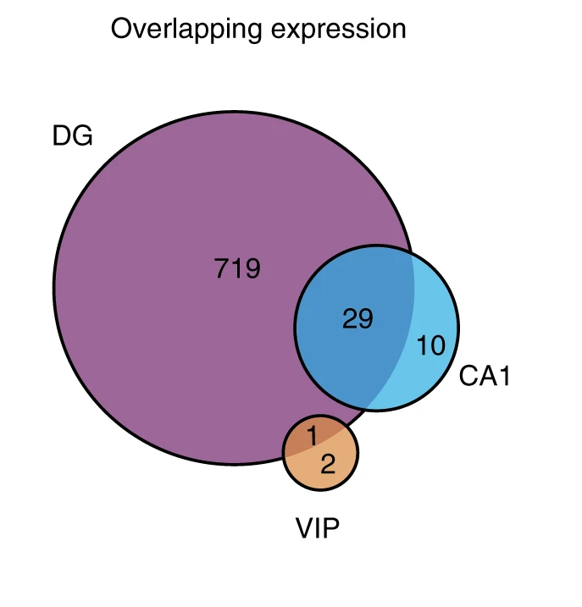
Right now I am focusing on Jeager et al., (2018)
7-8 week old female mice given novelty exposure,
Dentate Gyrus samples were labelled with Fos and Arc anti-body staining, not a true engram label.
Has timepoint data (1hr, 4hrs and 5hrs) and reactivation groups.
Contains different cell types, but the bulk of the data is DG Granule cells (DGCs) add in number of cells here.
Sequenced at ~1.5 average million reads per nucleus.

Slide 17
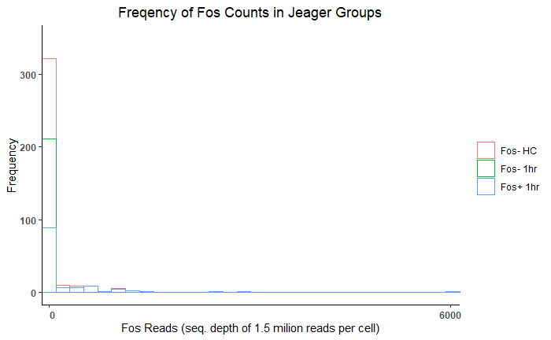
Using a single marker is not a robust label for
Putative Engram cells scRNA-seq data
Fos+ and Arc+ cells do not have observable expression. Most IEG expression is sporadic.
Just that the fact that cells with the protein label do not have detectable expression of these cells.
The fluorescent labels are protein level labels.
Important IEGs for this presentation: Fos, Arc, Inhba, Rsg4,
Notes:
Change figure title “Fos RNA is only detected in a subset of ”

Slide 18
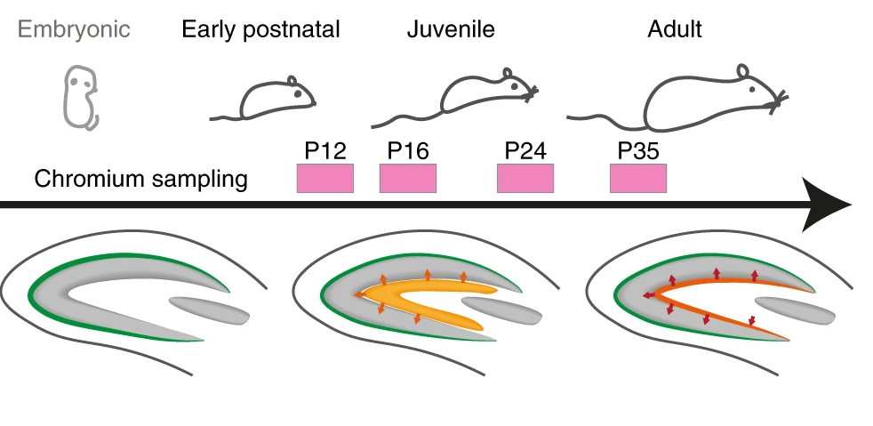
Putative Engram Cells in Hochgerner et al. (2020)
Another dataset taken across many developmental time points from Embryonic day 17 to postnatal day 120 was chosen to look at first.
Mixture of male and females, cells were mixed in together for sequencing.
Restricting my analysis to adult DGCs from P35 to avoid developmental effects (Jeager mice are 49-62 days old).
Sequencing depth ~40k reads per cell.

Slide 19
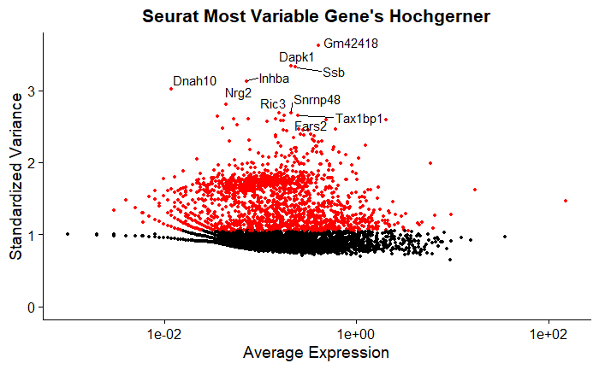
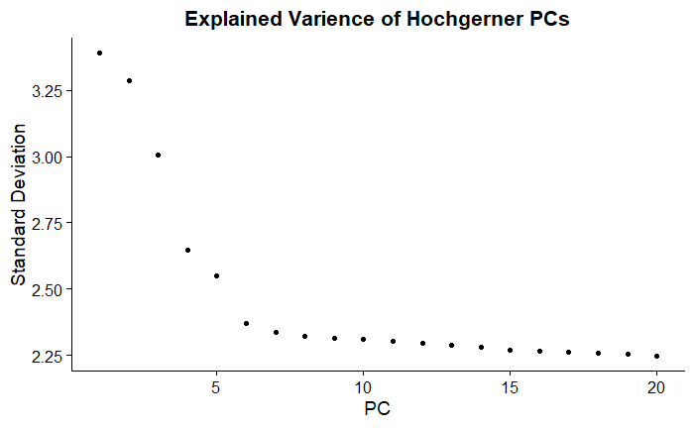
Seurat Clustering Hochgerner et al. (2018)
200 out of 900 Jeager DEGs are included in the top 2000 most variable genes.
16 out of 100 are Jeager DEGs from across many timepoints.
I initially used first 6 PCs for clustering.

Slide 20
Seurat Clustering Hochgerner et al. (2018)
PC_ 1
Positive: Malat1, Tmsb10, Rgs4, Sh3bgrl3, Igfbp6, Rasgrp1, Chgb, Nptx2, Penk, Inhba
Negative: Tmsb4x, Cck, Ahcyl2, Snca, Tubb2b, Olfm1, Pgm2l1, Neurod2, Adcyap1r1, Igfbp5
PC_ 2
Positive: Aldoa, Inhba, Rgs4, Rprm, Zwint, Lingo1, Meg3, Grp, 1110008P14Rik, Penk
Negative: Malat1, Ahcyl2, Actb, Tmsb4x, Ppm1h, Fst, Nat8l, Epha5, Neurod2, Dsp
PC_ 3
Positive: Tmsb10, Eif4a2, Fxyd6, Junb, Aldoa, Jun, Grp, Tuba1a, Gng3, Cxcl12
Negative: Inhba, Epha10, Adcy1, Asb11, Arc, Lingo1, Ddn, Nptx2, Chst1, Trim2
PC_ 4
Positive: Snhg11, Meg3, Krt2, Gm10605, Grp, Rprm, Tenm4, Tenm2, Pde1a, Arpp21
Negative: Tmsb4x, Ier2, Gadd45b, Junb, Arc, Rheb, Inhba, Samd4, Cenpa, Gadd45g
PC_ 5
Positive: Timp2, Meg3, Grp, Midn, Junb, Nrp1, Fxyd7, Vgf, Gng3, Arc
Negative: Ppp1r1a, Hist1h2bc, Adcy1, Opcml, Eif4a2, Epha5, Stk32c, Chn1, Fam101b, Neurod2
PC_ 6
Positive: Snca, Rplp0, Agap1, Ccnl2, Usp22, Pgm2l1, Mical2, Aldh3b1, Pgbd5, Ncs1
Negative: Junb, Scg5, Faf2, Fos, Ier2, Btg2, C2cd4b, Zfp956, Lrp11, Tmem246

Slide 21
Seurat Clustering Hochgerner et al. (2018)
PC_ 1
Positive: Malat1, Tmsb10, Rgs4, Sh3bgrl3, Igfbp6, Rasgrp1, Chgb, Nptx2, Penk, Inhba
Negative: Tmsb4x, Cck, Ahcyl2, Snca, Tubb2b, Olfm1, Pgm2l1, Neurod2, Adcyap1r1, Igfbp5
PC_ 2
Positive: Aldoa, Inhba, Rgs4, Rprm, Zwint, Lingo1, Meg3, Grp, 1110008P14Rik, Penk
Negative: Malat1, Ahcyl2, Actb, Tmsb4x, Ppm1h, Fst, Nat8l, Epha5, Neurod2, Dsp
PC_ 3
Positive: Tmsb10, Eif4a2, Fxyd6, Junb, Aldoa, Jun, Grp, Tuba1a, Gng3, Cxcl12
Negative: Inhba, Epha10, Adcy1, Asb11, Arc, Lingo1, Ddn, Nptx2, Chst1, Trim2
PC_ 4
Positive: Snhg11, Meg3, Krt2, Gm10605, Grp, Rprm, Tenm4, Tenm2, Pde1a, Arpp21
Negative: Tmsb4x, Ier2, Gadd45b, Junb, Arc, Rheb, Inhba, Samd4, Cenpa, Gadd45g
PC_ 5
Positive: Timp2, Meg3, Grp, Midn, Junb, Nrp1, Fxyd7, Vgf, Gng3, Arc
Negative: Ppp1r1a, Hist1h2bc, Adcy1, Opcml, Eif4a2, Epha5, Stk32c, Chn1, Fam101b, Neurod2
PC_ 6
Positive: Snca, Rplp0, Agap1, Ccnl2, Usp22, Pgm2l1, Mical2, Aldh3b1, Pgbd5, Ncs1
Negative: Junb, Scg5, Faf2, Fos, Ier2, Btg2, C2cd4b, Zfp956, Lrp11, Tmem246

Slide 22
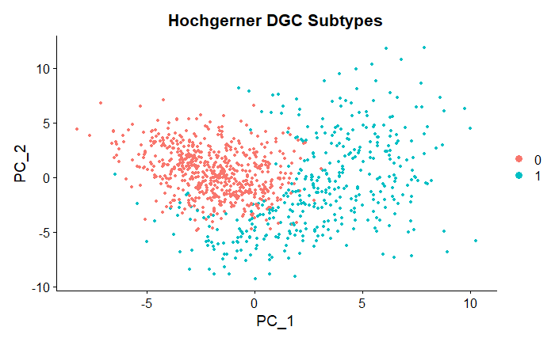
Jeager DEGs in Hochgerner et al. (2018) P35 adult DGCs
0 = Cck DGCs
1 = Malat1 DGCs
Malat1 cells generally had more Jeager DEGs and are smeared along PC1 (primarily Jeager DEGs)
Attempted to use just top 3 PCs to find engram cells but there was nothing.
Notes:
This graph needs a bit of work,

Slide 23
Unsupervised Workflow * Typos in Identify need fixing
Notes:
Also want a timeline, want a list of human datasets or mouse datasets. We may need to justify the classifier. We need a hypothesis, https://lucid.app/lucidchart/32083739-9932-4627-860c-51388e80b49d/edit?from_internal=true, add step 5 Identify robust Engram DEGs for scRNA-Seq

Slide 24
Unsupervised Workflow * Typos in Identify need fixing
Notes:
Also want a timeline, want a list of human datasets or mouse datasets. We may need to justify the classifier. We need a hypothesis, https://lucid.app/lucidchart/32083739-9932-4627-860c-51388e80b49d/edit?from_internal=true, add step 5 Identify robust Engram DEGs for scRNA-Seq

Slide 25
Unsupervised Workflow * Typos in Identify need fixing
Notes:
Also want a timeline, want a list of human datasets or mouse datasets. We may need to justify the classifier. We need a hypothesis, https://lucid.app/lucidchart/32083739-9932-4627-860c-51388e80b49d/edit?from_internal=true, add step 5 Identify robust Engram DEGs for scRNA-Seq

Slide 26
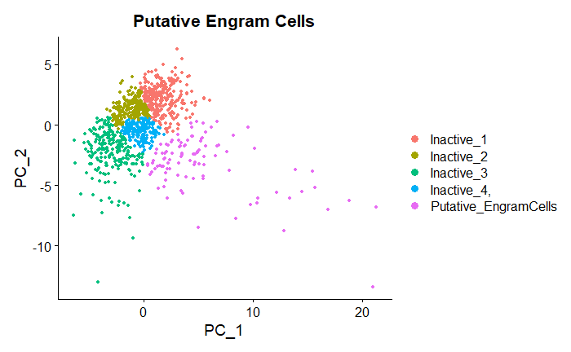
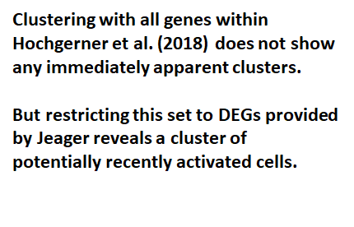
Clustering within Jeager et al,(2018)’s DEGs in other datasets
shows a cluster of Putative Engram Cells
Clusters 0-2 have few gene’s with any significant expression. Cluter0 intriguingly has Melatonin receptors upregulated.
Cluster3 is the most rarely expressed and has incredibly low pvalues for a number of IEGs notably Inhba and Rgs4
Notes:
Title is confusing and referes to multiple slices

Slide 27
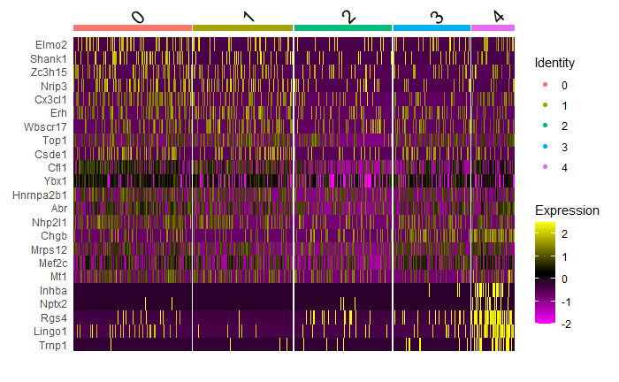
Clustering within Jeager et al,(2018)’s DEGs in other datasets
shows a cluster of Engram Cells
Clusters 0-2 have few gene’s with any significant expression.
Cluster3 is the most rarely occuring and has many genes with low p-values for a number of IEGs notably Inhba and Rgs4
Cluster0 has 21 genes with significance <0.05 and 10 with < 0.01 while Cluster3 has 25 and 22 genes passing those thresholds. Furthermore in terms of absolute log fold two change the genes in Cluster0 are more than double. The absolute average log fold change for genes passing 0.05 in cluster 3 is ~1.29 +/- 0.69 while all the other clusters have mean absolute lod2FC around ~0.3 +/- 0.2. This mateches the deinfition of an engram cell having low prevalence, with more variable, but higher, mean IEG expression. Need to do a stats test to confirm this intuition.
Notes:
Should have color scale for heatmap. Meltanonin is a distraction. Need table of gene’s Paul says you can’t mention the significance being greater or lesser, but make note of the NUMBER of significant gene’s in each group.

Slide 28

Clustering within Jeager et al,(2018)’s DEGs in other datasets
shows a cluster of Putative Engram Cells
Clusters 0-2 have few gene’s with any significant expression. Cluter0 intriguingly has Melatonin receptors upregulated.
Cluster3 is the most rarely expressed and has incredibly low pvalues for a number of IEGs notably Inhba and Rgs4
Notes:
slide Title is confusing and referes to multiple slides, also this plot needs to metion that this is the Hochgerner dataset

Slide 29
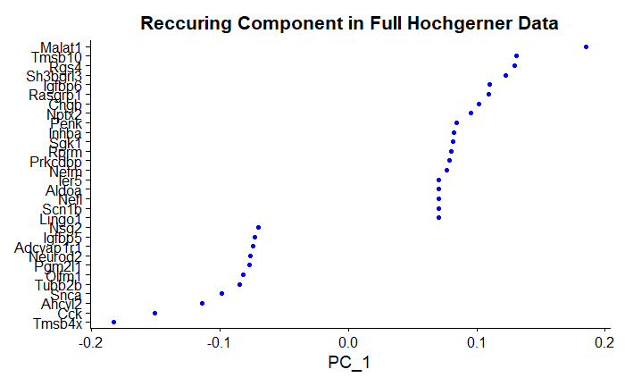
Erwin et al., (2020) found Penk+ over representation in Labelled Cells
Hypothesis: Penk will appear overexpressed in DGC datasets.
Also show the clusters for immature granule cells in Hochgerner.
Notes:
Should have color scale for heatmap. Meltanonin is a distraction. Need table of gene’s

Slide 30
Erwin et al., (2020) found Penk+ over representation in Labelled Cells
Hypothesis: Penk will appear overexpressed in DGC datasets.
Also show the clusters for immature granule cells in Hochgerner.
Notes:
Should have color scale for heatmap. Meltanonin is a distraction. Need table of gene’s

Slide 31
Erwin et al., (2020) found Penk+ over representation in Labelled Cells
Hypothesis: Penk will appear overexpressed in DGC datasets.
Also show the clusters for immature granule cells in Hochgerner.
Notes:
Should have color scale for heatmap. Meltanonin is a distraction. Need table of gene’s

Slide 32
Penk+ Expression in Putative Engram Cells Matches Erwin et al., (2020)
Penk Cells were over represented in the Engram Cells.
Notes:
Should have color scale for heatmap. Meltanonin is a distraction. Need table of gene’s

Slide 33
Penk+ Expression in Putative Engram Cells Matches Erwin et al., (2020)
Penk Cells were over represented in the Engram Cells.
Only 1 Penk Cell Coexpressed Cck and it was in the lowest qualtie of Penk expression.
Notes:
Should have color scale for heatmap. Meltanonin is a distraction. Need table of gene’s

Slide 34
Penk+ Expression in Putative Engram Cells Matches Erwin et al., (2020)
Penk Cells were over represented in the Engram Cells.
Only 1 Penk Cell Coexpressed Cck and it was in the lowest qualtie of Penk expression.
~25% (7/22) of Penk+ cells are putative Engram Cells as in Erwin et al., (2020) labelling with TRAP-Fos
Notes:
Should have color scale for heatmap. Meltanonin is a distraction. Need table of gene’s

Slide 35
Penk+ Expression in Putative Engram Cells Matches Erwin et al., (2020)
Penk+ Cells were over represented in the Engram Cells.
Only 1 Penk+ Cell Coexpressed Cck and it was in the lowest qualtile of Penk expression.
~25% (7/22) of Penk+ cells are putative Engram Cells as in Erwin et al., (2020) labelling with TRAP-Fos
They make up 0.2% of all DGC cells but 7% of Putative Engram cells.
Notes:
Should have color scale for heatmap. Meltanonin is a distraction. Need table of gene’s

Slide 36
Summary & whats next
Classifier

Slide 37
References
Cembrowski, M. S., Wang, L., Sugino, K., Shields, B. C., & Spruston, N. (2016). Hipposeq: a comprehensive RNA-seq database of gene expression in hippocampal principal neurons. elife, 5, e14997.
Citri, A., & Malenka, R. C. (2008). Synaptic plasticity: multiple forms, functions, and mechanisms. Neuropsychopharmacology, 33(1), 18-41.
Hawk, J. D. (2011). Investigation of the role of histone acetylation in hippocampus-dependent memory formation (Doctoral dissertation, University of Pennsylvania).
Huang, Anping & Zhang, Xinjiang & Li, Runmiao & Chi, Yu. (2018). Memristor Neural Network Design. 10.5772/intechopen.69929.
Hrvatin, S., Hochbaum, D. R., Nagy, M. A., Cicconet, M., Robertson, K., Cheadle, L., ... & Greenberg, M. E. (2018). Single-cell analysis of experience-dependent transcriptomic states in the mouse visual cortex. Nature neuroscience, 21(1), 120-129.
Liu, X., Ramirez, S., Pang, P. T., Puryear, C. B., Govindarajan, A., Deisseroth, K., & Tonegawa, S. (2012). Optogenetic stimulation of a hippocampal engram activates fear memory recall. Nature, 484(7394), 381-385.
Minatohara, K., Akiyoshi, M., & Okuno, H. (2016). Role of immediate-early genes in synaptic plasticity and neuronal ensembles underlying the memory trace. Frontiers in molecular neuroscience, 8, 78.
The University of Queensland. Long-term synaptic plasticity. Queensland Brain Institute. https://qbi.uq.edu.au/brain-basics/brain/brain-physiology/long-term-synaptic-plasticity
Sullivan, K. E., Kendrick, R. M., & Cembrowski, M. S. (2020). Elucidating memory in the brain via single‐cell transcriptomics. Journal of Neurochemistry.
Rao-Ruiz, P., Couey, J. J., Marcelo, I. M., Bouwkamp, C. G., Slump, D. E., Matos, M. R., ... & Kushner, S. A. (2019). Engram-specific transcriptome profiling of contextual memory consolidation. Nature communications, 10(1), 1-14.

Slide 38
EXTRA MATERIAL

Slide 39
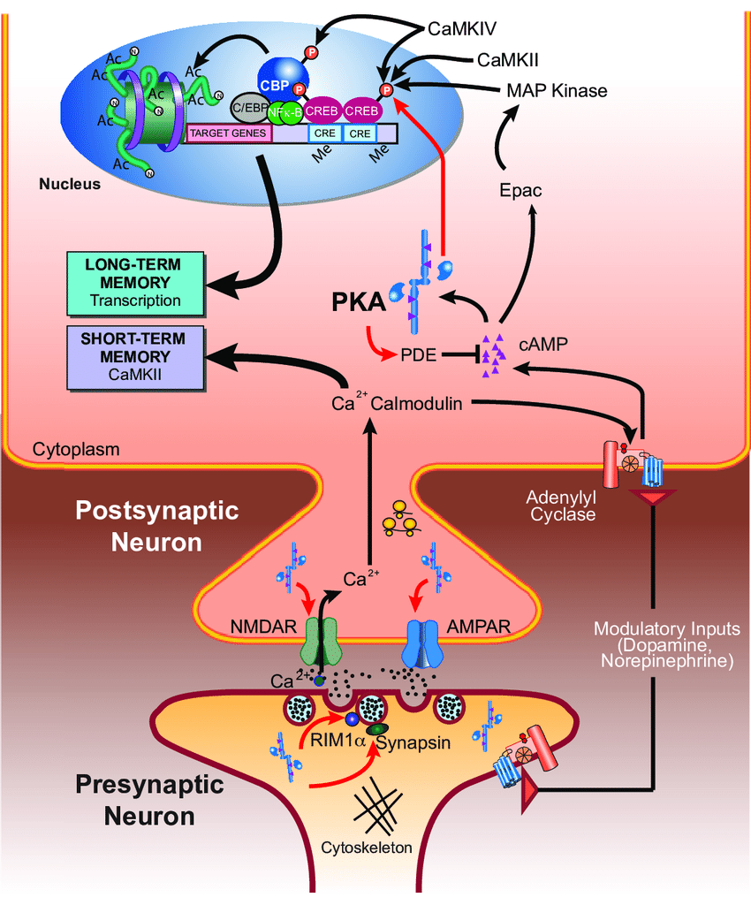
Hebbian Plasticity
NOTE: Keep this slide for when you have specific proteins you want to talk about.
Coactivation of neurons results in strengthening of memories as postulate by Donald Hebb postulated in The Organization of Behaviour (1949) coactivated neurons drives forming groups of strongly connected neurons called engrams.
“Neurons that fire together wire together.”
(Hawk, 2011)

Slide 40
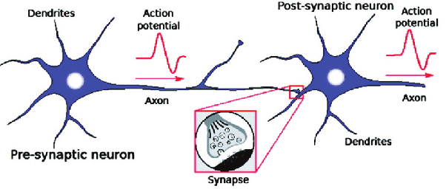
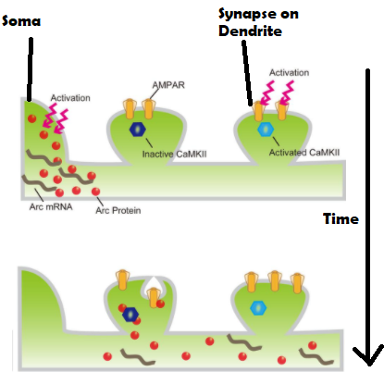
Hebbian Plasticity
Coactivation of neurons results in strengthening of memories as postulate by Donald Hebb postulated in The Organization of Behaviour (1949) coactivated neurons drives forming groups of strongly connected neurons called engrams
“Neurons that fire together wire together.”
Minatohara et al. (2016)

Slide 41
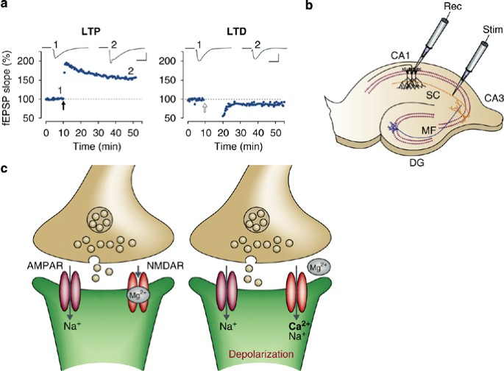
Hebbian Plasticity
Coactivation of neurons results in strengthening of memories as postulate by Donald Hebb postulated in The Organization of Behaviour (1949) coactivated neurons drives forming groups of strongly connected neurons called engrams
Long Term Potentiation and Long Term Depression are well accepted neural correlates of memory.
Fig 1 Citri and Melenka (2008)

Slide 42
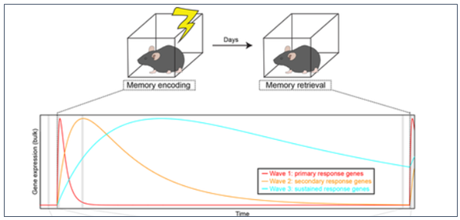
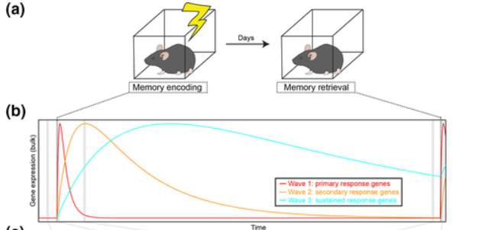
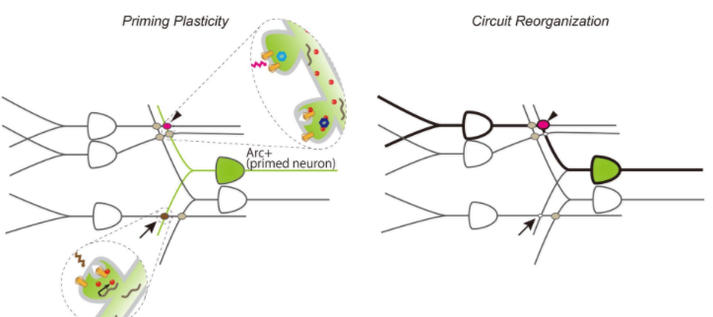
Immediate Early Genes (IEGs)
IEGs: Produced within minutes of a sustained event, many are induced by CREB from activated synapses. Some are tied to specific modulatory neurotransmitters (such as D1 or serotonin receptors).
Examples include erg-1, c-fos, homer1, BDNF. Their expression changes over time after the initial learning event.
Sullivan et al. (2020)

Slide 43
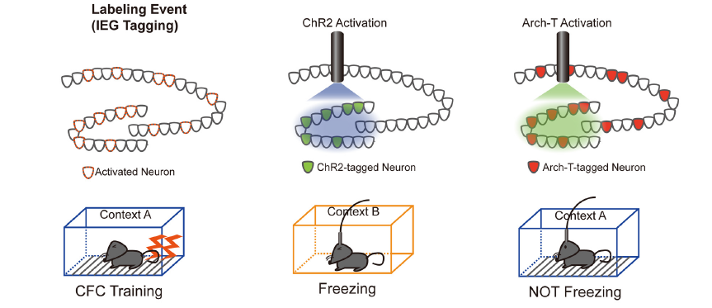
Immediate Early Genes and Long Term Memory
Minatohara et al. (2016)
et al.(2012)

Slide 44
Immediate Early Genes (IEGs)
Minatohara et al. (2016)
et al.(2012)

Slide 45

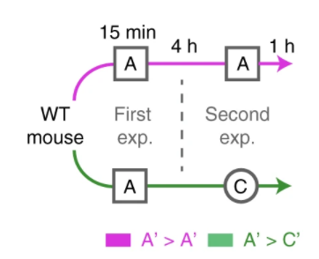

Jeager et al. (2018) Novel Environment Exploration followed by antibody staining for Fos and Arc expressing denate gyrus cells
Basic Experiment (Many Cell types):
Reactivation (DGCs Only):
Time Course (DGCs only):
Notes:
Provides a variety of specific time points and conditions for us to look into. Slide 27 has the experimental design figures for the recall and time course if they are interested (double check this slide number before presentation)

Slide 46
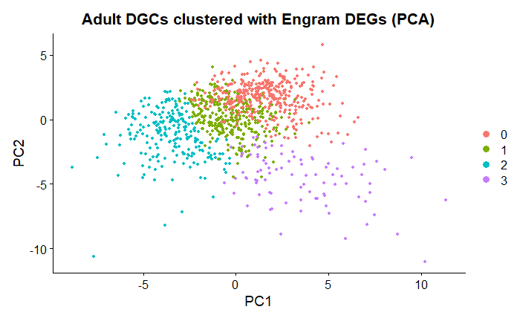
Clustering within Jeager et al,(2018)’s DEGs in other datasets
shows a cluster of Engram Cells
Clustering with all genes within Hochgerner et al. (2018) does not show any immediately apparent clusters.
But restricting this set to DEGs provided by Jeager reveals a cluster of potentially recently activated cells.

Slide 47
Bonus slide, show the results from the Immatrue DGCs and the all gene clusters
Clustering with all genes within Hochgerner et al. (2018) does not show any immediately apparent clusters.
But restricting this set to DEGs provided by Jeager reveals a cluster of potentially recently activated cells.

Slide 48
Engram Cell Labelling
Engram Cells are thought to be repeatedly activated neurons that a drive the activity of other cells associated with the event but which drop in or out of the assembly.
They are rare, as evidenced by calcium imaging studies.
They tend to upregulate IEGs (if this is the case for secondary response genes and late response gene’s is not clear)

Slide 49
Transcriptomic-Activity Coupling
Here’s how to visualize this,
Start with a bunch of empty cells, show what happens to them during a normal experiment, event A happens and they all follow a somewhat similar time course specific to that cell type.
Make note that there is a background rate of cells
which become sufficiently active to become engram cells, although they will not be following the same time course or due to differences between the experiences will show different expression.
Various studies have begun to sequence engram labelled tissue with both bulk and single cell.
Various authors have reported different transcription between different behavioral paradigms, we were also aware of
Each method is going to have its benefits and detriments sequencing
Notes:
In some ways studying these activity markers is nothing new. Studying activity induced transcription has been done in many in vitro studies but the engram label allow studying cells from within a living animal which experienced natural stimulation.

Slide 50
Logic of Putative Engram cells
Here’s how to visualize this,
Building on the last slide, have a population of empty cells essentially following different time courses. Our ability to detect long lasting transcriptional changes may be limited as they will themselves rexperience something new.
Visualize how in a normal labelling study we can be sure because of controls that the engram cells are probably from one event and are thus following a somewhat similar timecourse.
Never the less
Notes:
In some ways studying these activity markers is nothing new. Studying activity induced transcription has been done in many in vitro studies but the engram label allow studying cells from within a living animal which experienced natural stimulation.

