Slide 1
Thesis Proposal: Computational Methods for detecting Engram cells in unlabelled datasets
Angus Campbell
Master’s of Science in Bioinformatics

Slide 2
My CV in brief.
Bachelor of Science, Neuroscience (Sept 2010-May 2015)
Dalhousie University, Halifax, NS, Canada
Honor’s Thesis: Temporal properties of ChR2 depolarization in different RGC types. (May 2014 – May 2015)
Retina and Optic Nerve Research Laboratory, Under Dr. Steven Barnes
Research Assistant (May 2015-May 2016)
Haskin’s Laboratories, New Haven, CT, USA
Under Dr. David Ostry and Dr. Paul Gribble
Motor learning in perceptual cortex using psychophysics, fMRI, and EEG.
Master’s Student, Masters of Science in Bioinformatics (Sept 2020-Present)
University of British Columbia, Vancouver, BC, Canada
Courses so far: Topic in Mathematical Biology (A+), Topics in Bioinformatics (A+), Problem Solving in Bioinformatics(A+), Statistics for High Dimensional Biology (A-), Topics in Medical Genomics (A). Currently enrolled in a Directed Studies. Need to do professional development courses.
Notes:
Talk about your path through the masters.
Brain regions do not follow a uniform trajectory nor respond to exposures identically. (Vijayakumar et al., 2018; Pederson et al., 2014).
Sex differences emerge with age and are concentrated in regions associated with psychopathology (Ruigrok et al., 2014). Ethnic identity is a marker for different environmental exposures an individual may be subject to, for instance African-American have a disproportionate burden of lead exposure. (Cassidy-Bushrow et al., 2017).
Many studies examining these interactions have focused on a few brain regions often in cross sectional studies with too few subjects to have good power.

Slide 3
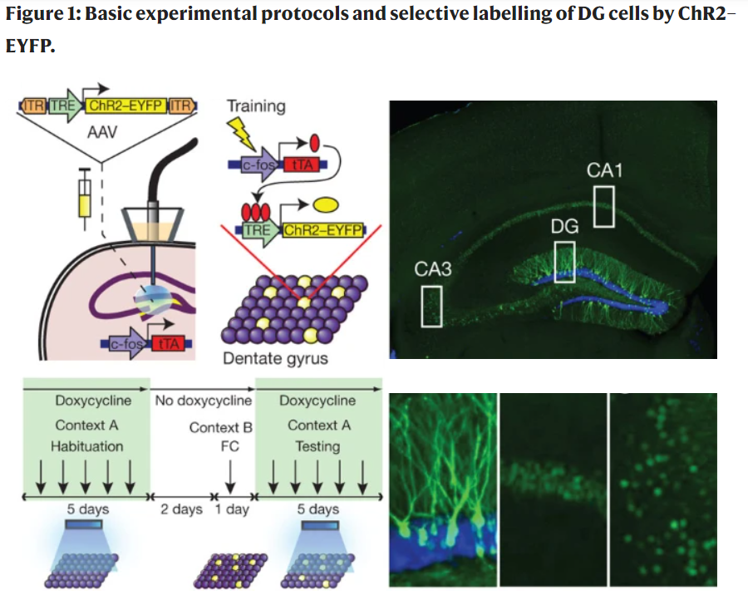
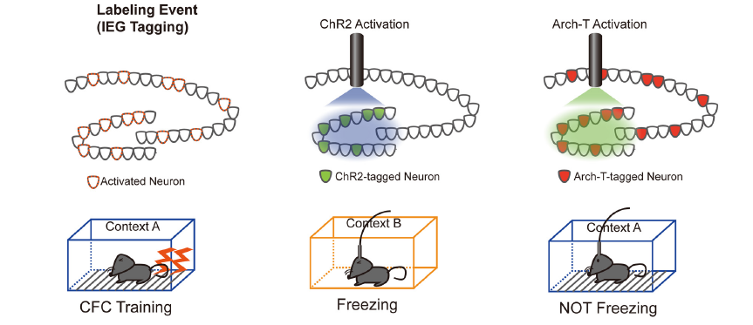
Engram Cell Labelling
Minatohara et al. (2016)
et al.(2012)
READ THIS: Yap, E. L., & Greenberg, M. E. (2018). Activity-regulated transcription: bridging the gap between neural activity and behavior. Neuron, 100(2), 330-348.
https://www.sciencedirect.com/science/article/pii/S0896627318309012
Liu, X., Ramirez, S., Pang, P. T., Puryear, C. B., Govindarajan, A., Deisseroth, K., & Tonegawa, S. (2012). Optogenetic stimulation of a hippocampal engram activates fear memory recall. Nature, 484(7394), 381-385)

Slide 4
Engram Cell Labelling
Engram Cells are thought to be repeatedly activated neurons that a drive the activity of other cells associated with the event but which drop in or out of the assembly.
They are rare, as evidenced by calcium imaging studies.
They tend to upregulate IEGs (if this is the case for secondary response genes and late response gene’s is not clear)

Slide 5
Transcriptomic-Activity Coupling
Here’s how to visualize this,
Start with a bunch of empty cells, show what happens to them during a normal experiment, event A happens and they all follow a somewhat similar time course specific to that cell type.
Make note that there is a background rate of cells
which become sufficiently active to become engram cells, although they will not be following the same time course or due to differences between the experiences will show different expression.
Various studies have begun to sequence engram labelled tissue with both bulk and single cell.
Various authors have reported different transcription between different behavioral paradigms, we were also aware of
Each method is going to have its benefits and detriments sequencing
Notes:
In some ways studying these activity markers is nothing new. Studying activity induced transcription has been done in many in vitro studies but the engram label allow studying cells from within a living animal which experienced natural stimulation.

Slide 6
Logic of Putative Engram cells
Here’s how to visualize this,
Building on the last slide, have a population of empty cells essentially following different time courses. Our ability to detect long lasting transcriptional changes may be limited as they will themselves rexperience something new.
Visualize how in a normal labelling study we can be sure because of controls that the engram cells are probably from one event and are thus following a somewhat similar timecourse.
Never the less
Notes:
In some ways studying these activity markers is nothing new. Studying activity induced transcription has been done in many in vitro studies but the engram label allow studying cells from within a living animal which experienced natural stimulation.

Slide 7
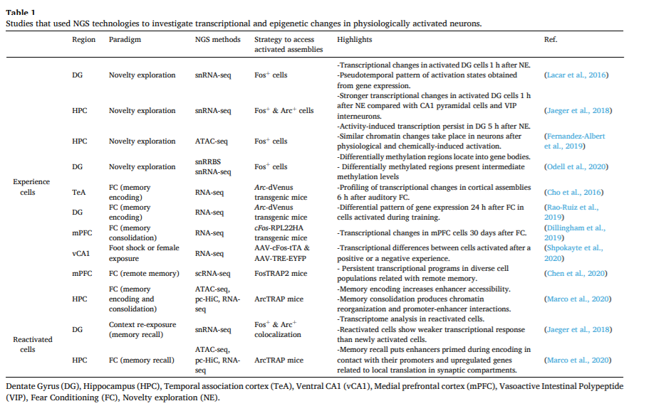
Studies of Sequencing Engram Labelled Cells
From: Fuentes-Ramos, M., Alaiz-Noya, M., & Barco, A. (2021). Transcriptome and epigenome analysis of engram cells: Next-generation sequencing technologies in memory research. Neuroscience & Biobehavioral Reviews
Notes:
This slide needs to go after a hypothesis.

Slide 8
Hypothesis: There should be low prevalence cell types within the DGC population of other datasets that express Engram Cell DEGs
Notes:
Also want a timeline, want a list of human datasets or mouse datasets. We may need to justify the classifier. We need a hypothesis, https://lucid.app/lucidchart/32083739-9932-4627-860c-51388e80b49d/edit?from_internal=true

Slide 9






Studies of Sequencing Engram Labelled Cells
From: Fuentes-Ramos, M., Alaiz-Noya, M., & Barco, A. (2021). Transcriptome and epigenome analysis of engram cells: Next-generation sequencing technologies in memory research. Neuroscience & Biobehavioral Reviews

Slide 10
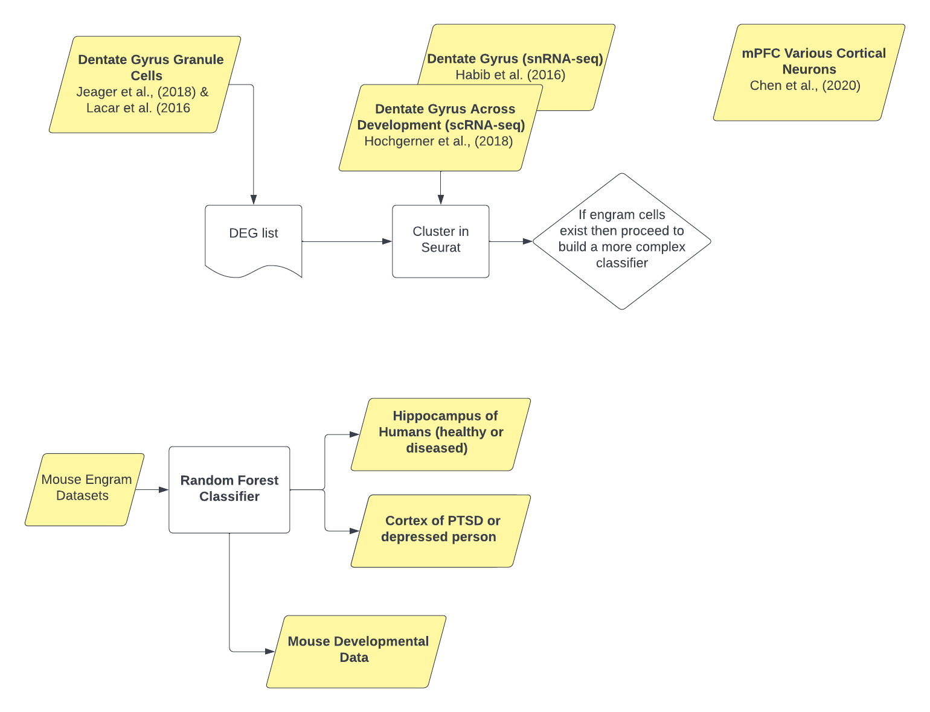
Workflow (Work in progress)
Notes:
Also want a timeline, want a list of human datasets or mouse datasets. We may need to justify the classifier. We need a hypothesis, https://lucid.app/lucidchart/32083739-9932-4627-860c-51388e80b49d/edit?from_internal=true

Slide 11
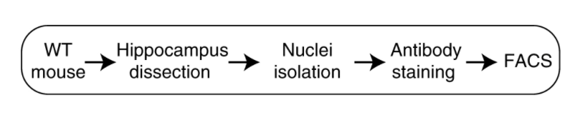
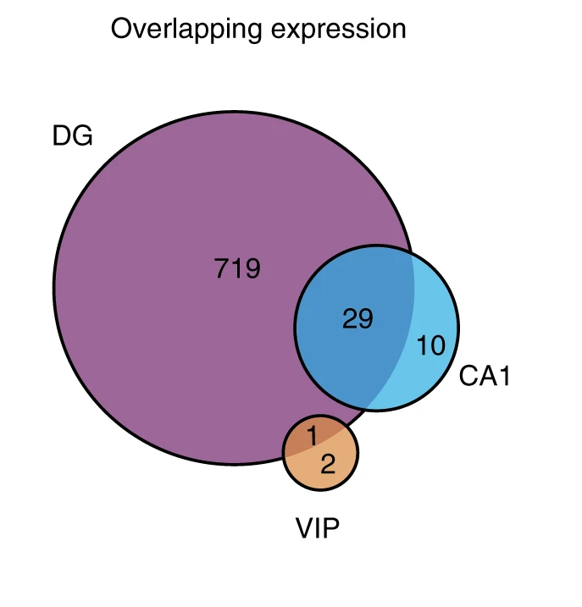
Right now I am focusing on Jeager et al., (2018)
A hippocampal dissection was done and using antibody staining they sorted different cell types and regions apart from eachother and post novel environment. Dentate Gyrus Granule Cells (DGCs) had the most robust transcriptional response and so were
Follow up experiments on DGCs studies time course (1hr, 4hr and 5hr) as well as a reactivations study (via reexposure to training environment).
Sequencing was deep (1.5 million reads per cell on average). Generated a list of DEGs which I refer to as the Jeager DEGs here after
Figure 1d from Jeager et al., (2018)

Slide 12
Right now I am focusing on Jeager et al., (2018)
A hippocampal dissection was done and using antibody staining they sorted different cell types and regions apart from eachother and post novel environment. Dentate Gyrus Granule Cells (DGCs) had the most robust transcriptional response and so were
Follow up experiments on DGCs studies time course (1hr, 4hr and 5hr) as well as a reactivations study (via reexposure to training environment).
Sequencing was deep (1.5 million reads per cell on average). Generated a list of DEGs which I refer to as the Jeager DEGs here after
Figure 1d from Jeager et al., (2018)

Slide 13
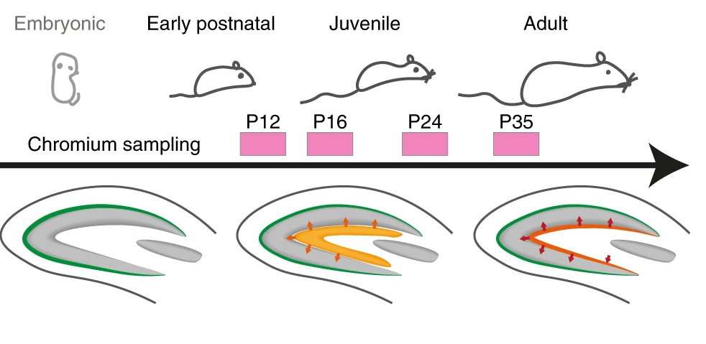
Putative Engram Cells in Hochgerner et al. (2020)
As engram cells are rare I was looking for another dataset containing many cells to increase the chance of finding them in a study that was not enriched for them.

Slide 14
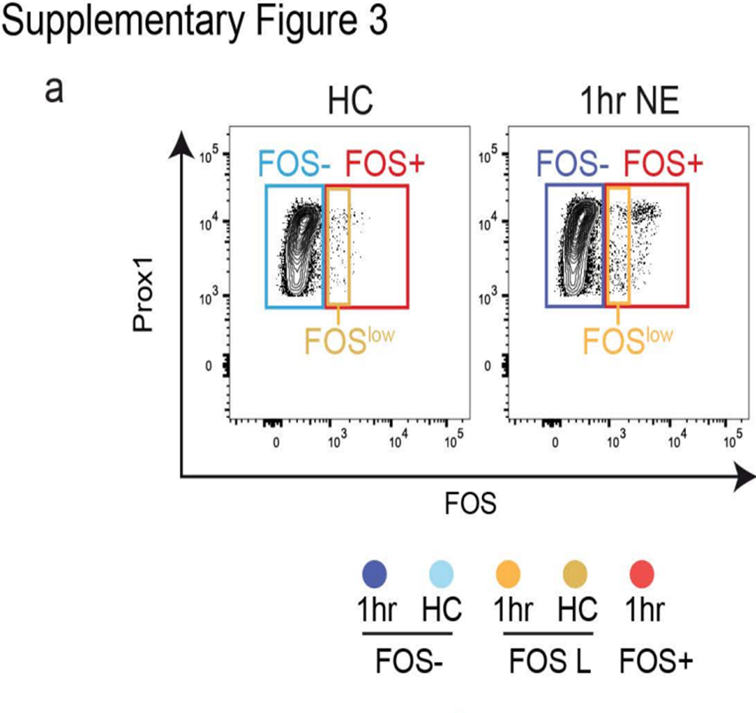
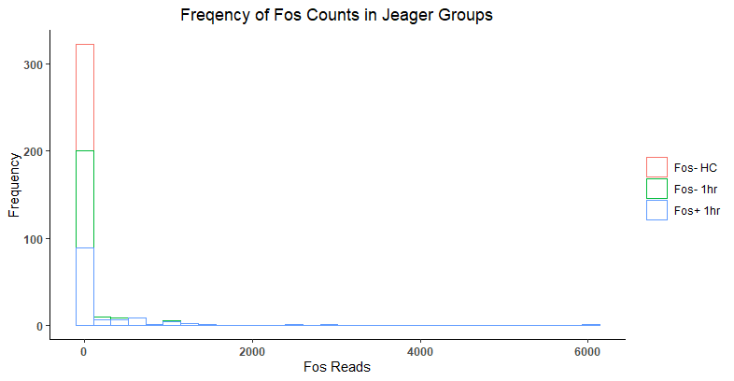
Engram Cells are and express IEGs
Based on expression of markers in Jeager et al., (2018) such as fos we expect engram cell clusters to be relatively rare cells with high IEG expression.
Cells primarily express no fos at all though there are a few rare cells which do.
Notes:
This graph needs a bit of work,

Slide 15
For Pavlab show the poor clustering
Ba To eat up some time just show that these cells are not immediately appartent in cell clustering it’s a more subtle effect.
Notes:
This graph needs a bit of work,

Slide 16
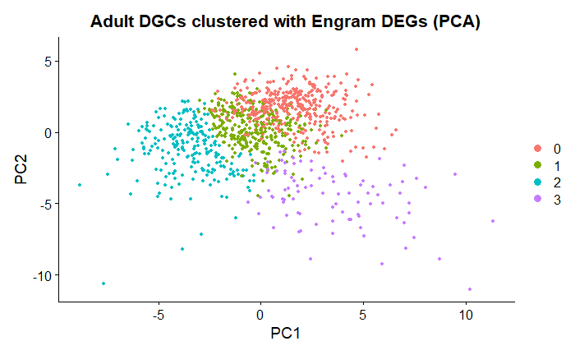
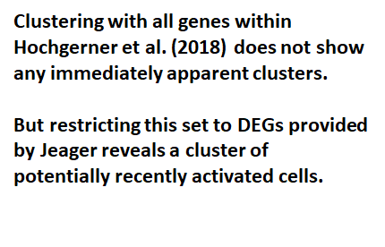
Clustering within Jeager et al,(2018)’s DEGs in other datasets
shows a cluster of Putative Engram Cells
Clusters 0-2 have few gene’s with any significant expression. Cluter0 intriguingly has Melatonin receptors upregulated.
Cluster3 is the most rarely expressed and has incredibly low pvalues for a number of IEGs notably Inhba and Rgs4
Notes:
Title is confusing and referes to multiple slices

Slide 17

Clustering within Jeager et al,(2018)’s DEGs in other datasets
shows a cluster of Putative Engram Cells
Clusters 0-2 have few gene’s with any significant expression. Cluter0 intriguingly has Melatonin receptors upregulated.
Cluster3 is the most rarely expressed and has incredibly low pvalues for a number of IEGs notably Inhba and Rgs4
Notes:
slide Title is confusing and referes to multiple slides, also this plot needs to metion that this is the Hochgerner dataset

Slide 18
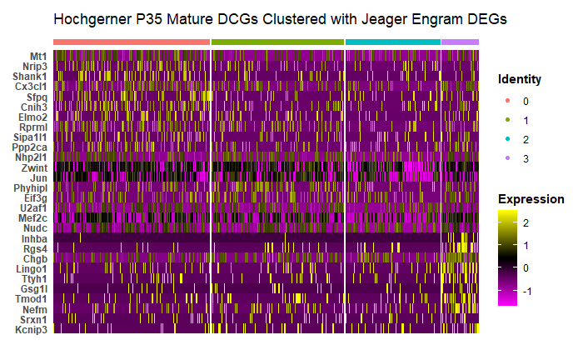
Clustering within Jeager et al,(2018)’s DEGs in other datasets
shows a cluster of Engram Cells
Clusters 0-2 have few gene’s with any significant expression.
Cluster3 is the most rarely occuring and has many genes with low p-values for a number of IEGs notably Inhba and Rgs4
Cluster0 has 21 genes with significance <0.05 and 10 with < 0.01 while Cluster3 has 25 and 22 genes passing those thresholds. Furthermore in terms of absolute log fold two change the genes in Cluster0 are more than double. The absolute average log fold change for genes passing 0.05 in cluster 3 is ~1.29 +/- 0.69 while all the other clusters have mean absolute lod2FC around ~0.3 +/- 0.2. This mateches the deinfition of an engram cell having low prevalence, with more variable, but higher, mean IEG expression. Need to do a stats test to confirm this intuition.
Notes:
Should have color scale for heatmap. Meltanonin is a distraction. Need table of gene’s Paul says you can’t mention the significance being greater or lesser, but make note of the NUMBER of significant gene’s in each group.

Slide 19
Next steps, examine Putative Engram Cells distribution within DGC subtypes.
Hypothesis: Penk will appear overexpressed in DGC datasets.
Also show the clusters for immature granule cells in Hochgerner.
Notes:
Should have color scale for heatmap. Meltanonin is a distraction. Need table of gene’s

Slide 20
References
Cembrowski, M. S., Wang, L., Sugino, K., Shields, B. C., & Spruston, N. (2016). Hipposeq: a comprehensive RNA-seq database of gene expression in hippocampal principal neurons. elife, 5, e14997.
Citri, A., & Malenka, R. C. (2008). Synaptic plasticity: multiple forms, functions, and mechanisms. Neuropsychopharmacology, 33(1), 18-41.
Hawk, J. D. (2011). Investigation of the role of histone acetylation in hippocampus-dependent memory formation (Doctoral dissertation, University of Pennsylvania).
Huang, Anping & Zhang, Xinjiang & Li, Runmiao & Chi, Yu. (2018). Memristor Neural Network Design. 10.5772/intechopen.69929.
Liu, X., Ramirez, S., Pang, P. T., Puryear, C. B., Govindarajan, A., Deisseroth, K., & Tonegawa, S. (2012). Optogenetic stimulation of a hippocampal engram activates fear memory recall. Nature, 484(7394), 381-385.
Minatohara, K., Akiyoshi, M., & Okuno, H. (2016). Role of immediate-early genes in synaptic plasticity and neuronal ensembles underlying the memory trace. Frontiers in molecular neuroscience, 8, 78.
The University of Queensland. Long-term synaptic plasticity. Queensland Brain Institute. https://qbi.uq.edu.au/brain-basics/brain/brain-physiology/long-term-synaptic-plasticity
Sullivan, K. E., Kendrick, R. M., & Cembrowski, M. S. (2020). Elucidating memory in the brain via single‐cell transcriptomics. Journal of Neurochemistry.
Rao-Ruiz, P., Couey, J. J., Marcelo, I. M., Bouwkamp, C. G., Slump, D. E., Matos, M. R., ... & Kushner, S. A. (2019). Engram-specific transcriptome profiling of contextual memory consolidation. Nature communications, 10(1), 1-14.

Slide 21
EXTRA MATERIAL

Slide 22
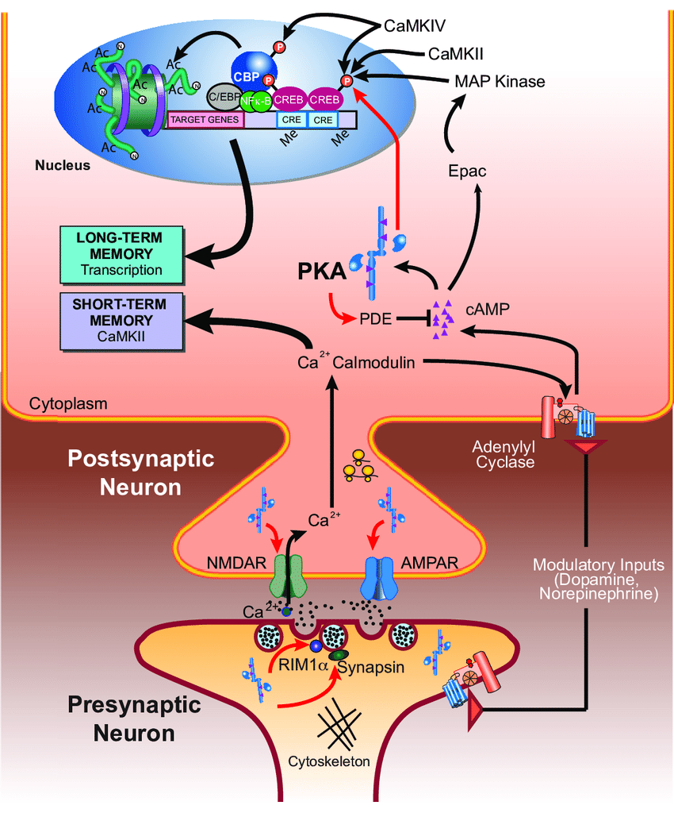
Hebbian Plasticity
NOTE: Keep this slide for when you have specific proteins you want to talk about.
Coactivation of neurons results in strengthening of memories as postulate by Donald Hebb postulated in The Organization of Behaviour (1949) coactivated neurons drives forming groups of strongly connected neurons called engrams.
“Neurons that fire together wire together.”
(Hawk, 2011)

Slide 23
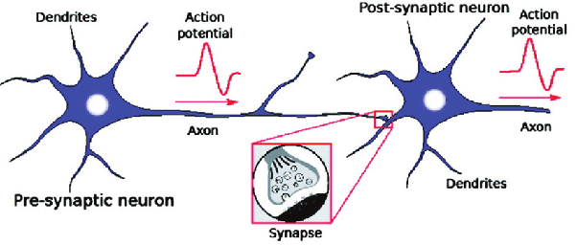
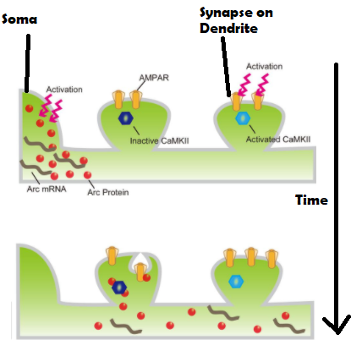
Hebbian Plasticity
Coactivation of neurons results in strengthening of memories as postulate by Donald Hebb postulated in The Organization of Behaviour (1949) coactivated neurons drives forming groups of strongly connected neurons called engrams
“Neurons that fire together wire together.”
Minatohara et al. (2016)

Slide 24
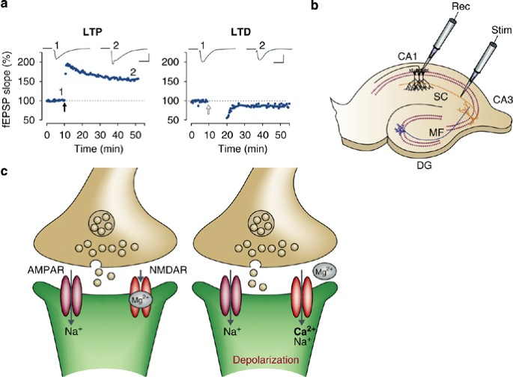
Hebbian Plasticity
Coactivation of neurons results in strengthening of memories as postulate by Donald Hebb postulated in The Organization of Behaviour (1949) coactivated neurons drives forming groups of strongly connected neurons called engrams
Long Term Potentiation and Long Term Depression are well accepted neural correlates of memory.
Fig 1 Citri and Melenka (2008)

Slide 25
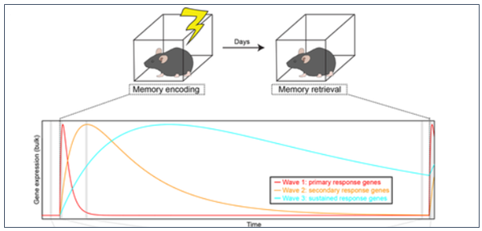
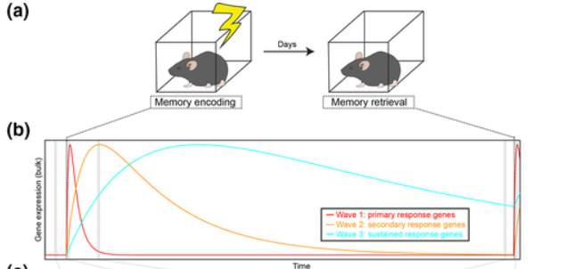
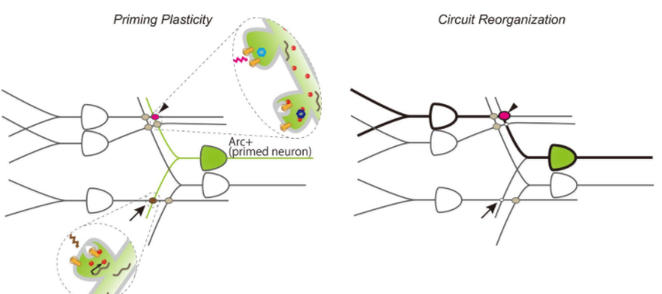
Immediate Early Genes (IEGs)
IEGs: Produced within minutes of a sustained event, many are induced by CREB from activated synapses. Some are tied to specific modulatory neurotransmitters (such as D1 or serotonin receptors).
Examples include erg-1, c-fos, homer1, BDNF. Their expression changes over time after the initial learning event.
Sullivan et al. (2020)

Slide 26
Immediate Early Genes and Long Term Memory
Minatohara et al. (2016)
et al.(2012)

Slide 27
Immediate Early Genes (IEGs)
Minatohara et al. (2016)
et al.(2012)

Slide 28

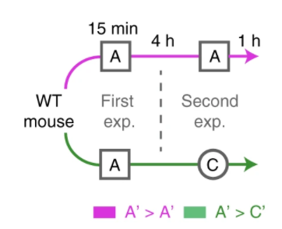

Jeager et al. (2018) Novel Environment Exploration followed by antibody staining for Fos and Arc expressing denate gyrus cells
Basic Experiment (Many Cell types):
Reactivation (DGCs Only):
Time Course (DGCs only):
Notes:
Provides a variety of specific time points and conditions for us to look into. Slide 27 has the experimental design figures for the recall and time course if they are interested (double check this slide number before presentation)

Slide 29
Clustering within Jeager et al,(2018)’s DEGs in other datasets
shows a cluster of Engram Cells
Clustering with all genes within Hochgerner et al. (2018) does not show any immediately apparent clusters.
But restricting this set to DEGs provided by Jeager reveals a cluster of potentially recently activated cells.

Slide 30
Bonus slide, show the results from the Immatrue DGCs and the all gene clusters
Clustering with all genes within Hochgerner et al. (2018) does not show any immediately apparent clusters.
But restricting this set to DEGs provided by Jeager reveals a cluster of potentially recently activated cells.

